Slide 1
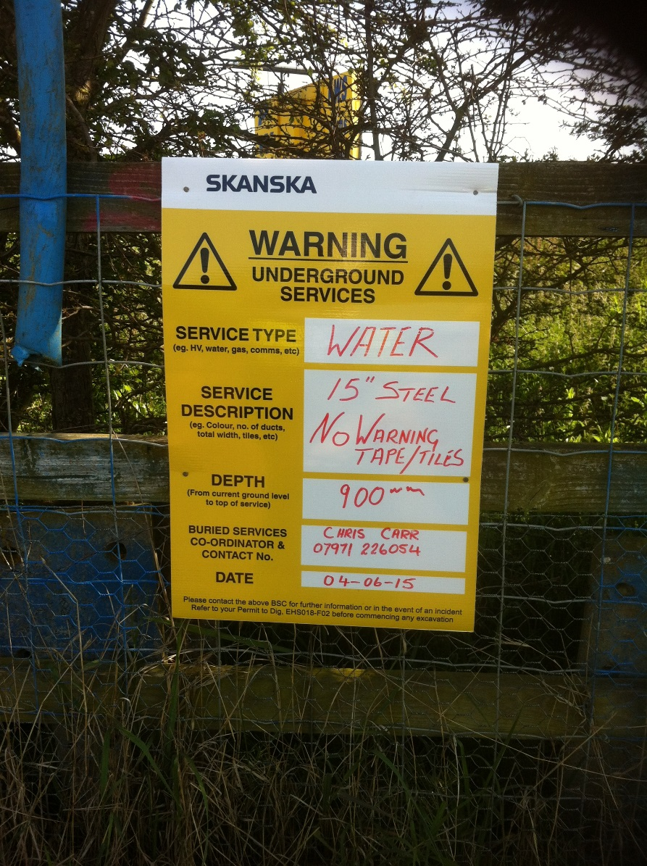
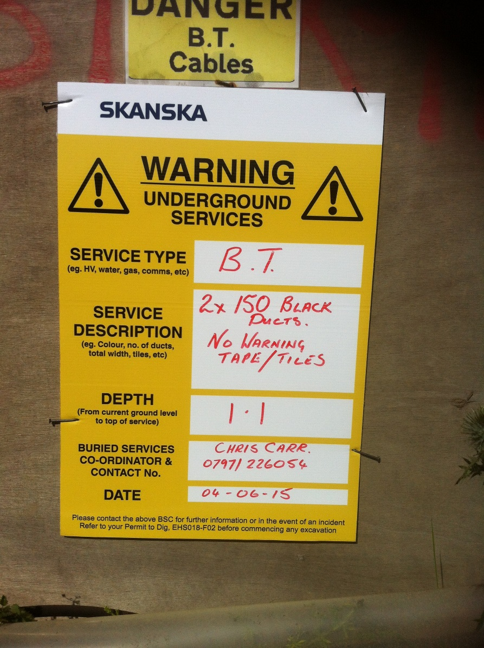
Working Near Services

Slide 2
CRITICAL stats identified with zones marked out with signs, ropes etc for permit to enter/dig – DB to send information to SCE
Activity Pack produced showing all forms/procedures/permits etc
Major services affected – e.g. BT 14,000 pair cable severed in 4 places
Weekly planning meeting for stats

Slide 3
Diversions done in advance of NTP – Generally those within the highway boundary
Project Board made things happen with each of the stats
Design to avoid any diversion if at all possible.

