Slide 1
SPaTS2 Eliminating Risk from the Outset - Home Safe and Well
Feedback Workshop
Bella Briccolani and Paul Dennis
24th August 2022

Slide 2
Workshop Agenda:
13:30 – 15:30 (10min break @14:20)
Health, Safety & Wellbeing Moment
WP2 – Design as a Process
WP3 – Learning from Design
WP4 – Measuring Design Performance
AOB

Slide 3
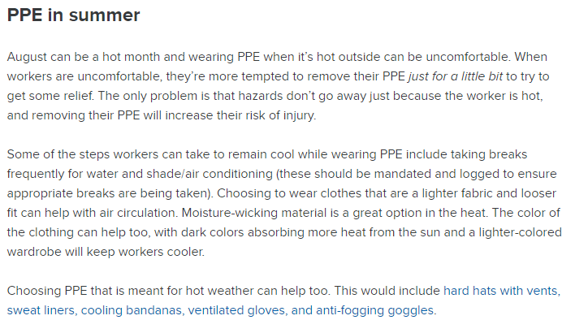
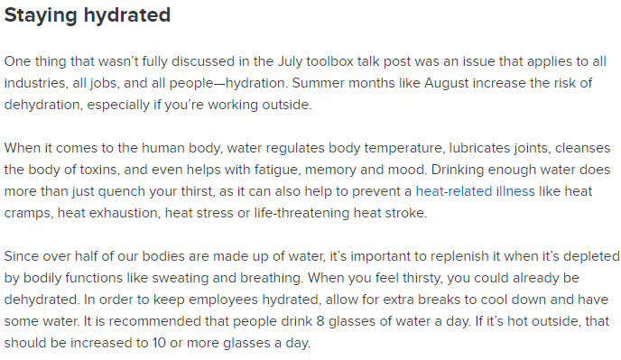
Health, Safety & Wellbeing Moment Safe Start Toolbox

Slide 4
WP2 – Design as a Process
The below are keys areas that formed discussions during the workshops previously held.
• Lessons Learnt Affecting Road Workers –review of PCF products produced at Stages 0-2 to identify if and how road worker safety is identified and initial hazard analysis.
• Standards – a review of what is already in place for identifying standards or specification updates as a design task.
• Working Space – review of a whole life health and safety assessment to be included as a PCF product from Stage 0 onwards
• Buildability – understand how to apply the CDM Regulations, gain insight and early involvement from duty holders from the outset of projects.

Slide 5
WP2 – Design as a Process
Recommendations
• From PCF Stage 2, there is a requirement for producing: Pre-construction Information, F10 notifications to the HSE of construction projects, a Health and Safety File and a Maintenance and Repair Statement.
We will work with National Highways to include this Pre-Construction Phase H&S Plan as a new PCF product.
Continued engagement with other groups so that they are involved in the review of this product such as the National Highways Principal Designers Working Group and Eliminating Risk from the Outset Task Group.
To review the latest version of the “Manual for Development of Documents” (MDD) to ascertain
if there is enough guidance on eliminating risk from the outset.
Arup to produce Stage 1 Pre-construction H&S Plan building on work previously undertaken in 2018 by others from the PDWG

Slide 6
Comments Sheet

Slide 7
WP3 – Learning from Design
The tasks set out for this Work Package have been split into three and summarised below:
A. Refining and concluding initial recommendations from the 2020-21 SPaTS ERO task, using this as the origin for work looking initially at what is currently done and the inconsistencies within the process;
B. Identify how and what we learn, how we share this learnt information and what outcomes this achieves with the objective of defining changes to improve existing processes(especially the outcomes); and
C. Make recommendations on process changes that can be implemented, identify those who will own those changes and offer ongoing support to those owners.

Slide 8
WP3 – Learning from Design
The Recommendations
Task A
Key recommendations from the SPaTS ERO 1-1141 task include central safety alert database, health and safety (H&S) alert amendments and a template for H&S alerts.
Task B
Currently, the NH Safety Alert process stops once the on-site investigation has been completed by the Contractor and does not determine if the incident was owing to a design issue. Not all incidents will warrant a full investigation into the design; however, the process to enable that investigation to be carried out consistently is required as it is not currently part of NH process.
This is where a change to GG104 would be appropriate and a workflow created to show how an investigation may progress.
Beyond the Safety Alerts, the only process currently used to note the lessons learned from any investigations is a log held by each of the project teams. An NH template for lessons learnt by project teams for central dissemination would be useful here.

Slide 9
WP3 – Learning from Design
The Recommendations
Task C
Recommendation 1: Outline a scope for easy retrieval of incident investigation data from HART.
Recommendations 2 & 3: Arup to provide amendments to existing H&S alert procedure including GG128, review of safety alerts in the process for drafting new standards
Recommendations: Lessons learned sharing.
Recommendation 4: Outline the provision of expert advice for NH investigation teams.
Recommendation 5: A standard NH template for H&S alerts.

Slide 10
Comments Sheet

Slide 11
WP4 – Measuring Design Performance
The Recommendations
Recommendation 1: engagement with the Safety, Engineering and Standards (SES) Data Analytics team, to update HART tool.
Recommendation 2: delivery Plan and Schedule of workshop findings.
Recommendation 3: work package will continue to support implementation.

Slide 12
WP4 – Measuring Design Performance
Deliverables
Engagement and Findings summary report with recommendations.
Implementation report for the process of measuring design performance in health, safety and wellbeing to support implement changes.
Investigate whether PCF products can provide a H&S performance metric to compare between projects and whether HART website is a good tool for reporting this metric
Trial Xactium tool for measuring designer’s performance on H&S risks and mitigation with live project data and discuss whether this may be something that NH roll out as mandatory/recommended on all schemes

Slide 13
Comment Sheet

Slide 14
AOB

