Slide 1
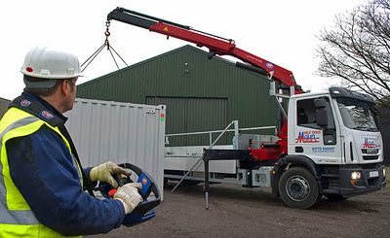
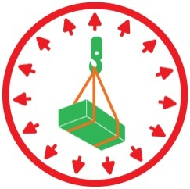
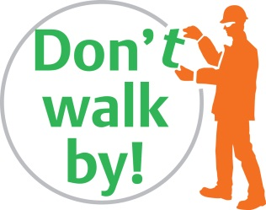
Safe use of remote controls
Notes:
Safe use of remote controls with lorry loaders. The same principles apply for other items of plat that use remote controls.
Introduction
This briefing is intended to be delivered to all persons involved in the planning, supervising and operations of plant that use remote control devices.
The information has been put together following the lessons learned from previous in house and external incidents as well as industry guidance.
Why are we doing this?
To provide those involved, but not necessarily formally trained in the safe use of remote control devices with an overview of the risks in order for to understand the particular control measures required to manage those risks.

Slide 2
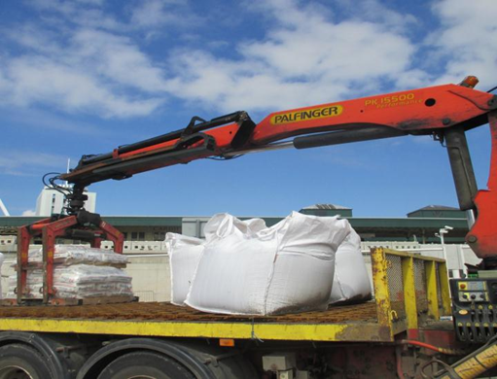
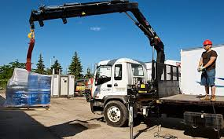
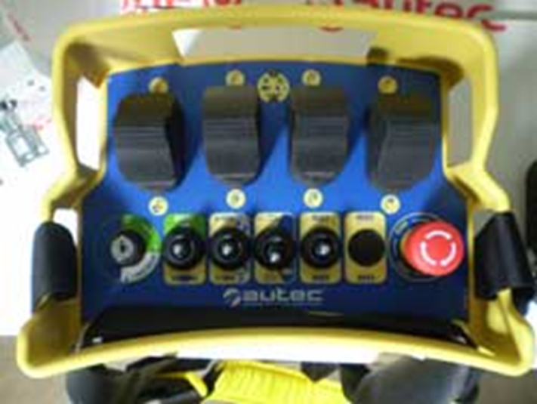
Points of note
Notes:
Ask the candidates if they can identify a list of issues that can occur during lifting operations using a lorry mounted crane and a remote control?
The list may include, but is not limited to:
Other persons entering the working area
Not enough space to deploy the out riggers correctly
The driver/operator is in a rush to get the job done and get away
Working at height
Jerky movements from the crane or attachment
Not sure how attachments should be used as there are so many
Overhead/underground obstructions, chambers or week ground.
Communications/signals unclear or the driver/operator uses different ones than our slingers are used too
Driver/operator walking around whilst still operating the controls
Driver/operator not making the remote control safe be for they or other approach the crane, attachments or load
Driver/operator starts the operation without firstly ensuring everyone close by is in a position of safety
If they have missed anything from the list ensure they are picked up before moving on.

Slide 3
Short video
Notes:
This training video was produced by the Association of Lorry Loader Manufacturers and Importers (ALLMI) and demonstrates the correct process in practice. ALLMI runs a training accreditation service, which is accepted by BAM Nuttall and is a standards body for the lorry loader industry. BAM Nuttall also accept CPCS lorry loader certificates of training. You can click on the picture to view it on YouTube at this link:
https://www.youtube.com/watch?v=BzfzK93kCow
After you have watched the video ask the candidates if they have learned anything new? And ask them to share their experiences

Slide 4
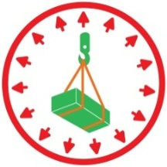
Questions
What must be established prior to the start of the task?
What must the operator do before it is safe for anyone to approach the crane, attachment or load?
What should you do if you notice one of the following:
The stabilisers of the lorry mounted crane are not fully deployed?
The operator is working at height without control measures?
The operator starts moving (e.g. walking) as the load is still moving?
The crane starts to move less than 5 seconds after the operator has got to a position of safety to start the lift?
Notes:
You can ask this as a set of group questions or you can go through it as a one on one.
Having watched the video hand taking part in the group discussion they should know the answers, however it is also important to establish if they know why it is correct.
What must be established prior to the start of the task?
Typical answers can include:
A safe system of work, competent persons, enough space, segregation, a lift plan, machine certification etc. All these are of course correct, however there are some specific points that need to be highlighted i.e.
Who is going to be involved in the operation e.g. slinger signallers, how they will communicate and most importantly (as it is additional to normal signals), establish a signal for confirming the remote has been made safe and the crane, attachment and or load is now safe to approach.
What must the operator do before it is safe for anyone to approach the crane, attachment or load?
Ensure the load is stable, press the emergency stop on the control to ensure the remote control is safe then give the slinger signaller the agreed signal to let them know it is safe to approach. Note the operator also need to make it safe for themselves before they approach. It is not good enough to put the remote down or swing it to the side or back as it can still be knocked. Several operator have had serious and on occasions fatal injuries as a result of this practice.
What should you do if you notice one of the following:
The stabilisers of the lorry mounted crane are not fully deployed?
Ensure you are in a position of safety and signal the operator to stop. Why? There are not many lorry mounted cranes that are designed to permit this type of duty. If they are the duty charts will clearly show it (regardless of what valves and other devices the operator tells you the crane has). This should have been made clear to those doing the works by the APL or lift supervisor before the lift commences, but if it has not stop and check.
The operator is working at height without control measures?
Ensure you are in a position of safety and signal the operator to stop. Why? If the operator falls they could have a serious accident.
The operator starts moving (e.g. walking) as the load is still moving?
Ensure you are in a position of safety and signal the operator to stop. Why? The operator must be stationary at all times as the crane is being operated, if they slip or trip they could accidentally move the wrong control and cause an accident.
The crane starts to move less than 5 seconds after the operator has got to a position of safety to start the lift?
Ensure you are in a position of safety and signal the operator to stop. Why? Tests have demonstrated that on average it takes more than 5 seconds to re-set the emergency stop button on the remote control, re-energise it and then then wait for it to re-establish the radio signal. Therefore if it moves quicker than 5 seconds there is a strong chance that the remote had not been made safe in the first place.

Slide 5
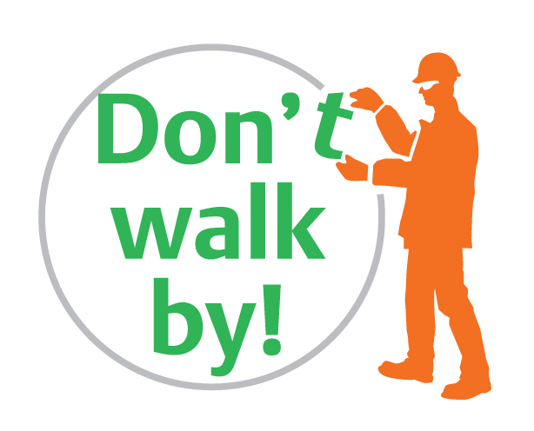
Our standards
Choose to be safe
Notes:
You do not have to be directly involved in an operation for you to question it if you feel it is not being done correctly.
Breaches to any of the rules we have discussed today could and has led to serious incidents.
Before everyone leave ensure that an SF201 is recorded.
Thank you & Don’t walk by!

