Slide 1
Consideration of user’s personal safety in bridge design
The kidnapping of Sarah Everard on 3 March has uncovered concerns and instigated discussions about personal safety, particularly for women.
71% of women of all ages have experienced sexual harassment in a public place with more than half taking place in the street.
As bridge engineers how can we make sure women and all other users feel safe in public spaces, particularly in the spaces we design?
Reference: The Sunday Times (14 March 2021)

Slide 2
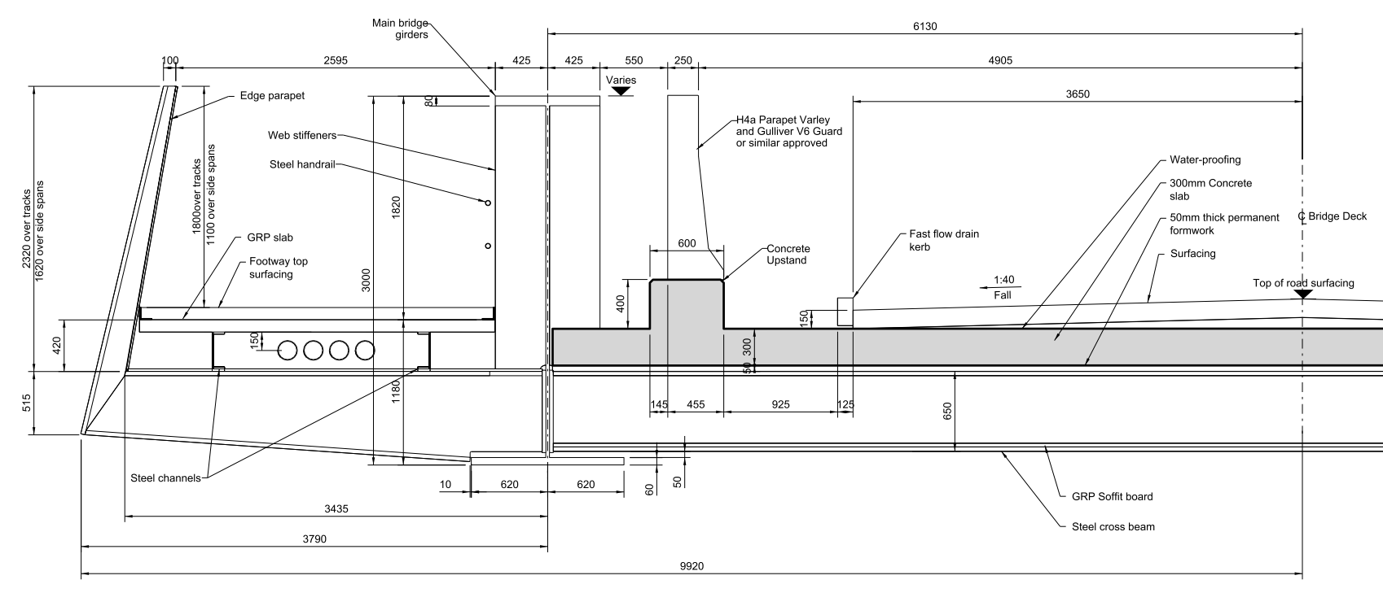
Bridge Deck Structural Depth Optimisation
Notes:
The proposed deck superstructure consists of a steel half-through arrangement, with two main longitudinal girders and transverse steel beams supporting a RC deck slab.
The main girders are located each side of the road carriageway, and pedestrian footpaths are supported on steel cantilevers outside the main girders.
This provides the minimum possible structural depth for the span arrangements, with approx.1.35m depth from FRL to soffit of girder, to the detriment of the pedestrian experience along the overbridge.
The optimum position of the main girders, would be outside the footpaths, but this would require a deeper crossbeam, and has therefore been discounted as it requires total remodelling of the A47 roundabout to a signalised junction (with HS2 informing BCC that this is not an option).

Slide 3
Cross-section (Rail spans)

Slide 4
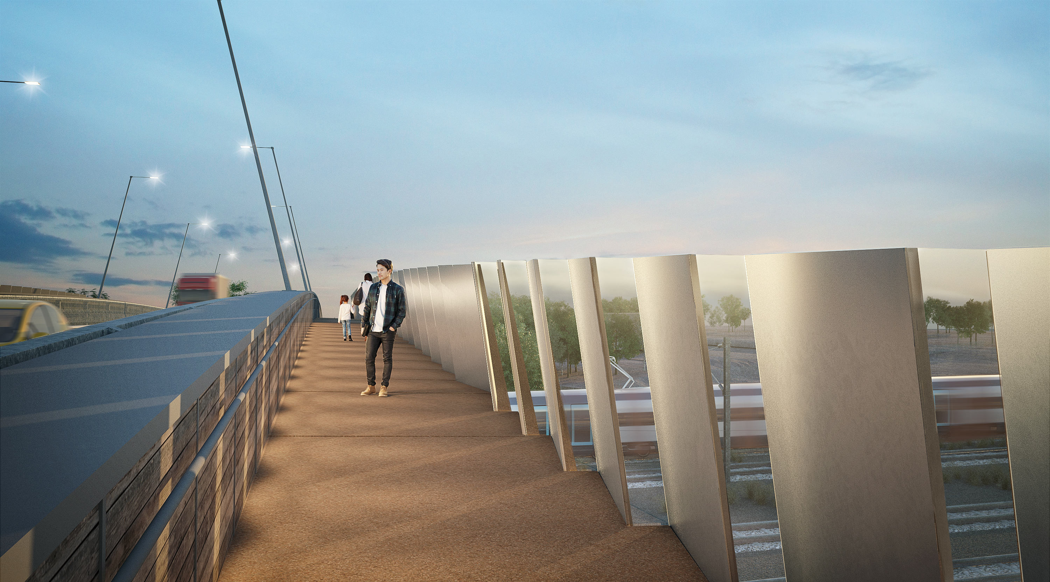
Design development View from walkway
July 2020
March 2021

