Slide 1
Revision to BS5975
for Principal Designer Working Group July 2019
Jim Tod

Slide 2
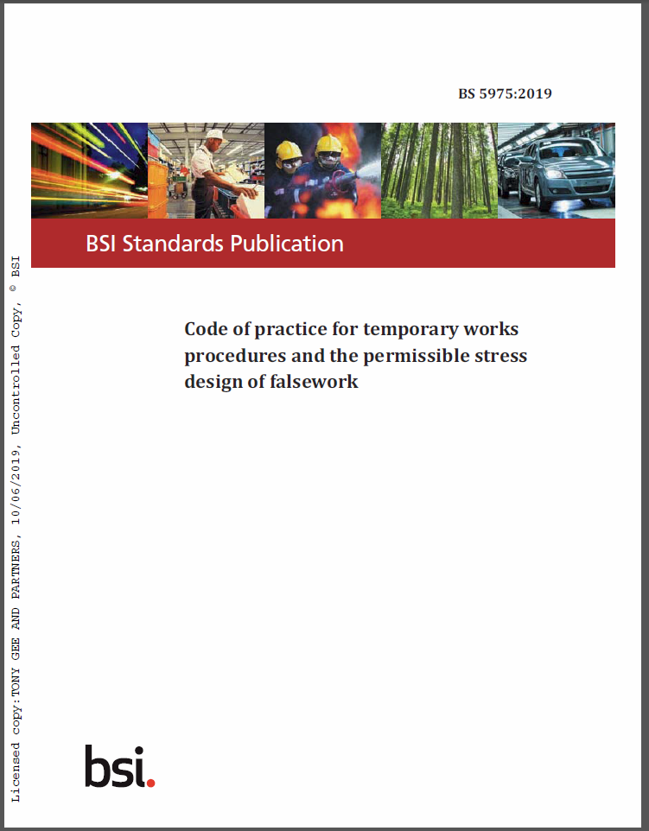
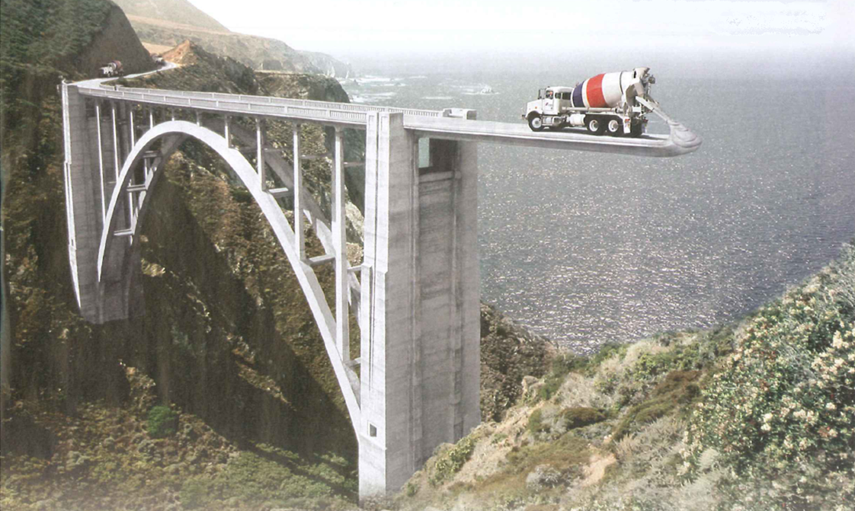
Revision to BS5975

Slide 3
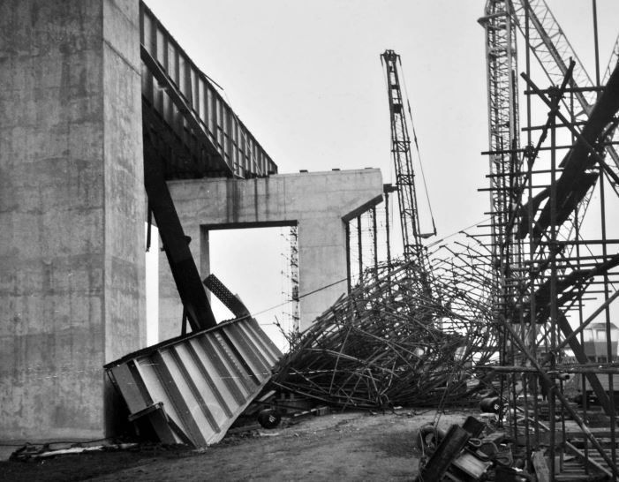
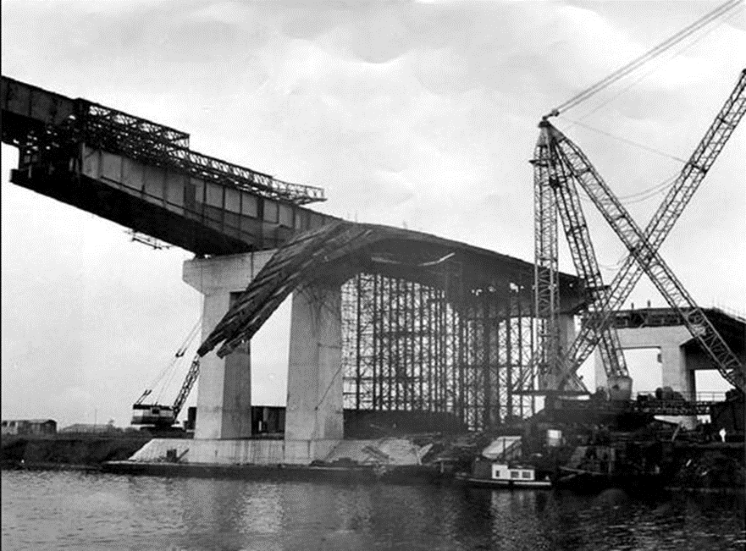
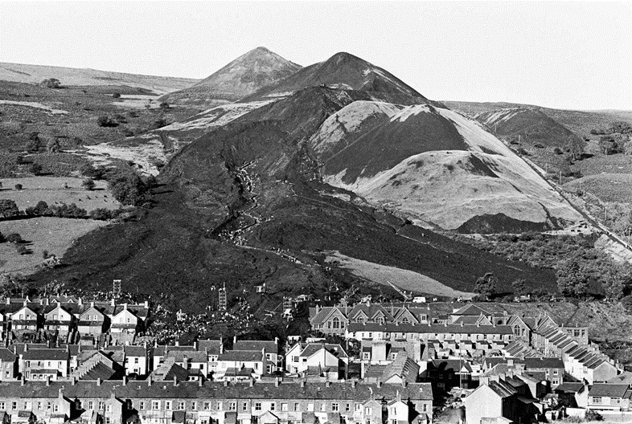
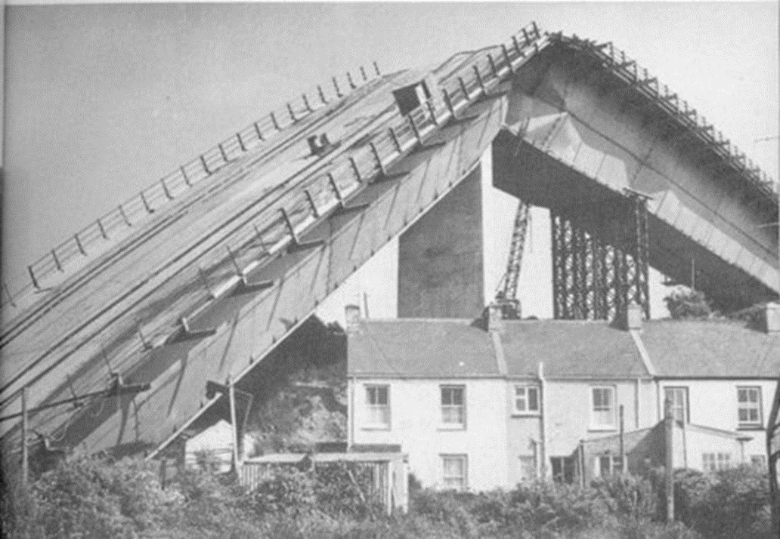
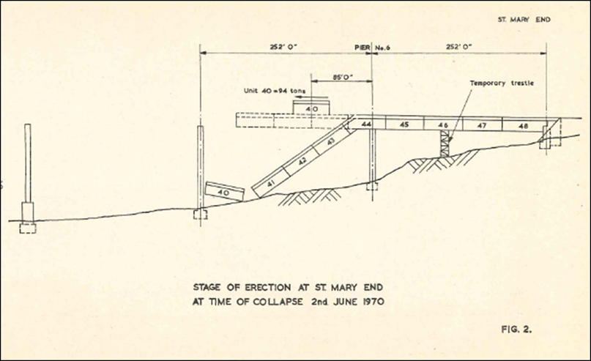
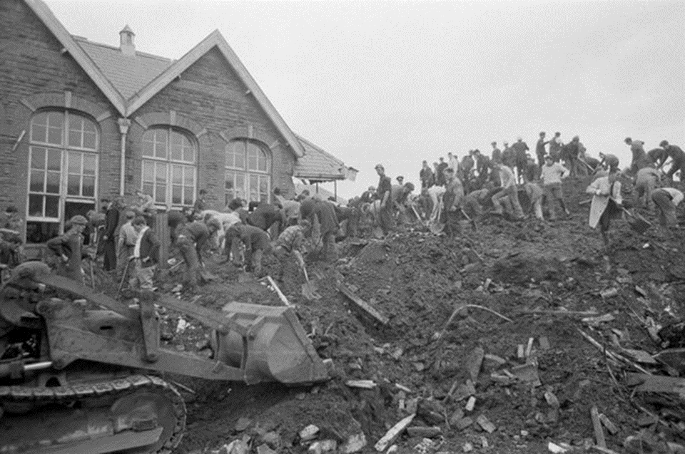
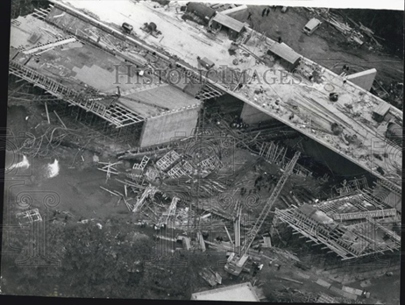
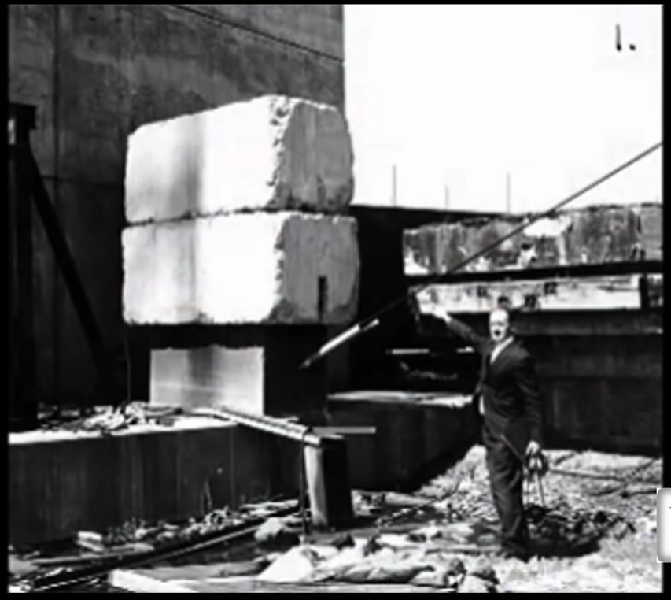
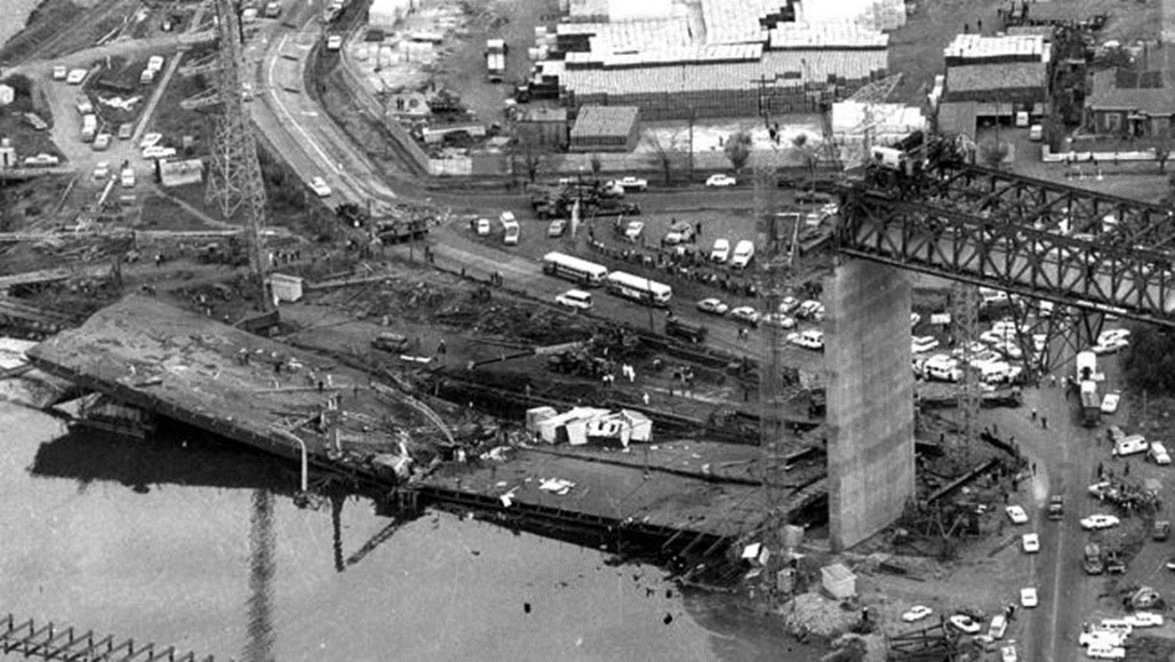
Notes:
Why do we have BS5975?
Barton Bridge 1959 M60
Aberfan 1966
Milford Haven and Great Yarra bridges
Merrison Committee

Slide 4
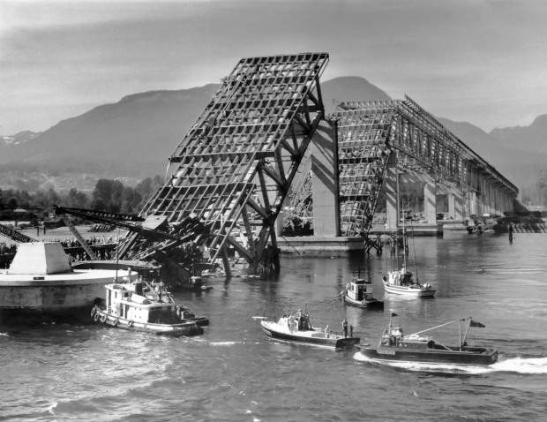
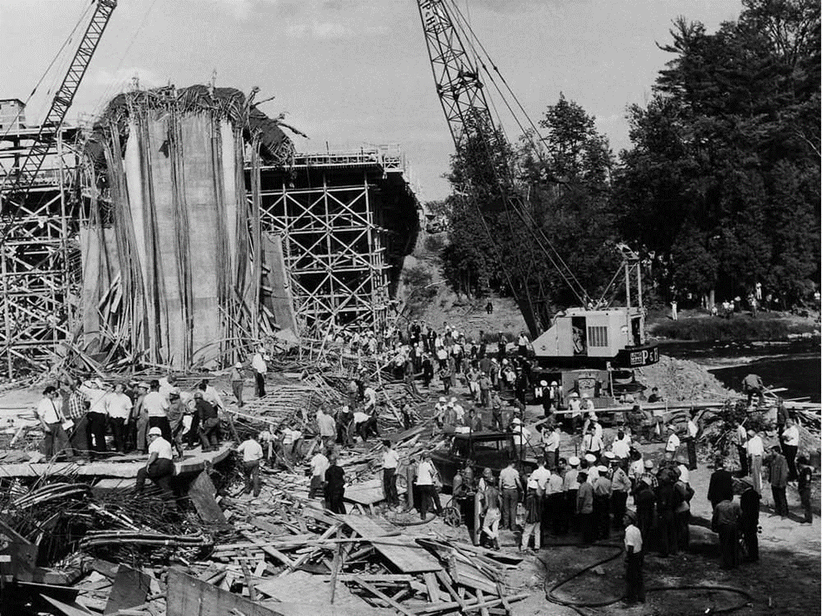
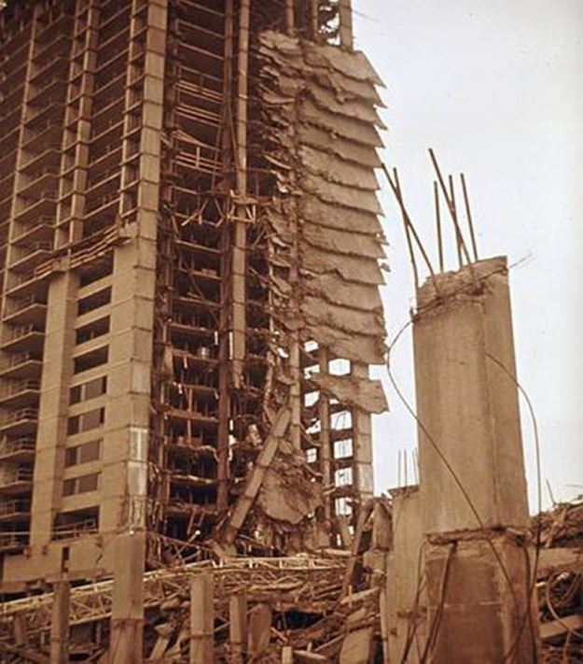
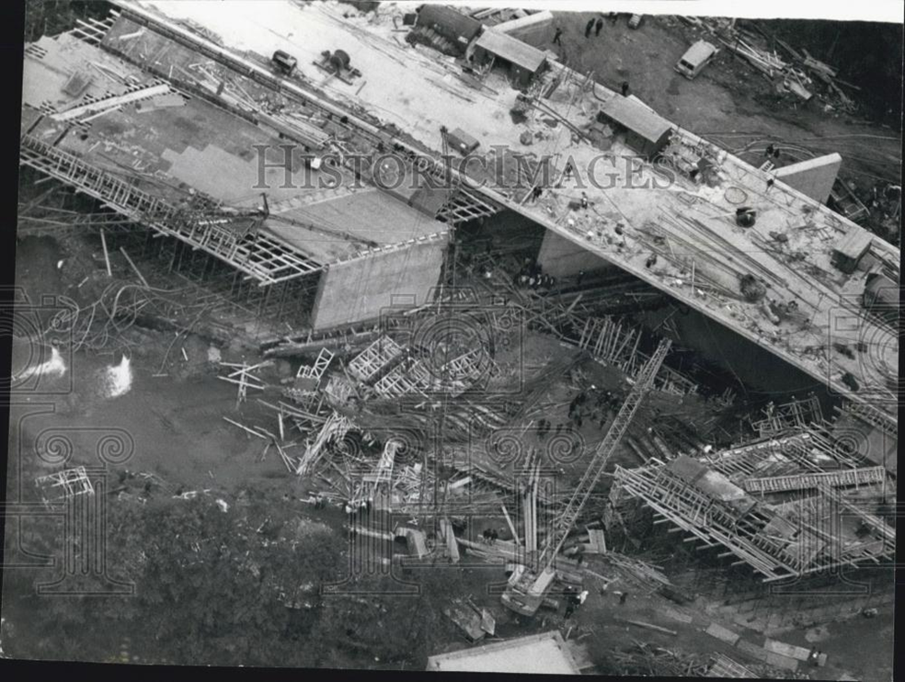
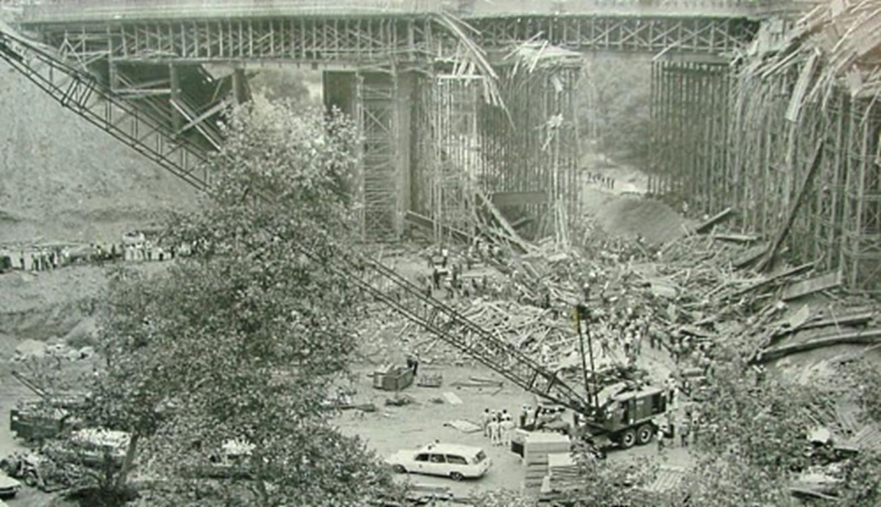
Second Narrows Bridge, Canada 1958
Heron Road Bridge,
Canada 1966
Skyline Plaza USA 1973
Arrayo Seco Bridge USA bv1972
Birling Road UK 1971
Notes:
Bragg Report 1975 HSE
Final report of the Advisory Committee on Falsework
Bragg talks of failings in design and failings in procedure – non are insurmountable
BS5975 took on these recommendations and also from TRCS 4

Slide 5
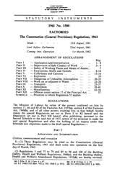
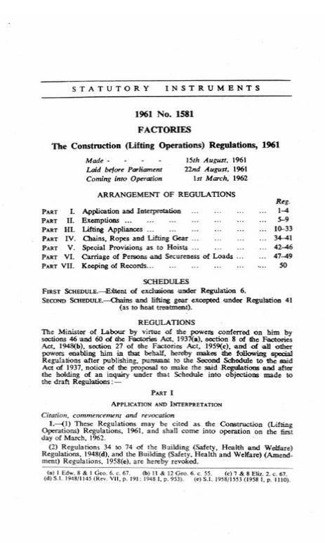
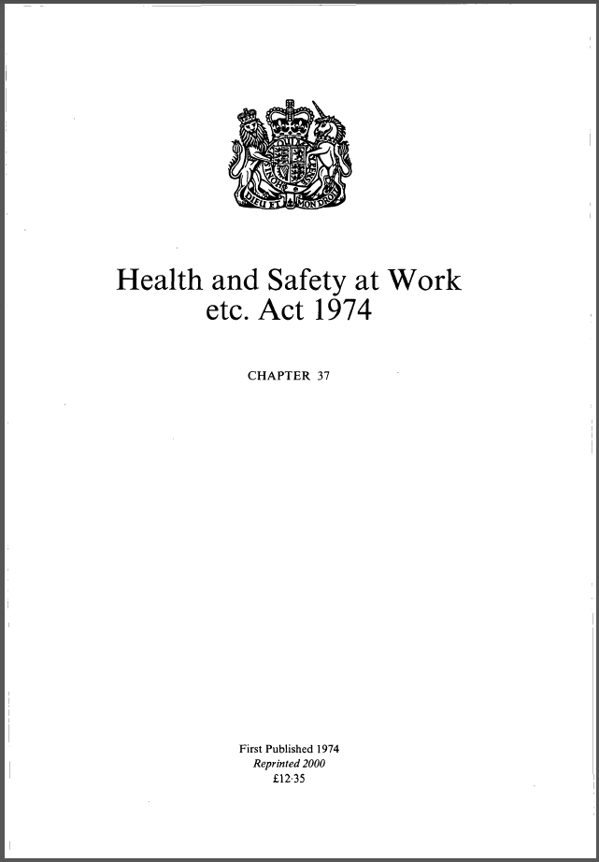
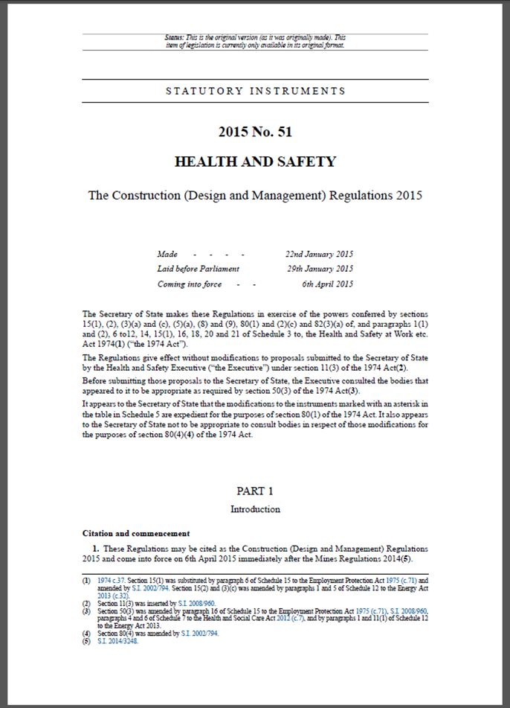
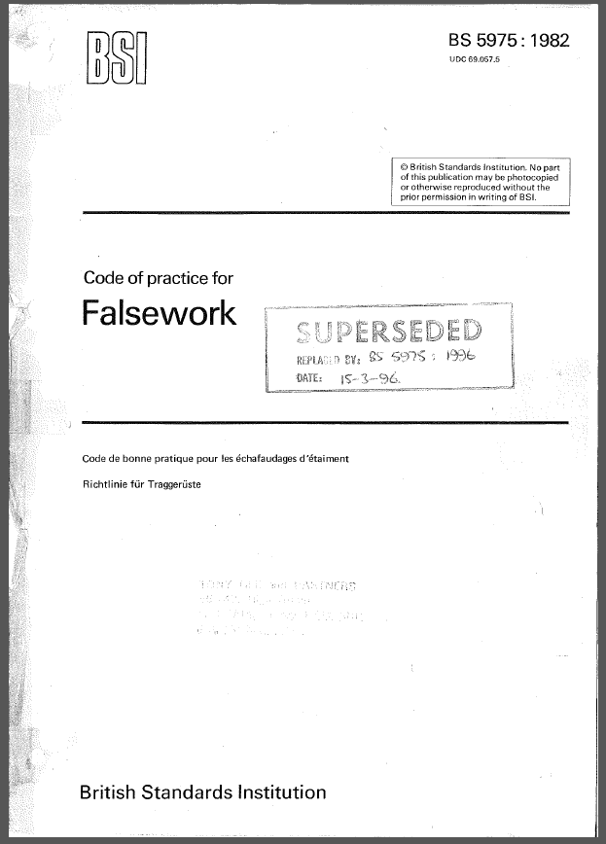
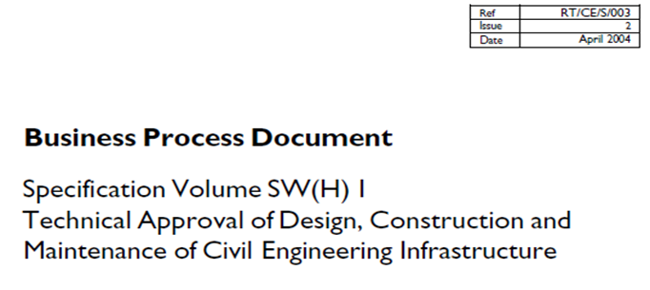
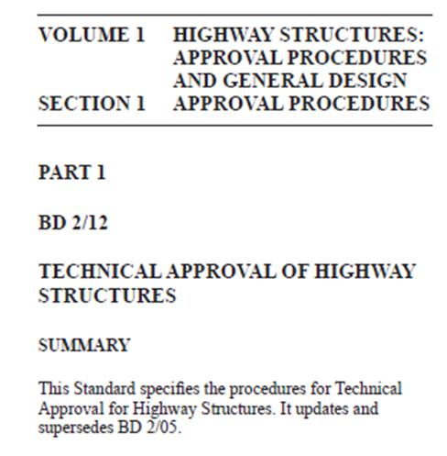
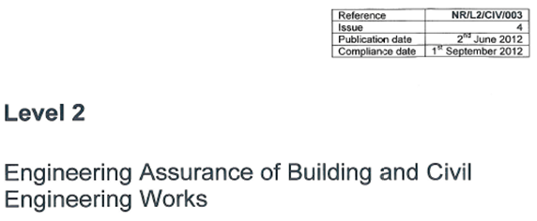
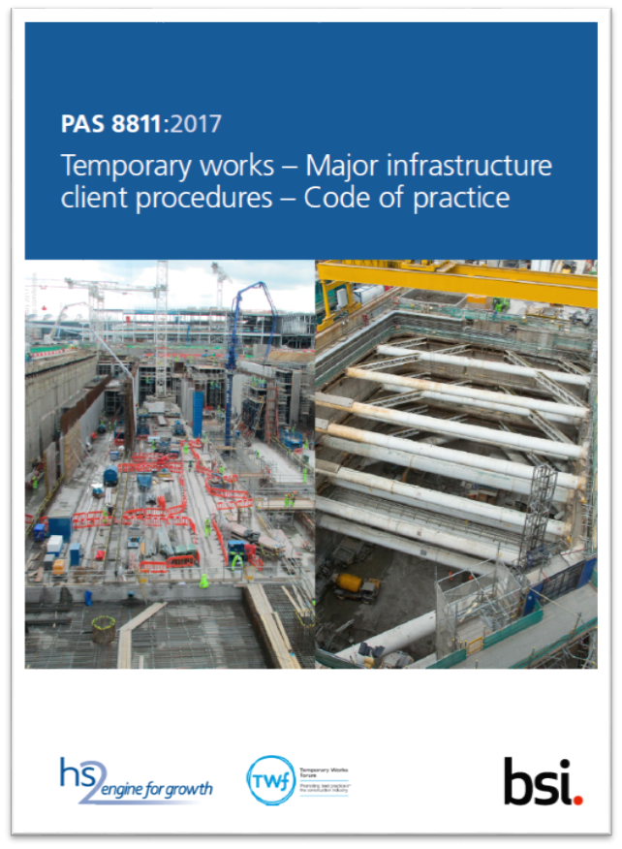
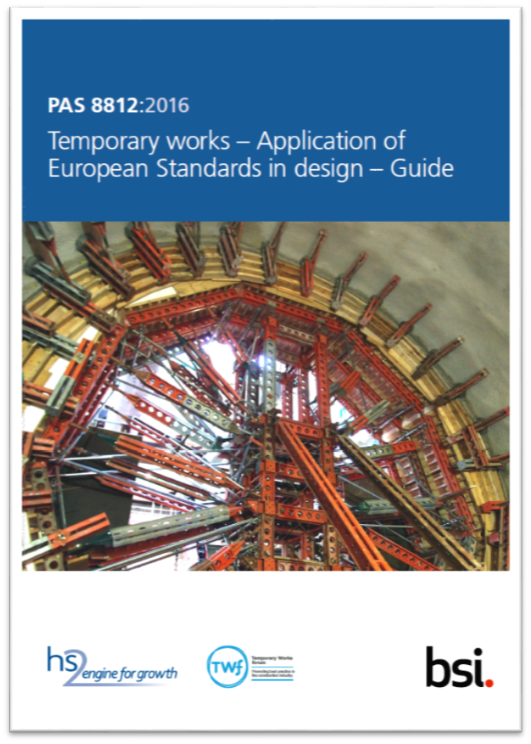
Highway:
Rail:
LUL:
Notes:
Construction regulations
HSAWA
HSE
BD2/12
Interim guidance
BS5400
NR and LUL standards

Slide 6
Difference between PW and TW
 | Permanent Works | Temporary Works
Serviceability stress levels | Low | High
Limit state | Usually ultimate | Often serviceability
Predominant codes | Limit state | Permissible stress
Robustness | High | Often low
Ratio imposed/dead load | Typical 50/50 | Typical 10/1; Extreme patterns
Duration of use | 60-120 years | Days, weeks or months
Component types | Bespoke to project, always new | Suppliers’ systems, often second hand / reused
Planning | Can take years | Quick, user site pressure
Budget | Determined by client | Determined by contractor

Slide 7
BS 5975
BS 5975 | 1982 | 1996 | 2008 | 2019
General and legal | 3 pages | 5 pages | 20 pages | 13 pages
Procedures | 3 pages | 3 pages | 15 pages | 49 pages
Materials and components | 8 pages | 12 pages | 23 pages | 20 pages
Loads | 12 pages | 17 pages | 26 pages | 27 pages
Foundations | 4 pages | 6 pages | 9 pages | 6 pages
Design | 13 pages | 15 pages | 43 pages | 42 pages
Work on site | 3 pages | 5 pages | 10 pages | 8 pages
Standard solutions | 2 pages | 8 pages | 0 pages | 0 pages
Appendices | 23 pages | 38 pages | 58 pages | 53 pages
Total, cover to cover | 80 pages | 130 pages | 228 pages | 250 pages
Notes:
Only procedural side has changed

Slide 8
BS 5975:2019
Aim of procedures:
Minimise the chance of errors being made, and to
Maximise the chance of errors being discovered
BS5975 make specific reference to
Clients,
Designers (Principal Designers, Permanent Works Designers and Temporary Works Designers),
Contractors (Principal Contractors, Contractors and Sub-contractors),
Suppliers and Manufacturers of temporary works equipment
Many of the activities required (procedures) are already being carried out “as routine” by competent organisations

Slide 9
BS 5975 Specific requirements
Specific requirements
5. Overview of temporary works procedures and training
6. Procedures (relates to all organizations)
7. Clients’ Procedures
8. Designers’ Procedures
9. Contractors’ Procedures
10. Supplier/manufacturer Procedures
Everyone engaged in Temporary Works should read the procedural parts in BS5975 (sections 5 – 10) at least once
For others, these are the highlights:

Slide 10
BS 5975:2019
5. Overview of temporary works procedures and training
High level over view of procedures and control measures
Organizations involved in Temporary Works and their relationships
Lines of communications and responsibility
Training

Slide 11
BS 5975:2019
Designated individual (5.1.1.11 & 6.1.2.1)
A senior person in the organisation
Responsible for establishing, implementing and maintaining procedures for the control of temporary works for that organisation
Client’s Designated Individual (7.3)
Designer’s Designated Individual (8.2)
Contractor’s DI (9.2)
Suppliers’ DI (10.2)
(the responsibility was introduced in BS5975 2008, but not spelt out)
Notes:
BS5975 2008 Cl 6.3.1.1

Slide 12
BS 5975:2019
5.2 Training
5.2.1 All those managing temporary works should have, as a minimum, an understanding of:
the procedures outlined in BS 5975 Section 2;
the specific procedures for the organisation for whom the person works;
the risk management aspect associated with the management of temporary works;
technical knowledge relevant to both the role and the complexity of the work; and
practical knowledge relevant to the complexity of the work.

Slide 13
BS 5975:2019
Specific requirements:
7. Client Procedures
7.1 Client Role
7.2 Client appointment of contractors (other than PC)
7.3 Client DI
7.4 Domestic Clients
8. Designer Procedures
8.2 Designers’ DI
8.3 Permanent Works designers
8.4 Temporary Works designers
8.4.2 Lead Temporary Works designers
8.5 Principle Designers

Slide 14
BS 5975:2019
The small print:
7.3 Client's DI
7.3.1 Clients should establish and maintain a procedure to control those aspects of temporary works (and associated risks) for which they have responsibility or can constrain or influence. The senior person responsible is defined as the client's DI (see 6.1.2).
7.3.2 The client’s DI should establish a procedure detailing how the main items for which the client has responsibility should be managed. The main items to be addressed are as follows.
The PD and PC and any other organization directly employed by the client should have in place a temporary works procedure in accordance with the recommendations of this British Standard.
The client's DI should ensure that the PD's and PC's procedure(s) for the control of temporary works are being implemented.
NOTE 1 Implementation can be checked either by using the client’s own staff during the contract, by using a consultant or an independent third-party audit and/or certification scheme.
Any assets belonging to the client or third party that might be affected by any temporary works should be identified.
Any requirement for review or formal acceptance of the temporary works by the client, including design brief and/or design statement and/or design output should be defined.
Notes:
Working space
Architectural features
Programme duration

Slide 15
BS 5975:2019
7.3 Client's DI Continued
e) The client should provide all necessary information to enable the PD and/or the PC to design, construct and remove temporary works and, where necessary, protect any assets which belong to the client or a third party.
NOTE 2 This information could include site investigation information (including that for the design of working platforms), computer models (including BIM [building information modelling] and/or design package input) to allow the temporary works designer to input the new information in relation to the temporary works, information on the assets which might be affected by the temporary works (drawings, results of any invasive investigations of the assets and any calculations which might be available).
f) Any requirement for client-specified hold points for temporary works, including signing of an acceptance certificate to release any hold point (as a permit to proceed), should be defined.
g) The procedures should define the actions to be taken in the event that a client does not accept a TW proposal, or withholds or delays the release of a hold point.
h) Any other constraints or criteria, performance or otherwise, should be defined.
7.3.3 Where the client directly appoints organizations, other than the PD and PC, that are involved in temporary works, the additional items for which client responsibility should be established are as follows.
Any organization directly employed by the client should be informed that they should adhere to the PD's or PC's procedures unless their own procedures are approved by the PD’s DI or PC’s DI, as appropriate, for use.
The arrangements should include provisions for the organization's management to both liaise with and be responsible to the PC’s TWC on matters related to their temporary works input (see 9.5.2).

Slide 16
BS 5975:2019
8.2 Designers’ DI
8.2.2 The designers' DI should establish a procedure describing how the main items for which the designer has responsibility should be managed. The main recommendations to be addressed, in addition to those in 8.1, are as follows.
Procedures should be appropriate to the type and complexity of work, and associated risks, which the designer is to consider.
Sub-consultants should have adequate procedures for managing the temporary works design.
Any temporary works design commissioned by a PC or other organization should be initiated with a design brief, from the PC’s TWC or TWC. The designer should prepare a design statement or approval in principle (AIP) or equivalent where so required.
Any temporary works design checker commissioned by a PC or other organization should be provided with the design brief, design statement or AIP or equivalent where prepared and the necessary drawings and other documents [as noted in 8.1.4c) but not calculations] before the design check is undertaken.
The designer should respond promptly and clearly to any request from the PC or a contractor, appointed to manage part of the temporary works, for information or design criteria, in respect of temporary works, to allow the TWD to complete the design and allow the PC or other contractor to manage and discharge their responsibilities.
The designer should liaise fully and clearly with all parties, initially with the TWC, but this may be extended to cover other designers and/or design checkers.

Slide 17
BS 5975:2019
8.3 Permanent Works Designers
8.3.1 Permanent works designers should address the buildability of the permanent works and identify, and make provision for, any temporary works and temporary conditions required by their design and their assumed method of construction. This should include:
a proposed method and sequence of construction which should have no adverse effects on the permanent works;
deciding on and communicating the intended construction process, giving particular attention to new or unfamiliar processes;
considering the stability of existing structures and partially constructed/erected/ demolished structures and, where this is not immediately obvious, providing information to show how temporary stability could be achieved;
identifying where standard industry details are not suitable, and where detailed structural design is to be carried out by others;
considering the effect of the proposed work on the integrity of adjacent/existing structures, particularly during refurbishment;
ensuring that the overall design takes account of temporary works which might be needed, no matter who is to develop those works;
ensuring that consideration has been given to the availability of sufficient space required to construct or maintain the structure; and
clearly stating loads for which the structure has been designed including the proposed plant installation loads and plant routes.

Slide 18
BS 5975:2019
8.4.2 Lead temporary works designers (applies equally to checker)
Where package of work includes several designers (or checkers) one designer should be appointed lead.
A single design certificate should be issued
Lead designer has duties to
manage design
distribute tasks,
ensure communication,
ensure compatibility,
holistic solution,
ensure completeness

Slide 19
BS 5975:2019
8.5 Principal Designers
In relation to temporary works, the PD should ensure that:
There is a coherent construction method which identifies all key temporary conditions and temporary works
The finally agreed construction method, sequence and temporary works are not deleterious to the permanent works
designers follow the recommendations of the relevant clauses within this British Standard (see 8.2, 8.3 and 8.4);
They share information with designers, and the PC’s TWC and TWC that might influence the design of temporary works or the selection of construction methods;
designers take account of the construction phase plan;
they retain appropriate information relating to temporary works that would be required for the health and safety file; this should include information on construction method or sequence including associated temporary works which might impact on future maintenance or deconstruction; this information should be obtained from the PC’s TWC; and
they carry out the domestic client’s duties with respect to temporary works, where these have been transferred to the principal designer (see 7.4).

Slide 20
Tony Gee’s Procedure

Slide 21
Tony Gee’s Procedure
Design Engineer; BIM Technician
Design Engineer; BIM Technician
Project Engineer
Project Director
Requirement for temporary works generated
Design review
to assess complexity
and allocate resources
Carry out work
(design or checking)
and further reviews
Output
with signed
Design/ Check
certificate
GN-DP-009-01

