Slide 1
Raising The Bar
Information Share
June 2020
Notes:
This is the holding screen, so people dialling in know they are in the right place!

Slide 2


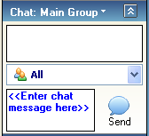
House Keeping
During the Webinar your phone will be muted to reduce background noise.
We are sat in an open office and there may be noise beyond our control
This Webinar is interactive and your questions are very welcome/ To ask a question, type it into the chat box; these will be answered during the event.
If time is limited, any unanswered questions will be added to the Q&A and included within the slide pack that will be made available after the event.

Slide 3
Introduction
‘’No one should be harmed when travelling or working on the strategic road network’’
Notes:
Introduce Mark Bridges & Phil Farrar
Today we will provide a refresh on the work of the Major Projects H&S Hub team and explain the raising the bar H&S guidance and what you should do with them.
Health and safety is our number one imperative as Highways England project leaders;
Our vision is that ‘’No one should be harmed when travelling or working on the strategic road network’’
And our value is ‘’ to keep ourselves and others safe – above all else’’
This is not just a legal or organisational responsibility but a moral one, It’s all about everyone going home safe to their families.

Slide 4

What is the MP H&S Hub ?
Notes:
To give some context as to where the raising the bar series originated I will provide you with some background.
The MP H&S hub was set up in 2012 as part of the MP delivery hub which aimed to deliver efficiencies and standardise ways of working.
The H&S hub team was set up;
Because Highways England and delivery partners recognised a need to improve H&S standards and performance in order to prevent harm.
it addresses inconsistent approaches by standardising ‘best’ practice and this resulted in the RTB initiative.
It was seen as an opportunity to share collective knowledge and improve engagement across the construction and maintenance community.
It supported the delivery of the objectives of the Highways Agency Aiming for Zero strategy and the Highways England H&S 5 year plan which has now evolved in to the Home Safe & Well approach.
Even though the original delivery hub has disbanded the H&S hub has continued as it was considered an effective team who’s members believed it was the right thing to continue with our work.

Slide 5

















Who are we ?
Notes:
Work is done by a group of people who want to make a difference from the following organisations.
Each of these organisations has a representative in the hub and they meet face to face every month.
The group has grown from 5 managed motorway framework principal contractors to 18 delivery partner organisations that represent all the construction and maintenance community including client, designers, principal contractors and extended supply chain.
Our work was initially Major Projects focussed but it has been recognised by Operations and has been adopted in to maintenance as well.
The members are unpaid and work is done voluntarily.

Slide 6


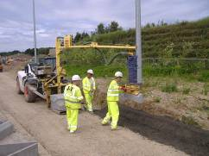
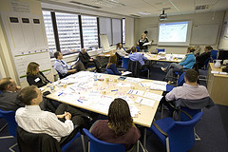
Our Objectives
IMPROVE QUALITY OF H&S TASKS
IDENTIFY AND ADOPT BEST PRACTICE
RAISE STANDARDS TO NEXT LEVEL
IMPROVE ENGAGEMENT WITH SUPPLY CHAIN
Notes:
The groups objectives form the bedrock of raising the bar.
1) Improving The Quality Of H&S Tasks – This is to improve consistency and ensure health and safety is managed to industry leading standards.
2) Identify & Adopt Best Practice – This is done by freely sharing information, identifying industry best practice and agreeing on the best solutions for common problems. These are communicated using the raising the bar guidance.
3) Raising Standards To The Next Level – We continuously improve by adopting new ideas and better ways of doing things and continuously review the guidance.
4) Improve Engagement – We have developed an open and honest culture where we can share and learn from each other.
Whilst it is great to do this in itself, what it really does is facilitate delivery of a culture and behaviours that support our aim of changing lives………….

Slide 7
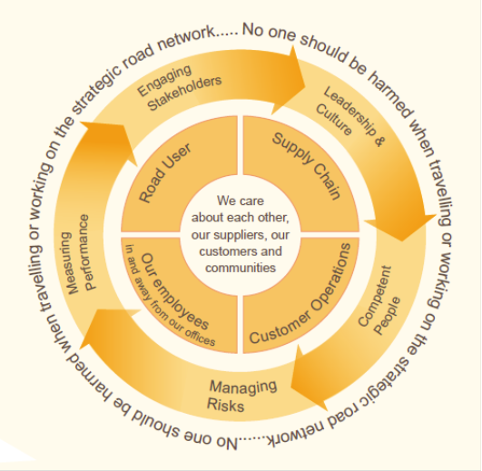
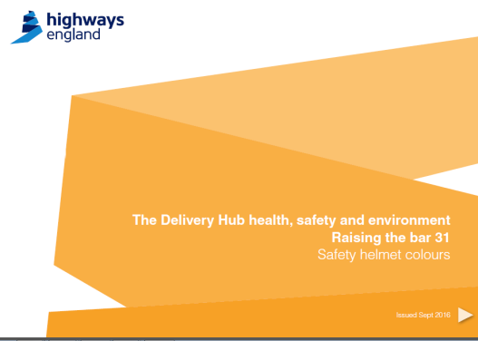
What have we delivered ?
  COLLABORATION & ENGAGEMENT
Notes:
We have delivered;
30 Raising The Bar guidance documents
Established web pages on the HE portal, gov.uk and highwayssafetyhub
Monthly briefings covering our work, successes, innovations, lessons learnt and anything relevant from wider industry
6 Best Practice Workshops, conferences that attracted up to 200 people
High Risk Campaigns with a new programme starting next month.
Monthly Meetings
Weekly teleconferences
H&S 5 YP, supported 25 actions and delivered 6 (supervisor competence, risk control, occ health)
Worked with relevant H&S groups e.g. ASG, MP Regional & Programme Safety Forums, Rowsaf, Roadworks Improvement, Procurement etc.
These are tangible deliverables but the most significant improvement which is harder to quantify is the community spirit that has developed which has greatly improved collaboration and engagement.
I will now focus on our key initiative ‘ raising the bar’

Slide 8
Raising The Bar Guidance
Notes:
The development of raising the bar guidance;
Has collaboratively identified H&S problem areas (using risk analysis, performance trends, inspections and audits)
It has established tried & tested best practice solutions, therefore approaches that are known to work.
They have set minimum requirements which are Mandated by a Major Projects Instruction and an Operations Construction Management Memo. This makes them a clear contractual requirement.
They foster raising standards to the next level by identifying desirable requirements.
They are checked by independent H&S inspection, safety tours and during site excellence wheel and maturity assessments.
They do not replace legislation or HE standards (i.e. DMRB, IAN’s), their aim is to achieve higher than compliance.
Raising the bar guidance is under continual review and updated where lessons are learnt and improved ways of working have been developed.
We have champions appointed as technical experts and focal points who have responsibility to maintain the raising the bar guidance.
They provide a reference guide for those managing H&S throughout the life of a project from design in to construction and operation.
They contain tried and tested solutions that have been developed together with our delivery partners in order that they are practical and achievable.
Raising the bar sets clear minimum requirements, sites should be aiming to achieve even higher standards.

Slide 9
What areas does Raising The Bar cover ?
And more !
Notes:
Here is a selection of some of the 30 areas covered by raising the bar guidance;
They cover high risk activities including;
Plant Person Interface *
Service Avoidance *
Occupational Health *
Working at height *
Traffic Marshalls *
They also cover holistic and cultural themes such as;
Design for safety *
Lean Health and Safety*
Behavioural Based Safety*
Plant and Equipment
Traffic Management Entry Exit
Temporary Safety Barrier
Caravan Temporary Sleeping Accommodation
Overhead services and structures protection
Manual Handling
Communication of risk
Influencing driver behaviour
Excavation protection access and egress
Slip trip and fall
Task Lighting
Dust control
Noise control
Transport logistic Management
Site Health and Safety Inductions
Hand arm Vibration
Loading and Unloading Vehicles
Managing TM incursions
Supervision
Safety Helmet Colours
Occupational Cancers

Slide 10
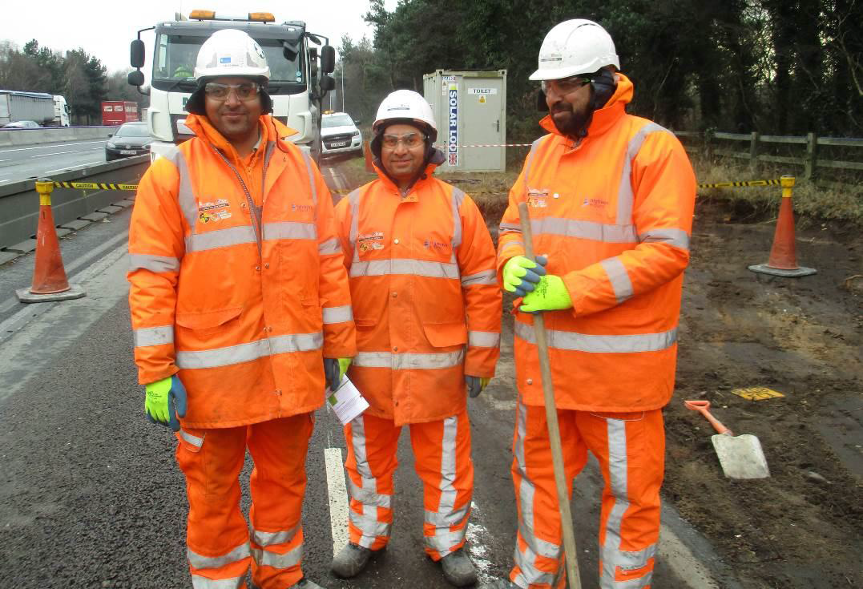
Has it made a difference ?
Notes:
So, has it made a difference ?
Feedback from inspections, safety tours and individuals has shown:
Our work and raising the bar guidance have definitely improved the quality of safety standards on site
Raising the bar guidance have definitely created a heightened awareness of the standards required and the need to continually improve H&S standards on site
There is widespread knowledge of the work we do
Positive feedback has been directly received from sites and individuals
The badges have gone, people are openly talking to each other and actively sharing information
The group has stuck together and built a community improving collaboration e.g. helped JV’s such as Manchester SM

Slide 11
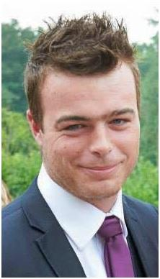
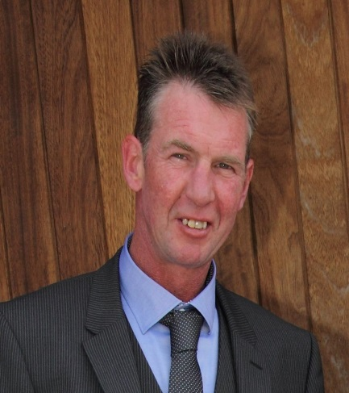
Tragically,
Ben Collins
Died 27 July 2015
Robert English
Died 10 October 2016
Notes:
Sadly, these 2 fatalities occurred on Major Projects sites.
Ben Collins, just 28 years old died on 27 July 2015 whilst using a vacuum excavator.
And
Robert English a 47 year old father of 3 died on 10 October 2016 when struck by a dump truck
The impact of these deaths on their families is immeasurable.
We all still have a lot of work to do in order to keep our teams safe.

Slide 12
Where can you find them ?
H&S pages on portal
Gov.uk
www.highwayssafetyhub.com
Notes:
So, where can you find the raising the bar guidance ?
They can be found on the HE Portal H&S pages
They are hosted on GOV.uk
The delivery partners have set up www.highwayssafetyhub.com
We are now going to look in depth at what the raising the bar guidance contains by looking at B7 Service Avoidance.

Slide 13
So what do they contain ?
Lets look at;
B9 Underground Service Avoidance
Objective
Background
Minimum Requirements
Desirable Requirements
References
Notes:
Expand on contents using overhead protection as an example;
https://www.gov.uk/government/publications/health-and-safety-for-major-road-schemes-service-avoidance
All our Raising the Bar Documents follow a simple similar structure
Objective – This is the overarching goal of the document, who it applies to and what we expect
Background – This gives an introduction of why this particular topic set was chosen. Its either through incident rates, poor audit findings or a general sense by the group that a particular topic requires standardising.
The document then sets out the minimum and desirable requirements expected on Highways England sites. Some of the earlier documents like raising the bar 1 Plant and Equipment are quite clear on what is minimum and what is desirable however as the documents have matured many of the documents follow a process such as Plan, Organise, Control and Monitor. In these documents it is clear what is minimum and what is desirable through the language that is used such as must or consider. As Phil mentioned earlier the minimum requirements are just that and sites should be aiming to meet the desirable elements overtime and in fact continually aim higher so that the next revision of the documents can be raised further.
References – Finally the document provides links and references to other industry guidance and material for further.

Slide 14
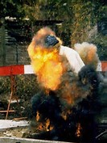
Continually Raising the Bar
“Using steel pins to penetrate the ground could have been avoided. There are a number of ways of conducting similar work which avoids using steel pins to penetrate the ground.” - HSE inspector Paul Thompson
LIFESAVER
CONDUCTIVE METAL SETTING OUT PINS ARE BANNED ON ALL HIGHWAYS ENGLAND SITES
http://www.shponline.co.uk/underground-cable-strike-caused-jet-of-fire/
Notes:
It should worth mentioning at this point that Raising the Bars are not there to replace or regurgitate current industry guidance or provide a management system for the DP. How Raising the Bar 9 – Service Avoidance differs from guidance such as HSG47 from the HSE is the RTB tries to go beyond the minimum. Unfortunately whilst this image is staged for the cover of HSG47 it is far too often a real example. As we were writing RTB9 there was a court case being reported following an incident in August 2011 where a worker was burned by a ‘jet of fire’ when a steel pin he was driving into the pavement made contact with a 415 volt underground electricity cable. Thankfully the workman escaped with minor burns to his arms and eyebrows.
http://www.shponline.co.uk/underground-cable-strike-caused-jet-of-fire/
Birmingham Magistrates fined the workers employers £2,500 and ordered to pay costs of £4,727. After the hearing, HSE inspector Paul Thompson said:
“The worker is very lucky to be alive. It is only because he was able to quickly jump back from the blast and extinguish the fire that he wasn’t electrocuted. As he struck the pin it caused a ‘Roman Candle’ effect of fire and sparks to erupt from the ground, sending a jet of fire up from the pin.
But what was more interesting was that he followed this up with the statement “Using steel pins to penetrate the ground could have been avoided. There are a number of ways of conducting similar work which avoids using steel pins to penetrate the ground.”
Because of this a couple of our delivery Partners (Carillion, Bam) had already started to ban the use of ferrous pins for setting out so as a result we set this as our lifesaving rule. The Lifesaving Rule doesn’t feature in all Raising the Bars but is in all that pose a significant risk to our workers and the aim is to set a few simple rules that if followed will prevent further injuries. These bold decisions are always up for challenge and this one in particular caused some discussion in regional forums by operational staff with claims that ‘You cant build a road without setting out pins’ Thankfully though many of our delivery partners were up for that challenge……

Slide 15
A1 Leeming To Barton Case Study
The Project
20km of new Motorway
18km of Local Access Road
600,000 tonne of road surface
3 million cubic metres of earth moved
113km of drainage
The Solution
Early Contractor Involvement
Use of GPS Technology
Notes:
None more so than our A1 Leeming to Barton Project
The A1L2B Project consists of building 20km of new Motorway and 18km of Local Access Road. Which required 600,000 tonne of road surface ~ 1,500 jumbo jets
3 million cubic metres of earth graded and moved ~ 1,100 Olympic swimming pools and the installation of 113km of drainage ~ Newcastle to Ripon
By engaging with their key suppliers earlier such as Aggregate Industries the project team identified and introduced specialist software which allows the pavers on the scheme to lay areas of surfacing that are up to 13m wide and 300mm thick in a single layer. The use of Global Positioning System (GPS) and Total Station Position System (TPS) combined with the Trimble Survey equipment meant that the A1L2B became the biggest data transfer in Europe with over 1000+ digital models produced.

Slide 16
A1 Leeming To Barton Case Study
The Benefits
Elimination of 25,000 pins
2 Million RIDDOR Free Hours
British Construction Industry (BCI) Awards
Notes:
The key benefit of this means there is no need to set out therefore not only did the project eliminate an estimated 25,000 setting out pins it also significantly reduced the need for any interface with our workforce and moving plant and machinery. Whilst it would be difficult to categorically say that this prevented a serious or fatal injury on site it is believed that this decision contributed to their excellent safety record. The A1 Leeming to Barton Improvement scheme also won this year’s Application of Technology Award at the British Construction Industry (BCI) Awards on the 12th October 2016 for the intiative. Further information can be found at: https://bcia.newcivilengineer.com/2016-winners

Slide 17

What do you need to do with ‘raising the bar’ guidance ?
Know what they are and where to find them.
Your responsibility to make sure they are applied on your sites.
Address inspection non conformances effectively.
Use safety leadership tours and excellence wheel / safety maturity assessments as opportunities to check.
Notes:
Thank you, Mark
So what do you need to do with the raising the bar guidance ?
You need to know what they are and where to find them – familiarise yourself with the layout and content in particular the minimum requirements.
Your responsibility to make sure they are applied on your sites – Champion them on your sites and make sure they are being used to meet the minimum requirements
Address inspection non conformances effectively – In conjunction with legislation and HE standards the raising the bar guides detail what is expected during inspections and remember these solutions have been developed by our delivery partners so you should be ‘pushing against an open door’
Use safety leadership tours and excellence wheel / safety maturity assessments as opportunities to check – the raising the bar guidance can be used as an H&S leadership tool.

Slide 18
Technical support
Hub delivery partner champions
Delivery partner H&S advisors
Our Highways England H&S advisors
www.highwayssafetyhub.com contacts
Notes:
The following people are able to provide support;
Each organisation has a hub delivery partner champion, who are highways H&S specialists.
Each project will have delivery partner H&S advisors who are in direct contact with the champions
Our Highways England H&S advisors
Link to useful contacts;
http://www.highwayssafetyhub.com/contact.html

Slide 19

What are we doing next ?
Support of Home Safe & Well
Support Supply Chain Safety Leadership Group working groups.
Continual review of raising the bar
Notes:
We are;
Supporting the Highways England Home Safe & Well approach
Supporting the Supply Chain Safety Leadership Group working groups; Accident Investigation, Safety Passport, IPV & TM Incursions, Mental Health, Safety in Design, Safe use of Plant, Utility Strike Avoidance, 60mph in roadworks
- Reviewing RTB with the Risk Champions and HE H&S team. We will be sharing lessons learnt during the implementation of RTB and feedback from H&S inspections and current incident trends.

Slide 20
Summary
Today we have covered;
What is the MP health & safety hub
What is raising the bar
What you need to do
Where to find them www.highwayssafetyhub.com
Who can support you
Please support us
Thankyou for listening
Notes:
In summary we have covered;
What is the MP health & safety hub
What is raising the bar
What you need to do
Where to find them www.highwayssafetyhub.com
Who can support you
I will be adding today’s attendees to our briefing distribution and upload this presentation to website.
Remember the guidance is a minimum requirement, not a ceiling.
We must improve our H&S culture and standards to prevent harm and ensure everyone goes home safe.
Please support us
We welcome you questions.

Slide 21

Notes:
Back to CoE host to have a dialogue with presenter(s) to pick up any questions / points raised in chat room during webinar

Slide 22
Questions and Answers
Notes:
Place holder to capture any Q&A raised during the session – need to ensure chatroom data is saved as text file to the desktop before ending the meeting.

