Slide 1
Principal Designer Working Group (Meeting 31) March 2023

Slide 2
What do we know about suicides on the SRN?
Estimated 50 suicides per year on our network.
Even more suicide attempts
2022 Number of suspected suicides per month
Jan | Feb | Mar | Apr | May | Jun | Jul | Aug | Sept | Oct | Nov | Dec | Total
9 | 5 | 3 | 5 | 3 | 1 | 4 | 4 | 8 | 6 | ***6 | 5 | 59
2019 – 2021 Three-year monthly average of suspected suicides
Jan | Feb | Mar | Apr | May | Jun | Jul | Aug | Sept | Oct | Nov | Dec | Total
5 | 2.3 | 3.3 | 2.3 | 4.7 | 3 | 1.7 | 4.3 | 3.3 | 4.7 | 6 | 5.3 | 46

Slide 3
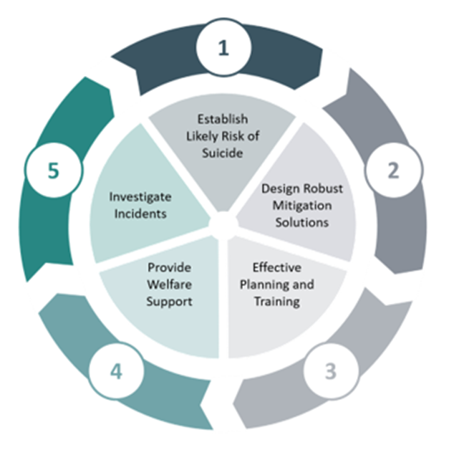
Setting and industry wide-approach
Raising the bar guidance
Highways Safety Hub
HART Reporting
Training

Slide 4
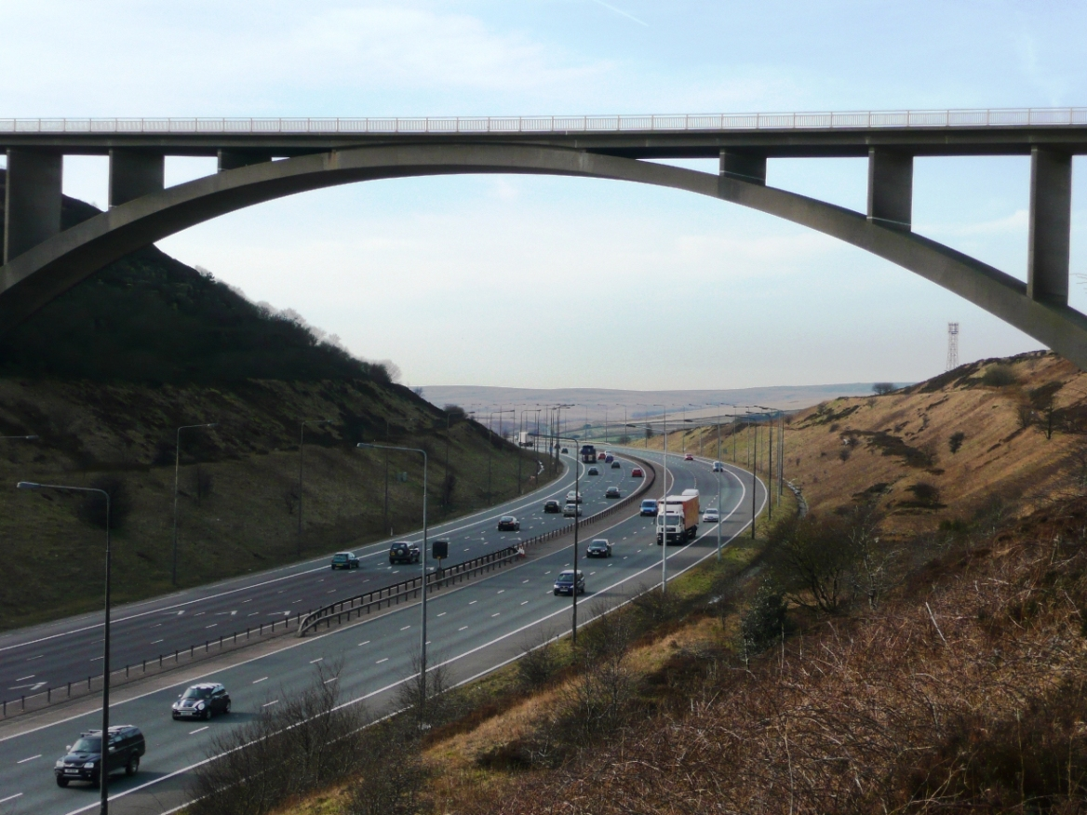
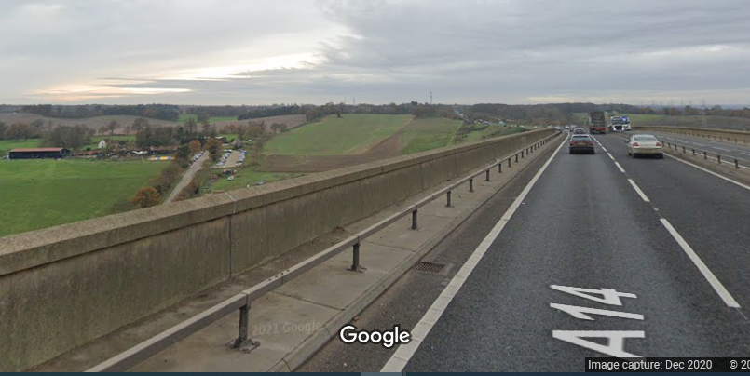
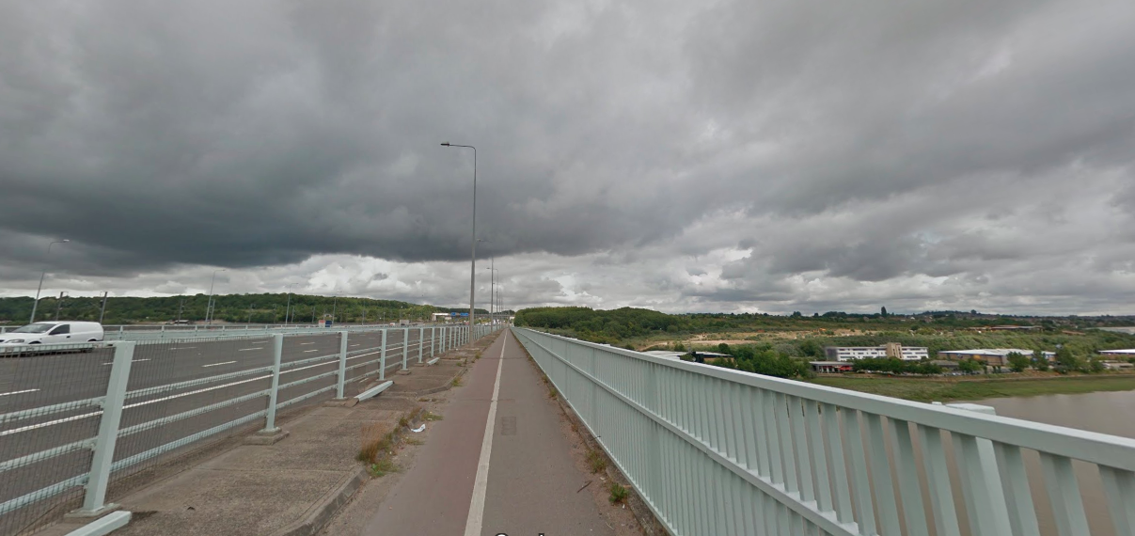
High Frequency Locations

Slide 5
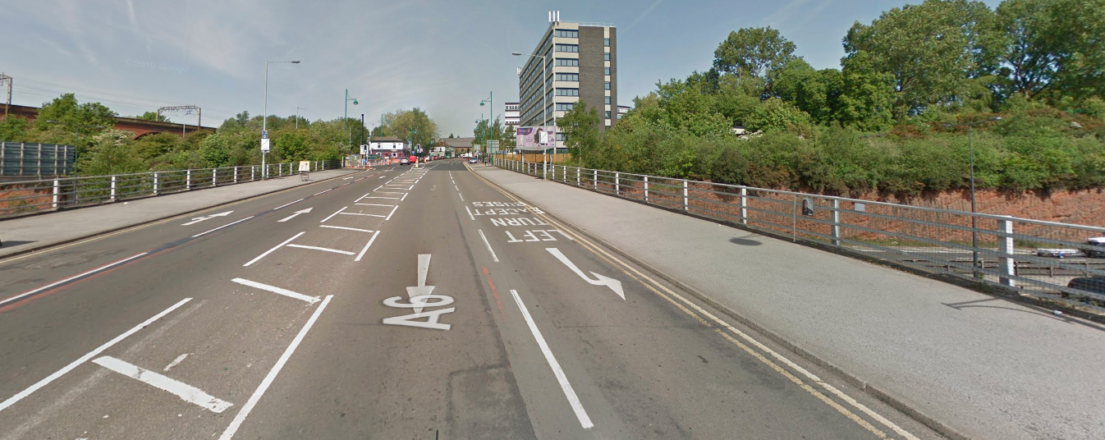
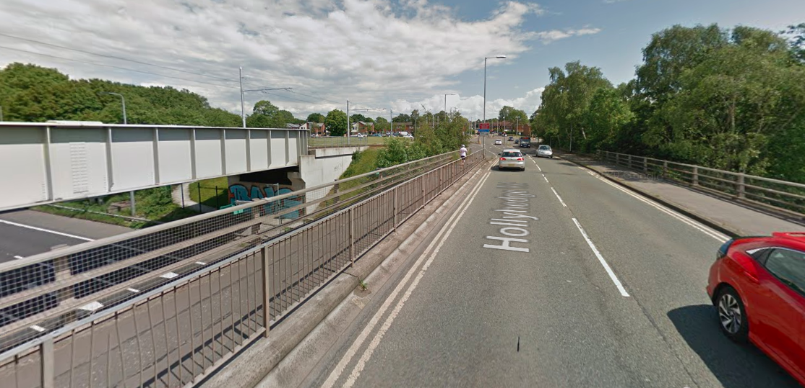
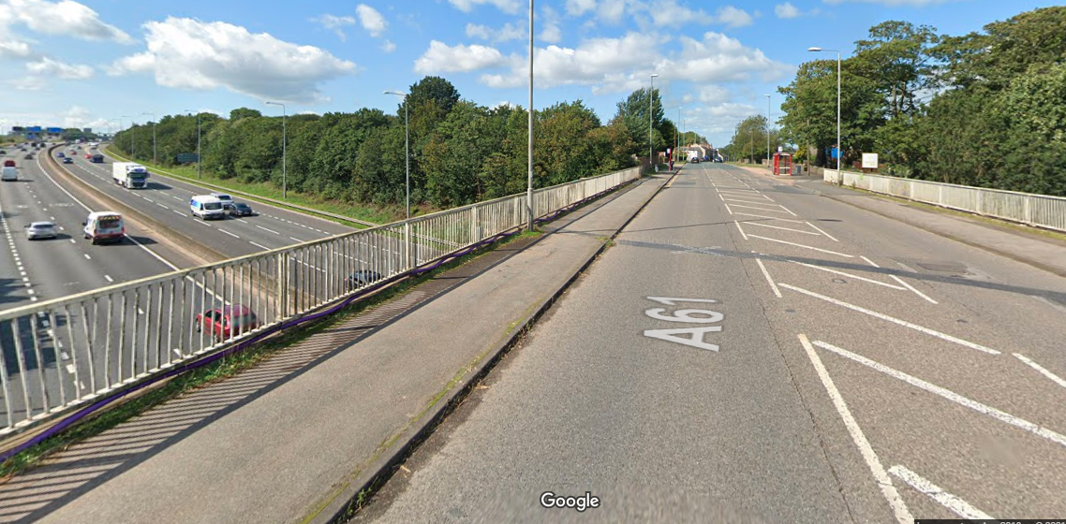
High Frequency locations

Slide 6
Advisory Group
Designers
Operations Renewals and Improvements
Suicide Prevention - SME
Major Projects
Road Safety Audits
Standard Owners
Risk Requirements

Slide 7
Overview of Suicide Prevention Risk Management Process

Slide 8
Step 1: Assess the risk
Deprivation data
ControlWorks Data
HART Data
National Suicide Datal
Suspected Suicide
Reports due July 2023

Slide 9
Step 2 : Risk assessment table for suicide risk at structures
Likelihood (I) x Severity (S) = Risk Value (R) |  |  |  | Severity (S)
 |  |  |  | 1 | 2 | 3 | 4 | 5
 |  |  |  | Very low probability of death if an attempt is made | Low probability of death if an attempt is made | Medium probability of death if an attempt is made | High probability of death if an attempt is made | Very High probability of death if an attempt is made
Likelihood (l) |  | 1 | Very unlikely; no attempts over the next 5 years | 1 | 2 | 3 | 4 | 5
 |  | 2 | Unlikely; 1-2 attempts over the next 5 years | 2 | 4 | 6 | 8 | 10
 |  | 3 | May happen; 3-5 attempts over the next 5 years | 3 | 6 | 9 | 12 | 15
 |  | 4 | Likely; 6-10 attempts over the next 5 years | 4 | 8 | 12 | 16 | 20
 |  | 5 | Almost certain; over 10 attempts over the next 5 years | 5 | 10 | 15 | 20 | 25
Risk Value (R) |  |  |  | Required action
Potentially low (1-9) |  |  |  | Existing control measures should be maintained and reviewed, and future proofing should be considered.
Potentially medium (10-19) |  |  |  | Suicide reduction measures should be considered in the design on a case-by-case basis.
Potentially high (20-25) |  |  |  | Suicide reduction measures should be included in the design.

Slide 10
Step 3: Design Guidance
Design principals
Recommended design mitigation based on risk values
Applies to Major Projects and Operations

Slide 11
Next Steps
Finalise the design guidance
Update relevant products in PCF, 3D and associated standards.
Share the risk reports
Continue with risk tool development
Develop a standard for suicide prevention?

Slide 12
Thank you – Any questions?

