Slide 1
CIRIA work relating to Lean in Construction
Owen Jenkins, CIRIA

Slide 2
CIRIA
We work collaboratively to be the leading provider of knowledge aimed at improving performance in our chosen themes in the construction and built environment sectors.

Slide 3
CIRIA members
2017
Notes:
Overview of members.
Quite a few major consulting companies – sector list in your pack – Arup, Atkins, WYG. Big one missing is Gleeds.
Grown by 20% in last 12 months, 68 members (20% of my budget)
If you join you will have an opportunity to engage and work with clients, T1 contractors and other major consulting companies at practitioner level to improve performance on industry wide issues

Slide 4
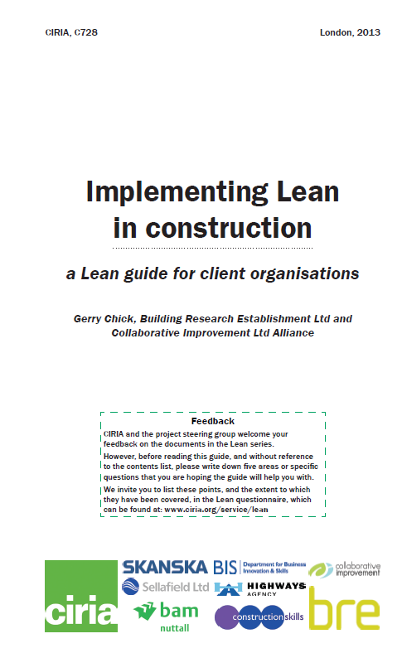
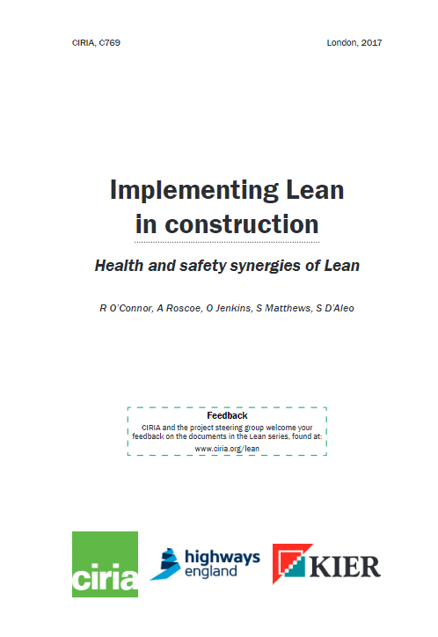
2011
2013
2017
2018/19
Lean tools
Lean benefits realisation
Lean and BIM
Lean and Sustainability
Lean for clients
Working with Lean consultants
Building Lean capacity through training
Lean and the design process
Quantifying lean benefits – case studies

Slide 5
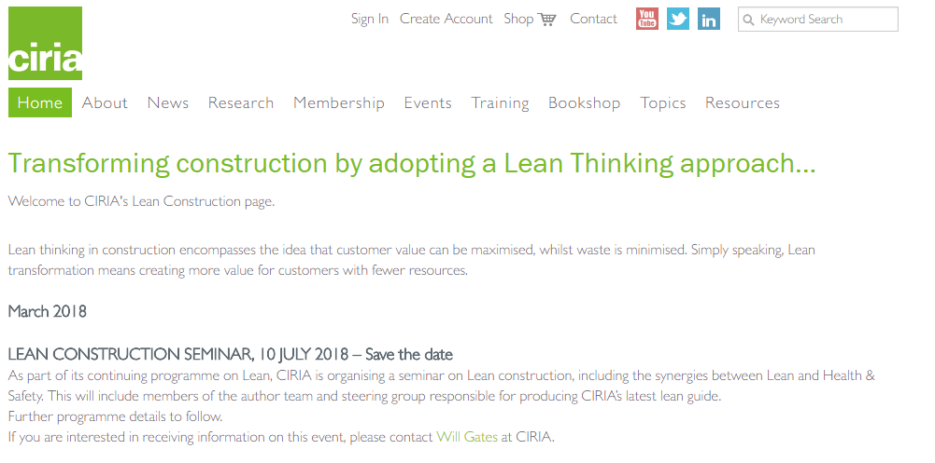
www.ciria.org/lean

Slide 7
Lean
communicating with all those concerned with successful production
analysing the processes involved
identifying what is inefficient, ineffective or dangerous and removing the associated ‘waste’.

Slide 8
Health e.g.
Pressures leading to stress and affecting mental wellbeing.
Exposure to harmful chemicals, combustion hazard, noise and dust resulting in respiratory and other physical conditions.
Physical e.g.
Musculoskeletal disorders arising from use of vibration-inducing equipment.
Slips, trips and falls caused by poor site management and storage of materials.
Physical injuries arising from poor site set-up and management (including being hit by vehicles).
Locational e.g.
Risks arising from working at height.
Risks arising from work under suspended loads or from other falling objects.
Poor ergonomics.

Slide 9
Some underlying causes of hazards
Risk assessment and communication
Information / changes
People

Slide 10
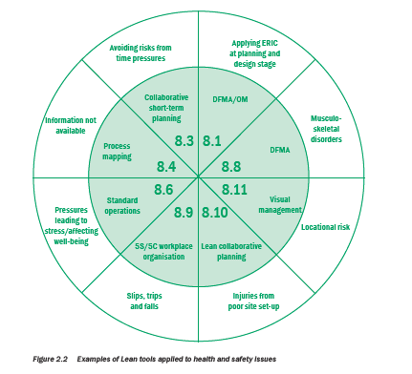
Applying Lean tools to H&S hazards

Slide 13
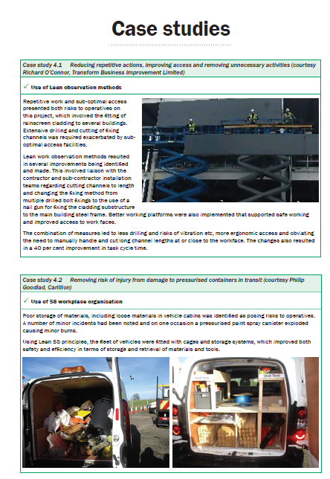
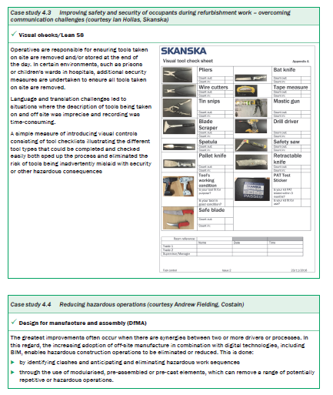

Slide 14
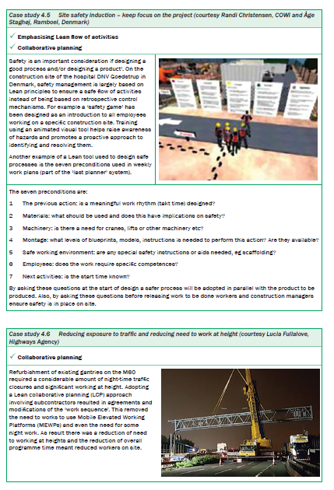
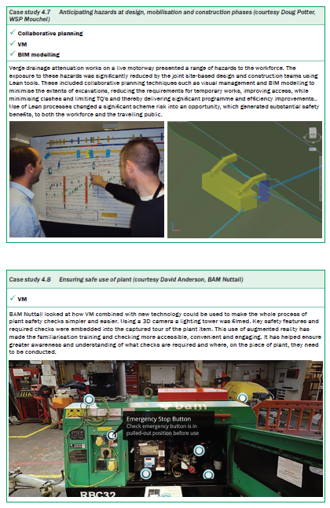

Slide 15
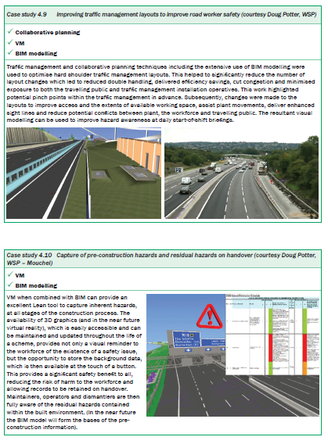
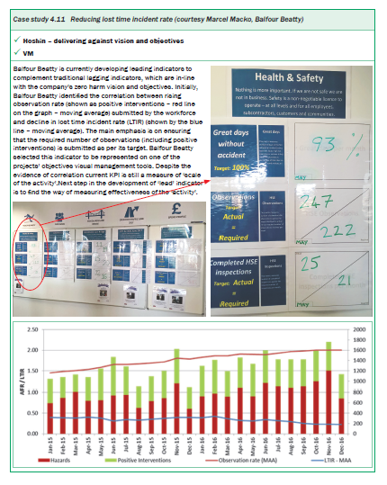

Slide 16
Post publication survey Respondents

Slide 17
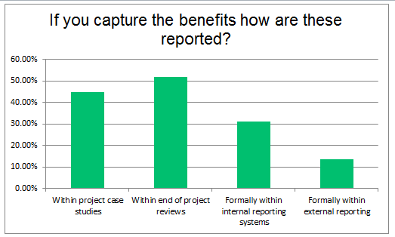

Slide 18
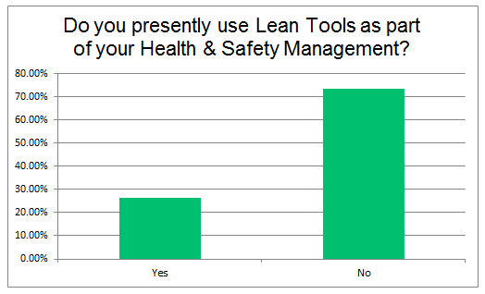

Slide 19
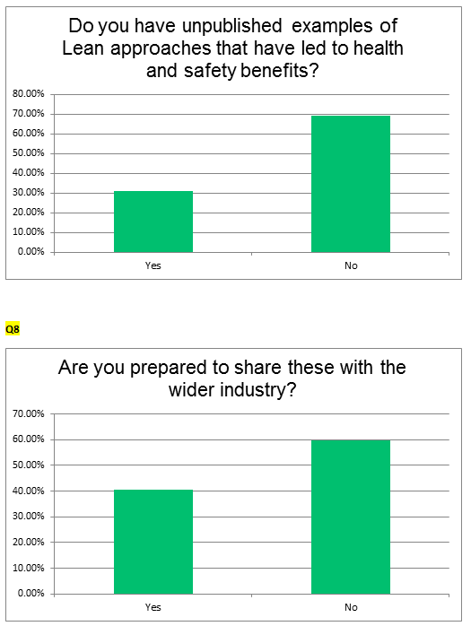

Slide 20
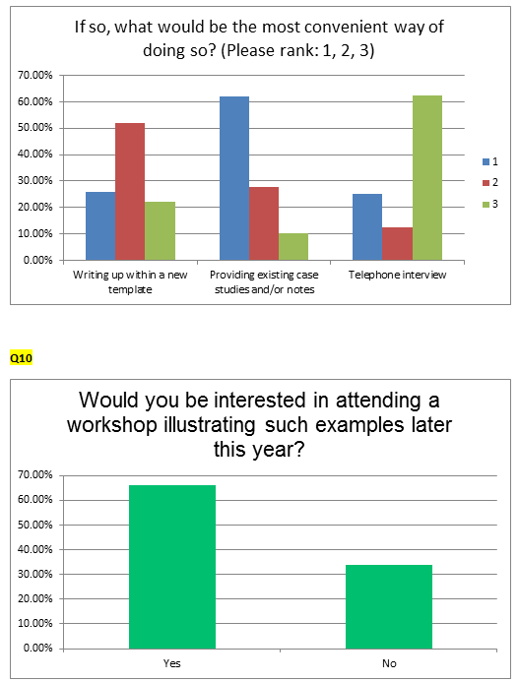

Slide 21
Diary date 10 July 2018 London 2:00pm – 4:30pm
Provisional programme
Introduction to Lean and H&S
David Anderson, BAM
Reducing H&S risks through Lean
Richard O’Connor, transform business improvement
Choosing by Advantages
Randi Christensen COWI
Cultural aspects
Tony Roscoe, Kier
+ BIM and H&S

Slide 22
Thank you
Owen.Jenkins@ciria.org

