Slide 1
Services Campaign
‘Going Underground?’

Slide 2
Today marks the start of the ‘going underground?’ campaign
To help raise awareness of the risks associated with working near underground services, please take part in a special ‘going underground?’ Stand-up today. The stand-up is based on a real life film and is aimed at all employees and suppliers.
Please ensure that your team sends a completed attendance sheet to your local health and safety administrator.

Slide 3
Today we will cover
Why we are running this campaign
An outline of the campaign
Campaign resources
Obtaining feedback from the campaign
What we need from you

Slide 4
Why are we running a campaign?
PLAY ‘DOUGS STORY’ HERE

Slide 5
Why are we running a campaign?
HSE figures 2012/13, all industries - Injuries related to exposure to fire, explosion and electricity:

Slide 6
Highways Network Stats
113 Service Strikes
49 strikes due to poor planning or non compliance with procedures
72 were contact with electricity
Alarmingly 1 incident occurred which exposed operatives to an explosion when a gas pipe was hit

Slide 7
Why are we running a campaign?
Work has been undertaken by USAG (Utility Strike avoidance group) following a series of incidents
The USAG group have developed a Charter and a toolkit to help change the way work is carried out around underground services
Many contractors are now part of the USAG Group and have signed up to the Charter

Slide 8
Why are we running a campaign?
Captures the output from ‘Underground Services Avoidance Group’
Commitment to the USAG Charter
Shift focus to Design, Planning and Construction
The use of the USAG BPAUS toolkit
The use of the ‘Proximity wheel’
The ‘Permit to dig’ becomes ‘Permit for Avoiding Underground Services’
A new process for services in concrete
The use of LinesearchbeforeUdig.co.uk or similar
New HSG47

Slide 9
Posters
Notes:
A2 poster

Slide 10
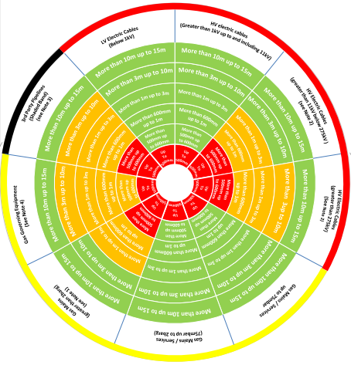
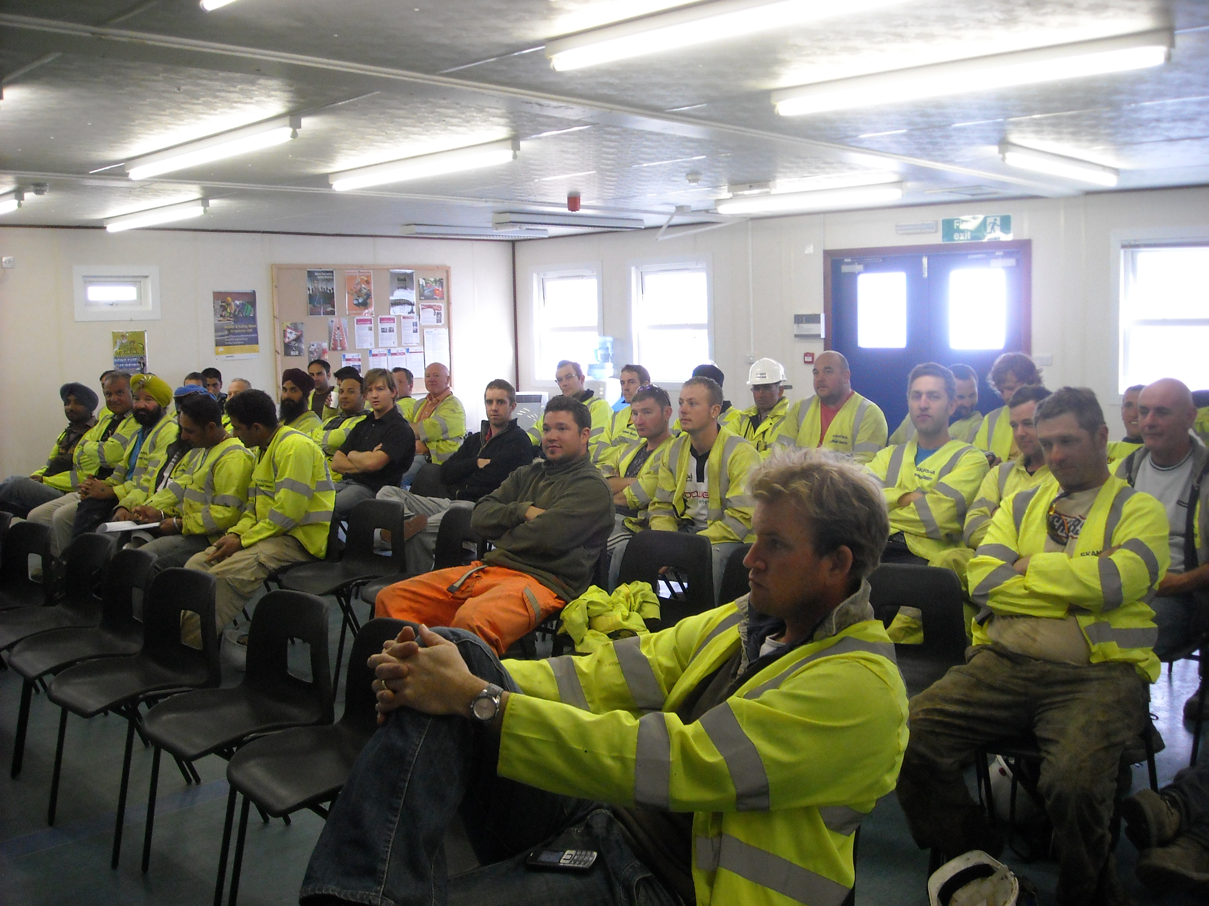
Stand up (with video)
Proximity Wheel
Notes:
A5 briefing card back

Slide 11
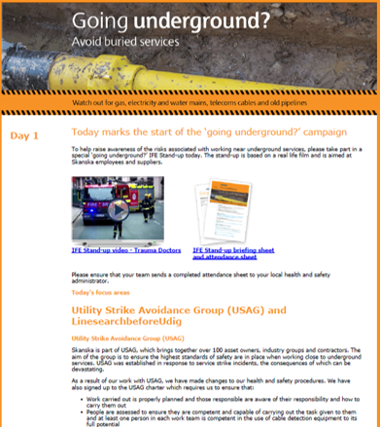
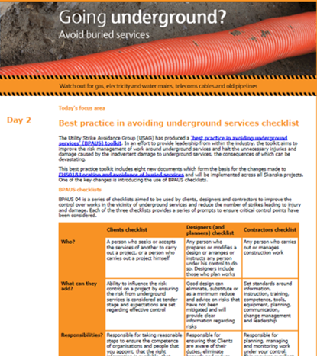
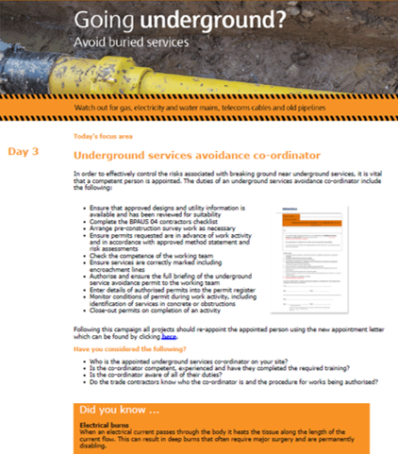
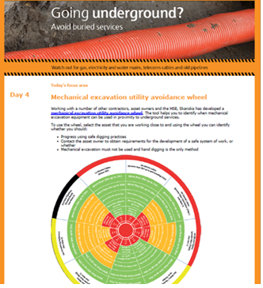
Topic focused emails
Notes:
Daily emails

Slide 12
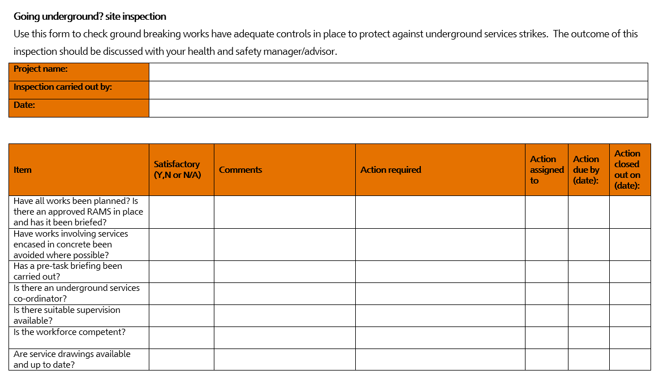
‘Going Underground’ Inspection
Going underground? site inspection
Notes:
Daily emails

Slide 13
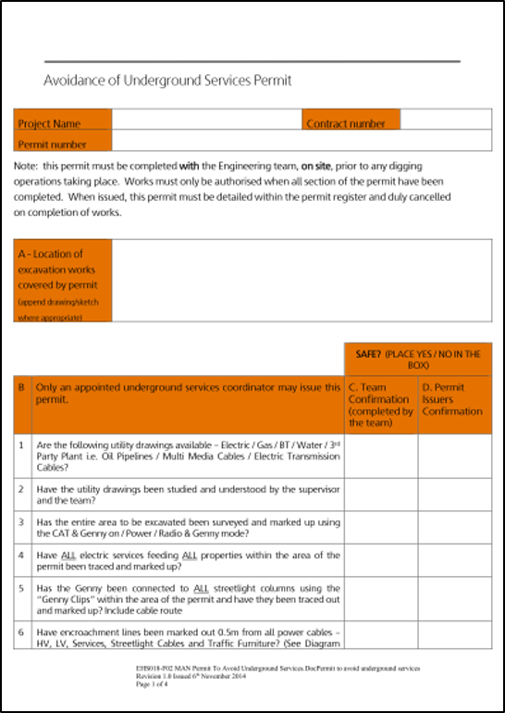
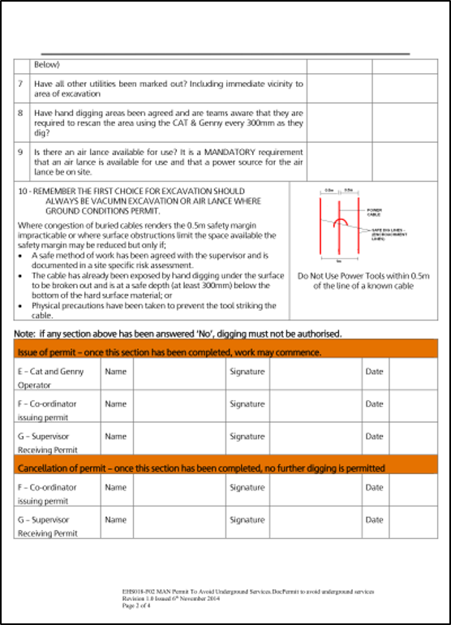
An Example of an Avoiding Underground Services Permit
Notes:
Daily emails

Slide 14
What we need from you…
Promote involvement with the campaign and the use of the resources provided
Take photos of the campaign in action
Complete the audit and feedback after the campaign
Notes:
Daily emails

