Slide 1
Principal Designer Working Group

Slide 2
The Construction (Design and Management) Regulations 2015
The Construction (Design and Management) Regulations 2015 applies to Highways England
Highways England will be the ‘client’ predominantly
An Asset Management (CDM) standard and other associated documents have been developed for Operations and Major Projects

Slide 3
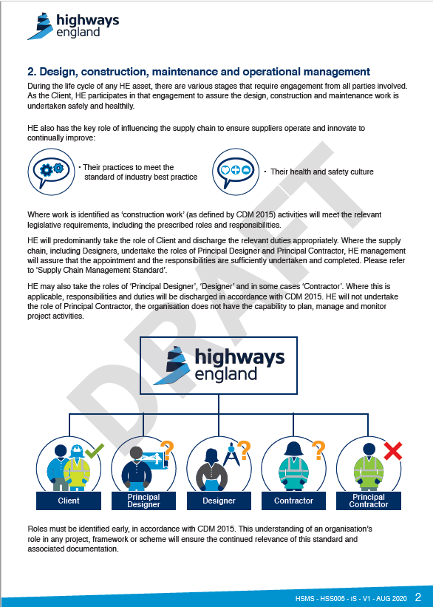
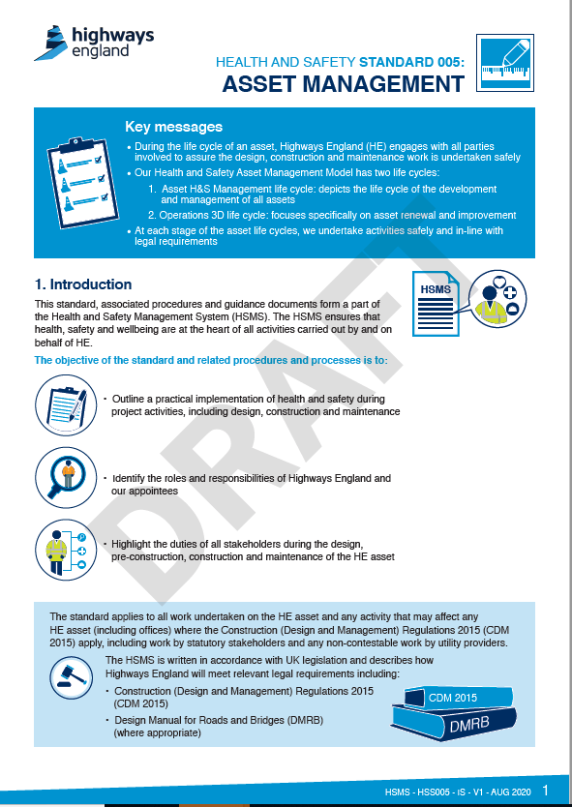
Asset Management Standard

Slide 4
Strategy & Prioritisation Procedure

Slide 5
Preliminary Design Procedure

Slide 6
Pre-Construction Information

Slide 7
Health and Safety File

Slide 8
Health and Safety file template & guidance

Slide 9
Design Safety Assurance Tour

