Slide 1
Principal Designer Working Group Root Cause Analysis – Capture & Application of Lessons Learnt
Supporting Home Safe and Well

Slide 2
Safety Alerts - Recent
Within the period since we last presented our Safety Alerts review back on the March 2021 we have received 28 and reviewed 25 safety alerts within our safety team (Principal Designers / H & S Practitioners) at our monthly Safety, Design and Designers meetings.
Highways England Safety Alert | Topic | Date Received
HEi238 | Overturned Dumper | 11 May 2021
HEi239 | Unsafe Position of Worker Alongside Live Traffic | 12 May 2021
HEi240 | Tailgating | 12 May 2021
HEi241 | Contact with Overhead Line Equipment | 20 May 2021
HEi242 | Plant Immobilisation | 20 May 2021
HEi243 | Stihl Saw Blade | 26 May 2021
HEi244 | Portal Gantry Sign Support Connections | 26 May 2021
HEi245 | Vehicle Immobilisation | 01 June 2021
HEi246 | Road Traffic Incident | 04 June 2021
HEi247 | Sharps Sticking Upright | 07 June 2021
HEi248 | Refuelling Activities and Risk of Fire | 14 June 2021
HEi249 | Tensioned VRS – Potential for Injury if Persons not Competent to Dismantle | 14 June 2021
HEi250 | Mobile Phone and Seat Belts | 15 June 2021
HEi251 | Fatality of an Independent Connections Provider Operative | 15 June 2021
HEi252 | Roller Emergency | 16 June 2021
HEi253 | Items Left in Verges | 18 June 2021
HEi254 | Incident Involving Overhead Assets | 18 June 2021
HEi255 | Faulty DNO Cabinet | 24 June 2021
HEi257 | Lorry Driver Near Miss – Head Stuck Under Tipper Body | 09 July 2021
HEi258 | Fractured Ankle Injury | 13 July 2021
HEi259 | Early Release of a Rolling Road Block | 15 July 2021
HEi260 | Extreme Heat Warning | 20 July 2021
HEi261 | Vehicle Windscreen Damage | 26 July2021
HEi262 | Angle Grinder Chainsaw Discs | 27 July 2021
HEi263 | Duct Bracket Failure | 6 Aug 2021
HEi264 | Unsafe Manhole Cover | 12 Aug 2021
HEi266 | Failure of High Access Equipment | 24 Aug 2021
HEi267 | Tree Shears and Grapple Saws | 25 Aug 2021
Available at http://www.highwayssafetyhub.com/alerts.html

Slide 3
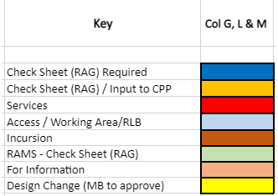
Categorising – Safety Alerts

Slide 4
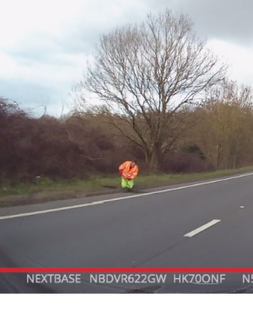
Highways England H & S Alerts – Arcadis Summary
HEi238 - Overturned Dumper Link
Lessons Learned:
A dual view dumper allows driver to operate in both directions while facing forward by turning the cab round. In this case the operator shouldn't need to reverse. Several site rules appear to have been broken here. The alert doesn't say if the driver was sacked for being over the alcohol limit. A clear breach of site rules and plant operating procedures.
HEi239 - Unsafe position of worker alongside live traffic Link
Lessons Learned:
There was inadequate clearance apparently, no lane closure or IPV, operative in safety zone.
No warning signs. Was he litter picking? Is it normal practice for Arcadis or other consultants
to walk verges? Not allowed unless sufficient clearance. Area teams have well developed
procedures and risk assessments. Possibly someone 'having a quick look at something', but
he was observed. Cutting corners is not acceptable at any time. Familiarity with site is
required: verges can go to nothing.

Slide 5
Highways England H & S Alerts – Arcadis Summary
HEi240 – Tailgating Link
Lessons Learned:
This does not relate to a specific incident but is for information only, to make people aware HE are trialling tailgating detection technology. Whereas weaving and undertaking tend to take place at certain locations where there are a large number of lanes and/or lane gain/lane drops, tailgating can occur anywhere on the network and is more of a driver behaviour issue. Chevrons painted on the road can be a possible design solution in certain locations where tailgating is perceived as an issue. Compliance can be hit or miss though when traffic volumes are high.
HEi242 – Plant Immobilisation Link
Lessons Learned:
There have been a number of issues around poor compliance with rules of operation concerning plant: leaving keys in or plant switched on when the plant operator dismounts. In this case the operator moved the tracking control lever from outside the cab but moved it in the wrong direction. From the point of view of plant design there should have been a safety feature to avoid this happening when there's no weight on the driver's seat. (Plant operators can override these sometimes, although this is a breach of HSWA). This incident would probably not have been possible with a larger item of plant.
HEi243 - Stihl Saw Blade Link
Lessons Learned:
Was there a cut off mechanism on the saw? Even then there would probably still have been a time lag before the cut off stopped the saw from rotating; it would have continued to have momentum when it hit the operative in the face. The operative should have been wearing a mask and goggles. It is not clear from the alert what PPE was being worn. Did the operative pull the saw towards himself to free it when it jammed? Should the blade have had a protective cover in case of shattered blades or debris/ dust? More information is needed to identify the primary cause(s). Had the guard been removed or was it incorrectly adjusted?

Slide 6
Highways England H & S Alerts – Arcadis Summary
HEi244 - Portal Gantry Loose Sign Support Connections Link
Lessons Learned:
There would appear to be a number of causes here. High strength friction grip (HSFG) bolts should have been used: these should be torqued to a prescribed level using load indicating washers or a calibrated torque wrench. In that case the bolts would not have come loose or undone. The bolts were too short; there should be 2-3 threads visible at the end at least, not 1 full thread protruding as stated in the safety alert. The bolts were therefore almost certainly non-compliant with the specification: this should have been picked up if the site supervision was up to the mark.
HEi245 – Vehicle Immobilisation Link
Lessons Learned:
This would appear to be driver error and not related at all to site activities. Handbrake appeared to have not been engaged correctly.
HEi246 – Road Traffic Incident Link
Lessons Learned:
It is difficult to see how this could have been managed differently on site due to the member of the public action. The safety alert identifies a number of actions to prevent recurrence including eliminating the risk with a road closure if possible. Site teams should always consider abnormal situations that may arise when developing risk assessments and safe systems of working.

Slide 7
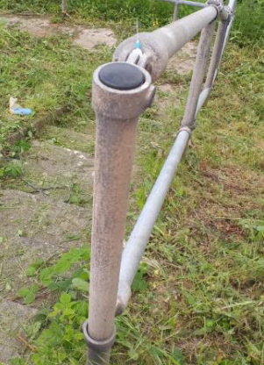
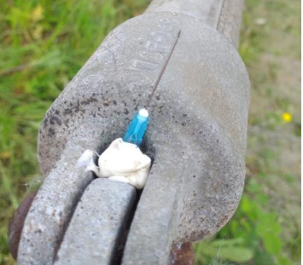
Highways England H & S Alerts – Arcadis Summary
HEi247 – Sharps Sticking Upright Link
Lessons Learned:
The issue of sharps being attached to step handrailings and similar locations with the
deliberate intention of causing injury has been raised in a number of previous safety
alerts: this is something that all site staff should be aware of and should consider in their
safe systems of work and PPE. As with HEi253, consideration should be given to using sharps resistant (Cat 3?) protective gloves: the highest protection factor would be desirable, but may not be appropriate to certain tasks as they may limit finger dexterity. As such their use by vegetation clearance operatives may not be feasible.
HEi248 – Refuelling Activities and Risk of Fire Link
Lessons Learned:
Safety alert for information only: does not relate to a specific incident on site. Points for inclusion in RAMS where appropriate.
HEi249 - Tensioned VRS – Potential for Injury (Competent Person) Link
Lessons Learned:
A key point is that VRS should only be worked on by a trained competent member of the service provider’s VRS team, with a suitable safe system of work. Traffic management teams should have been well aware of this. The TM team should have called on the VRS team, or trained emergency services, to undertake this operation. The risk and requirement to use trained personnel should be shared with relevant teams, vehicle recovery operators and suppliers as required.

Slide 8
Highways England H & S Alerts – Arcadis Summary
HEi250 – Mobile Phone & Seat Belts Link
Lessons Learned:
Safety alert for information only: this does not relate to a specific incident on site. Points are to be noted by supervisors of staff travelling to/from site, to ensure staff are adequately briefed/ aware. Mobile phone use while driving should be banned.
HEi251 – Fatality of an Independent Connections Provider Operative Link
Lessons Learned:
Had isolation procedure been followed? Why was live working being used here? Was it not possible to identify where to isolate the circuit? If so, why not? (Possibly the Health and Safety File was deficient or unavailable?) Insufficient information in the safety alert to judge.
HEi252 – Roller Emergency Stop Brake Failure Link
Lessons Learned:
The brakes on this roller were not working, this should have been resolved before the plant was allowed to be used again. Defective maintenance routine.

Slide 9
Highways England H & S Alerts – Arcadis Summary
HEi253 – Items Left in Verges Link
Lessons Learned:
It would be very difficult in practice to avoid bottles and other debris in verges. Sharp resistant (Cat 3?) protective gloves are available: highest protection factor would be desirable here but this as this may limit finger dexterity it would not always used by vegetation clearance operatives. RA should determine type of gloves to be used. This is relevant to environmental teams/ site clearance teams.
HEi254 – Incidents Involving Overhead Assets Link
Lessons Learned:
In the past 12 months there have been 13 reported Airsweb incidents involving collisions with overhead structures and services, from our supply chain.
Goal posts are needed before bridge to alert drivers before they get to an overhead obstruction. Most sites do have these. Incidents may be due to low loader drivers who are unfamiliar with the specific site. RAMS have not been followed in relation to preparing items of plan being brought to site/ taken off site. The Health and Safety File needs to be accessible/ available to enable an assessment of structural integrity when an incident of this kind occurs.

Slide 10
Highways England H & S Alerts – Arcadis Summary
HEi255 – Faulty DNO Cabinet Link
Lessons Learned:
There is in general no requirement for earth rods, which could cause more safety issues than they would solve. If inserted into ground where there is already a high concentration of power cables and other services then earth rods could contact existing HV cables or cause damage.
Cabinets are normally on a concrete plinth and earthed back to the supply at the feeder pillar. In this case the neutral feed somehow became live. (Earth and live bonded together?). The fault was upstream of the cabinet itself.
Different wiring arrangements on different schemes could create another safety issue.
• Does the specification need to be changed?
• Is a change to the standard detail required?
Heath and safety file should be able to evidence that the unit was earthed. All technicians should have a non-contact volage detector with them when on site.
.

Slide 11
Highways England H & S Alerts – Arcadis Summary
HEi257 – Lorry Driver Near Miss – Head Stuck Under Tipper Body Link
Lessons Learned:
The tipper lorry would appear to be intrinsically dangerous if it is possible to trap body parts between the tipper body and the chassis. There should be safety devices installed to prevent this happening. If this is not possible then warning signs should be deployed and the RAMS should clearly identify the risk.
Suggested that there should be a cut-out to prevent the tipper body lowering if the driver is not in his seat (or similar). This is similar in some respects to HEi242 where plant could be operated without the driver being in the correct location.
HEi258 – Fractured Ankle Injury Link
Lessons Learned:
For night time closures it is relevant to all to check that task lighting is suitable: this should be included on any pre- site visit checklist. Noted that the method of working here was less than ideal in respect of manual handling, requiring as it did that every sign be lifted over the VRS barrier prior to placing. It would have been preferable for this to be a two person task, with one person on foot on the parapet side of the barrier receiving the signs from someone riding on the TM vehicle. It is assumed there were no overhead signs available at this location.

Slide 12
Highways England H & S Alerts – Arcadis Summary
HEi259 Early Release of a Rolling Road Block Link
Lessons Learned:
Information only - Radio communication for releasing the rolling road block should be channelled through the ROC to confirm the scene is clear in line with agreed protocols.
Messages relayed between the parties should be clear and concise. Instructions should be acknowledged, and clear understanding of the request confirmed.
If there is any doubt about the meaning of a message given in a safety critical environment, no action should be taken to release traffic
HEi261 – Vehicle Windscreen Damage Resilience Link
Lessons Learned:
Tanker in question weighed 35 tonnes truck and should have required the deployment of an appropriate recovery truck. The tanker had twin rear axles but a single drive, whereby drive is transferred to other axle when one loses traction. The ratchet strap was not a sufficient or appropriate tow rope. There are 2 separate safety incidents involved here:
i. Insufficient maintenance of the compound/ haul road which had become waterlogged due prolonged use, heavy rainfall and no drainage.
ii. Inappropriate use of a member of the public, who was not inducted, being allowed onto site to assist in freeing the tanker.
Noted that the TW design of the haul road/access track was in accordance with HE specification. However there had been a week of heavy rain, which had resulted in the compound surface becoming deformed in one area. In hindsight geogrid could have been used in conjunction with 6F5 aggregate; however budget was tight. There was an EA licence in place restricting the selection of aggregate.

Slide 13
Highways England H & S Alerts – Arcadis Summary
HEi262 – Angle Grinder Chainsaw Link
Lessons Learned:
Similar chainsaw blades for use on angle grinders are available on Amazon and from other online suppliers. The Office for Product Safety and Standards (OPSS) has issued a Safety Alert for a similar chainsaw disc attachment that has been incorrectly sold for use with angle grinders.
These attachments are not designed to be used together and are likely to cause loss of control which could result in serious injury or even fatality. Reports have been received of injuries arising from kickback caused by the chainsaw gripping the cutting surface and forcing the angle grinder to sharply turn or jump out of the hand of the operator. Any consumers who have these angle grinder attachments in their possession are urged to stop using them immediately. They should contact the seller for redress if they believe the product was incorrectly marketed as compatible for use with an angle grinder. OPSS is also telling any business that sells these chainsaw discs as attachments for angle grinders to remove them from the market immediately as they do not comply with the Supply of Machinery (Safety) Regulations 2008.
HEi263 - Duct Bracket Failure Link
Lessons Learned:
This involved a progressive collapse due to lack of inspection/ maintenance of the duct hangers. This was a completely enclosed system, such that the 5 yearly Principal Inspection hadn't picked it up. There have been at least a couple of other incidents of this type. The design life of the hangers should be more than 28 years. Is the load capacity sufficient? How are lessons learned post safety alert : noted that communities of practice in NE serve this purpose.

Slide 14
Principal Designer Working Group AIRSWeb Upgrade Working Group National Highways Incident Reporting Tool
Supporting Home Safe and Well

Slide 15
National Highways – Incident Reporting Tool
Updates to AIRSWeb
Arcadis have used our background investigation work into Root cause analysis to assist in the AIRSWeb upgrade working group. This group has been involved in the development of National Highways Incident Investigation Tool (HEART) to aid improvements in data gathering which will help root cause analysis.
A brief update is as follows:
Attended Incident Reporting Tool briefing meeting on behalf of PDWG – 26th May 2021
Output to review and provide suggestions of the following event form reporting contents:
Asset Infrastructure
Near Miss / Undesired
Security
Personal Injury
Attended HEART release meeting to review proposed incident reporting for updated National Highways Incident Reporting Tool – 27th July 2021
Submitting comments on behalf of PDWG to National Highways – 16th August 2021
Attending meeting with Adam Porter and Richard Wilson to discuss and agree proposals – 17th August 2021. The proposals on behalf of PDWG are the following:

Slide 16
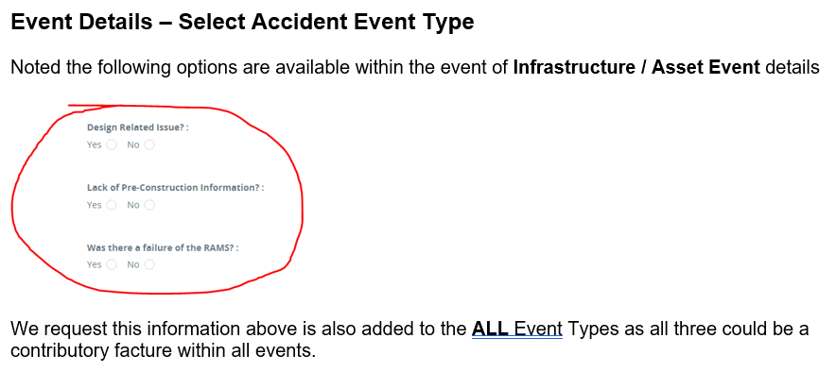
National Highways – Incident Reporting Tool

Slide 17
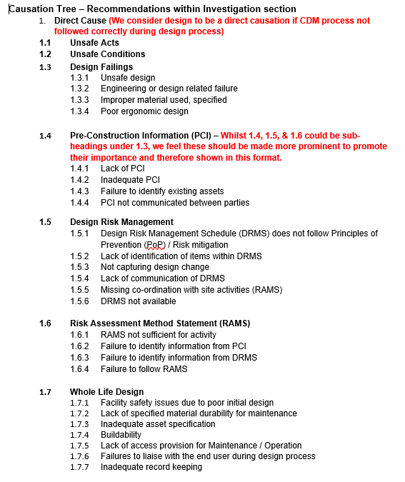
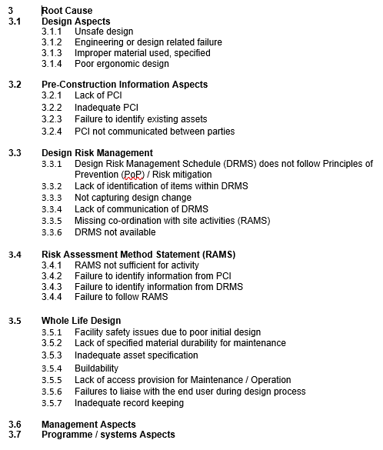
National Highways – Incident Reporting Tool

