Slide 1
Principal Designer Working Group
Root Cause Analysis – Capture & Application of Lessons Learnt
Supporting Home Safe and Well

Slide 2
Safety Alerts - Recent
Within the period since we last presented our Safety Alerts review back on the 31st March 2022 we have received 6 and reviewed 4 safety alerts within our safety team (Principal Designers / H & S Practitioners) at our monthly Safety, Design and Designers meetings.
National Highways Safety Alert | Topic | Date Received
HEi291 | Overhead Cable Strike – Link | 29th March 2022
HEi292 | Traffic Management Operative Struck by Vehicle – Link | 5th April 2022
HEi293 | Faulty Drilling Rig Interlock – Link | 5th April 2022
HEi294 | Protester Tunnelling – Link | 27th April 2022
HEi295 | Lantra Awards Validity Checks - Link | 12th May 2022
HEi296 | MEWP Hoist Potential Separation – Link | 12th May 2022
Available at http://www.highwayssafetyhub.com/alerts.html

Slide 3
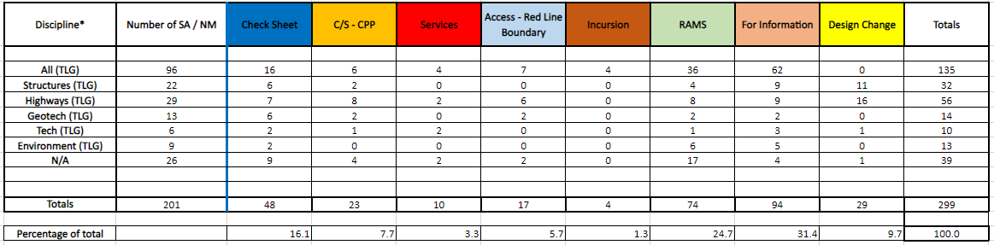
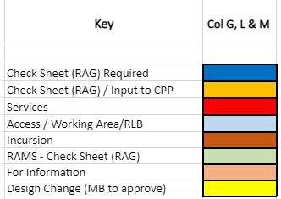
Categorising – Safety Alerts

Slide 4
National Highways H & S Alerts – Arcadis Summary
HEi291 – Overhead Cable Strike
Lessons Learned:
Designers need to follow RTB 9 and identify clearance height etc. It is the designer's responsibility to provide information and to design out the residual risk wherever possible.
This is also a behavioural issue here relating to how people react when confronted with an emergency situation. How much training do excavator drivers get in what to do if they hit a HV power line? Driver failed to remain calm and exited vehicle without lowering raised parts in contact.
No work had been planned near the Overhead Cable, on the day of the incident, an excavator and dozer driver changed their location without informing site management. This change took them closer to the overhead powerlines.
Re-brief site personnel on STOP, CHECK, GO, and ensure changes needed be added to the site RAMS and briefed to the workforce

Slide 5
National Highways H & S Alerts – Arcadis Summary
HEi292 – Traffic Management Operative Struck by Vehicle
Lessons Learned:
RTB27 states that TM should be monitored for driver behaviour to evidence whether drivers' understanding of the layout is adequate. Do the individual circumstances of the TM installation require additional signing and/ or better sight lines?
RTB 27 requires that an assessment be carried out by the TSS (Traffic Safety Supervisor – Previously TSCO) of the TM company. If any of the symptoms noted the TTM are encountered then the TTM /supervisor should investigate the cause and report.

Slide 6
National Highways H & S Alerts – Arcadis Summary
HEi293 – Faulty Drilling Rig Interlock
Lessons Learned:
The Principal Contractor must ensure that daily plant checks have been carried out prior to any plant being used onsite. In this case the daily PUWER check was unavailable. Consultants GI team must be included in the circulation for this alert
The operation of interlocks should be part of the daily checks and maintained in accordance
with the manufacturer’s instructions. As this is a key safety function for the drill rig.

Slide 7
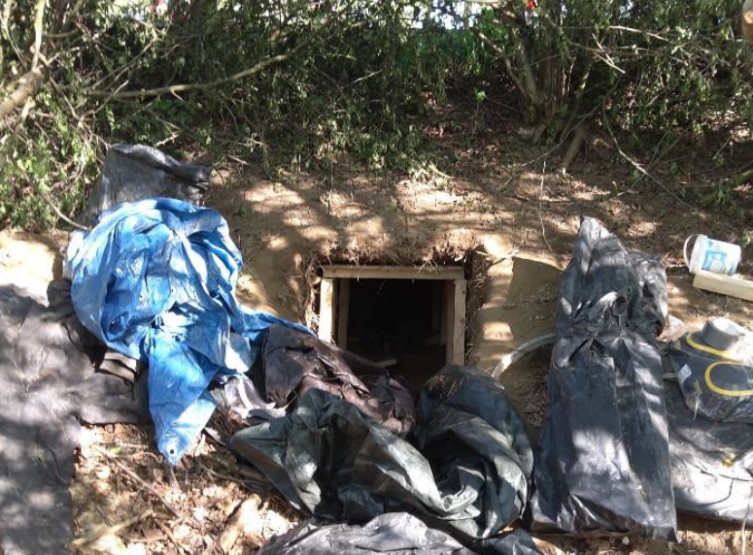
National Highways H & S Alerts – Arcadis Summary
HEi294 – Protester Tunnelling
Lessons Learned:
The site identified on this alert is in the middle of nowhere. In practice it is hard to identify where tunnelling activity is taking place, but this alert highlights some tell-tale signs. This risk to be added to site RAMS checklist. Consultants visitors to sites to be aware of the tell- tale signs abandoned (presence of digging tools, tarpaulins etc) and not to approach a potential tunnel location or protesters but to report it.
Indicative signs can also be indicative of unlawful activities, with thieves on the lookout for copper or other valuable materials, etc. Potential for violence if such people are approached.
Any part of the SRN could be targeted, but those parts of the SRN close to refineries and oil storage depots are particularly at risk.

Slide 8


