Slide 1
Principal Designer Working Group Root Cause Analysis – Capture & Application of Lessons Learnt
Supporting Home Safe and Well

Slide 2
Safety Alerts - Recent
Within the period since we last presented our Safety Alerts review back on the 27th January 2022 we have received 7 and reviewed 6 safety alerts within our safety team (Principal Designers / H & S Practitioners) at our monthly Safety, Design and Designers meetings.
National Highways Safety Alert | Topic | Date Received
HEi283 | Network Defaults – Link | 4th February 2022
HEi284 | PIMS – TS (post COVID 19 condition) - Link | 7th February 2022
HEi285 | Pavement Coring using CAT ad Genny - Link | 21st February 2022
HEi286 | Anchor Shackles Failure – Link | 24th February 2022
HEi287 | Vehicle Restraint Installation Requirements – Link | 2nd March 2022
HEi289 | Vehicle Struck by Temp Traffic Barriers - Link | 17th March 2022
HEi290 | Environmental Survey Team Encounters Seasonal Shooter - Link | 21st March 2022 – To be reviewed
Available at http://www.highwayssafetyhub.com/alerts.html

Slide 3
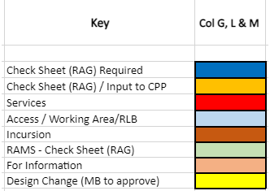
Categorising – Safety Alerts

Slide 4
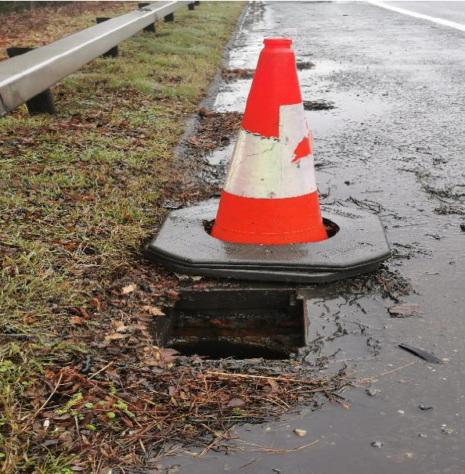
National Highways H & S Alerts – Arcadis Summary
HEi283 – Network Defects
Lessons Learned:
When visiting site for survey purposes, staff need to be aware there may be defects present and the means used to identify these. Designers on site should never move cones etc. without good reason. An ever present risk for site visitors is falling into manholes obscured by vegetation. Designers need to be mindful of this risk and add it to their site risk assessment.
On Scotswood site, timber sheeting had been placed over a manhole which was inadequate and constituted a hazard itself .
An extra column to be added to the Safety Alert register to record third party/ external interface. In this instance this could include a note that the alert is to be developed as safety share. (N.B. Scotswood sheeting incident was originally raised by Graham Rice, NEC Supervisor, as a safety observation to contractor CJP.)
The issue has been discussed also on M4SMP site where people have reported not being aware of the procedure for reporting defects to NH. The manhole in this instance had not been reported to the ROC. Reporting details were previously (although the contact email may have changed now that it is National Highways):

Slide 5
National Highways H & S Alerts – Arcadis Summary
HEi284 – PIMS – TS (Paediatric Multisystem Inflammatory Syndrome) (post COVID 19 condition)
Lessons Learned:
Paediatric multisystem inflammatory syndrome (called PIMS-TS or PIMS for short) is a new condition that can happen in some children and young people sometime after they have had COVID-19.
The condition is a delayed reaction to the body trying to overcome the virus, and this causes swelling throughout the body.
Relevant to people with small children. No work-related lessons to be learned here for civil engineering designers.

Slide 6
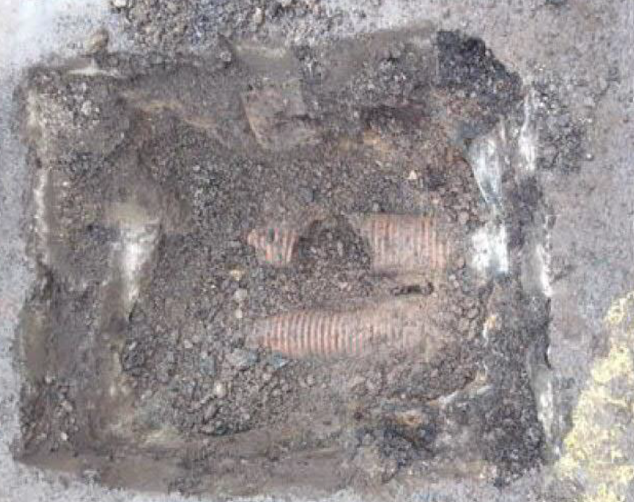
National Highways H & S Alerts – Arcadis Summary
HEi285 – Pavement Coring using CAT and GENNY
Lessons Learned:
There is no reference in the alerts to Raising the Bar 9 - Utility Avoidance. The alert should refer to RtB 9 requirements if it's a NH site. The following are minimum requirements of RtB 9:
Mandatory Elements
Conductive metal setting out pins are banned on all National Highways sites.
Where designers identify a requirement for excavation GPR surveys must be undertaken prior to completion of detailed design.
Designers must undertake clash detection workshops during preliminary and detailed design phases.
Interpretation of survey data must be undertaken by experienced qualified personnel in accordance with PAS128 and HSG47.
All persons involved in the planning, permitting, scanning and excavating around live utilities needs to be trained in an accredited HSG47 (Avoiding danger from underground utilities) course.
Permits should always be briefed at the dig location.
Cable avoidance tools must have GPS and a data logging capability which is operated.
A CAT must always be used with a genny.
Vacuum excavators should be the default method when excavating around buried services wherever practical.
Insulated hand digging tools must be used .
GS6 must be in place to protect overhead utilities.
Investigations to follow the USAG Incident Investigation format.
Further information on RtB9 is at https://www.highwayssafetyhub.com/uploads/5/1/2/9/51294565/b9_utility_avoidance_feb_2022.pdf
N.B if this was a LA site then RtB9 wouldn't have necessarily been followed.
Discussed also a recent incident where a medium pressure gas main had been ruptured on a site during a planing exercise over a culvert. The gas main had been only 70mm beneath the road surface, however noted as being below 600mm either side of culvert. The gas main appeared to have been a relatively recent installation. Suggested that this safety alert should be issued as a safety share.

Slide 7
National Highways H & S Alerts – Arcadis Summary
HEi286 – Anchor Shackles Failure
Lessons Learned:
Note for personnel on any site where lifting is going on which may potentially be using these 1" shackles, to make sure that the contractor has seen this alert and is acting on it. A spot check on LOLER certificates may be required.
HEi287 – Vehicle Restraint Installation Requirements
Lessons Learned:
Installation of vehicle restraint systems needs to be in accordance with manufacturer's instructions or they may not perform as required. The safety alert is vague about what had not been done correctly in this instance. Time of installation (night-time?) and access and egress constraints may have affected the working method followed? In addition, as built information may not be complete, and on any given section there could be existing installations from different manufacturers with different post details.
All staff should be aware that barriers may be tensioned and installation/ taking down RAMS reflect this.

Slide 8
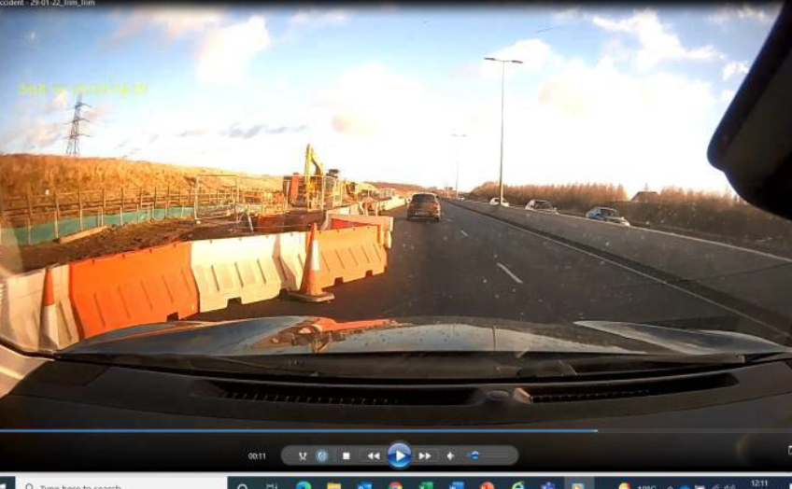
National Highways H & S Alerts – Arcadis Summary
HEi289 – Traffic Barriers
Lessons Learned:
Plastic barriers here were incorrectly ballasted with water; it is not clear if the water leaked out or whether the units were incorrectly ballasted in the first place? In a recent instance, the contractor had been using water filled barriers and excavating directly behind them. Barriers had been installed across openings. The deep excavation behind the barrier may have been the consequence of lack of working space and/or RLB issues.
Installation of these barriers constitutes temporary works and should have been subject to the appropriate design/ checking procedures. The client needs to be included in temp works discussions. In practice this may be difficult to require.
Noted there had been a recent APS presentation on a similar topic.
Check manufacturer’s guidance on fill levels and suitability for use in high winds.
Critically examine emergency protocols when bad weather is forecast.

Slide 9
National Highways H & S Alerts – Arcadis Summary
Non National Highways
Operative Struck by Nozzle of High Powered Water Jetter
Lessons Learned:
Could this work not be done remotely, avoiding the need to involve a human operative? Failure to adhere to RAMS or operator error were the most likely causes here
Slippery Surface at HS2 Chiltern Tunnel North Portal (Great Missenden) site
Lessons Learned:
Review compounds for potential low points where water ./ debris can accumulate
Review designs and layout of compounds and assess where there may be changes in level, kerbs, etc to mitigate potential risks of slips, trips and falls

