Slide 1
Principal Designer Working Group Root Cause Analysis – Capture & Application of Lessons Learnt
Supporting Home Safe and Well

Slide 2
Safety Alerts - Recent
Within the period since we last presented our Safety Alerts review back on the Nov 2021 we have received 5 and reviewed 4 safety alerts within our safety team (Principal Designers / H & S Practitioners) at our monthly Safety, Design and Designers meetings.
National Highways Safety Alert | Topic | Date Received
HEi277 | Personal Protective Equipment- Link | 9th Nov 2021
HEi279 | High Potential Incidents Involving Live Lane Access- Link | 3rd Dec 2021
HEi280 | Shared Learning – Wire Fence HiPo- Link | 10th Dec 2021
HEi281 | Christmas Shutdown and New Year Restart- Link | 17th Dec 2021
HEi282 | Serious Incident – Mobile Elevated Work Platform – Link | 26th Jan 2022
Available at http://www.highwayssafetyhub.com/alerts.html

Slide 3
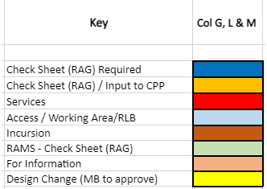
Categorising – Safety Alerts

Slide 4
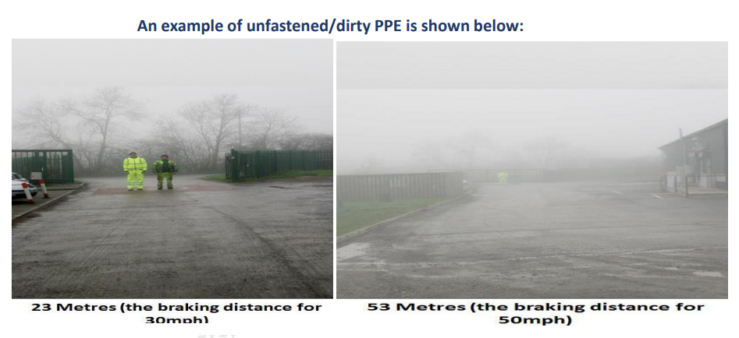
National Highways H & S Alerts – Arcadis Summary
HEi277 – Personal Protective Equipment
Lessons Learned:
A key message of this alert is that visibility of PPE is greatly reduced when it is dirty or not fastened properly. Noted that designers undertaking site visits for the most part have clean PPE. Nonetheless it is a timely reminder that maintenance of PPE and cleanliness is important to good visibility.
An previous HE initiative was to move to orange PPE throughout, in order that subcontractors would all be the same colour. This initiative appears to have foundered.
Is orange PPE more visible than yellow? It had been observed that yellow PPE may be more difficult to pick out against the glare of headlights.
PPE incorporating LED lights has been trialled, and was the subject of a previous safety alert: this can be beneficial for high risk activities such as TM operative on motorways but is unlikely to be required by designers for site visits.

Slide 5
National Highways H & S Alerts – Arcadis Summary
HEi279 – High Potential Incidents Involving Live Lane Access
Lessons Learned:
NH are making a high profile drive to reduce incursions. An incursions working group has been set up for that purpose. Designers need to consider inter alia how they can contribute to a reduction in incursions.
Chapter 8 sets out access and egress provisions in TM. Scheme designers typically don't get involved with TM design, leaving this to the TM subcontractor. Nevertheless TM design, including the design of access points, constitutes an element of temporary works design. As with other types of TW design, consideration needs to be given to how it relates to the Scheme design. DP provided an example from A19 Scotswood, where deep excavations required immediately within the works boundary were demarcated by plastic barrier. This was a poor TW design detail, but the alternative of installing a steel VCB could have required a night closure to relocate and may have introduced greater risks. Given that the excavation was continuous over a significant length, the question arose how/ where to plan alternative opening(s). It is unlikely the TM designer would have been advised of the deep excavations planned behind the barrier; he/she was probably just told to design a certain number of access points.

Slide 6
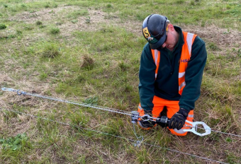
Highways England H & S Alerts – Arcadis Summary
HEi280 – Wire Fencing High Potential Incident
Lessons Learned:
Not clear from the safety alert exactly what happened.
The IP here shouldn't have been allowed to work alone. Should work have stopped while the colleague went off to fetch tools? Should the tools not have been brought to location prior to start of works? A tick box section in RAMS could have been included to state what equipment was required and that no work was to take place until that equipment was in place.
This involved a low level strand - it is not clear how the IP got struck in the face in this instance unless he had bent down to get very close to the work.
The alert notes that there was no issue with the equipment in use. In any case, the specification of fencing equipment is not relevant to PW designers.

Slide 7
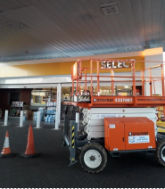
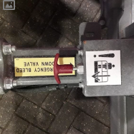
Highways England H & S Alerts – Arcadis Summary
HEi282 – Serious Incident – Mobile Elevated Working Platform (Not yet reviewed by Arcadis)
Lessons Learned:
Whilst positioning the Scissor Lift, it appears he accidentally raised the platform. The operatives head came into contact with the canopy, as a result, he immediately lowered the lift however, for reasons unknown at this time, he then raised the lift again, trapping his head and neck between the canopy and the lift for a period of approximately six minutes.
EMERGENCY ARRANGEMENTS: Ensure that all operators and those working in the area of MEWP’s are fully aware of the specific emergency procedures for the equipment.
PRACTICE: Ensure that emergency drills are practiced by the users of the MEWP and those working in the area.

