Slide 1
Principal Designer Working Group Incident Investigations – Supply Chain Safety Leadership Group
Common Intent Document

Slide 2
GG128 remains the definitive document for specific requirements for reporting incidents, events and undesirable circumstances: health, safety, wellbeing, structural and environmental. This Common Intent sets broader expectations in the way in which we will adopt approaches that go beyond simple compliance and help us to reduce accidents and incidents. Guidance/advice on interpretation of requirements and the common intent, including best practice examples, are being added to the Raising the Bar Documents:

Slide 3
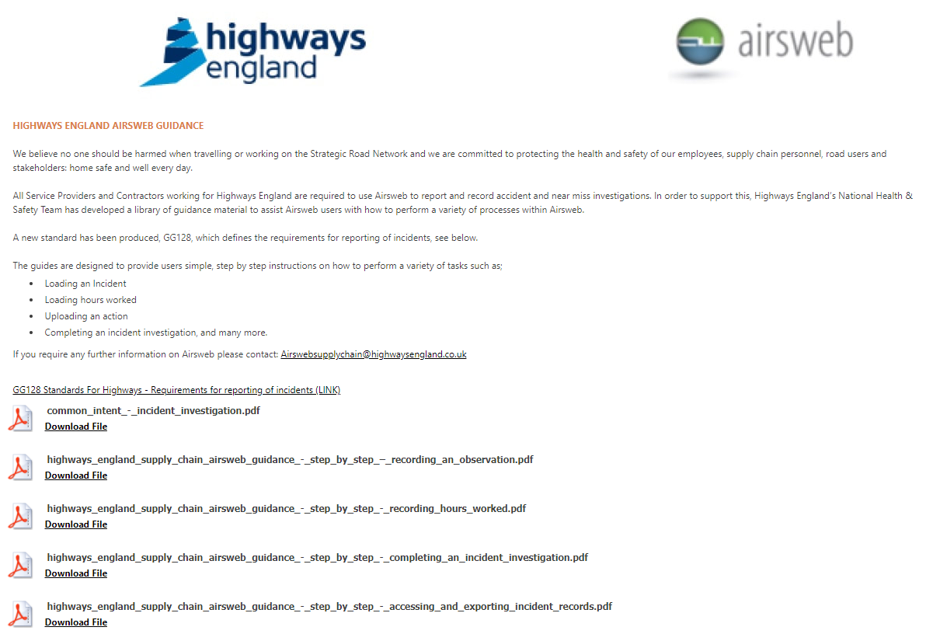
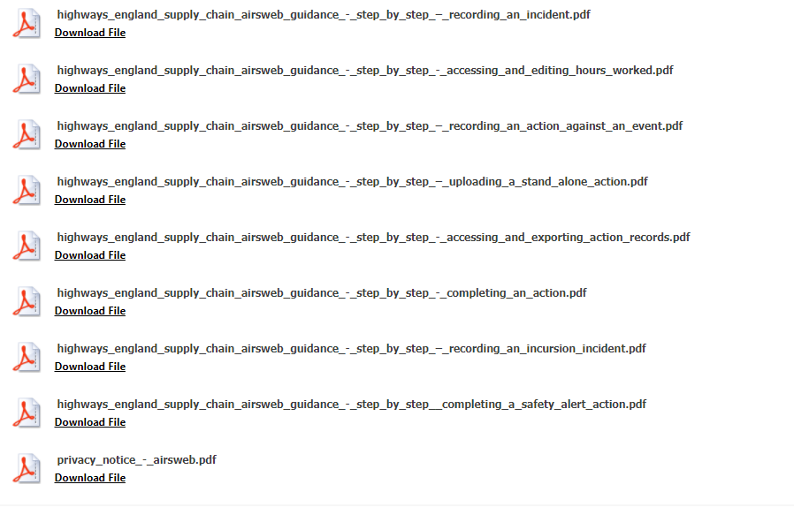
Incident Investigations – Common Intent Document
Common Intent available via Highways Safety Hub - Link.

Slide 4
Incident Investigations – Common Intent Document
Principles of Approach to be Adopted:
It promotes application of policies to improve investigation activities and outcomes and requires the level of all investigations to be based on the highest reasonably foreseeable potential impact and not on the actual outcome
Openness and transparency is critical for us to learn as an industry and avoid future incidents therefore, as Suppliers to Highways England, we will share as much as we can, as early as we can.
Consideration of Root Causes will not stop at on-site processes and procedures but will also consider how designs could have been improved so that we are learning fully from the event. To assist in this, we will involve a design and Highways England representative in all investigations for improvement projects, unless it can be demonstrated that design could not have contributed

Slide 5
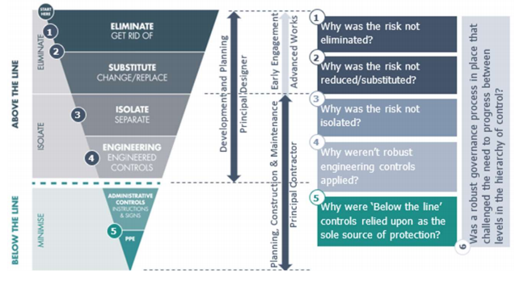
Incident Investigations – Common Intent Document
Principles of Approach to be Adopted: (Cont.)
We will consider what and why decisions have been taken to move through each of the levels in the Hierarchy of Control.

Slide 6
Incident Investigations – Common Intent Document
Principles of Approach to be Adopted: (Cont.)

Slide 7
Incident Investigations – Common Intent Document
Specific Area that We Will Better Address:
We will categorise all events based on the highest reasonably foreseeable potential severity
Aligned to GG128
We will use AIRSWeb to report incidents to Highways England.
Record (as draft) incident cause on AIRSWeb as soon as practically possible.
Seeking extensions to the 10-day requirement as appropriate, providing sufficient evidence of progress
We will implement a clear Incident Protocol
Appointment of a suitably experienced and (for HIPOs and RIDDORs) qualified lead investigator
Reports produced following investigation will be reviewed and signed off by a manager of appropriate seniority (Managing/Sector/Operations Director or equivalent Level for HIPO and RIDDOR incidents)
We will report all incidents to the Principal Contractor
No later than 24 hours.

Slide 8
Incident Investigations – Common Intent Document
Specific Area that We Will Better Address: (Cont.)
We will comply with requests for investigations by others
We will regularly brief/share any lessons learnt
Via the Safety Hub, the Engagement Council, live operational maintenance contracts and Major Projects
Integrate into our working practices any improvements identified
We will produce a SMART action plan for implementation of risk control measures
Aim to prevent reoccurrence on the same project and Wider SMART actions aimed at preventing occurrences elsewhere.
Ensure that proposed additional risk controls are reviewed by, and assigned to, people at appropriate levels for timely completion and monitoring
For high potential investigations (serious, major or fatal potential) Managing/Sector/Operations Directors (or equiv.) will be involved with the investigation throughout the process
The same Senior Director will ensure that agreed risk control measures are implemented within appropriate timescales and ensuring findings from investigations are shared throughout the supplier community
We will have a suitable process in place to review the effectiveness of the investigation
conduct regular audits to ensure that recommendations are adequately considered/applied

