Slide 1
Data From Incursions Working Group
Incursions update - (Report produced from AIRSweb figures exported on WD2)
Total number of incursions recorded (since 2017) is 7465
Total number of incursions recorded in February 2021 is 264
Total number of incursions recorded with coordinates in February 2021 is 262 [99%]

Slide 2
Data From Incursions Working Group
Top 3 summary of incursion recorded in February 2021
Overall in February 2021, incursions to 'Seek Information' was ranked first with 98, followed by 'Seek Benefit' as second with 80 incursions, and third being 'Driver confused' with 40 instances. 'Follow-In' incursions is ranked as fourth with 12 instances, with the fifth being 'Breach of Rolling Roadblock (TOS)' with 9 instances, and sixth being 'Result of accident' with 5 instances. There were 98 incursions 'Because of Breakdown' also recorded.
Major Projects - Incursion summary
'Seek Information' was the greatest number of instances recorded with 93 and ranked first. This was followed by 33 instances of 'Seek Benefit' incursions and ranked third is 'Driver confused' with 14 instances. 'Follow-In' incursions is ranked as fourth with 6 instances, with the fifth being to 'Result of accident' with 3 instances, and sixth being 'Breach of Rolling Roadblock (TOS)' with 1 instance. There were 93 incursions 'Because of Breakdown' also recorded.

Slide 3
Data From Incursions Working Group
Operations Directorate & DBFO's - Incursion summary
'Seek Benefit' was the greatest number of instances recorded with 32 and ranked first. This was followed by 16 instances of 'Driver confused' incursions and ranked third is 'Breach of Rolling Roadblock (TOS)' with 6 instances. 'Follow-In' incursions is ranked as fourth with 5 instances, with the fifth being 'Seek Information' with 5 instances, and sixth being 'Result of accident' with 1 instance. There were 5 incursions 'Because of Breakdown' also recorded.
Traffic Officer Service - Incursion summary
'Seek Benefit' was the greatest number of instances recorded with 14 and ranked first. This was followed by 5 instances of 'Driver confused' incursions and ranked third is 'Result of accident' with 1 instances 'Follow-In' incursions is ranked fourth with 1 instance, with the fifth being 'Breach of Rolling Roadblock (TOS)' with 1 instance, and finally, no [zero] incursions resulting from 'Seek Information' being recorded. No [zero] incursions 'Because of Breakdown' were recorded this month.

Slide 4
Data From Incursions Working Group
IPV Strike
No IPV strike has been recorded in February 2021 on any project.

Slide 5
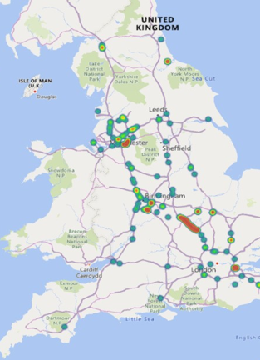
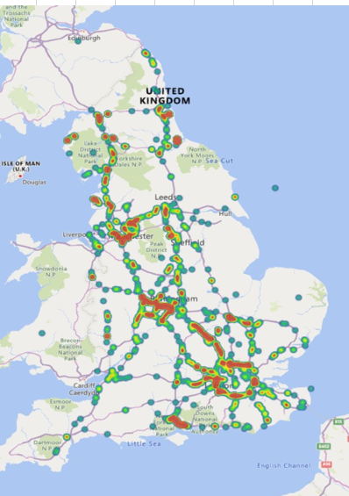
Data From Incursions Working Group
All Incursions Heat Map – Right Picture
February 2021 Incursions Heat Map – Left Picture.

