Slide 1
Data From Incursions Working Group
Incursions update - (Report produced from AIRSweb figures exported on WD2)
Total number of incursions recorded (since 2017) is 9646
Total number of incursions recorded in August 2021 is 279
Total number of incursions recorded with coordinates in August 2021 is 279 [100%]
48 historical incursion records were added this month

Slide 2
Data From Incursions Working Group
In Month incursions Summary
Overall in August 2021, incursions to 'Seek Benefit' was ranked first with 58, followed by 'Driver confused' as second with 36 incursions, and third being 'Breach of Rolling Roadblock (TOS)' with 19 instances. 'Follow-In' incursions is ranked as fourth with 8 instances, with the fifth being 'Result of accident' with 3 instances, and sixth being 'Seek Information' with 1 instances. There were 153 incursions 'Because of Breakdown' also recorded. 1 'IPV Strike' was recorded this month.
Major Projects - Incursion summary
Our Major Projects recorded the following this month - 'Driver confused' type incursion was the greatest number recorded with 25 and ranked first. This was followed by 10 instances of 'Seek Benefit' incursions and ranked third is 'Follow-In' with 4 instances. 'Result of accident' incursions is ranked as fourth with 3 instances, 0 [nil] incursions as a 'Breach of Rolling Roadblock (TOS)' have been reported, and finally, 0 [nil] incursions resulting from 'Seek Information' being recorded. There were 139 incursions 'Because of Breakdown' also recorded.

Slide 3
Data From Incursions Working Group
Operations Directorate & DBFO's - Incursion summary
Our Operations Directorate & DBFO's recorded the following this month - 'Seek Benefit' type incursion was the greatest number recorded with 34 and ranked first. This was followed by 7 instances of 'Driver confused' incursions and ranked third is 'Follow-In' with 4 instances. 'Result of accident' incursions is ranked as fourth with 0 instances, 0 [nil] incursions as a 'Breach of Rolling Roadblock (TOS)' have been reported, and finally, 0 [nil] incursions resulting from 'Seek Information' being recorded. There were 14 incursions 'Because of Breakdown' also recorded.
Traffic Officer Service - Incursion summary
Our Traffic Officer Service recorded the following this month - 'Breach of Rolling Roadblock (TOS)' type incursion was the greatest number recorded with 18 and ranked first. This was followed by 13 instances of 'Seek Benefit' incursions and ranked third is 'Driver confused' with 4 instances. 'Seek Information' incursions is ranked fourth with 1 instance, 0 [nil] 'Result of accident' incursions being reported, and finally, no [zero] incursions resulting from 'Follow-In' being recorded. No [zero] incursions 'Because of Breakdown' were recorded this month.

Slide 4
Data From Incursions Working Group
Within MP and excluding breakdown type incursions, Driver Confused incursions were the greatest with 9 on MP-0179 - A2 Bean & Ebbsfleet Junction Improvement (Study) project.
In Operations and excluding breakdown type incursions, to Seek Benefit type incursions were the greatest on DBFO - M25 (Area 5) and in Area 9.
The majority of historical incursions added in August were because of breakdown (27), with 19 ‘Seeking Benefit’ and 2 of ‘Driver Confused’.

Slide 5
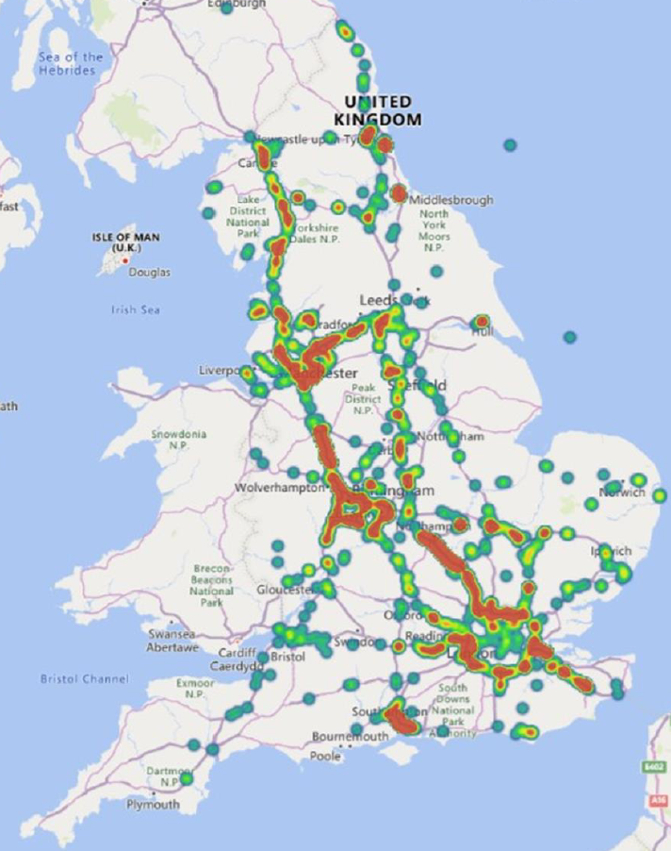
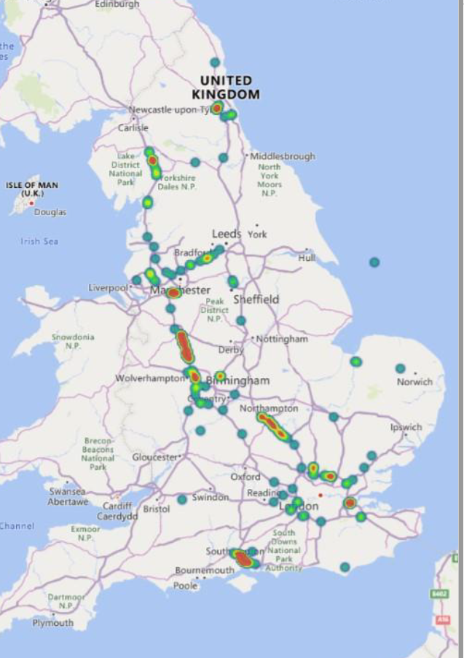
Data From Incursions Working Group
All Incursions Heat Map – Left Picture
August 2021 Incursions Heat Map – Right Picture.

Slide 6
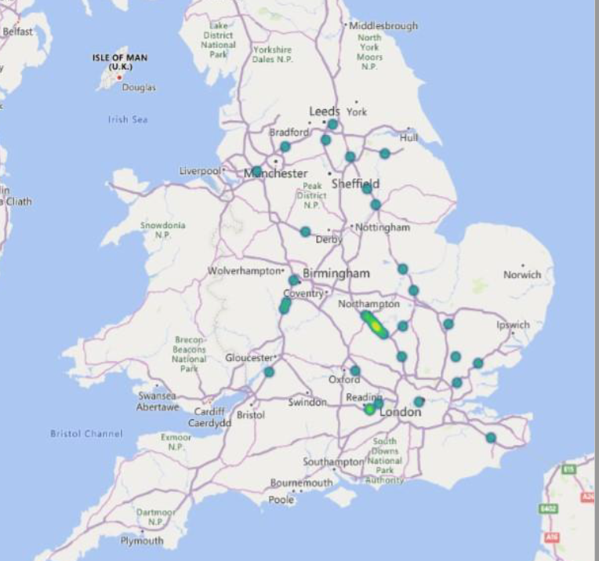
Data From Incursions Working Group
Heatmap of all IPV Strikes recorded.

Slide 7
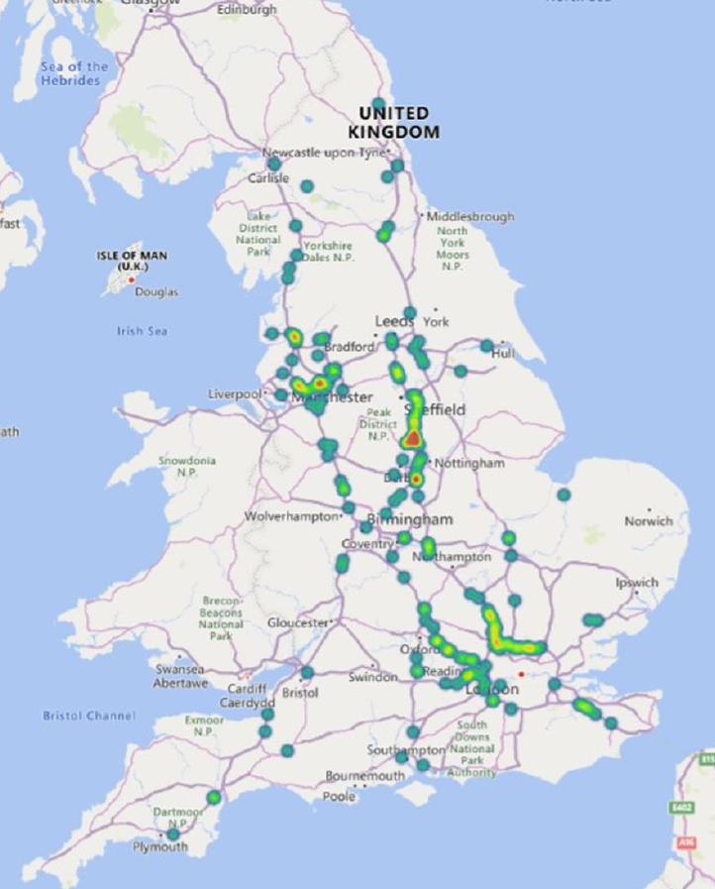
Data From Incursions Working Group
Heatmap of Worker Abuse recorded in August 2021

