Slide 1
Principal Designer Working Group Event No 25
Health, Safety & Wellbeing Moment
Mark Lamport, Arcadis

Slide 2
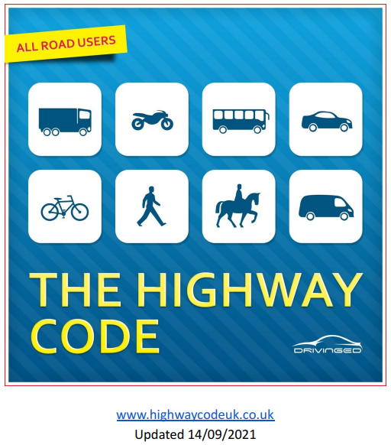

Slide 3
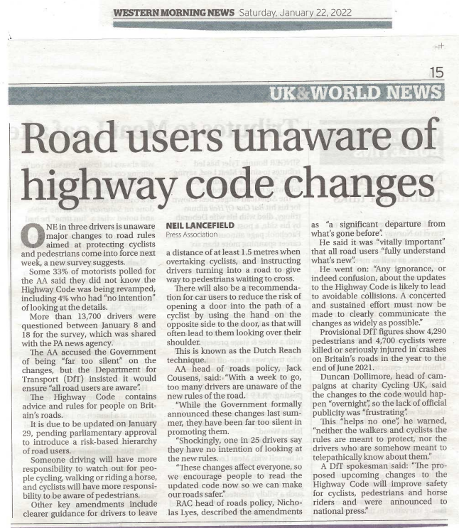

Slide 4
AA survey between 8/1/2022 & 18/1/2022 involved more than 13,700 drivers:
33% were unaware that the Highway Code is being changed
4% had no intention of looking at the details

Slide 5
Current version of the Highways Code was issued on 14/9/2021
212 pages
Free download from: https://www.highwaycodeuk.co.uk/uploads/3/2/9/2/3292309/the_official_highway_code_-_14-09-2021.pdf
Updated Rule 258 covers “Red X”
Rules updated to cover Smart Motorways - 270 Emergency Areas (EAs), 275 Places of Relative Safety (PRS)
Due to be further updated at end of January 2022 (pending parliamentary approval to introduce a “risk-based hierarchy of road users”)
“a significant departure from what’s gone before” (quote from RAC Head of Roads Policy, Nicholas Lyes)

Slide 7
National Highways – Driving on Motorways https://nationalhighways.co.uk/road-safety/driving-on-motorways/#bite Contains short videos on: How do smart motorways work? Do you know what to do when you see a red X? What do the traffic signs and signals mean? What if you break down on a motorway? What if you break down in a 'live' lane?

