Slide 1
Principal Designer Working Group Event No 25
Health and Safety Files Digital Development
Mark Lamport, Arcadis

Slide 2
Task and Finish Group Kick-Off Meeting
Held on 18/1/2022
Next meeting to be held in March 2022 - date TBC

Slide 3
Task and Finish Group Team
Mark Lamport – Arcadis
Doug Potter - Arcadis
Natalie Mansell - Atkins
Tim Bowes – Atkins
David Owens – Costain
Rob Butcher – Jacobs
Richard Wilson – National Highways, PDWG Chair
Kevin Clague - National Highways, Asset Needs Manager - Operations NW
Darren Allen – Telent
Jon Horrill – WSP
Jason Glasson (National Highways, Head of Asset Management ) to be invited to the next meeting

Slide 4
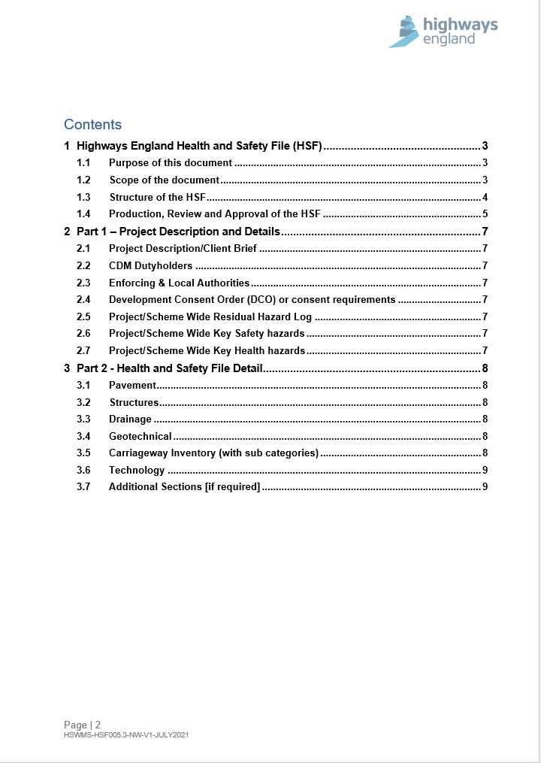
National Highways CDM Standard H&S File
Template available from Supply Chain Portal – PCF product guidance for H&S File

Slide 5
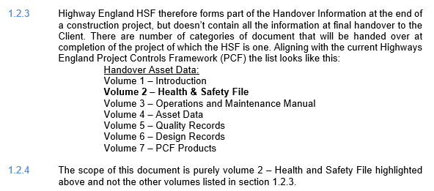
National Highways CDM Standard H&S File

Slide 6
Interface and Alignment with other National Highways Initiatives
Discussion on transition of H&S Files to GIS-based platform already underway within National Highways – how can this T&F Group support this development work?
Ensure alignment with National Highways 5 Year Digital Transformation Plan
Alignment with National Highways MP BC structure (?10 volume or 12 volume)
Ongoing discussions with Neal Symmons around integration of Lean into the digital handover process
Interface with Asset Information - H&S Improvement in Data Management Steering Group (last meeting on 20/1/2022)

Slide 7
Future Actions
Terms of Reference (Scope, Objectives, Outputs and Timescale) to be agreed.
Civils Maintenance (AD/MAC/ASC) Handover Document and Certificate (Stage 6) PCF product needs to be brought into alignment with the new CDM Standard and the new H&S File Template (Stage 2 product)
We need to understand end-user requirements:
What information do they need from the H&S File?
In what format?
On what platform?
Ensure we take learning from the BIM 4 Health & Safety Sub-group led by Andrew Rouse and Gordon Crick looking at integration of H&S into BIM

