Slide 1
Highways England CDM Audit Process (1)
10 Question Test to Safe by Design
1/ Do I know how it will/can be assembled? Satisfactory?
2/ How will it behave during construction?
3/ What impact does the construction sequence have on my design?
4/ Have I assumed a construction method in my design?
5/ What plant would be needed and how do materials get to site and into the works?

Slide 2
Highways England CDM Audit Process (2)
6/ Is anything in my design very sensitive to construction tolerances?
7/ Have my important assumptions been communicated?
8/ What might go wrong and how could I de-risk it?
9/ Is there a simpler way to do this?
10/ What does the Project Technical Reviewer think?

Slide 3
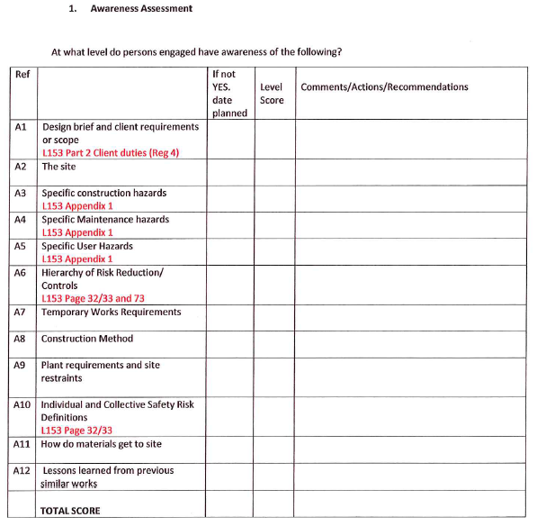
Highways England CDM Audit Process (3)

Slide 4
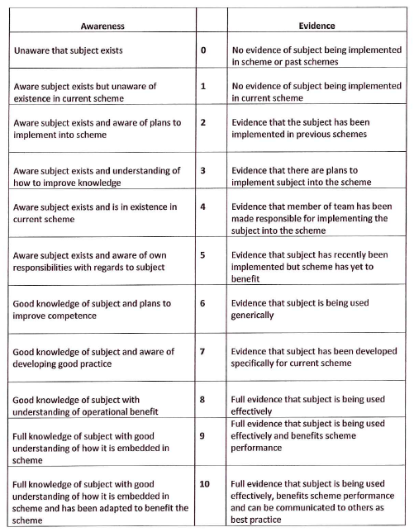
Highways England CDM Audit Process (4)

Slide 5
HE Health & Safety File Workshop Feedback (1)
Workshop convened by Philippa Lea (Corporate Quality Manager for SMP) and Tom Merry (SMP H&S Lead), held in Birmingham on 17/4/2018
Representation by SMP, RIP, CIP, AIG
Current Position
What does good look like?
Quality and the H&S File
How do we get there?

Slide 6
HE Health & Safety File Workshop Feedback (2)
Presentation of work done by PDWG – recommendations agreed
Points agreed at the workshop were:
H&S file content needs to be decoupled from other Handover documentation
Information in the PCF needs to be aligned to support any change – may be a requirement to split into two PCF products. New quality criteria to be developed to support requirements for fit for purpose documents
The five recommendations of the Principal Designer Working Group were a sensible starting point
Working towards adoption of Part A of the Lower Thames Crossing proposal would be a realistic option

Slide 7
HE Health & Safety File Workshop Feedback (3)
Questions around the role of the Principal Designer/Principal Contractor in delivering H&S file need to be bottomed out – also linked to procurement, contracts and target price
Management of maintainers – there is a requirement to better hold maintainers to account and prevent rework of surveys
Once rolled our across Major Projects, Business Collaborator could be used for storage of the H&S file (at least during development) but specific consideration to be given to RIP and Local Authority needs of the H&S file – often there is a tie-in to the Local Authority network on RIP schemes.

Slide 8
Highways England PD Additional Duties
Initial version for M4 Jn 3 – 12 SMP presented at PDWG on 20/12/2017
Revised version incorporating comments from Nick Balsdon and Ian McMillan submitted in May 2018
May be time-limited

