Slide 1
Leica Geosystems Utility Avoidance and Mapping
Steve Scales, Utilities Sales Manager
16th May 2019

Slide 2
Leica Detection Solutions Agenda
NEW Leica DD Utility Locator
Leica DX Software
Leica DX Manager Mapping
Questions

Slide 3
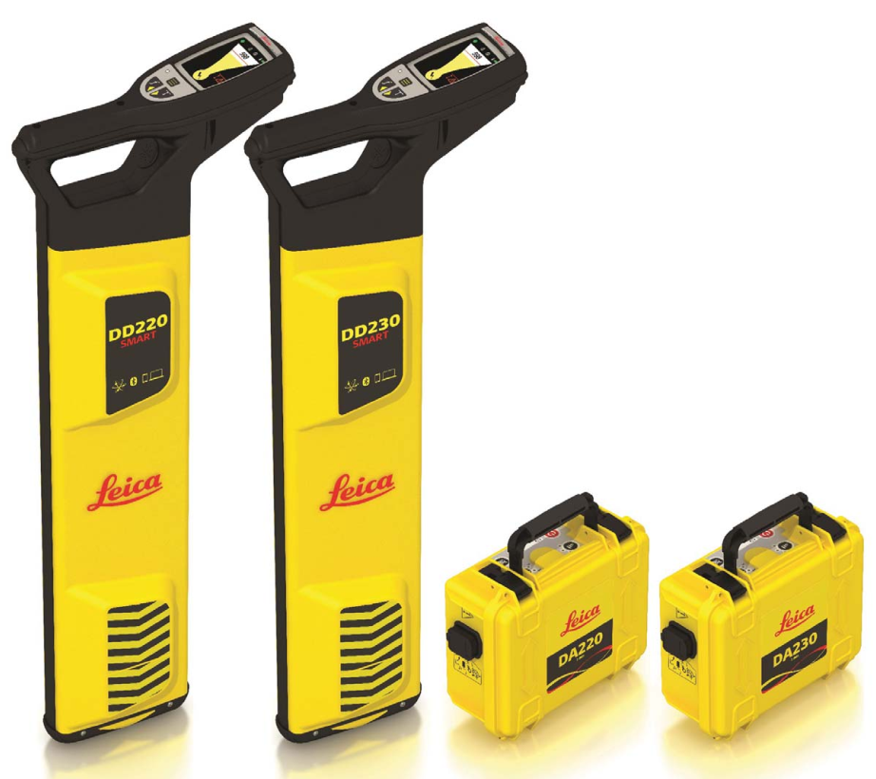
Leica DD Utility Locators

Slide 4
Leica DD Utility Locators
DD SMART Series
Leica DD220 SMART
Best in class detection performance
Innovative digital antenna
Depth detection up to 7 meters (23 feet)
Bluetooth connectivity
Data Logging and GPS
IP66 rating - protection from dust and water
Leica DD230 SMART
Additional to DD220 SMART
Extended trace range with additional 512Hz, 640Hz frequencies and signal current measurement
Increased depth detection up to 10 m

Slide 5
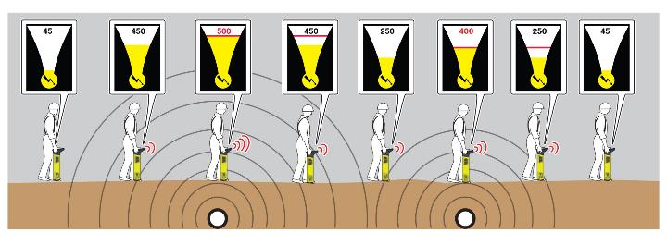
Providing greater performance Simplifying Use
Auto mode sweeps in both Power and Radio modes
Digital Signal Processing (DSP) filters signals to ensure best detection capabilities
Automatic controls replaces manual sensitivity
Pinpointing with numerical and graphical display readings

Slide 6
Providing greater performance Passive and Active Modes
Power Mode
Detect power signals radiated by energised cables & pose a serious risk
Radio Mode
Detect signals originating from distant radio transmitters
Auto Mode
Combines power and radio for a one sweep process
131 kHz
Improves the detection of small diameter cable such as telecoms
33 kHz
Standard tracing frequency on avoidance locators, used for everyday site use
8 kHz
Mid-range distance tracing
512 Hz
Improves long distance tracing
640 Hz
Improves long distance tracing

Slide 7
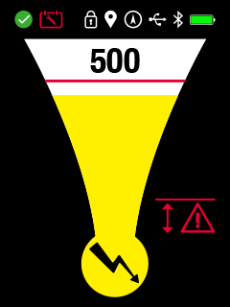
Providing clear information Instrument display
Status Bar
Numeric Indicator
Health Check (EST) Icon
Scheduled Maintenance
Mode Lock
Point of interest
GPS Status
USB Status
Bluetooth
Battery Condition
Peak Indicator
Graphical Indicator
Alerts Area
Operating Mode

Slide 8
Increasing operator confidence On-board training videos
Provides onsite operator support
Refresh operator skills
Promotes best practice
Supports point of delivery
Simplifies hand over process during hire
Strengthens demonstration process

Slide 9
Increasing operator confidence Good-to-Go Health Check
Checks functionality on-demand
Confirms each day that instrument is Good-to-Go
Can be run manually or scheduled
Stores results to the instruments memory

Slide 10
Increasing operator confidence Calibration verification
Pay as you go calibration verification
Provides a service due indicator
Alerts when a service is recommended
Can lock unit to prevent operation if no service has been carried out
Connect instrument to PC/Laptop - portable
Calibration verified using an internet connection
Certificate can be printed
Latest firmware can be uploaded

Slide 11
Green Credentials Improved sustainability
Rechargeable battery pack (Leica Rugby compatible charger)
Interchangeable between locator and transmitter
Extended operating life to 5 years
Waste Reduction
Save more than £250 on Alkaline batteries*
Eliminates disposal of Alkaline batteries
Reduced environmental impact

Slide 12
Industry leading warranty Piece of mind support
Leica PROTECT
3 Year warranty
myWorld
Technical support
Instant access to information
Keep you and your equipment up-to-date

Slide 13
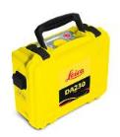
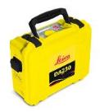
Leica DA Signal Transmitters
Image | Overview | Compatibility
 | DA220/230 1 Watt Signal Transmitter Trace frequencies, 512Hz, 640Hz 8kHz, 33kHz,131kHz and combined (33 kHz +131 kHz) Rechargeable battery as standard IP67 rating 3 Year warranty | DD220/230 Smart Locator
 | DA220/230 3 Watt Signal Transmitter Trace frequencies, 512Hz, 640Hz 8kHz, 33kHz,131kHz and combined (33 kHz +131 kHz) Rechargeable battery as standard IP67 rating 3 Year warranty | DD220/230 Smart Locator

Slide 14
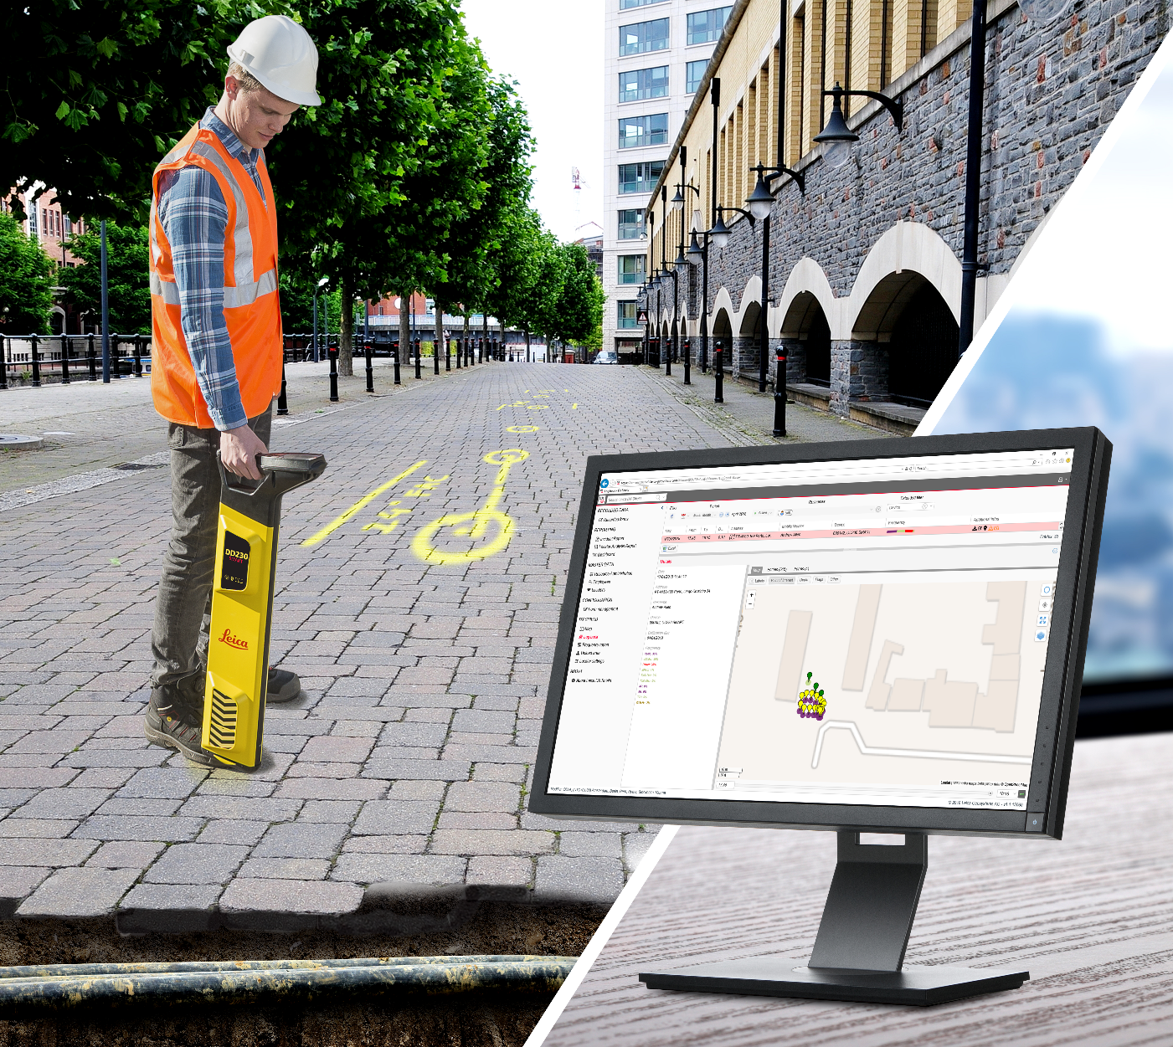
Leica DX Shield Software

Slide 15
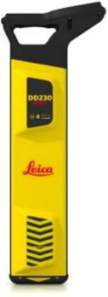
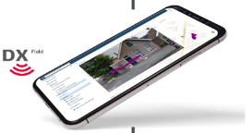
DX Shield Workflow
DX Shield software provides organisations with a single-source solution protecting operators and utilities from harm.
DX Manager Shield
Centralised, accessible information
Processes & reports on the locator usage information
Holds all site documentation e.g. health & safety forms
Keeps all site photos logged in the project folder
4
Transfer data using DX Field Shield
2
3
Upload to DX Manager Shield or
DX Office Shield
4
DX Office Shield
Processes & reports on the locator usage information
Connects to CalMaster and link to the web for web calibration verification
1
Locator Scan data
Site Documentation

Slide 16
DX Shield Software DX Office Shield
PC software for product maintenance and analysis:-
Product Maintenance;
Connect to the PC for product maintenance and configuration.
Over the internet Calibration Verification
Update firmware
Update and customise your locator
Data Analysis;
Download locator data directly to the PC or integrate emailed data files
Run basic analysis reports
Upload data directly to DX Manager Shield

Slide 17
DX Shield Software DX Manager Shield
Three levels:-
Standard;
Free download with viewable data for a 3 month rolling period, basic system and report functionality
Pro;
Subscription based with 12 month data access, additional system and report functionality
Number of users
Customised reports
Simple management tools
Expert;
Subscription based available to DX Manager Shield Pro subscribers
Automated report functions.
Upload photos and site notes

Slide 18
DX Shield Software DX Field Shield
Links field operations and DX Software:-
Upload to DX Manager Shield;
Fully automated;
Auto sync using 1 SMART device and SMART locator per user, minimal user interface
Or
Group uploading;
1 SMART device, multiple SMART locators, multiple account holders – supervisor uploads and assigns locator data to account holders reduced capital investment and ongoing running costs
Email;
Locator data files for individual analysis no additional cost

Slide 19
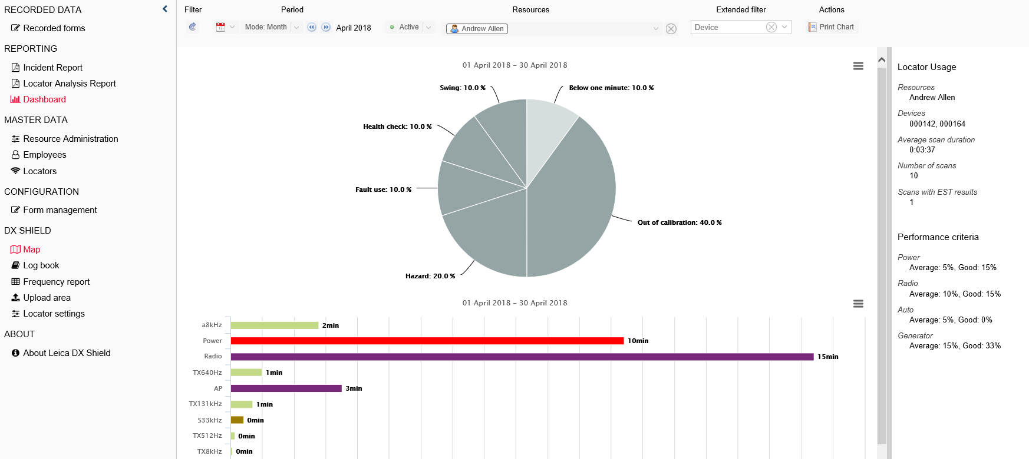
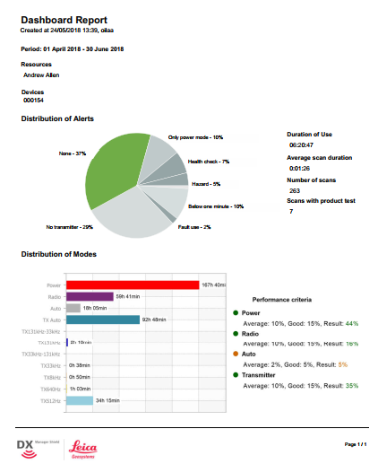
DX Manager Shield Software
Create Reports :-

Slide 20
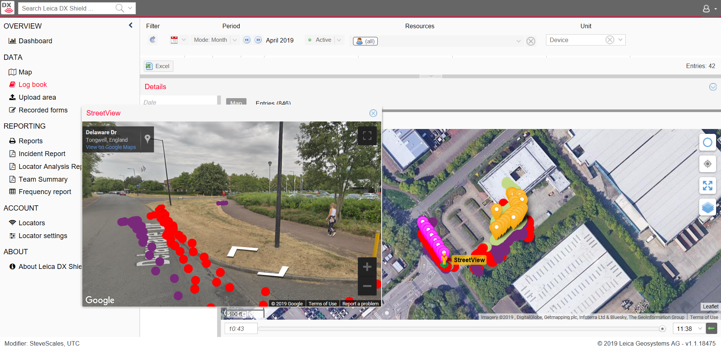
DX Manager Shield Software
Visualise all site locations :-

Slide 21
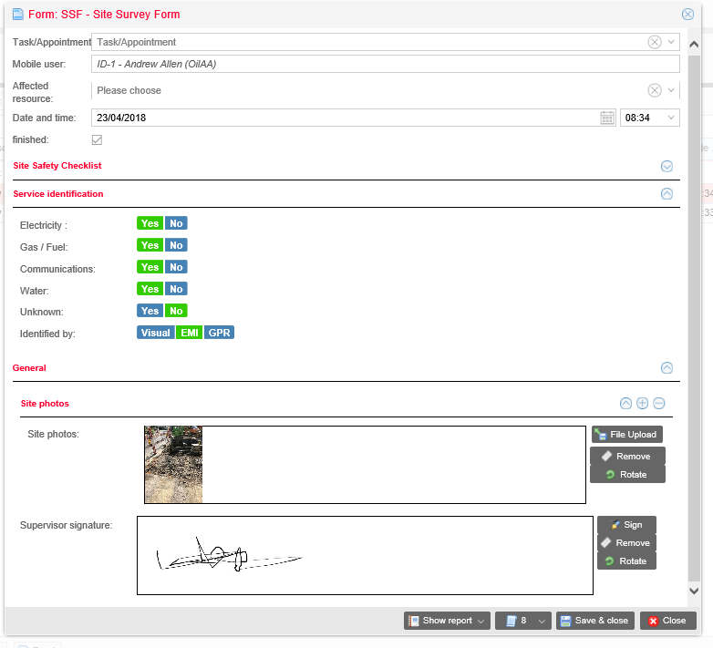
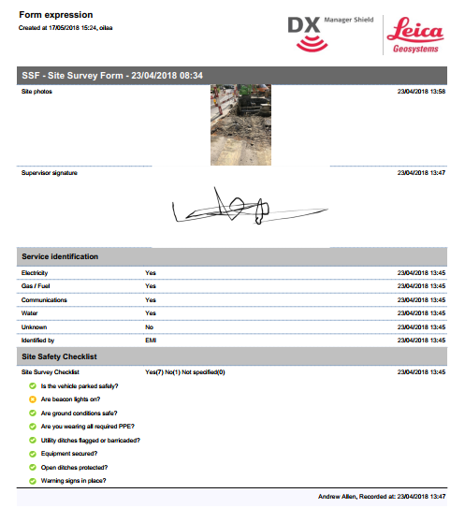
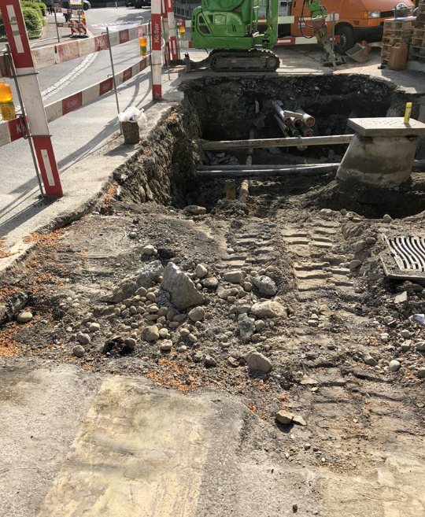
DX Manager Shield Software
Review Site Notes and Photos:-

Slide 22
DX Shield Software
https://dxmanagershield.leica-geosystems.com/MomentBde/ModuleDxManager/LogBookList.aspx

Slide 23
Leica DX Manager Mapping

Slide 25
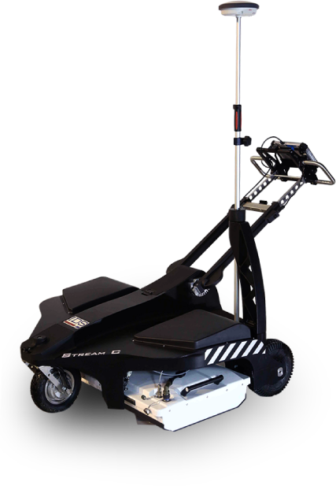
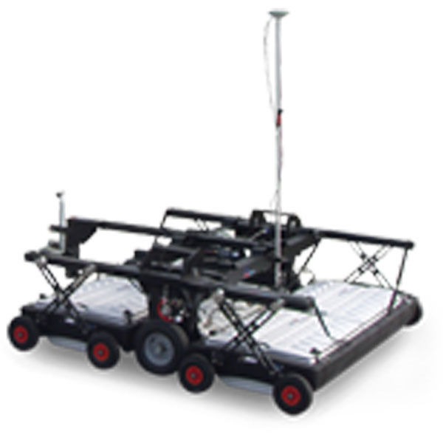
STREAM C & STREAM EM
ARRAY GPR Solutions

Slide 26
STREAM C
Massive array of 34 antennas in two polarisations
Automatic Pipe Detection
Compact size
Robust Construction
3D Radar Tomography
Professional Subsurface Surveys
System Benefits -
High Productivity
No Advanced Training needed
Reduced User Fatigue
Facilitates Large Surveys

Slide 27
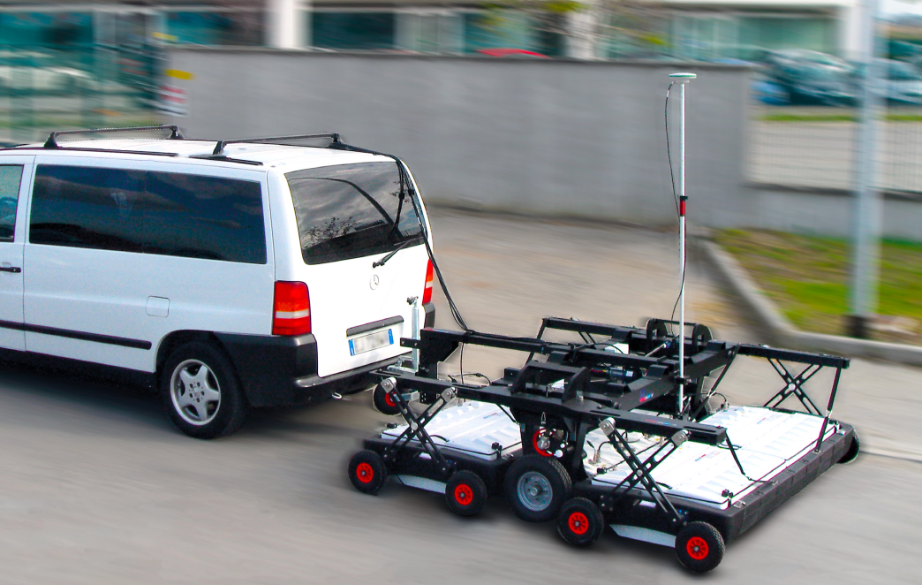
STREAM EM
Massive array of 40 antennas in two polarisations
Cost and Time Reduction
Modular for flexibility to survey type
System Benefits -
High Productivity
No Advanced Training needed
Reduced User Fatigue
Facilitates Large Surveys

Slide 28
GRED HD Time Slice

Slide 29
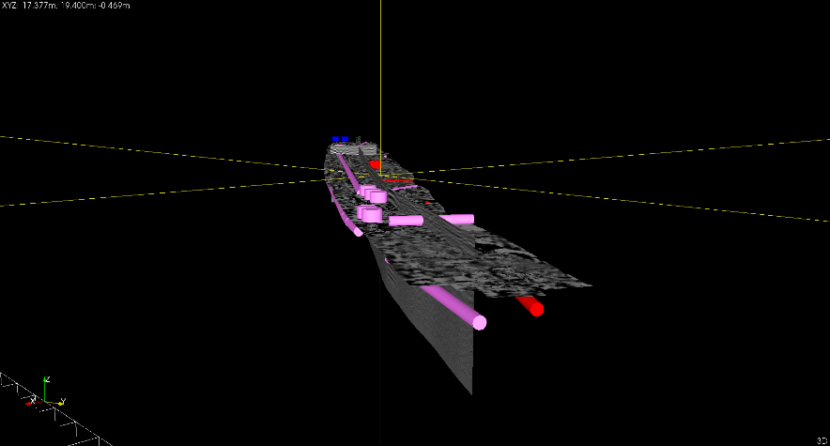
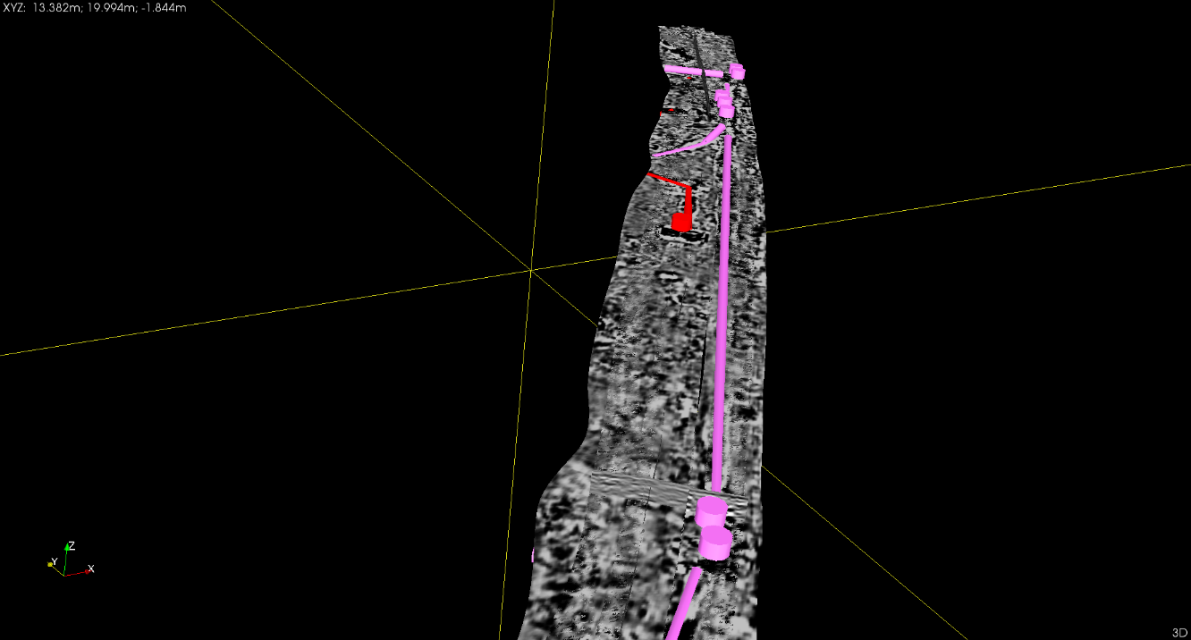
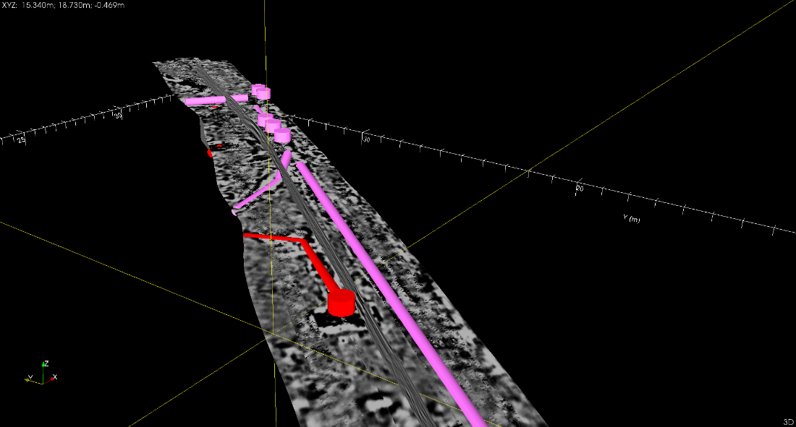
3D Rendered Display
GRED HD allows us to automatically produce a 3D rendered image of targets selected which can be exported as a DXF file for use in AutoCAD

Slide 30
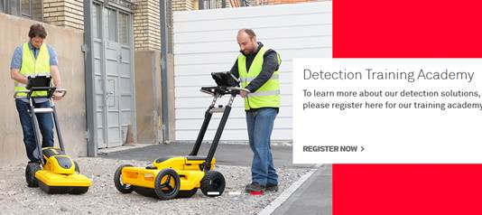
Leica Detection Training Academy
Leica now offer a range of certified courses which are carried out at the Detection campus in Stoke. Courses include;
Cable Avoidance
Basic GPR
Advanced EML and Mapping
GPR to Deliverable
5 Day Utility Surveyor

Slide 31
Upcoming Events
Leica will be exhibiting at the upcoming shows;
Utility Week Live – 21st – 22nd May – NEC
Geobusiness – 21st – 22nd May – Business Design Centre
Plantworx – 11th – 13th June – Peterbough Arena
We will be holding seminars on Asset Management, Protecting Assets and Multi-Array GPR. All products shown in this presentation will be on display

