Slide 1
PRINCIPAL DESIGNER WORKING GROUP
Lean application in CDM:
Whole Life H&S Design Knowledge Transfer
Design Risk Management
16th May 2019
Pav Singh
Associate Technical Director CDM HSEQ Services

Slide 2
Lean Application by HE
Highways England are using Lean to achieve strategic outcomes

Slide 3
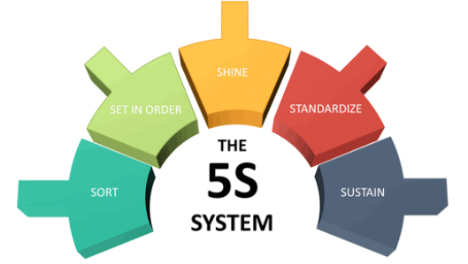
Lean Application in CDM
How is PDWG implementing Lean principles
Implement 5S in CDM
Supporting CIRIA C769
Implement Lean in Construction
Develop case studies on lean application
1. Whole life H&S in Design Knowledge Transfer
2. Design Risk Management

Slide 4
1. Whole Life H&S in Design Knowledge Transfer
The Need
The Designers and Principal Designers
A standardised authorised source of information
Consideration of lessons learnt from all industries
Common Language for key terms
Best Practice case studies working with CIRA guides
Sources of information including worked examples
The H&S Hub & PDWG - Whole life H&S Sub Group highlighted
We need a design library
Best Practice is needed for every engineering disciplines including coordination .
Standardised approach to designing out O&M issues - alarms when drainage fills up
Design and constructability constraints to consider in planning
Design to consider Temporary Works and Buildability - Working areas for plant

Slide 5
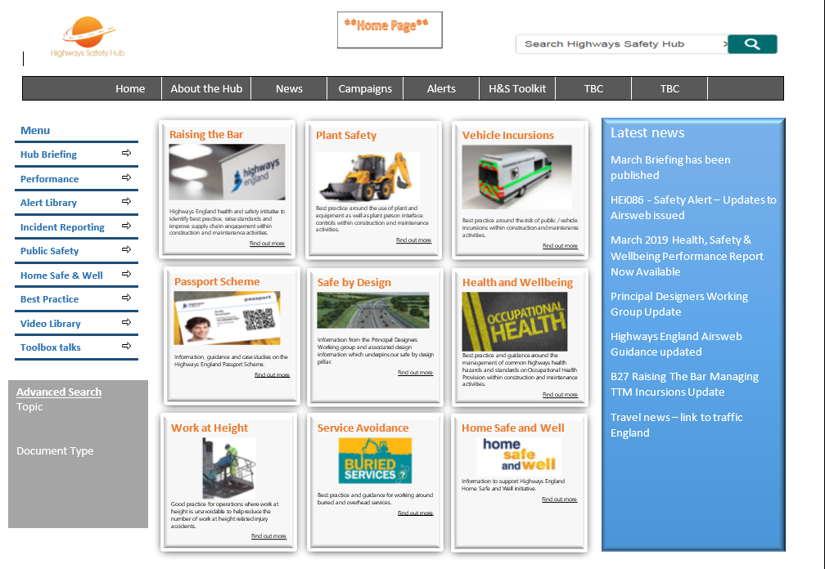
Whole Life H&S in Design Knowledge Transfer
The Proposal and Action:
We have the opportunity to develop Whole Life H&S in Design Knowledge Transfer Platform within H&S Hub Webpage
Next Steps – Nominations needed – Whole life H&S subgroup
Develop data workflow for subjects and structure information
Develop metadata for allowing advanced searches to take place
Develop sub-tiles to coordinate information on website.

Slide 6
2. Design Risk Management – Issues
Design Risk Management requires standardisation to improve communication between different phases of the projects.
Training is required to improve communication skills of designers
Consideration is needed for Health risks as well as safety
Compatibility is required for next stages of evolution for Design Risk Management including BIM and GIS
We need information that can stand up to legal scrutiny if there are accident investigations.

Slide 7
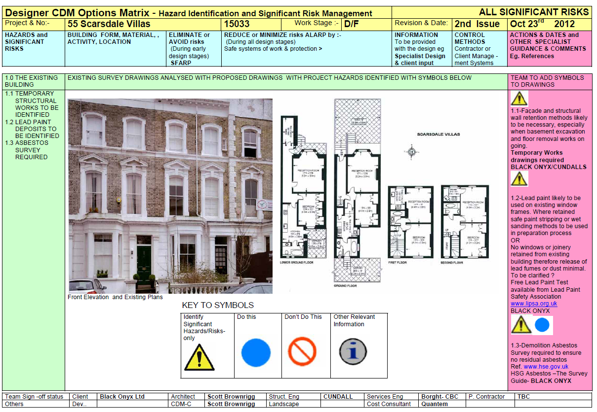
DRM – Architecture

Slide 8
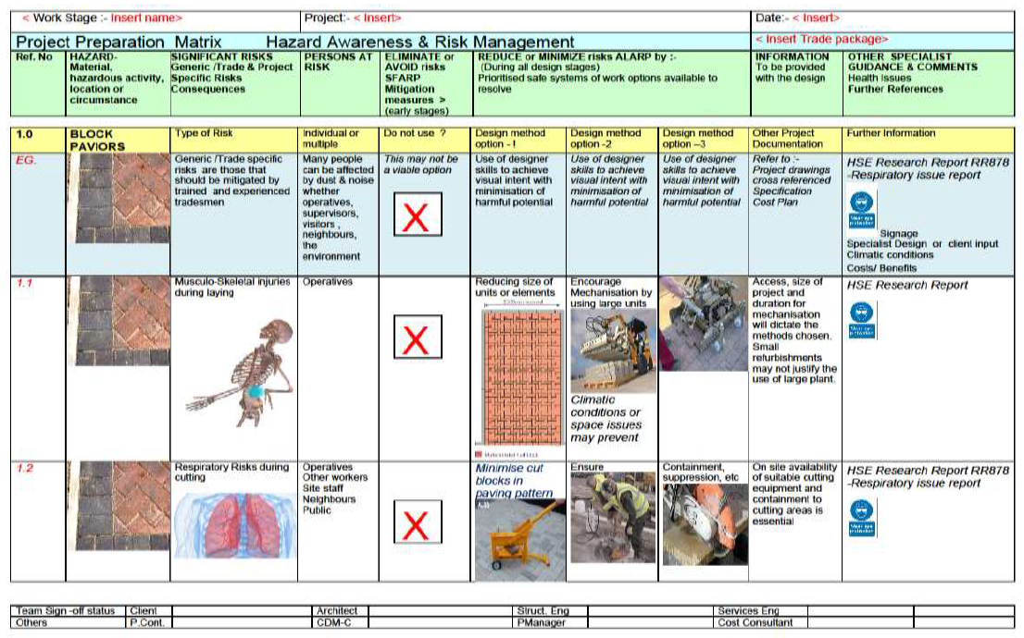
DRM – HSE Preconstruction Phase

Slide 9
DRM – HSE Construction Phase

Slide 10
DRM – HE Complex Projects - Excel

Slide 11
Design Risk Management – Next Steps
Nominations needed – Whole life H&S subgroup
Develop the webpage for Knowledge Transfer for DRM
Develop metadata for allowing advanced searches to take place
Current practise from all industries – use of Hazard Triangles NR.
Develop different case studies and sources of information e.g. CIRA
Nominations needed – Future of DRM
Implement lean standardise process and improve efficiency
Consider update of standard CIP and Major Projects DRM
Data base approach to managing risk consider ARM or equivalent approaches
Consider risk within multi disciplinary requirements
Develop risk management in BIM and GIS - common library of symbols
Nominations needed – Complex risk management
Integration and use of GG104
Complex projects including Tunnels

