Slide 1
Whole Life Design Task Group
Membership
Andrew Finch, Chair (Jacobs)
Richard Wilson (Highways England)
Ian Scott (Highways England)
Martin Partington (Jacobs)
Doug Potter (Arcadis)
Tim Goddard (Arcadis)
Paul Brown (WSP)

Slide 2
Whole Life Design Task Group
Feedback from Task Group meeting of 30/04/19
O&M Safety Shares
RTB 26 update
Design Change Process
Modular Construction - PD Safety Alert

Slide 3
Whole Life Design Task Group
Feedback from Task Group meeting of 30/04/19
‘Task and Finish’
High impact quick wins
Concentrate on Operations, Maintenance and Dismantling
Capture lessons from asset management teams and contractors
Further work required on root cause analysis
Identify the most effective methods for knowledge sharing

Slide 4
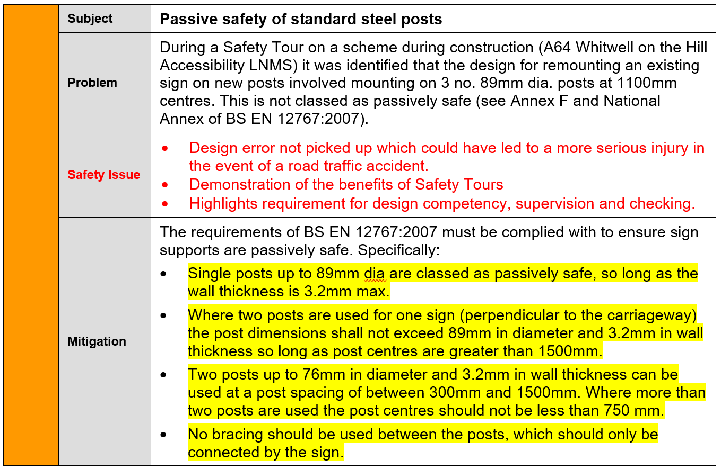
O&M Safety Shares

Slide 5
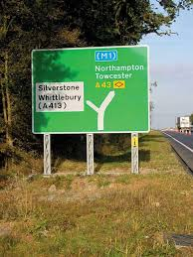
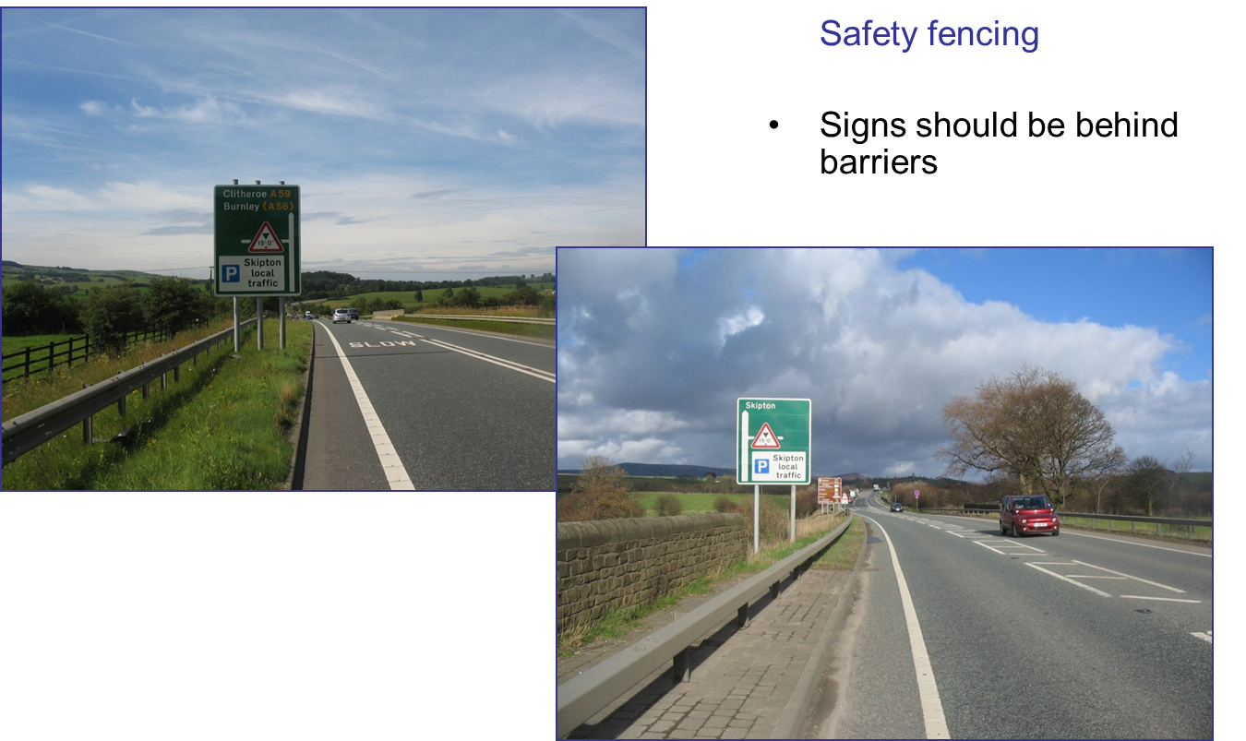
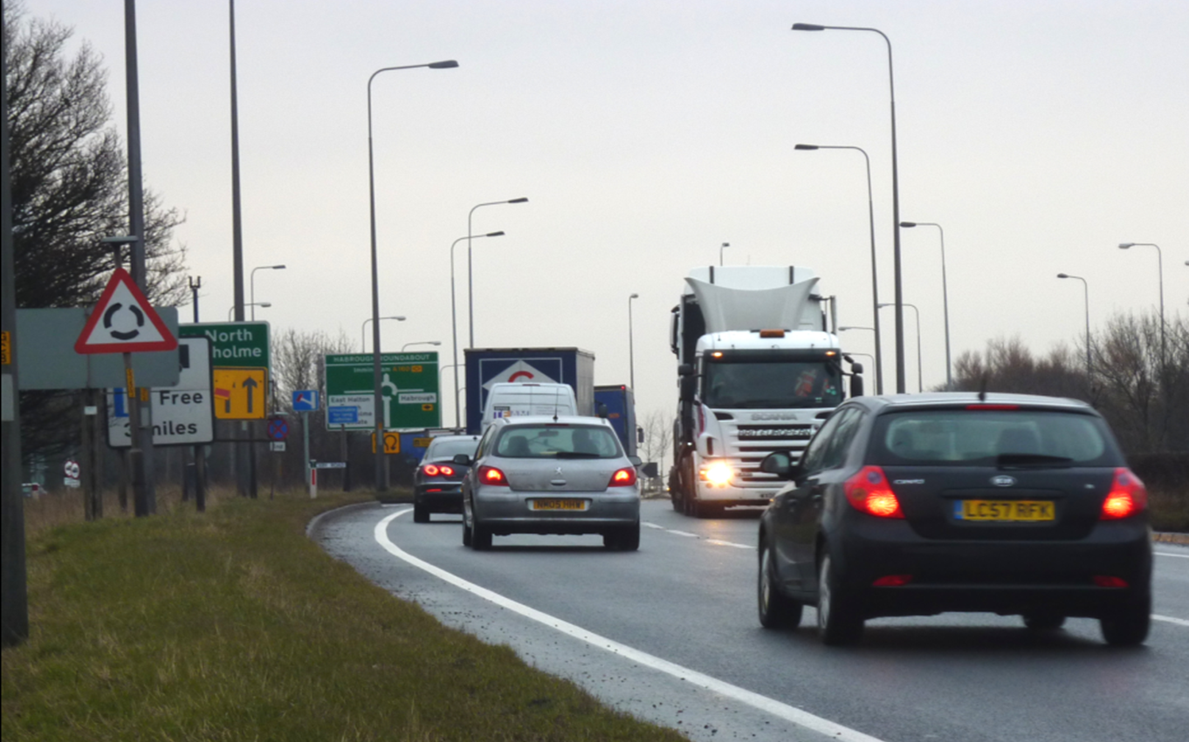
O&M Safety Shares

Slide 6
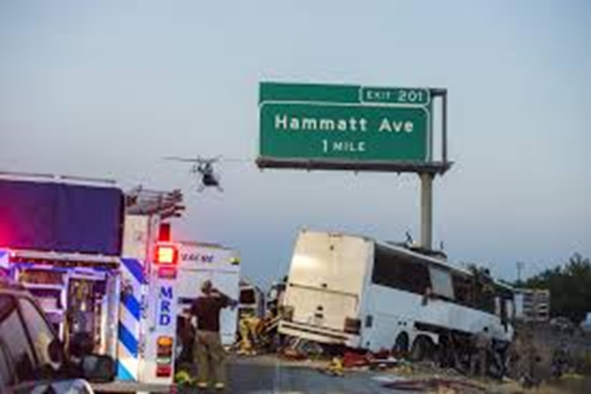
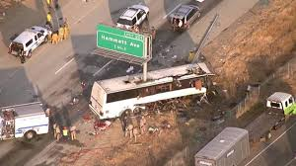
O&M Safety Shares

Slide 7
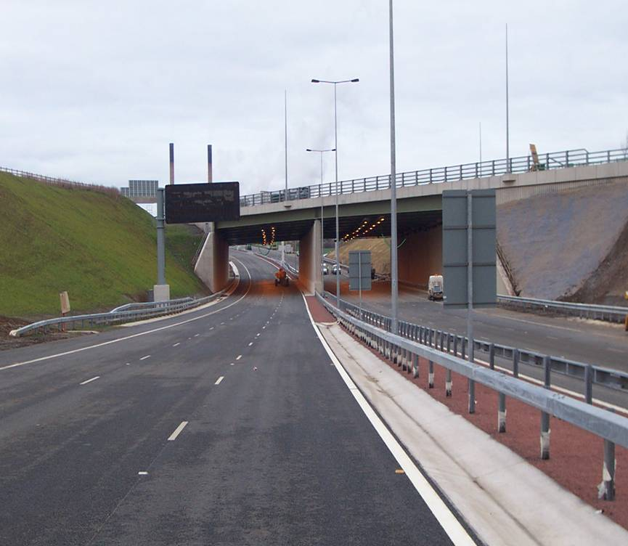
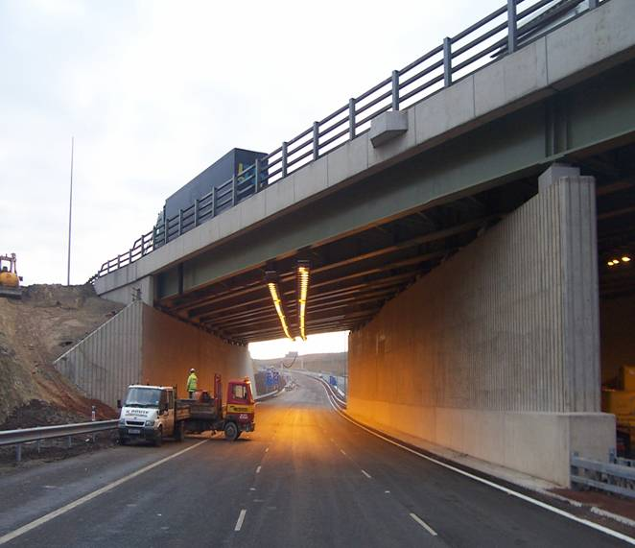
O&M Safety Shares

Slide 8
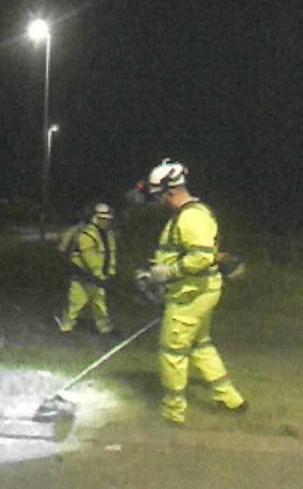
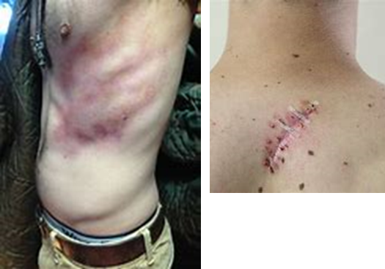
Maintenance and Operations
3000 - Landscaping
Impact & likelihood
Persons Affected
Broken leg
Torn calf muscle
Back sprains
Jarred shoulder
Lacerations
Cracked ribs
Twisted knee
[7% of all injuries occurring across 4 maintenance areas]
Verge/ Landscape maintainers
Inspectors/ Surveyors
Public
[7% of all injuries occurring across 4 maintenance areas]

Slide 9
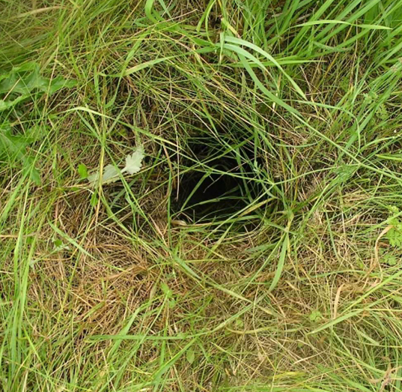
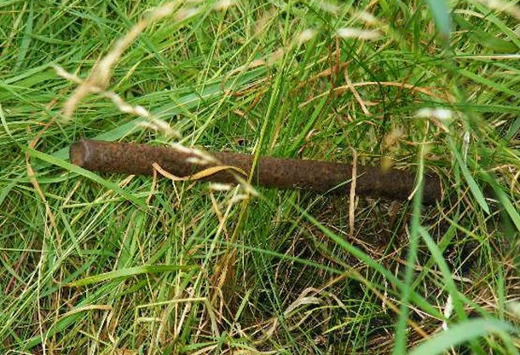
Maintenance and Operations
3000 - Landscaping
Impact & likelihood
Persons Affected
Hazard
Potential Root Cause
Why
Broken leg
Torn calf muscle
Back sprains
Jarred shoulder
Lacerations
Cracked ribs
Twisted knee
[7% of all injuries occurring across 4 maintenance areas]
Verge/ Landscape maintainers
Inspectors/ Surveyors
Public – drivers & verge walkers
Protruding dead post
Rabbit hole
Post hole
Manhole no lid
Cables
TM signs
Exp time
Wet grass
Animals crossing road
Long grass
Seed type
Fertile topsoil
Sign post detail
Safety barrier verge detail
Attractive food
[7% of all injuries occurring across 4 maintenance areas]

Slide 10
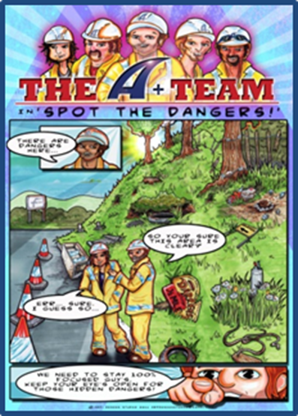
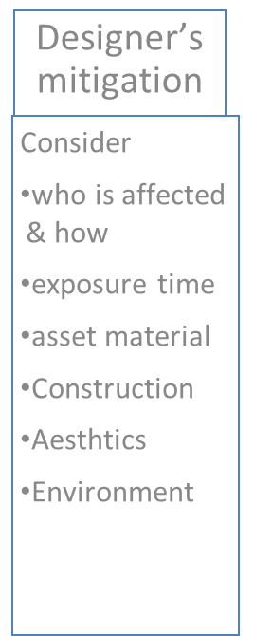
Maintenance and Operations

Slide 11
Issue – Pre- Construction Statutory Undertakers Information
Background
Some designs for various reasons put the onus of responsibility for the trials on the contractor. This is contrary to CDM2015 and could result in an accident
Under CDM2015 all schemes should be designed with risks As Low As Reasonably Practicable.
In the case of schemes that have underground services which could complicate construction works, it is reasonably practicable to have sufficient trial holes/trenches/pits dug to confirm the C2 returns to enable the scheme to be designed and built safely. We are expected to do everything which is reasonably practicable to obtain information to protect the health and safety of the workforce.
Action
Ensure where necessary that trial pit investigations are undertaken as part of scheme development (Preliminary design) to determine impact of underground services on proposed construction works, allowing the designer to eliminate or minimise the impact of these
The Pre construction information (PCI) needs to have this included within it
Result
Early gathering of information which affects the design gives greater certain over the design solution passed to the contractor for construction. Better design information reduces uncertainty giving greater confidence in both costs and programmes

Slide 12
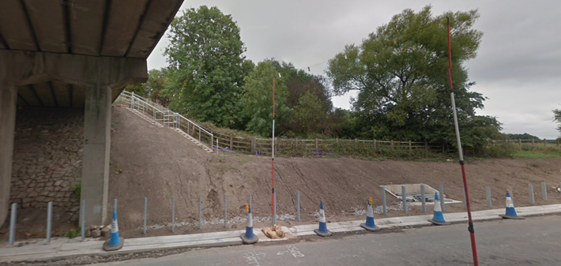
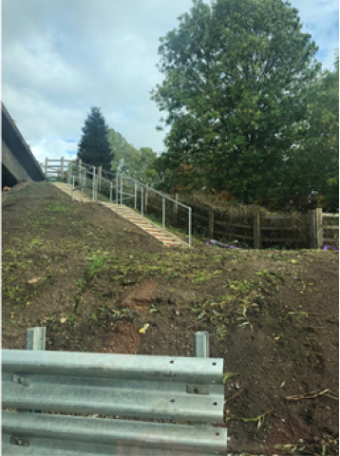
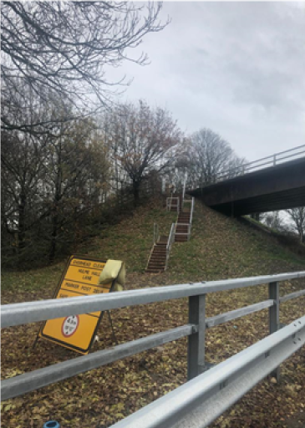
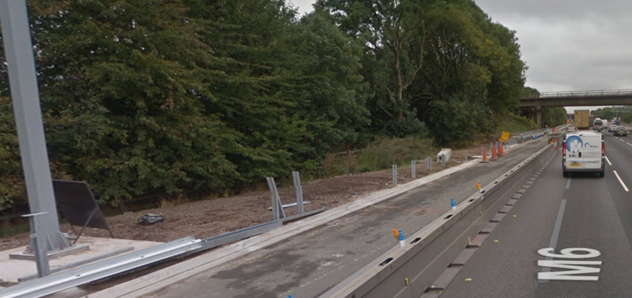
Off Network Access Considerations

Slide 13
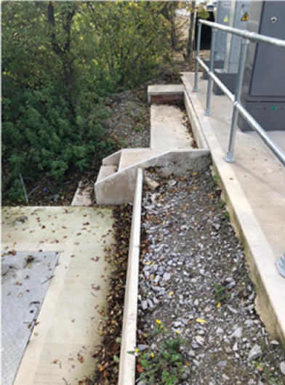
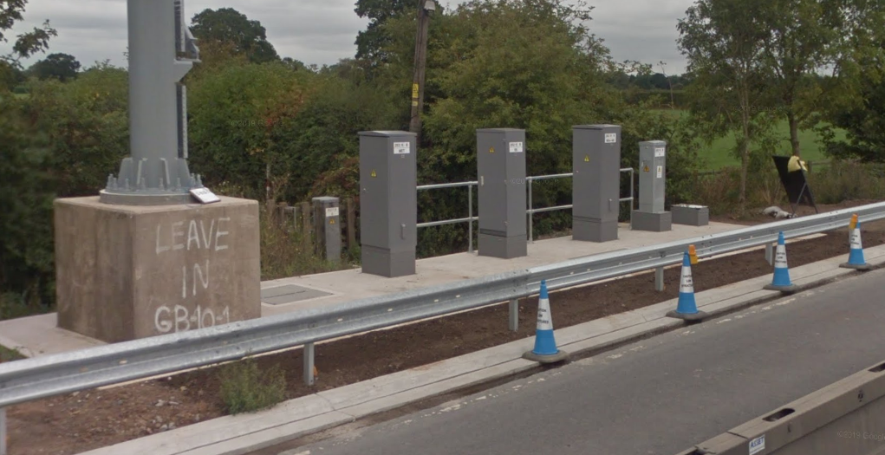

Slide 14
CDM Compliance
Route designed by the scheme to provide off network access.
Steps stop without a dedicated pathway.
Routes require operative to walk close to VRS adjacent to a live lane.
Some access is considerable distance away from asset.
Areas at height are unprotected.
Maintenance of steps and handrails essential to safe access – ASC/AD?
Condition of access/walking routes essential to safe access – ASC/AD?
Who within HE H&S Teams inputs to these designs?
Is the Health and Safety File detailing these access arrangements available?

Slide 15
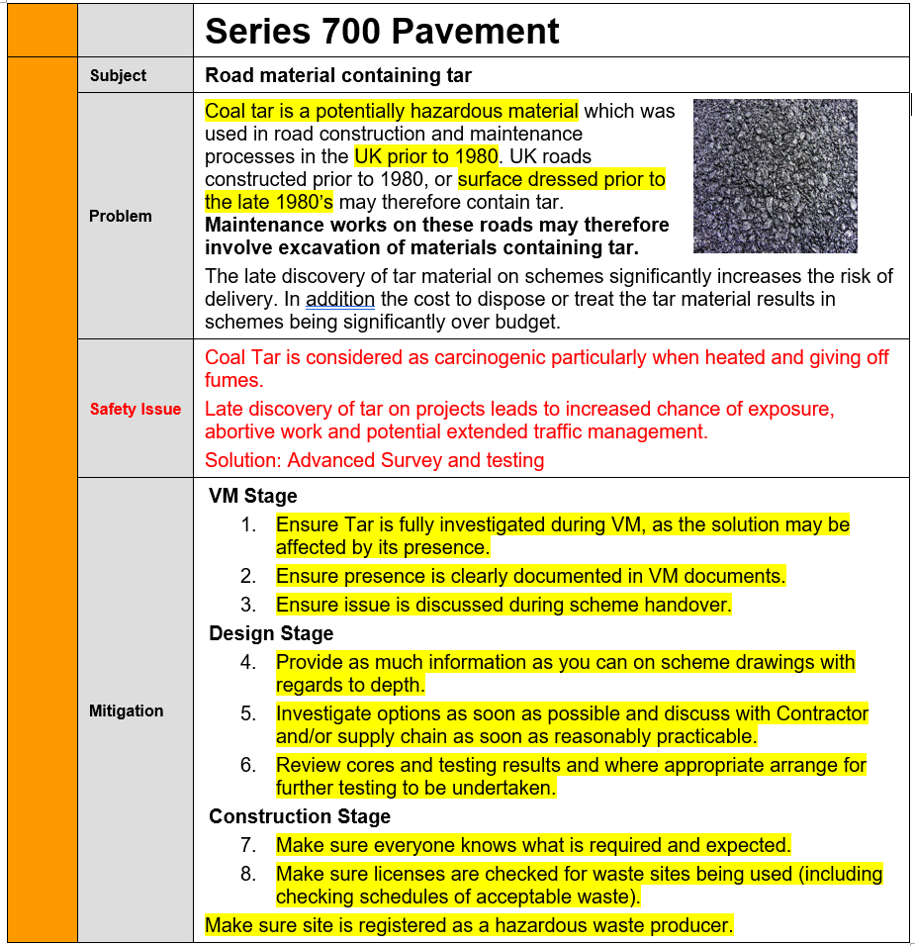

Slide 16
