Slide 1
Update on Predictive Tool for Suicide Risk
March 2022

Slide 2
Summary of data sources
A variety of data sources were used as inputs into the model
Data provided by National Highways
Published data sources
Data from experts
Structure data: 8,855 structures managed by National Highways
Incidents data- 10,897 incidents in the last 5 years within 200m of a structure.
Suspected Suicide (Fatals) data: 92 fatalities (cause= bridge falls) in the last 5 years
Included in the current model
Index of multiple deprivation
Population density
Urban or rural classification
Number of higher educational institutions
Expert opinion was gathered from five experts from academia, the Samaritans and the British Transport Police, supported by expert judgement from members of the Suicide Prevention team at National Highways.
To be included in the future:
Number of pubs or clubs nearby
Medical facilities

Slide 3
Model development process
Data-led approach
Data linking
Statistical analysis
Link the incident, fatals, CCTV and published data to the structure dataset provided by National Highways
Exploratory analysis and regression modelling to establish the relationship between the input variables and outcome variable (number of attempts)
Model structure developed
Bayesian belief network
Expert judgement
Developing a model structure based on the literature review and previous expert judgement
Survey development
Expert data elicitation
Development of the model using a combination of data and expert opinion
Survey developed to elicit expert judgement for factors where no data was available. A combination of a questionnaire and workshop using mentimeter was used to gather data.
Survey data analysis to develop inputs for the model
Model calibration and validation

Slide 4
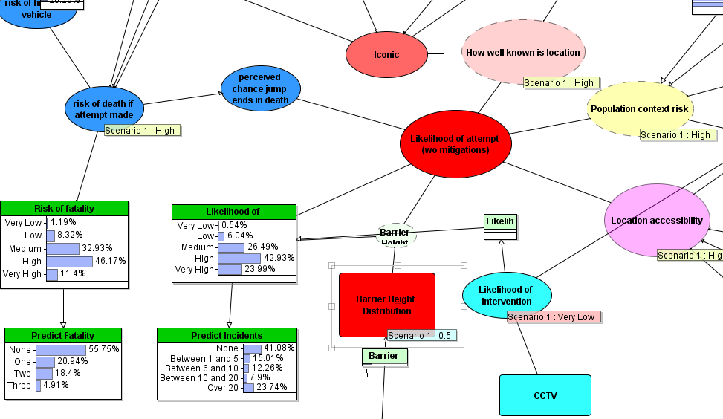
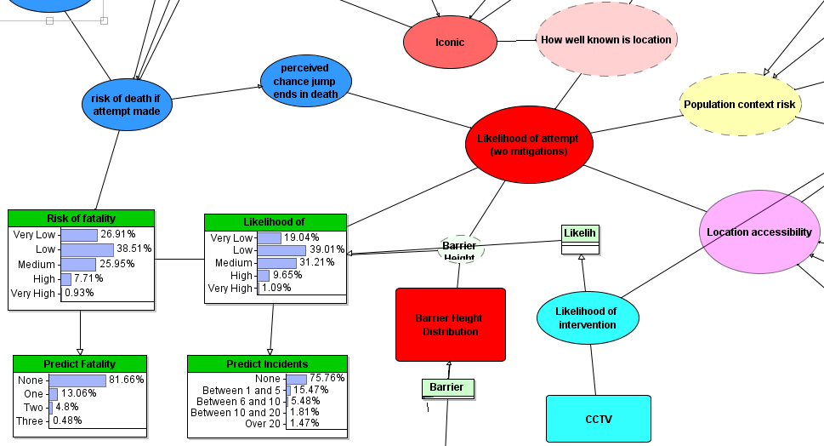
Model output: outcome variable
Baseline
Scenario output
High risk of death if attempt is made
Well known location
High population context risk
Accessible location
Likelihood of an intervention is low
Low barrier height
Likelihood of incident | Probability
Very low | 0.19
Low | 0.39
Medium | 0.31
High | 0.09
Very high | 0.01
Likelihood of incident | Probability
Very low | <0.01
Low | 0.05
Medium | 0.26
High | 0.42
Very high | 0.23

Slide 5
Main Findings
Some limitations to its validation, due to the lack of complete information around known structures
Validation has demonstrated risk estimates in line with the rates of suicide attempts and rates of fatalities from suicide – further refinement is needed
The output end users are given after using the tool, and how this output translates to action, is critical. This should be a key activity for any future work
Embedment into DMRB and references in PCF and 3D critical
In conclusion, the need for this tool is evident: when combined with best practice guidance, it could play a significant role in reducing suicide attempts on the SRN.

Slide 6
Next Steps?
Thank you
Questions?

