Slide 1
Highways Safety Hub & SCSLG Update
Principal Designers Working Group
25 March 2021
V1

Slide 2
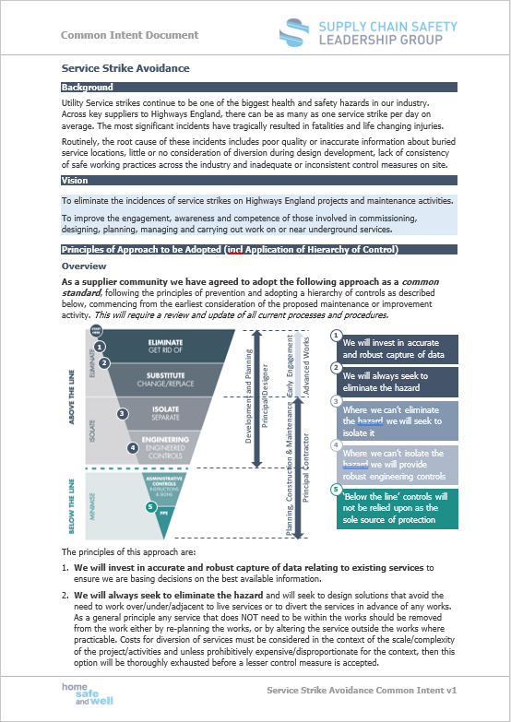
Update since last meeting
1 No. common intent document published by the SCSLG
Road Works
1 No. raising the bar document revised by the Hub
RTB 3 – Plant Person Interface
These can all be found on dedicated focus area pages on the Highways Safety Hub website

Slide 3
Work to conclude in 2020 / 2021
Task and Finish Group from 2020
Supervision Common Intent and revision to RTB 29
Completion of RTB
RTB 26 – Safety by Design
RTB 1 – Plant Standards
RTB 37 – Use of IPVs

Slide 4
What is the Plan for 2021 / 2022?
Task and Finish Groups 2021
Ground Investigations Common Intent and new RTB
Archaeology Common Intent and new RTB
Live Lane Working and Carriageway Crossing Common Intent and new RTB
Excavations Common Intent and update to RTB 13
Commercial Vehicle Roadworthiness Common Intent and new RTB
Health Common Intent and update to RTBs 8, 12, 18, 19, 22, 24, 33 and potentially a new RTB on Health by Design
Considering
Suicide Prevention Common Intent and new RTB

Slide 5
New Case Study Issued
Share Best Practice
Learnings
Create a library

Slide 6
Capturing Learning Toolkit
Case Studies
Lessons Learnt
Blue Stars
Whole Life Design

Slide 7
Questions

