Slide 1
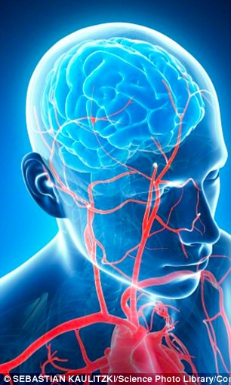
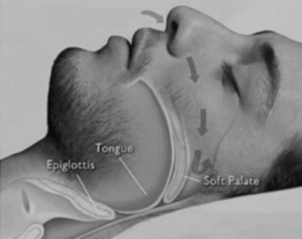
OBSTRUCTIVE
SLEEP APNOEA [OSA]
Notes:
Daytime drowsiness can be a normal physiological phenomenon, particularly after a heavy lunch. However, obstructive sleep apnoea is increasingly being recognised as a cause for excessive daytime sleepiness. The specific significance is the neural pathways or cortical networks in the brain and cardiovascular processes.
Reliably associated with a risk of road crashes, the detection of undiagnosed sleep apnoea is important and can be improved with education, recognition by organisational managers and clinical advisors.

Slide 2
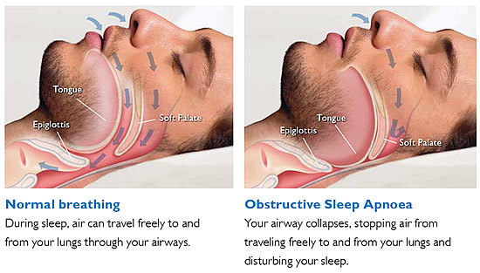
OSA – a common problem
Notes:
OSA is a relatively common condition where the walls of the throat relax and narrow during sleep, interrupting normal breathing.
Sleep disruption is frequent with low level of oxygen in the blood and too high a concentration of carbon dioxide. This causes headaches on waking, poor concentration, and subsequent work impairment, e.g. drowsiness at the wheel
During an episode, the lack of oxygen triggers the brain to pull the person out of deep sleep – either to a lighter sleep or to wakefulness – so the airway reopens and normal breathing returns.

Slide 3
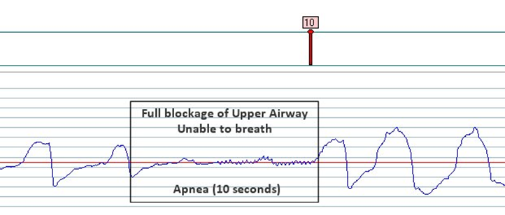
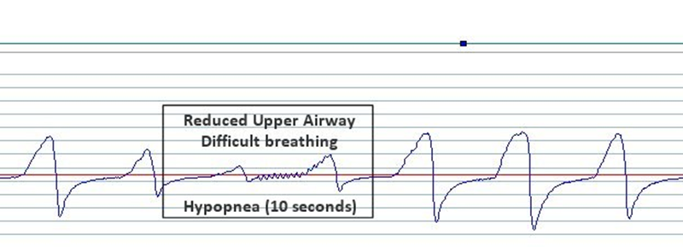
Two types of breathing interruption characteristic of OSA:
APNOEA – where the muscles and soft tissues in the throat relax and collapse sufficiently to cause a total blockage of the airway
HYPOPNOEA – a partial blockage of the airway that results in an airflow reduction of greater than 50% for 10 seconds or more
Notes:
There are two types of breathing interruption characteristic of OSA:
APNOEA – where the muscles and soft tissues in the throat relax and collapse sufficiently to cause a total blockage of the airway; it's called an apnoea when the airflow is blocked for 10 seconds or more
HYPOPNOEA – a partial blockage of the airway that results in an airflow reduction of greater than 50% for 10 seconds or more
People with OSA may experience repeated episodes of apnoea and hypopnoea throughout the night. The top graph is spelt the American way.
These events may occur around once every one or two minutes in severe cases.

Slide 4
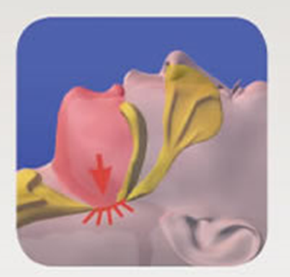

APNOEA VS SNORING
During apnoea airflow is completely blocked
During snoring airflow is partially blocked
Notes:
Not to be confused with snoring
As many as one in four people in England snore regularly.

Slide 5
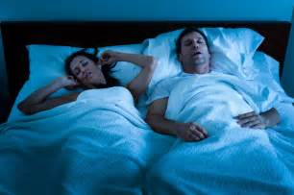
Signs of OSA in someone sleeping can include:
Loud snoring
Noisy and laboured breathing
Repeated short periods where breathing is interrupted by gasping or snorting
Notes:
The symptoms of OSA are often first spotted by a partner, friend or family member who notices problems during sleep.
Some people with OSA may also experience night sweats and may wake up frequently during the night to pass water.
Many of our workers live away from family members for long periods staying in caravans or B&Bs so they might not be fully aware of a problem

Slide 6
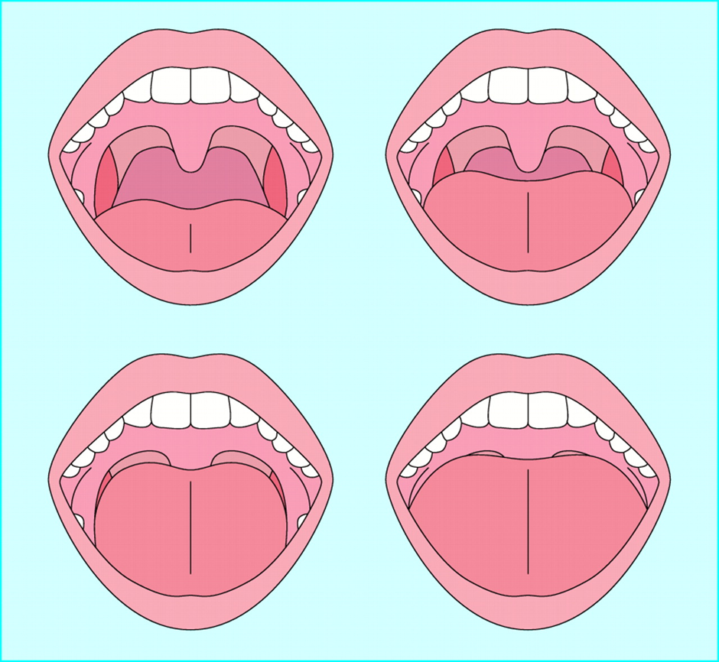
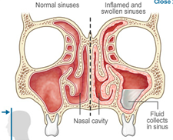
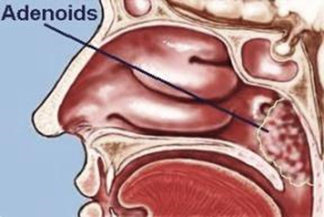
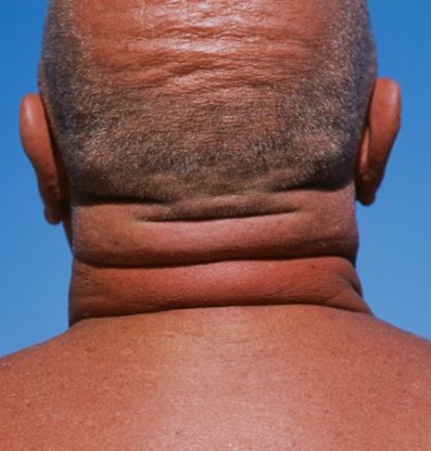

CAUSES
Notes:
CAUSES [11 examples are listed below]
Being overweight – excessive body fat increases the bulk of soft tissue in the neck, which can place a strain on the throat muscles; excess stomach fat can also lead to breathing difficulties, which can make OSA worse
Being male – it's not known why OSA is more common in men than in women, but it may be related to different patterns of body fat distribution
Being 40 years of age or more – although OSA can occur at any age, it's more common in people who are over 40
Having a large neck – men with a collar size greater than around 43cm (17 inches) have an increased risk of developing OSA.
Some of our workers are keen body builders so are at increased risk of larger neck
5. Taking medicines with a sedative effect – such as sleeping tablets or tranquillisers
6. Having an unusual inner neck structure – such as a narrow airway, large tonsils, adenoids or tongue, or a small lower jaw
7. Alcohol – drinking alcohol, particularly before going to sleep, can make snoring and sleep apnoea worse. Whilst many workers abstain from alcohol due to job requirements, some workers increase their alcohol intake because living away from home can increase unhealthy choices
8. Smoking – you're more likely to develop sleep apnoea if you smoke
9. The menopause (in women) – the changes in hormone levels during the menopause may cause the throat muscles to relax more than usual
10. Having a family history of OSA – there may be genes inherited from your parents that can make you more susceptible to OSA
11. Nasal congestion – OSA occurs more often in people with nasal congestion, such as a deviated septum, where the tissue in the nose that divides the two nostrils is bent to one side, or nasal polyps, which may be a result of the airways being narrowed

Slide 7
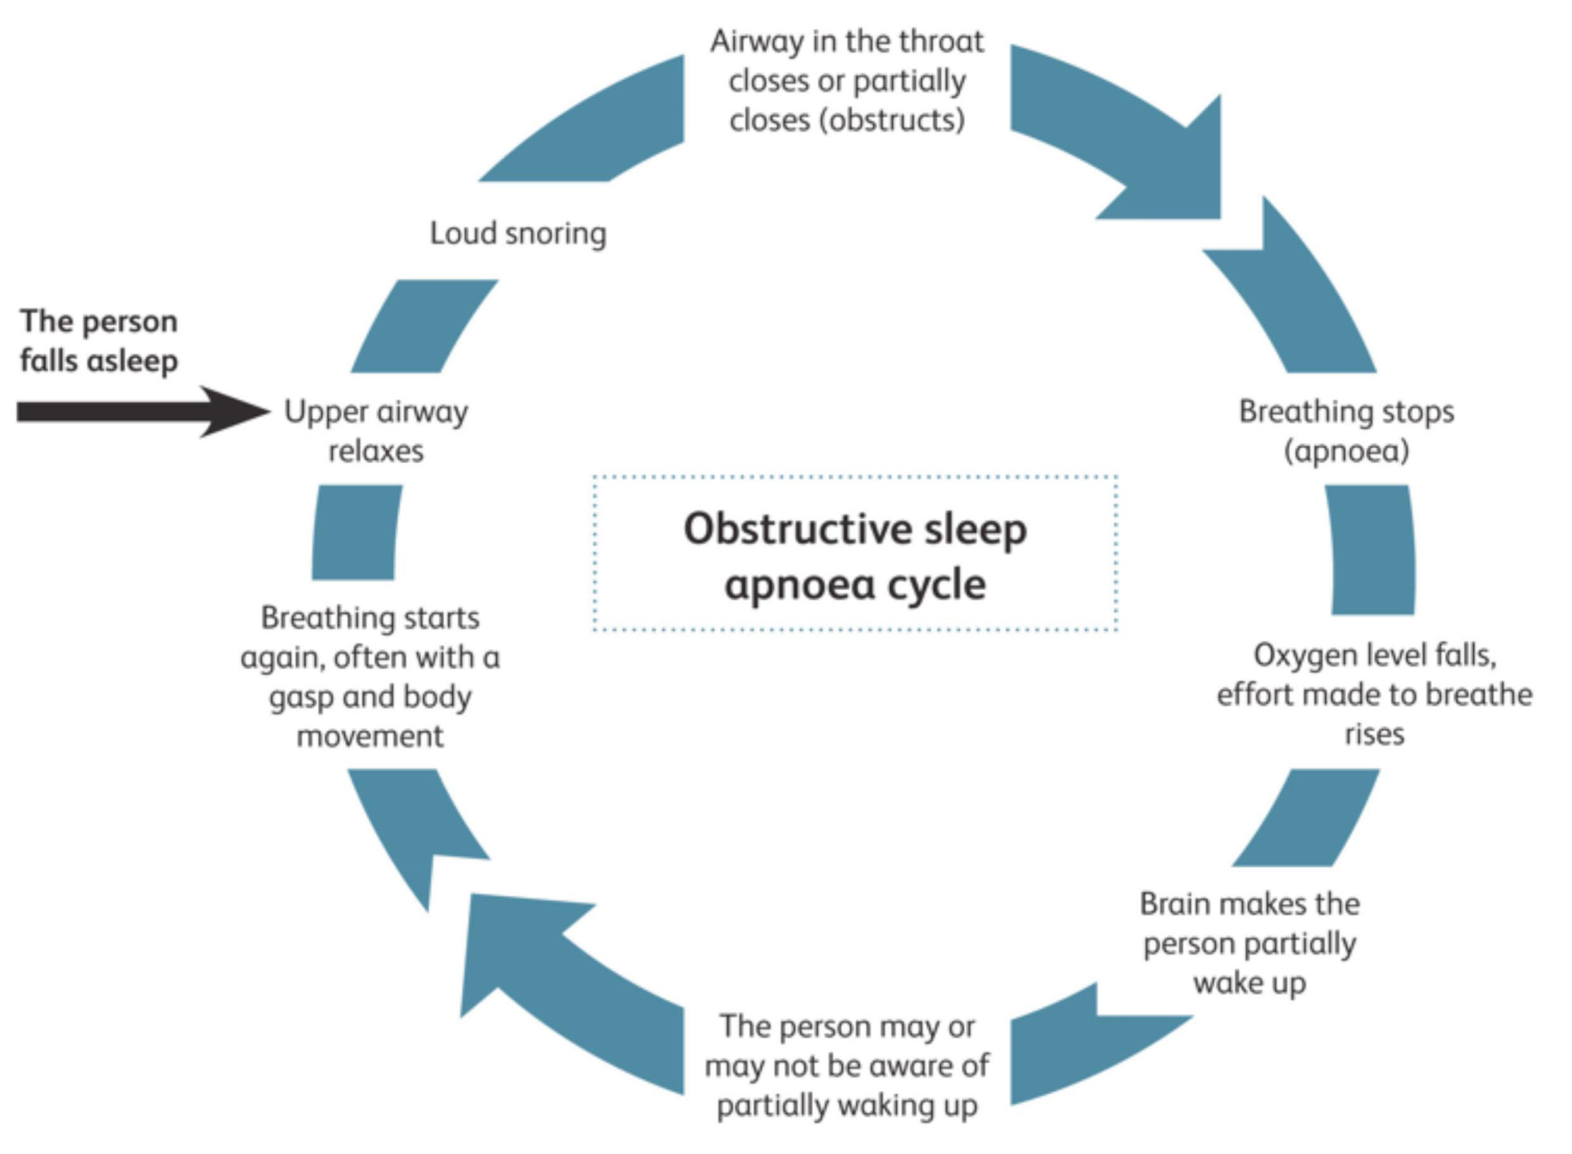
Tiredness
Notes:
These repeated sleep interruptions can cause tiredness during the day. Often the sufferer has no memory of interrupted breathing, so may be unaware they have a problem, therefore someone with OSA may not notice they have the condition, so it often goes undiagnosed.

Slide 8
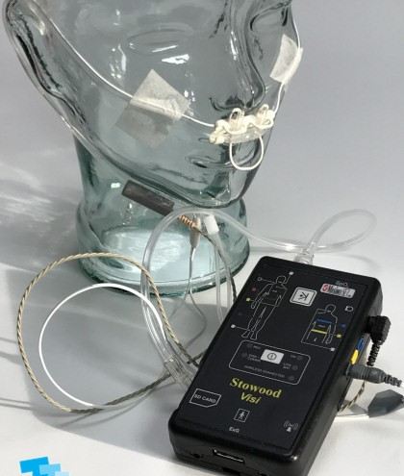
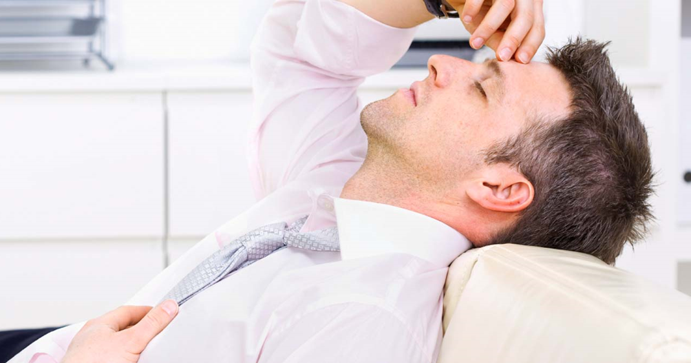
Diagnosis
Notes:
Diagnosis can be difficult: because patients frequently contend that night-time sleep is normal, the problem, in their view it’s the daytime that is the problem, unless their partner complains of loud snoring.
Home recording is a useful means of diagnosing OSA.
TESTING AT HOME
The sleep centre will teach you how to use portable recording equipment while you sleep at home.
The equipment you are given may include:
a breathing sensor
sensors to monitor your heart rate
bands that are placed around your chest
oxygen sensors that are put on your finger
The equipment records oxygen levels, breathing movements, heart rate and snoring through the night.

Slide 9
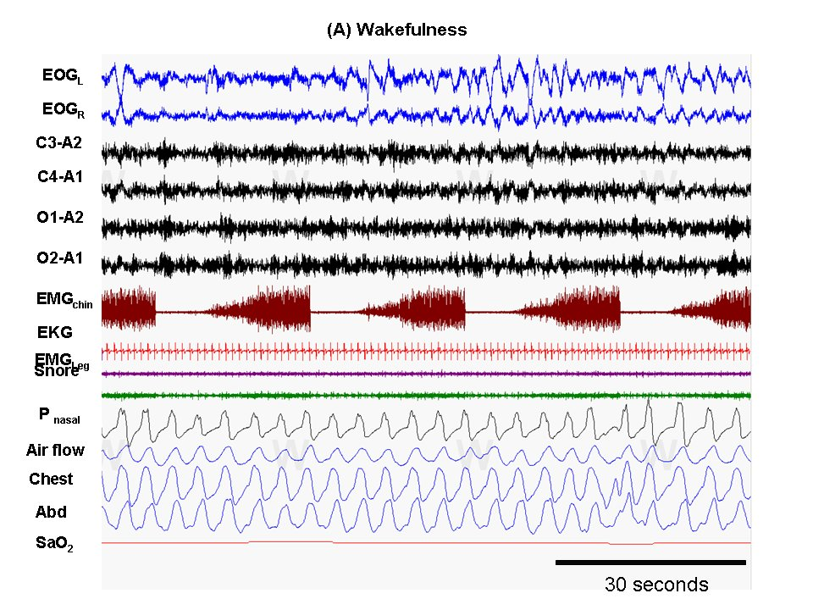
Polysomnography
Notes:
Testing at a sleep centre
The main test carried out to analyse your sleep at a sleep centre is known as polysomnography.
During the night, several different parts of your body will be carefully monitored while you sleep.
✓Bands and small metallic discs called electrodes are placed on the surface of your skin and different parts of your body.
✓Sensors are also placed on your legs and an oxygen sensor will be attached to your finger.
A number of different tests will be carried out during polysomnography, including:
electroencephalography (EEG) – this monitors brain waves
electromyography (EMG) – this monitors muscle tone
recordings of movements in your chest and abdomen
recordings of airflow through your mouth and nose
pulse oximetry – this measures your heart rate and blood oxygen levels
electrocardiography (ECG) – this monitors your heart
Sound recording and video equipment may also be used.
Once a diagnosis of OSA has been made, you may be advised to stop driving until your symptoms are well controlled

Slide 10
Shift Work
Notes:
Sufferers struggle with rotating shift work;

Slide 11
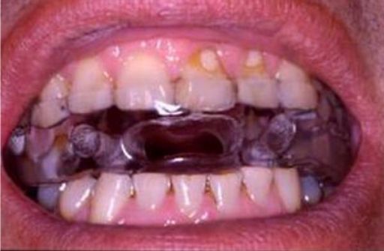
OSA is a treatable condition, and there are a variety of treatment options that can reduce the symptoms:
■ Lifestyle changes
■ Wearing a mandibular advancement device (MAD)
TREATMENT
Notes:
Lifestyle changes – e.g. losing excess weight, cutting down on alcohol and sleeping on your side, stop smoking
A mandibular advancement device (MAD) is a dental appliance, similar to a gum shield, sometimes used to treat mild OSA

Slide 12
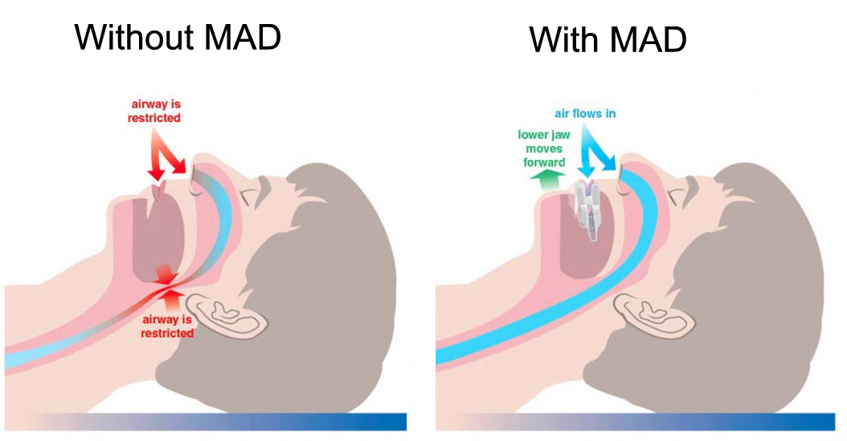
Ask your dentist
Notes:
An MAD is worn over your teeth when you're asleep. It's designed to hold your jaw and tongue forward to increase the space at the back of your throat and reduce the narrowing of your airway that causes snoring.
Off-the-shelf MADs are available from specialist websites, but most experts don't recommend them, as poor-fitting MADs can make symptoms worse.
It's recommended you have an MAD made for you by a dentist with training and experience in treating sleep apnoea.

Slide 13
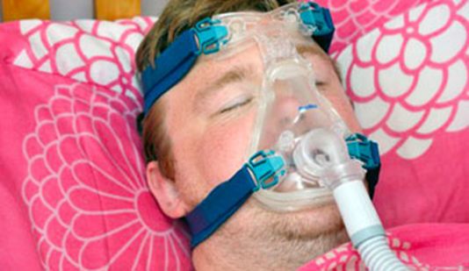
Severe Cases
Notes:
The severity of OSA is determined by how often your breathing is affected over the course of an hour. These episodes are measured using the apnoea-hypopnoea index (AHI).
Severity is measured using the following criteria:
mild – an AHI reading of 5 to 14 episodes an hour
moderate – an AHI reading of 15 to 30 episodes an hour
severe – an AHI reading of more than 30 episodes an hour
CPAP has good results. Continuous positive airway pressure (CPAP) devices prevent your airway closing while you sleep by delivering a continuous supply of compressed air through a mask By controlling the apnoea, it improves sleep quality. You're more likely to wake up feeling refreshed, and stay alert throughout the day.
CPAP also suppresses the snoring, meaning that your partner can sleep better too.

Slide 14
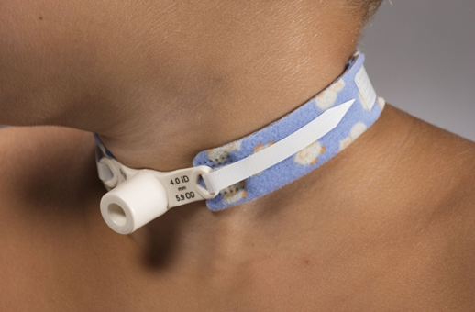
Surgery
Notes:
Surgery is usually only considered as a last resort when all other treatment options have failed, and also if the condition is severely affecting your quality of life.
A range of surgical treatments have been used to treat OSA. These include:
tonsillectomy – where the tonsils are removed if they're enlarged and blocking your airway when you sleep
adenoidectomy – where the adenoids, small lumps of tissue at the back of the throat above the tonsils, are removed if they're enlarged and are blocking the airway during sleep
tracheostomy – where a tube is inserted directly into your neck [as shown] to allow you to breathe freely, even if the airways in your upper throat are blocked
weight loss (bariatric) surgery – where the size of the stomach is reduced if you're severely obese and this is making your sleep apnoea worse
Surgery to remove excess tissue in the throat to widen your airway (uvulopalatopharyngoplasty) used to be a common surgical treatment for OSA, but it's performed less often nowadays.
This is because more effective treatments are available, such as CPAP.

Slide 15
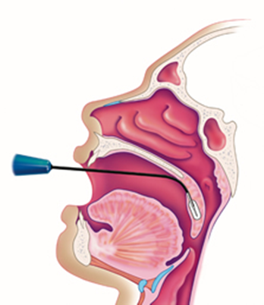
Soft palette implants
Notes:
Soft palate implants make the soft palate, part of the roof of the mouth, stiffer and less likely to vibrate and cause an obstruction. The implants are inserted into the soft palate under local anaesthetic.
The National Institute for Health and Care Excellence (NICE) has said soft palate implants are safe, but they're not currently recommended for treating OSA as there's a lack of evidence about their effectiveness. However, this form of treatment is recommended for treating snoring associated with OSA in exceptional cases.

Slide 16
Screening Tools
Epworth Sleepiness Scale
Notes:
The Epworth Sleepiness Scale is widely used in the field of sleep medicine as a subjective measure of a patient's sleepiness. The test is a list of eight situations in which you rate your tendency to become sleepy on a scale of 0, no chance of dozing, to 3, high chance of dozing. When you finish the test, add up the values of your responses. Your total score is based on a scale of 0 to 24. The scale estimates whether you are experiencing excessive sleepiness that possibly requires medical attention.
Why not try it now?..

Slide 17
Write down the number corresponding to your choice in the right-hand column.
Total your score below.
Sitting and reading
Watching TV
Sitting inactive in a public place (e.g., a theatre or a meeting)
As a passenger in a car for an hour without a break
Lying down to rest in the afternoon when circumstances permit
Sitting and talking to someone
Sitting quietly after a lunch without alcohol
In a car, while stopped for a few minutes
No chance of dozing | 0
Slight chance of dozing | 1
Moderate chance of dozing | 2
High chance of dozing | 3
Notes:
How Sleepy Are You? Score the result according to the numbers on the left
How likely are you to doze off or fall asleep in the following situations? You should rate your chances of dozing off, not just feeling tired. Even if you have not done some of these things recently try to determine how they would have affected you

Slide 18
Analyse Your Score
Interpretation:
0-7 | It is unlikely that you are abnormally sleepy.
8-9 | You have an average amount of daytime sleepiness.
10-15 | You may be excessively sleepy depending on the situation. You may want to consider seeking medical attention.
16-24 | You are excessively sleepy and should consider seeking medical attention.
Notes:
If you or someone you know has OSA, it's important to visit the GP in case referral to a sleep specialist needed for further tests and treatment.
Before seeing a GP it may be helpful to ask a partner, friend or relative to observe you while you're asleep, if possible. If you have OSA, they may be able to spot episodes of breathlessness.

Slide 19
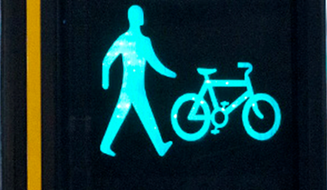
NICE: prevention of obesity in the workplace
Workplaces should provide opportunity for a healthy diet and physical activity
Notes:
We know this already and encourage healthy eating: e.g. healthy choices in welfare, vending machines,
Active travel policies – salary sacrifice cycle scheme
Supportive physical environment – stairwells, showers, secure cycle parking
Recreation – out of hours social activities, lunchtime walks, use of local leisure facilities
2006 CG43 Obesity: guidance on the prevention, identification, assessment and management of overweight and obesity. London: NICE GUIDANCE

Slide 20
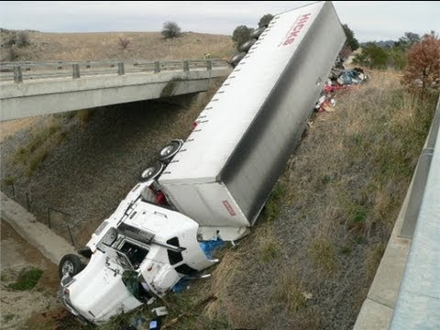
ACCIDENTS
Notes:
Research has shown someone who has been deprived of sleep because of OSA may be up to 12 times more likely to be involved in a car accident.
2004 STUDY: The Department for Transport brought together a group to explore the potential significance of sleep disorders in accidents. Further, drivers with sleep disorders may be less able to cope with the sleep disturbance likely to be inherent in a lifestyle involving shift work.
Excessive daytime sleepiness and driving: regulations for road safety. Clin Med [London, England], 2004; 4 [5]: 454-6.
It is not entirely clear what aspects of sleep disturbance in OSA lead to poorer driving ability; is it just sleepiness and briefly ‘nodding off’ at the wheel, or is there also general impairment of driving skills such as eye-hand coordination (similar to the effects of alcohol), or a mixture of both?

Slide 21

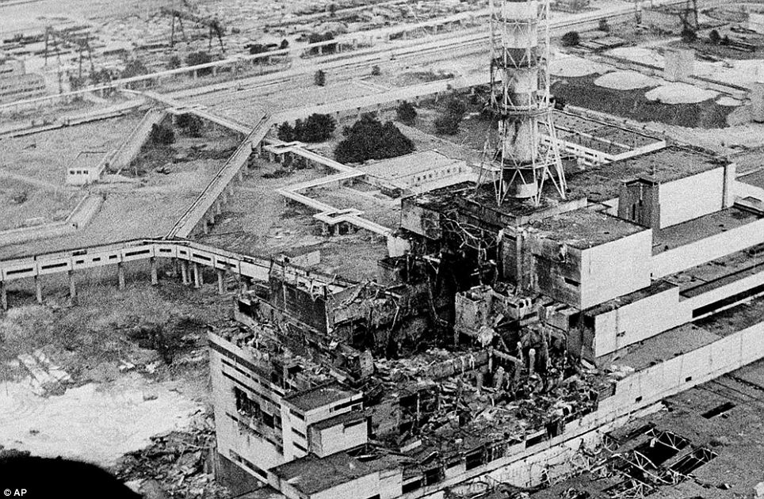
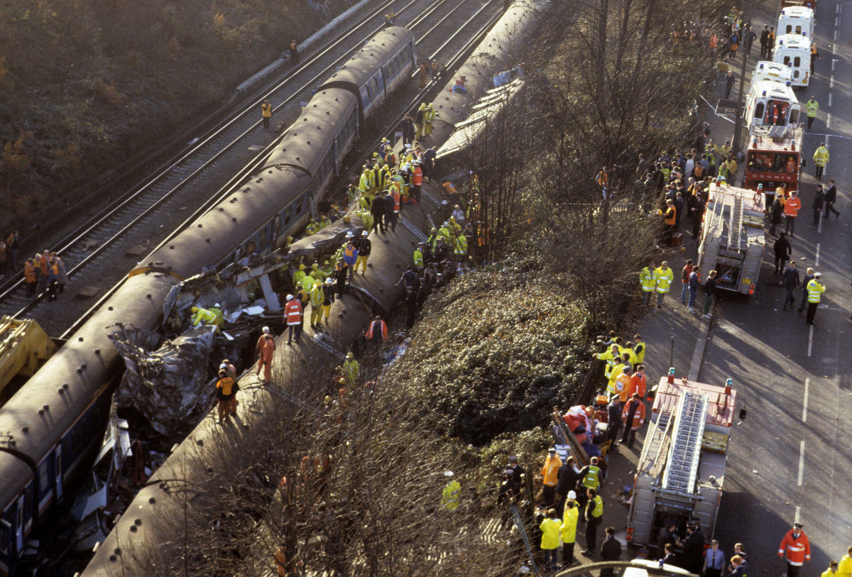
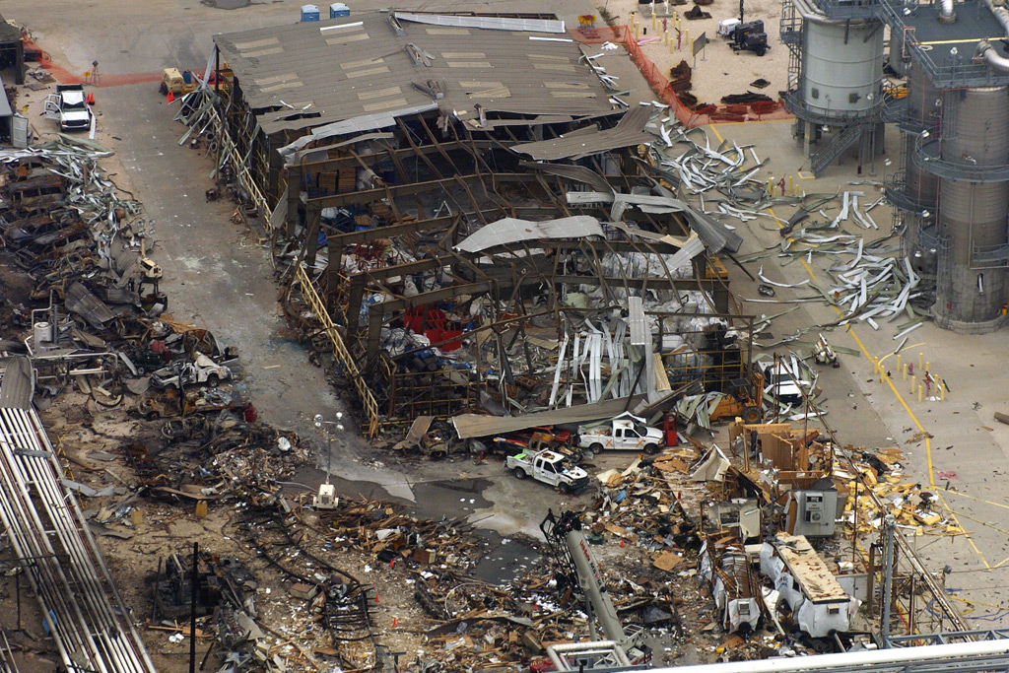
SAFETY CRITICAL
2
1
4
3
Notes:
We known that accidents are not isolated to driving. Fatigue can lead to errors and accidents, ill-health and injury, and reduced productivity. It is often a root cause of major accidents e.g.: 1. Herald of Free Enterprise, 2. Chernobyl, 3. Texas City refinery explosion, 4. Clapham Junction rail crash , also [not shown] NASA's space shuttle Challenger accident was a devastating tragedy that killed seven astronauts and shocked the world on Jan. 28, 1986.
On March 24, 1989, the tanker Exxon Valdez grounded on Bligh Reef in Alaska's Prince William Sound, rupturing its hull and spilling nearly 11 million gallons of Prudhoe Bay crude oil into a remote, scenic, and biologically productive body of water.
Fatigue has also been implicated in 20% of accidents on major roads and is said to cost the UK £115 - £240 million per year in terms of work accidents alone

Slide 22

As little as a 10kg weight loss can have a significant benefit
✓ Blood pressure
✓ Serum lipids
✓ Glucose control
✓ Mortality
Notes:
Two systematic NICE* reviews examined the use of workplace health promotion programmes and found evidence to support this as an effective intervention for the overweight worker. That’s as little as 1.5 stone. Factors that appeared to be beneficial included ►dieting ►supervision of exercise ►and personal counselling
*NICE = National Institute of Clinical Excellence, studies that are evidence based

Slide 23
RISK ASSESSMENT
e.g.
► Working at height
► Heat stress
► Shift work
► Driving duties
► Safety critical duties
Notes:
There maybe work place duties why a risk assessment is required.

Slide 24
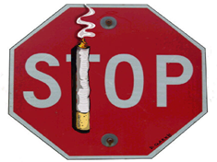
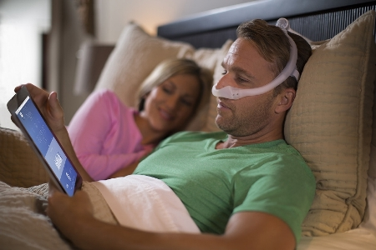
Self Management
Notes:
Compliance with therapy and self management are important aspects of risk reduction.
Sometimes job adaptations maybe required if a temporary or permanent limitation occurs, e.g. driving
Poorly controlled OSA may also increase your risk of:
•developing high blood pressure (hypertension)
•having a stroke or heart attack
•developing an irregular heartbeat – such as atrial fibrillation
•developing type 2 diabetes – although it's unclear if this is the result of an underlying cause, such as obesity

Slide 25
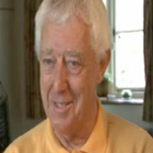
CASE STUDY
I fell asleep while driving'
Terry Gasking was diagnosed with obstructive sleep apnoea after a couple of terrifying incidents where he fell asleep at the wheel.
'"I was driving along the A418 when I suddenly woke up and found myself going down the wrong side of the road.
"The second time was particularly frightening. I was driving past a village school.
Notes:
"I must have fallen asleep at the wheel, even though I didn't feel particularly tired. Thankfully, nothing was coming the other way or I wouldn't be here today.
"The second time was particularly frightening. I was driving past a village school and remember being fully alert, watching the children to make sure they didn't step into the road. "The next moment, I was gone – I'd fallen asleep, completely unaware. I woke up 50 yards away, about four feet from a brick wall. I could have killed a child.
"The worst thing about snoring and sleep apnoea is that you have no idea that it's happening to you. You think you're sleeping for hours, but you're not – you're only sleeping for very short spells.
"In my case, I was diagnosed as a moderate sufferer. I stopped breathing 28 times an hour. This means my average sleep period was just two minutes.
"When you think sleep deprivation is a form of torture, you realise that people with sleep apnoea go through torture every night because they're not getting enough sleep.
"I tried every simple 'remedy' I could lay my hands on – nose clips, things to put up your nose. Nothing worked. Then I tried CPAP [continuous positive airway pressure].
"The sleep deprivation that I'd suffered for 30 years went overnight. Suddenly, I was given the energy I had 20 years ago."

Slide 26
CASE STUDY
A 2006 study simulated study found ‘The average reaction times for OSAS patients were 0.5 s slower than those of the control subjects. This means that these patients needed 0.5 s longer than control subjects to analyse the situation and to start braking.
This was the first study evaluating the consequences of OSAS and the impact of its treatment on driving performance using the more natural driving environment of a road safety platform.
Notes:
Driving ability in sleep apnoea patients before and after CPAP treatment: evaluation on a road safety platform. Eur Respir J 2006; 28: 1020-8

