Slide 1
Slips, Trips & Falls
October 2023

Slide 2
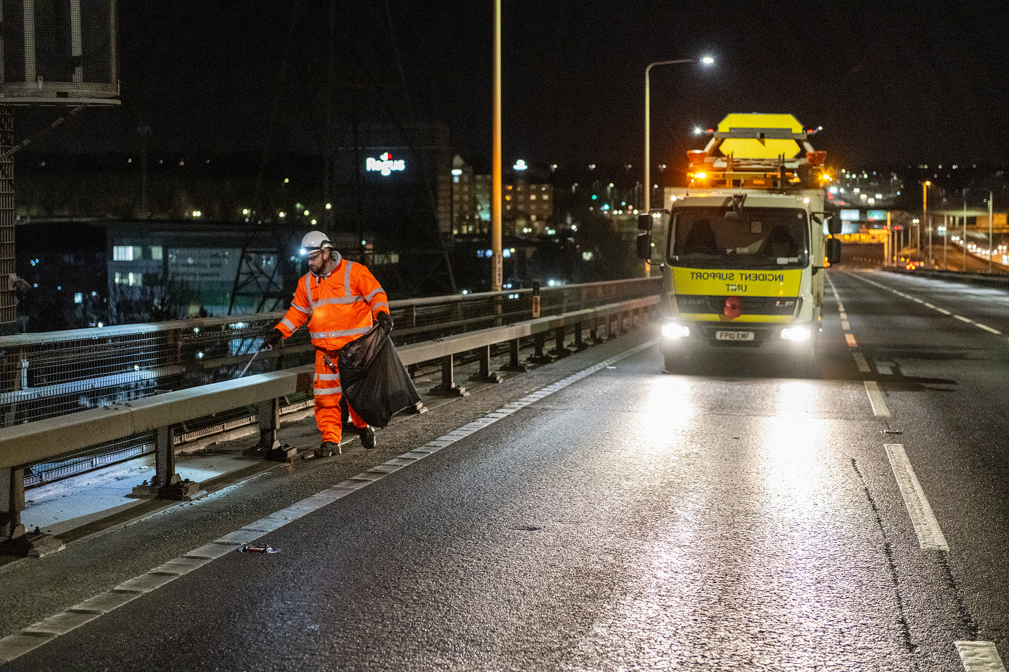
Agenda
What is a Slip, Trip, Fall type incident?
Examples
Headline Statistics
Improving the working environment by bringing these figures down
Our ask of you

Slide 3
What is a Slip, Trip, Fall type incident?

Slide 4
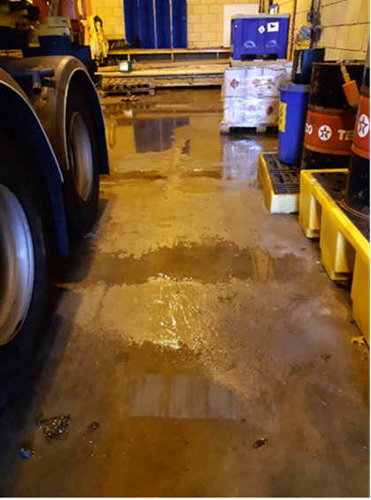
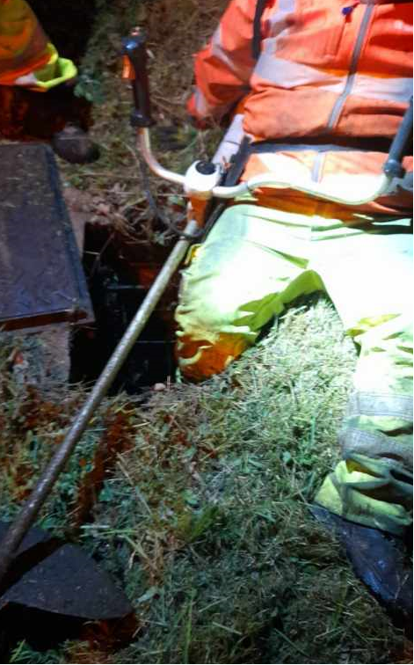
Slips
Slips and trips are the most common cause of injury at work.
A slip or a trip is likely to result in a fall which can result in injury
Trips
Slips are caused by the surface/floor of working environment becoming slippery due to water, ice, mud or by other low-friction contaminants such as oil
Trips are caused by obstructions, obstacles, voids or uneven surfaces in the working environment.

Slide 5
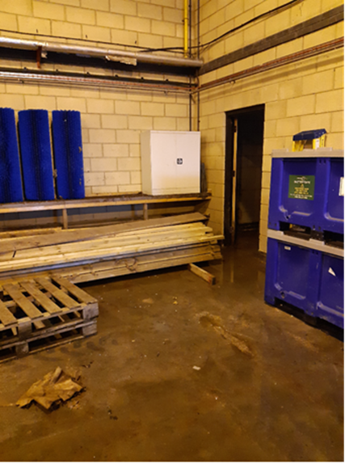
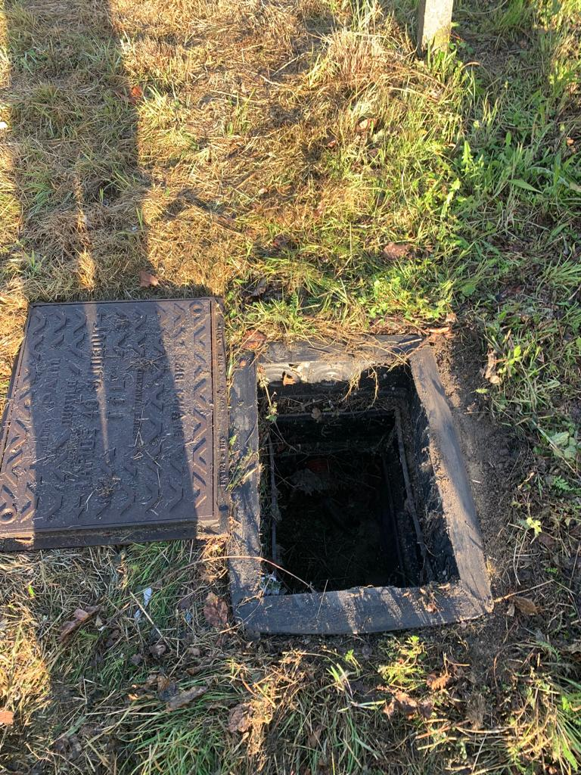
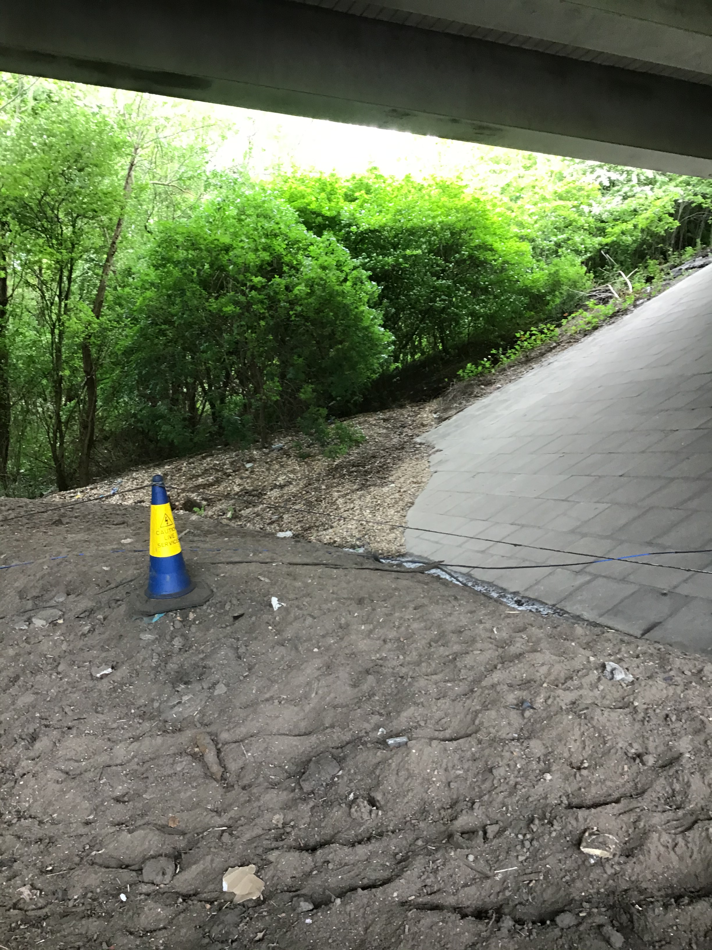
Examples – Slip & Trip hazards
Wet floor and poor housekeeping with obstacles in walkway
Voids – chamber cover not on frame
Uneven surfaces
Notes:
Each of these hazards present a risk of injury to our people. Each of the real-life example slips/trip hazards shown here caused falls which resulted in a lost time or a RIDDOR injury.

Slide 6
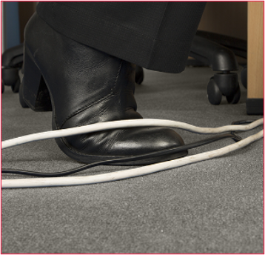
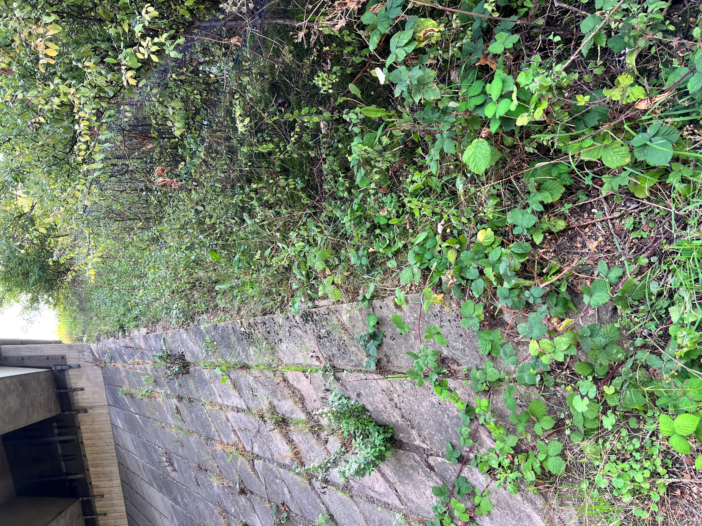
Examples – Slip & Trip hazards
Uneven ground (steep slope), obstacles/ obstruction with undergrowth
Office workplace obstructions
Notes:
Each of these hazards present a risk of injury to our people. Each of the real-life example slips/trip hazards shown here caused falls which resulted in a lost time or a RIDDOR injury.

Slide 7
Headline Statistics
Across National Highways and the Supply Chain, in the 12 months to 30th Sept 23, there have been:
10 RIDDOR injuries (>7day) – of which 5 resulted in broken bones (Major Injuries)
11 Lost Time Injuries (LTI) of < 7days
6 undesired circumstances
24 Non Lost Time Injuries
This represents 42% of all RIDDOR injuries and 24% of all LTIs across our network

Slide 8
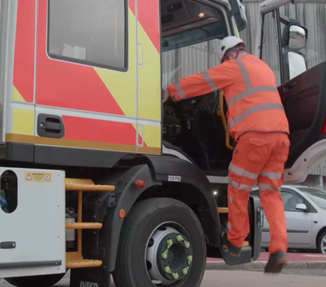
Slips, trips and falls – Vehicles

Slide 9
Slips, Trips & Falls – Vehicle related Statistics
More than 2,000 serious injuries to people falling from vehicles are reported to the HSE each year.
Falls from stationary vehicles are one of the most common accidents in the workplace.
Over 800 incidents involve major injuries, and of those over half result in broken bones.
More than 75% of falls involve loading/unloading vehicles and climbing/descending vehicle steps.
On average 5 people die each year as a result of a fall from a vehicle.
Profitability is also affected, with over 80,000 days a year across all industries being lost to falls from vehicles.

Slide 10
Slips, Trips & Falls - Top Tips - Driver/Passengers
Notes:
DON’T jump from the vehicle – it’s bad for your knees and ankles, and you are more likely to injure yourself.
Always use the steps and handholds provided.
Keep 3 points of contact with the vehicle.
Report any damaged/worn steps or handholds.
Always carry out a pre-start check on your vehicle.
Keep the vehicle tidy- remove any slip & trip hazards.
Where possible use vehicle washing facilities. Diesel, grease or mud greatly increases the likelihood of slipping on steps and load areas.
Wear your safety footwear correctly.
Keep the soles of your footwear clean to reduce the risk of slipping. Remove any build up of mud or diesel contamination.
Where possible get out of a vehicle onto the footpath side.
Follow safe systems of work for loading and unloading vehicles.

Slide 11
Improving the working environment

Slide 12
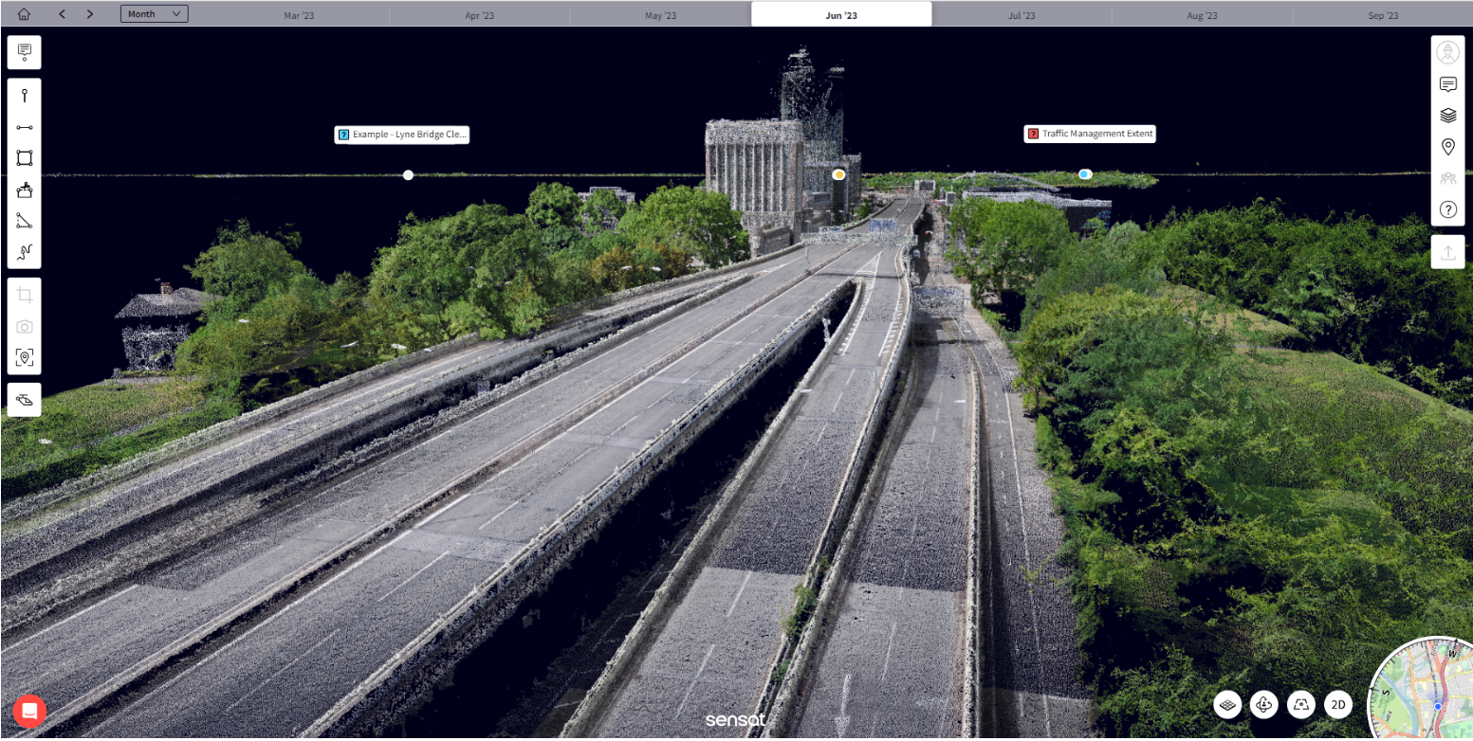
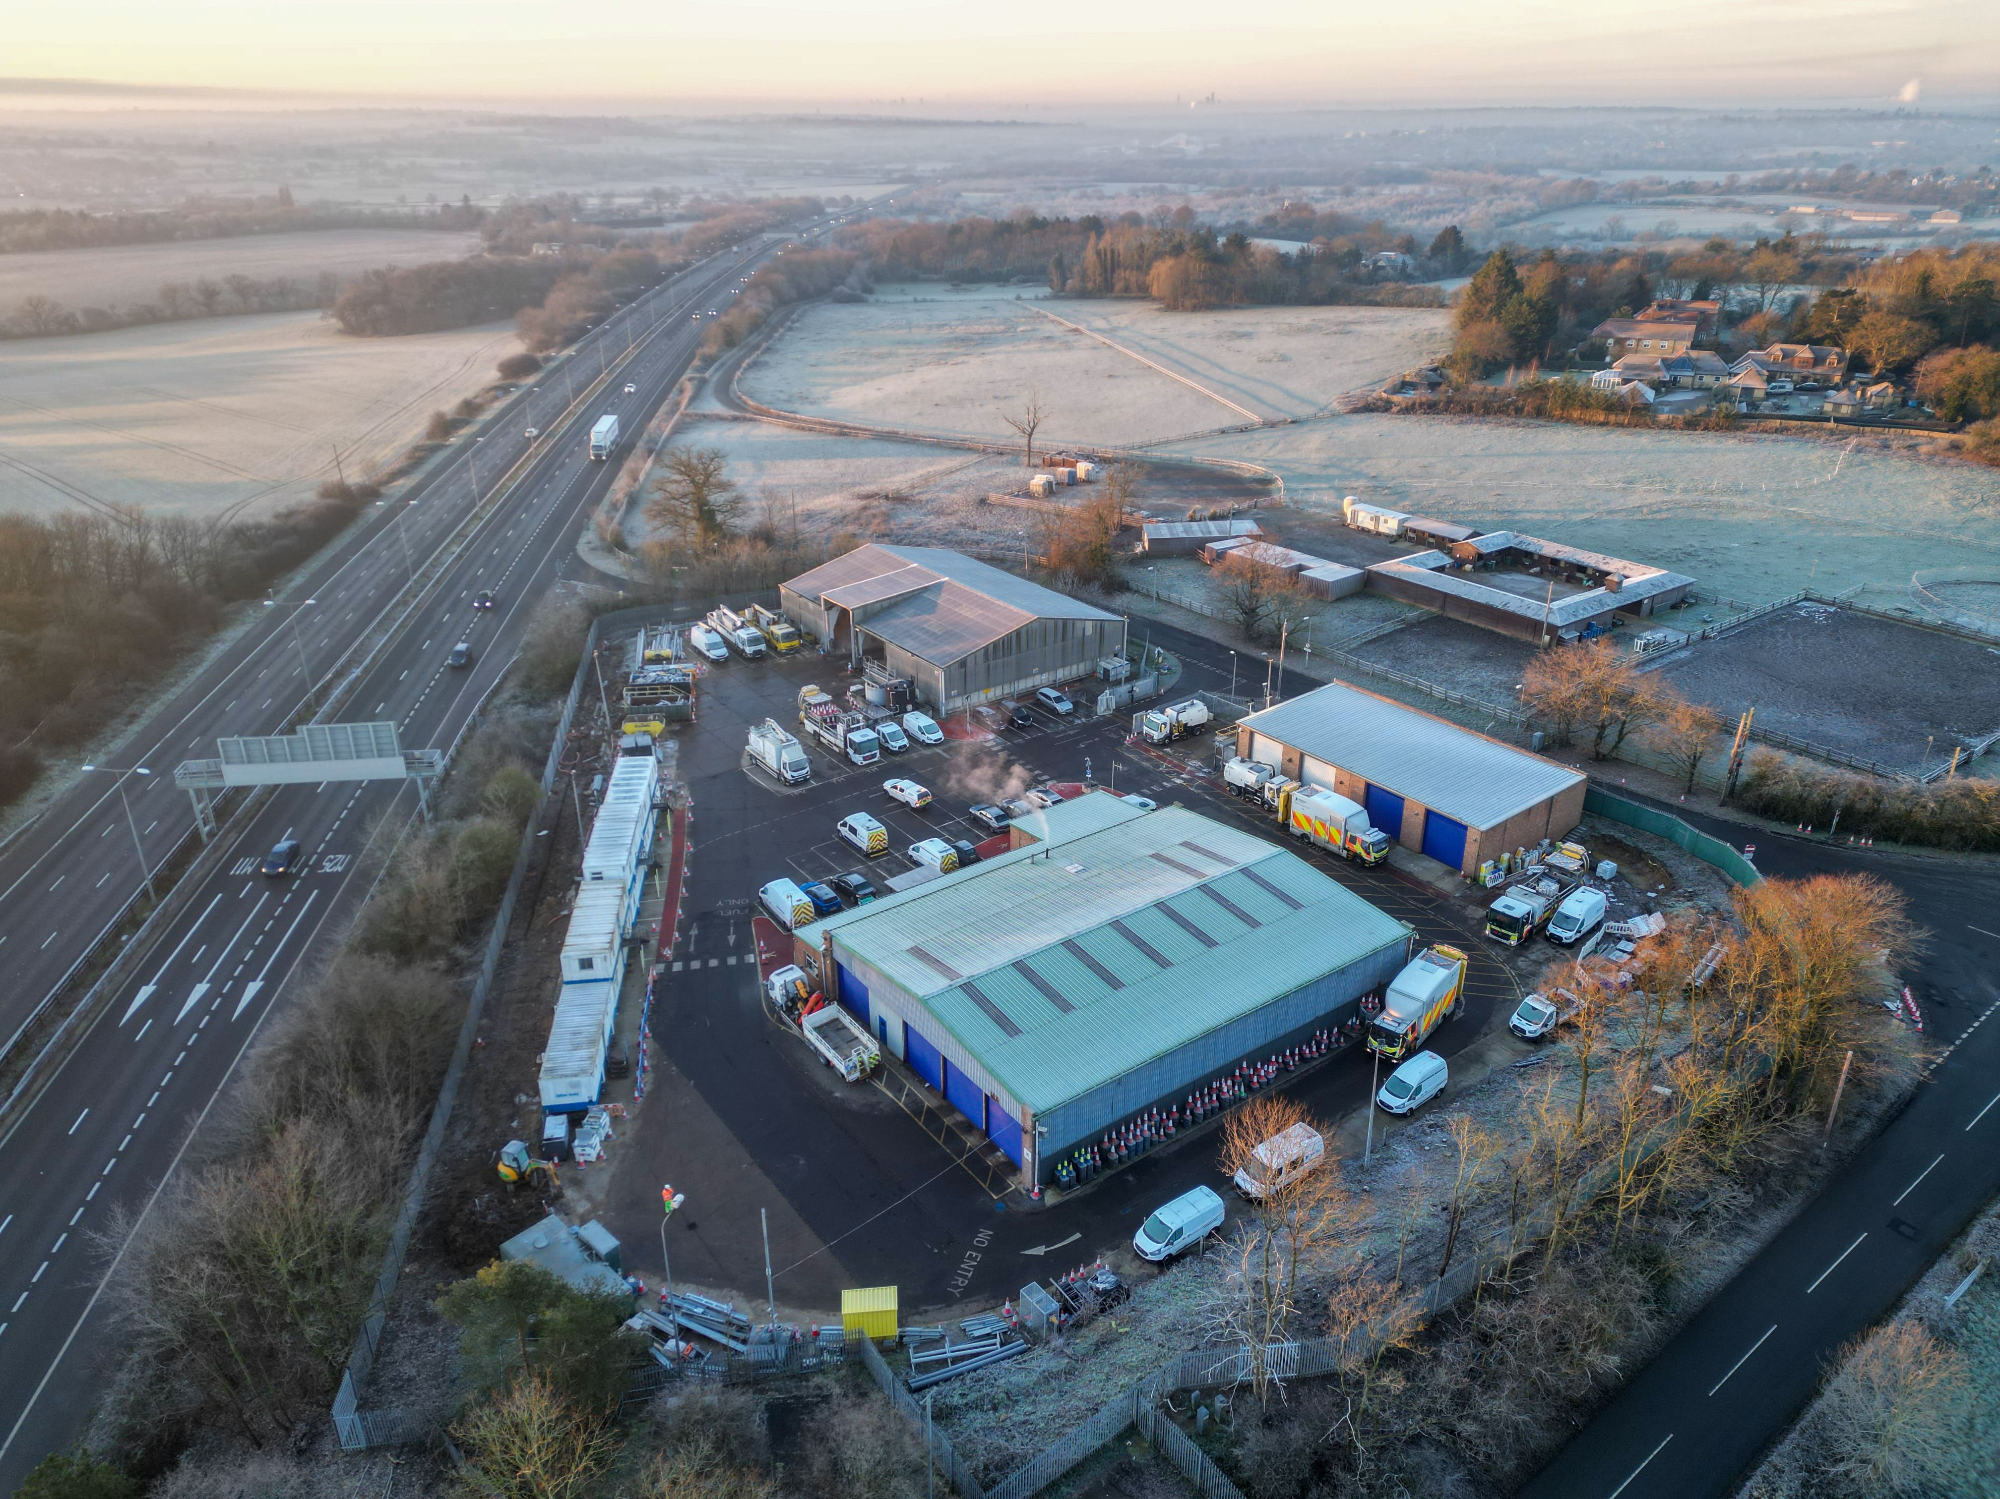
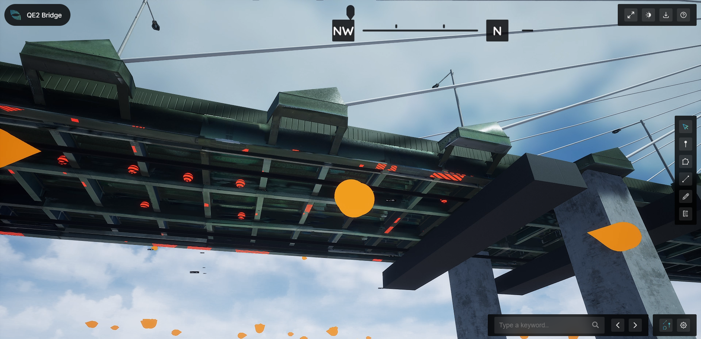
Planning for Safety using the ERIC Principles
ERIC: Eliminate, Reduce, Isolate, Control
Eliminate
Works planning should include an assessment of how the risk of slips, trips and falls can be eliminated. This can also include an approach of ‘designing out’ the risk up front.
Example of a network digital model
Reduce
If it is not possible to eliminate the risk, works planning should include an assessment of how the risk of slips, trips and falls can be reduced. This can also include an approach of ‘designing out’ the risk up front. For example:
Coordinated works planning
Use of remote controlled equipment
Example of an airlock
Dept roof inspections using drones
Asset inspections using drones
IPV Strike
Notes:
Eliminate
Works planning should include an assessment of how the risk of slips, trips and falls can be eliminated. This can also include an approach of ‘designing out’ the risk up front. For example:
- Are there other ways of undertaking the works without someone having to visit the workplace ? Examples of this can be the use of digital network models (sometimes referred to as a digital twins) to allow designers to obtain accurate works information without the need for a site visit and eliminating any need for the associated traffic management.
- Digital models can also assist in planning of works activities without the need for site visits.
Reduce
If it is not possible to eliminate the risk, works planning should include an assessment of how the risk of slips, trips and falls can be reduced. This can also include an approach of ‘designing out’ the risk up front. For example:
- Coordinated works planning to optimise the programme with the purpose of maximising the use of lane/carriageway closures to minimise the number of interventions using traffic management installations. i.e. risk reduction by exploring more efficient ways of working and incorporating more works in the same closure. Less traffic management equal less people on the network.
- Use of remote controlled equipment for undertaking works usually undertaken on foot. For example use of drone surveys for certain inspection types. Remote controlled robo-mowers for vegetation management

Slide 13
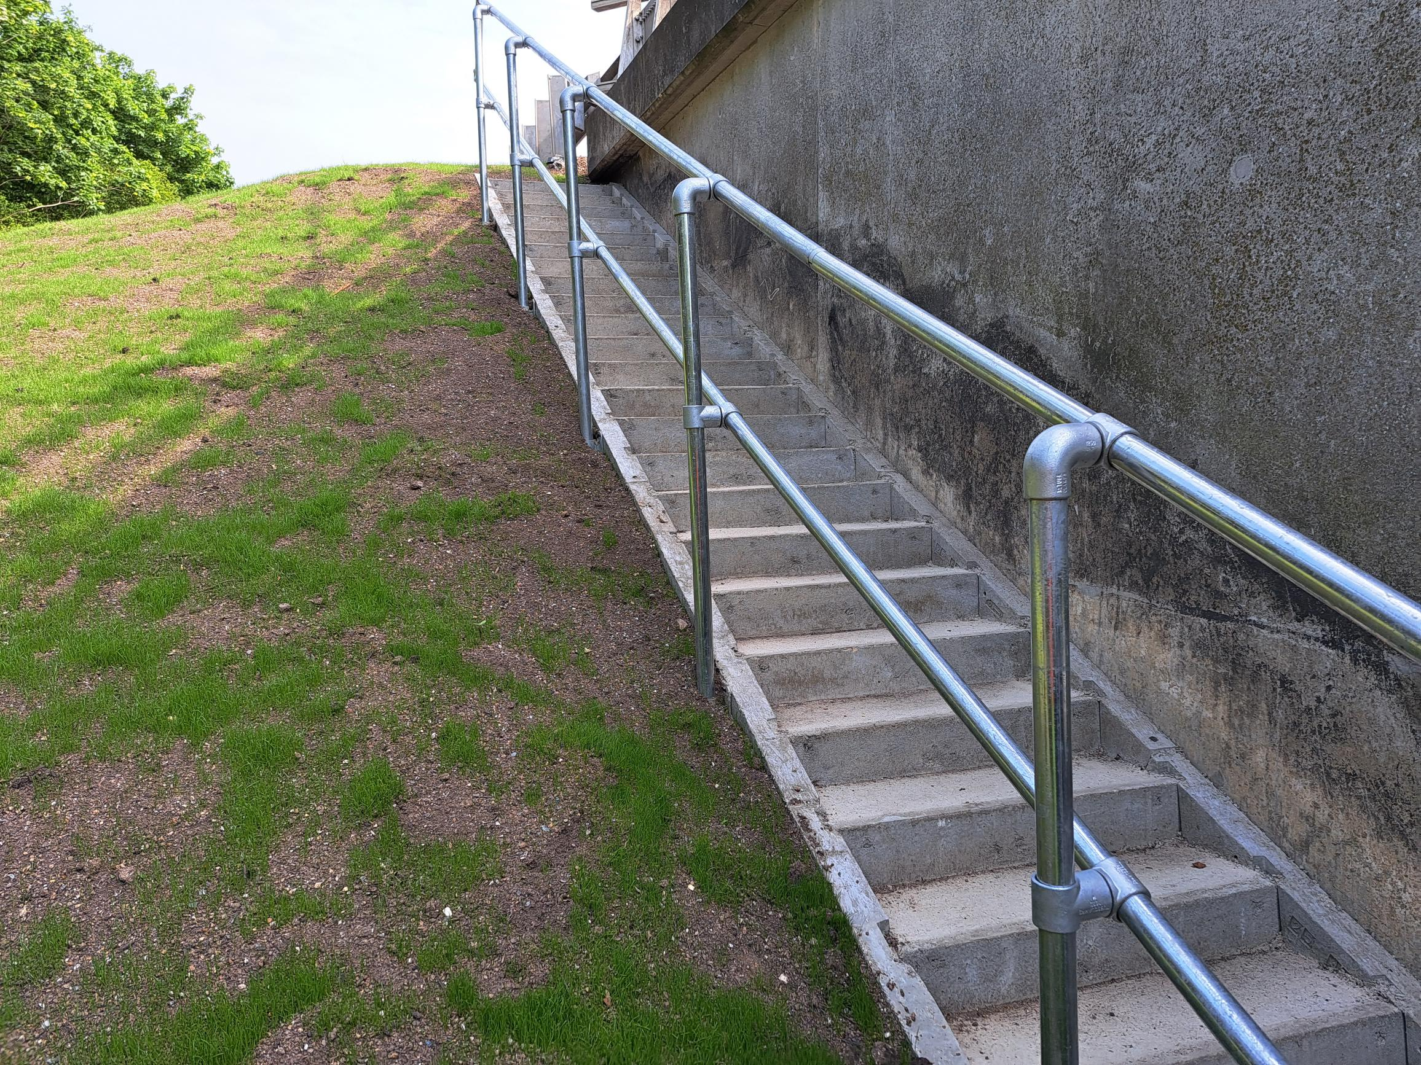
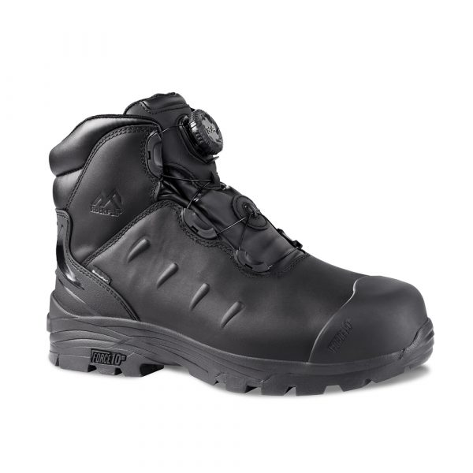
Planning for Safety using the ERIC Principles
Isolate
Another way of reducing the risk can be to isolate the hazard as much as possible. Again, an approach of ‘designing out’ the risk up front can assist in this as can intelligence and data on the locations where the risk of slips trips and falls is higher along with data showing where incidents have happened in the past.
Retro-fit access/egress steps in high risk asset locations
Example of an airlock
Control
Accepting that all efforts have been made to eliminate, reduce and isolate the risk as much as possible, workforce/employee access to the highway network and other workplaces will always be necessary. Safe systems of work, procedures, training, supervision and selection of PPE will be a feature in ‘controlling’ the risk
Footwear selection to offer maximum protection and reduce severity of injuries
IPV Strike
Notes:
Isolate
Another way of reducing the risk can be to isolate the hazard as much as possible. Again, an approach of ‘designing out’ the risk up front can assist in this as can intelligence and data on the locations where the risk of slips trips and falls is higher along with data showing where incidents have happened in the past. An example of isolating the risk is:-
- Data showing particular structures (or other highways assets) being difficult to access for detailed inspection activity and having likelihood of future programmed works being prioritised for retrofit for permanent step access.
- Undertaking an asset risk based approach for all structures/highway assets for the access requirements for inspections and maintenance and prioritising safe means of access and safe routes to access for the worst scoring population to isolate the risk by providing safer access routes.
Control
Accepting that all efforts have been made to eliminate, reduce and isolate the risk as much as possible, workforce/employee access to the highway network and other workplaces will always be necessary. Safe systems of work, procedures, training, supervision and selection of PPE will be a feature in ‘controlling’ the risk. Some examples of good practice in this area include:-
- ‘Boot Camps’ have been a feature on a number of our projects. These allow a specific focus for our workforce/employees on the condition of safety boots (tread and wear) and how boots should be correctly worn and laced in order to minimise the chance of injury should a slip/trip occur.
- Certain types of footwear can reduce the severity of injuries following a slip/trip/fall. Research on the best types of footwear and consultation with the workforce can result in the optimum protection whilst also considering comfort for the wearer.
- Point of Work Risk Assessments (POWRAs) can be a useful way for the workface/employees to mimimise the risk of an incident. Taking the time before a task commences to stop and look at the environment and assess the live risks – such as the weather conditions and the underlying surface/ground conditions, the vegetation and obstructions present etc can bring a focus on the likely things that could contribute to an incident. Examples here are where POWRAS could lead to decisions where works could be postponed in higher risk areas where the conditions are wet – and re-programme for a dry day.

Slide 14
Our ask of you
Please keep reporting best practice you have developed in areas to reduce STF type incidents!
We can only make progress in reducing the number of incidents if we have the data to share best practice across our communities.
Accurate reporting data (via HART) leads to more targeted focus to improve the safety of all of our workforce/employees.

Slide 15
Any questions?

