Slide 1
National Highways Principal Designer Working Group discussion paper September 2021

Slide 2
Objective
Prompt discussion, ideas and commitments to minimise by design, risk in gantry access:
engineer vehicle access and safe parking location
engineer personal access.

Slide 3
Introduction
From discussions with M&R contract colleagues, there is concern about safe access to gantries.
Gantries had previously ceased being provided with caged fixed ladder or safe location for parking.
Consequently access has been required to be arranged and enabled by Traffic Management and MEWPs with associated significant risks.
MEWPs might have to operate close to live lanes with the consequent risk of incursion or live lane encroachment.
Argued that the only adequate safe way to access some of these items would be with a full closure.
Example has been given of one occasion where £3K TM was required to change a 50p fuse.
The new design of gantries does include caged access but some of them still don't have an emergency refuge area or pathway to access the bottom of the gantry instantly, resulting in more TM to access the site and disruption to the travelling public.
The technology teams’ activities on gantries would be much quicker, safer and easier if the design included:
an emergency refuge area adjacent to the gantry or close to it with a path
secure and safe fixed means of access and egress.
Perhaps a safer access / egress option than cage ladder could be considered also.

Slide 4
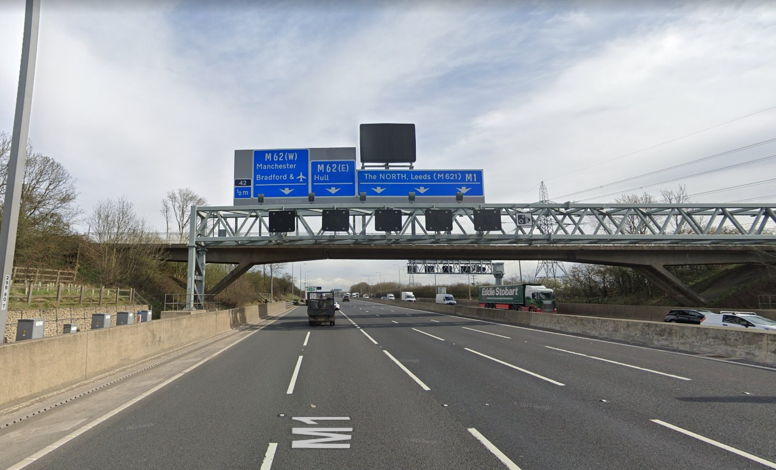
A high level mounted MS4 with zero access. The only way to access this sign is to close 80% of the carriageway with TM (lanes 2,3,4,5) and only access at night with a high reach 22m elevated work platform.

Slide 5
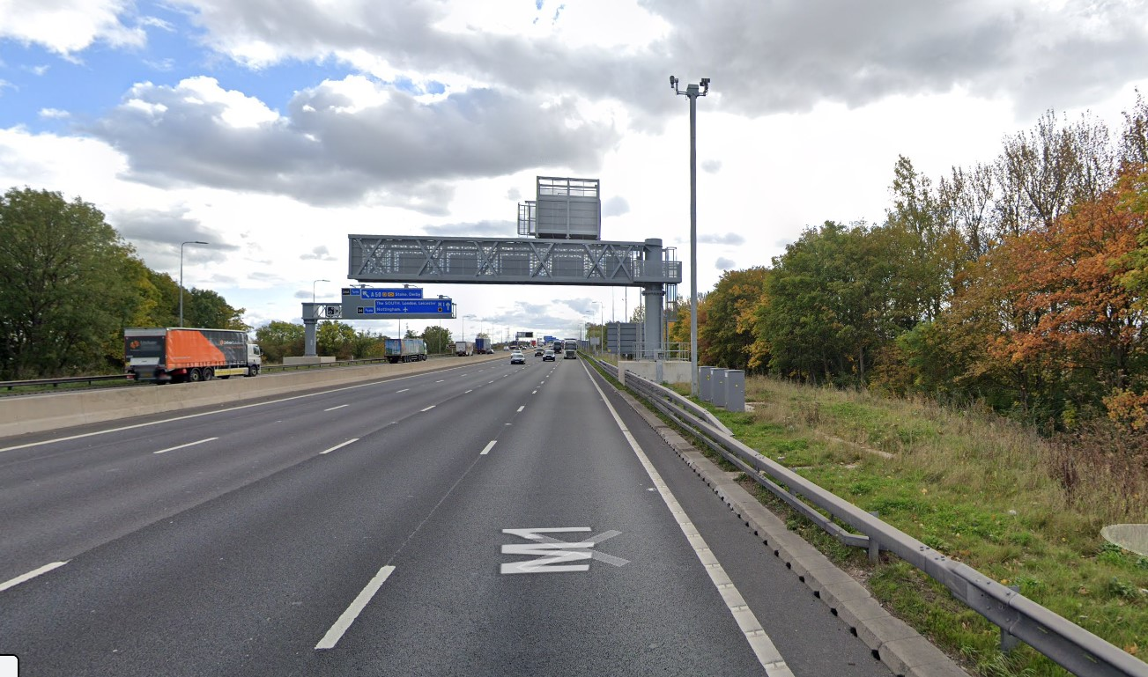
Accessible (enclosed ladder and platform) gantry mounted MS4 with a pathway but no parking area; a lane 1 TM closure has to be established to gain access to the pathway.

Slide 6
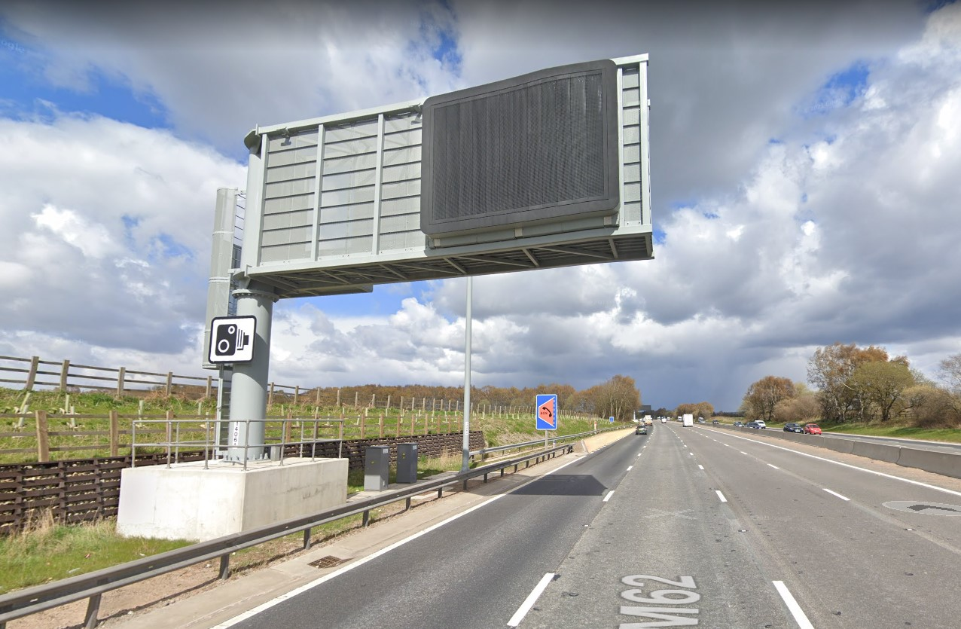
All accessible gantry and accessible emergency refuge area for vehicle parking. Allows instant access for the tech engineer to repair the sign with zero TM costs, zero disruption to the travelling public, a much quicker repair time for the MS4 to be back in service and also much safer for the technology engineer.

Slide 7
Comments on asking internally?
“Does the discussion include looking at the design of the whole gantry and not just the access? I was thinking about a swing system for the smaller gantries (MS4 etc..) so you could turn the gantry 50 degrees left/right over the verge so access would be from the verge if using a MEWP”.
“I understand from my colleagues that Traffic Scotland Account does have the issue with older gantries.
However all new ones are designed and provided with safe access as part of the spec I believe”
all new ones have safe parking access and safe access / egress as a standard Transport Scotland specification

Slide 8
Comments on asking internally?
”Good to see that HE are putting some work into this issue. I remember about 5 years ago when I was in Area 10 a inspector had stopped on the hard shoulder (M56) and went to undertake a visual inspection of a MS4 and when he got back in his van he was hit by a HGV, spent 4 weeks in hospital and never went back to work. There should have been an access layby nearby but it was never built”.

Slide 9
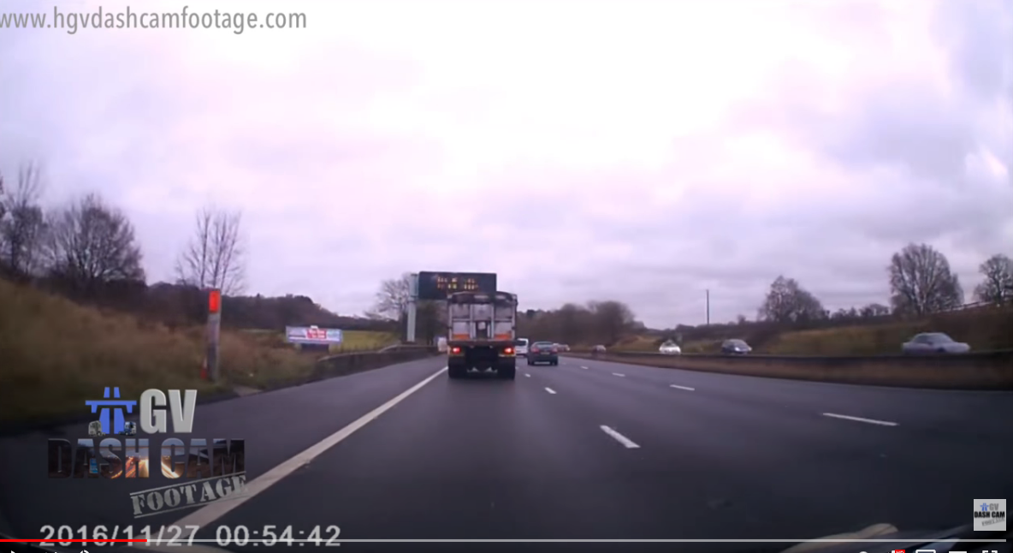
Inspector had stopped on the hard shoulder (M56) and went to undertake a visual inspection of a MS4 and when he got back in his van he was hit by a HGV,

Slide 10
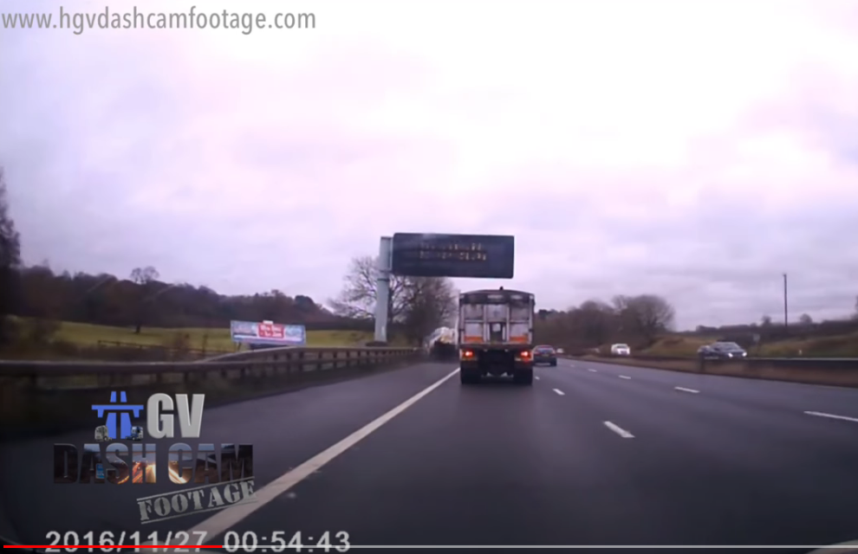
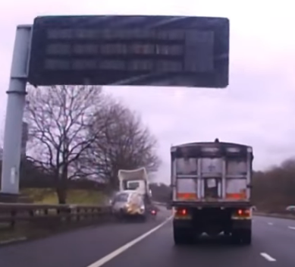
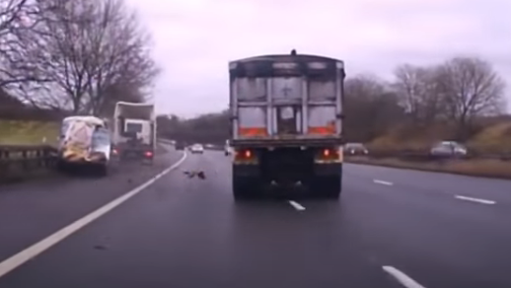
Inspector had stopped on the hard shoulder (M56) and went to undertake a visual inspection of a MS4 and when he got back in his van he was hit by a HGV,

Slide 11
Thoughts?

