Slide 1
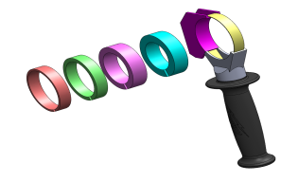
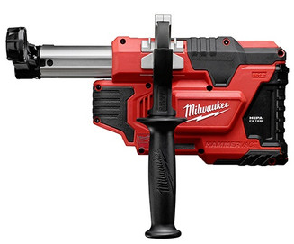
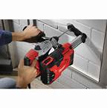
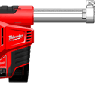
M12DE –
DUST EXTRACTOR
M12™ CORDLESS
UNIVERSAL DUST EXTRACTION UNIT
Attaches to any brand of drill with a collar from 43 to 59mm
Can be mounted on both sides left/right
Diameter capacity 20mm max
Doubles up as a hand held vac.
For use of cleaning after maintenance work
3 selection modes/ Engages when nose compressed
Continually on for use as hand held vacuum
HEPA Filter - High efficiency particulate air filter
Self powered extraction system
Doesn’t take power from drill or
effect performance
Most Universal
Fits on all drills from 43-59mm
Best Ergonomics
Can be attached on both left/right sides
AVAILABLE NOW
Non Scratch Nozzle
Leaves minimal marking on surface

Slide 2
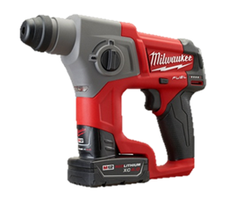
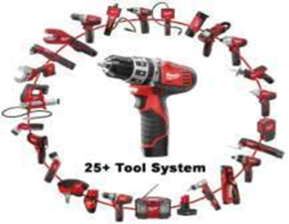
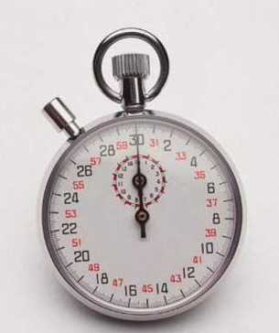
M12CH FUEL SDS
Plus Hammer
M12™ CORDLESS
Red Lithium 4.0 Batteries
Superior Power to weight ratio in its class - 1.7KG
2 Mode SDS-plus Hammer Brushless motor
SDS Concrete Drilling up to 13mm (optimized 4-10mm)
Drilling in wood / metal (13mm / 10mm)
Up to 75% faster then M12H
1.1J EPTA blow energy
Led light Highlights work area for improved visibility
Low Vibration Value of 4.4m/s² which Enhances usage time
Best Handling & Ergonomic Soft Grip
DPM – Digital Power Management Protects operator and machine
if drill bit jams
Forward & Reverse Switch - For added Versatility in fastening
Applications
Available it Kit 4.0ah and naked
Compatible with M12 DE-0 Dust extractor
Built-in LED
AVAILABLE NOW
Best Performance
up to 75% faster in diameter 6-10mm

Slide 3
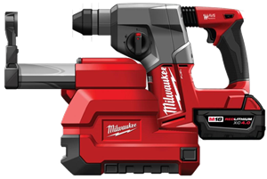
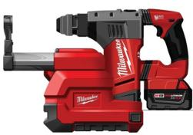
M18 Fuel Hammer
Dust Extraction
M18CDE-0 & M18-28CPDEX-0
M18™ CORDLESS
99.97%
Efficient
M18CDE-0
M18-28CPDEX-0
COMING OCTOBER

