Slide 1
Lean for Safety in design – some thoughts
Lean – basic terms and concepts
Lean, and waste, in the construction industry
How we can use Lean principles in safety - thoughts

Slide 2
Introductions
Chris Wearne, Facilitator, 35 years experience, contractor, design, client
Green belt equivalent trained, by recognised Lean trainers
Trained in facilitation, accredited by APMG
Led Collaborative Planning, Boston Manor repair, (2012 Olympics)
Lean Improvement; Plant Management, M25 design review, Departures
Communications Cells, for scheme development, scheme delivery
Collaborative Planning, 30+ major projects,
Only current provider of training dedicated to Collaborative Planning
Lead Author of Simplified Lean Capability Assessment

Slide 3
Lean is… the strength to deliver the right service to the customer at minimum cost
Understand
the
customer
Understand
the
process
Continuous Improvement
Based around
collaborative
working
and good communication
‘Flow’
‘Pull’

Slide 4
Lean is…1/5 understand the customer
Understand the customer. This will assist in providing exactly what is wanted and, also doing nothing
unnecessary
An example relating to consulting engineers; some clients want weekly updates and involvement in decisions; others just want the finished design and consider weekly updates to be a waste. The art lies in knowing the difference.
If some taxpayers came to your desk and looked at your work,
would they see value in what you are doing. The NASA question.
Value for - The public
- Highways England
- Government
- Neighbours

Slide 5
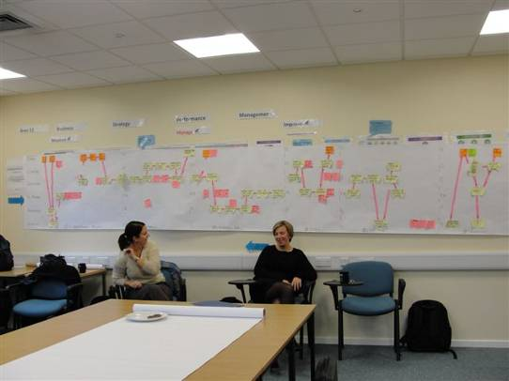
Lean is…2/5 understand the process
Understand the process. The more that everyone understands the process, the more they will see how to improve it
An example; the Ops Director could not understand why there was so much plant in the yard and why off-hiring plant took so much effort. This process chart showed why.

Slide 6
Lean is…3/5 flow
Look for ‘flow’
‘Standardise, Straighten, Sort, Sweep, Sustain
Just in time, minimising ‘Work in Progress’
Failure Mode Effects Analysis
Poke yoke – error elimination
Exercise in 5S – 20 SECONDS ALLOWED
An example; the road paver or concrete pump is most efficient when there is always one supply truck pouring material, already quality–controlled, into the hopper. No trucks means standing time, a line of trucks is both wasteful and liable to impede efficiency.
‘Flow’. Flow is best thought of as matching the heartbeat of the operation to that of the demand

Slide 7
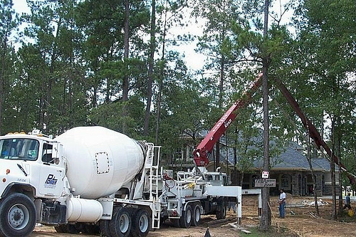
Lean is…4/5 pull
An example; a good ’chippy’ always has two or three people in, waiting one or two minutes, for freshly fried chips.
‘Pull’ This is the discipline of ensuring that processes are only undertaken when the demand is there

Slide 8
Lean is…5/5 continuous improvement, reducing waste
“The greatest waste is the waste we do not see” Shingo
We know it’s there We can see it now We can take it out
But remember, one person’s waste….may be another’s job.
Labour
Plant
Materials
Labour
Plant
Materials
………
Waste
Labour
Plant
Materials

Slide 9
Recognising waste - the 8 wastes – TIM WOODS
Transport
Inventory
Motion
Waiting
Over-processing
Over-production
Defects
Skill Misuse
Notes:
9

Slide 10
Recognising waste - the 8 wastes - Transport
Looks like – piles of fuel receipts
Feels like - you’re on first name terms with TNT
Sounds like – “Anything for me to take while I’m going?”
Examples - transferring files by taking a CD every week
- liaison across multiple offices
- meetings when a VC may suffice
- a 2 hour trip round the TM because access is one-way
Notes:
10

Slide 11
Recognising waste - the 8 wastes - Inventory
Looks like – the Berlin Wall
Feels like – vaguely reassuring, actually
Sounds like – “we can keep these guys busy by doing these..”
Examples - Starting work before the instruction – the ‘pull’
- printing off drawings early, to avoid the Friday rush
- the plant yard when I could not see the back fence
- purchasing materials to avoid year end ‘variances’
Notes:
11

Slide 12
Recognising waste - the 8 wastes - Motion
Looks like – impressive, certainly for a short time
Feels like – you’re at the top of the stairs, wondering why
Sounds like - “keeps me fit, Managing By Walking About”
Examples - from emergency meeting to emergency meeting…
- one project, different teams on different floors
- the two team members who ‘have issues with each other’
- that gang who appear to be ’moving a hole’
Notes:
12

Slide 13
Recognising waste - the 8 wastes - Waiting
Looks like – the huddle, arms folded
Feels like – an irrational desire to ‘fix’ the copier with a 14lb hammer
Sounds like – “I never realised it was holding you up, sorry”
Examples - late arrivals for meetings, 15 people, 5 minutes = £100
- waiting for authorisations you cannot control, why?
- change of programme sequence
- just not turning up, so everyone else waits
- 7 blokes stood by a trench full of obstructions, cables etc
Notes:
13

Slide 14
Recognising waste – Over - processing
Looks like – no different to 6 weeks ago
Feels like – walking through treacle
Sounds like – “who reads all of this?”
Examples - the (Creative) Complicationists ©
- ticking the box – environmental, safety (don’t shoot me)
- masses of BIM info – but no idea where the gas main is
- applying 6 sigma when there is insufficient data
- the fancy glove at the petrol pump
Notes:
14

Slide 15
Recognising waste – Over - production
Looks like – the corridors are very narrow
Feels like – a vague feeling of satisfaction
Sounds like – “we’ve felled a forest to build this”
Examples - quality beyond requirements
- that mass of safety information at every site entrance
- overlap with other schemes
- extensive coverage of the flippin’ obvious
- too much concrete – a dead elephant at the roadside
Notes:
15

Slide 16
Recognising waste - Defects
Looks like – the package is ready but one drawing’s back on the printer
Feels like - nausea
Sounds like – “I’ve just checked them now, and…”
Examples - wrong information from others
- OSINTOT
- crummy decisions made without the discipline or full facts
- the temporary works sequence error, in Florida University
Notes:
16

Slide 17
Recognising waste – Skills misuse
Looks like – your behavioural safety specialist is fixing the printer
Feels like – square peg, round hole
Sounds like – “we’ve asked one of the graduates to make a start….”
Examples - inadequately trained staff using cancer screening equipment
- trying to keep everyone busy
- experts carrying out routine tasks
Notes:
17

Slide 18
Recognising waste…. the 9th waste – Conflict?
Now examine the wastes you have listed…
How many were due to conflict or could readily lead to conflict?
Any one like paying lawyers….or shall we collaborate?
How many were due to basic lack of communication?
Anyone like doing stuff twice….or shall we use collaborative tools?

Slide 19
In response - three legs of lean
Collaborative Planning
which drives process improvement and communication
Visual Management
which drives collaboration and process improvement
Process improvement which drives communication and collaboration

Slide 20
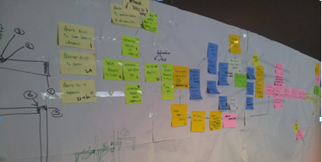
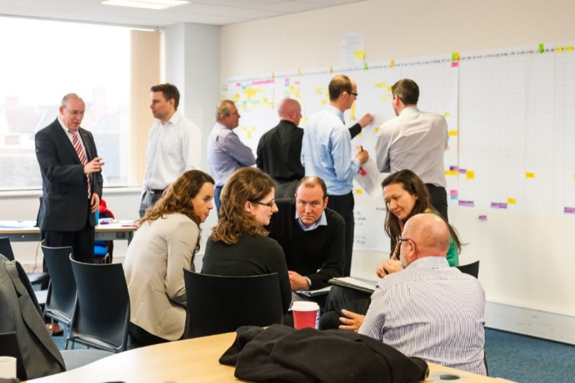
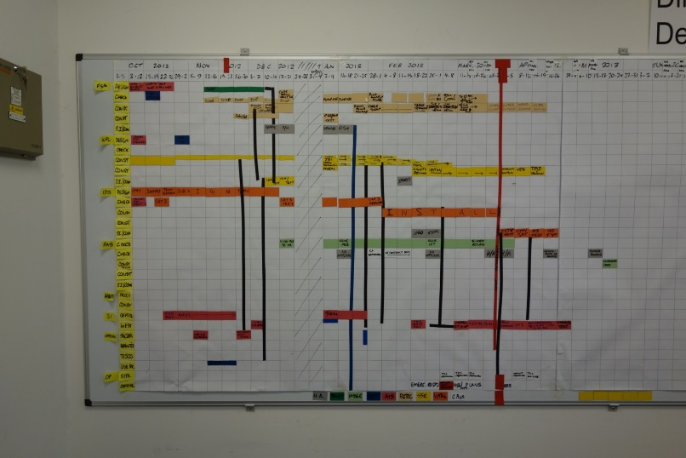
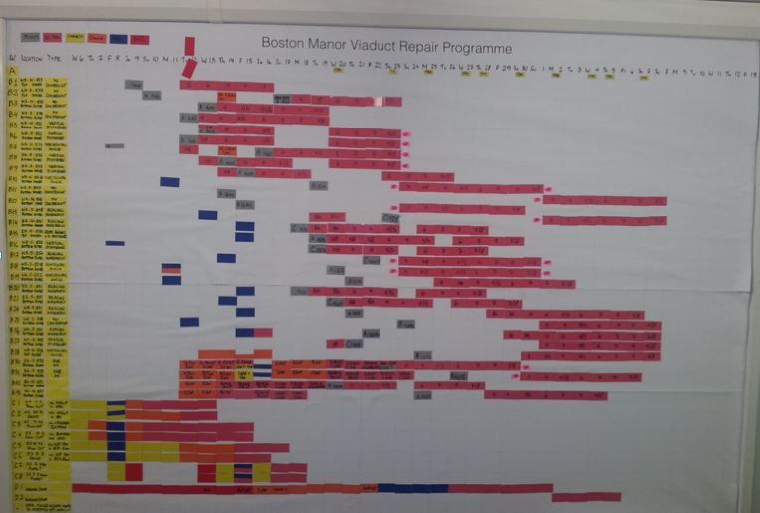
Collaborative Planning – the integrated team
Engagement, Project Managers and Engineers can’t resist fiddling with it…

Slide 21
Collaborative Planning – elements Establish what is Value to the client Plan as an Integrated Team Short Interval Review Display to Engage and Inform Analyse Learn and Improve

Slide 22
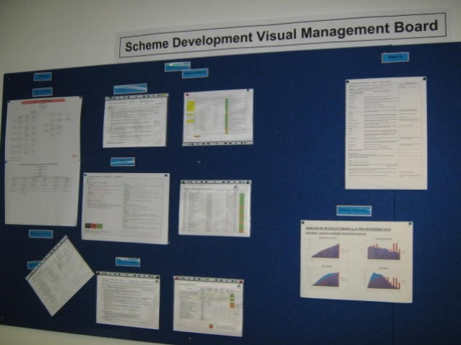
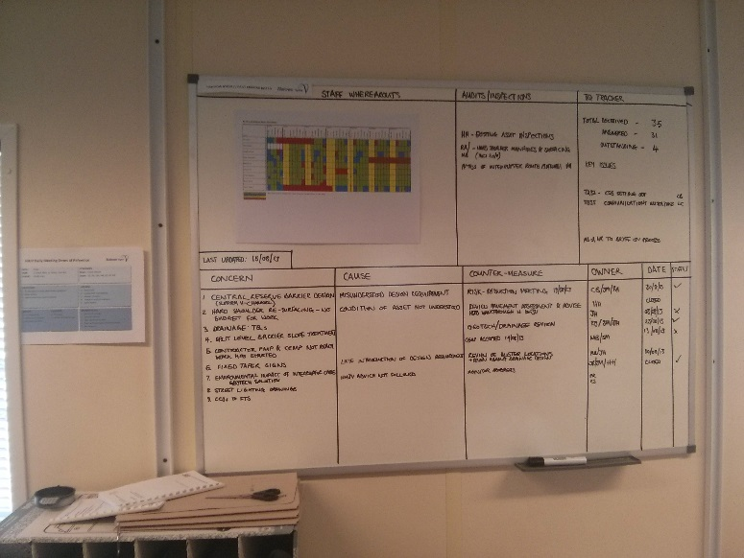
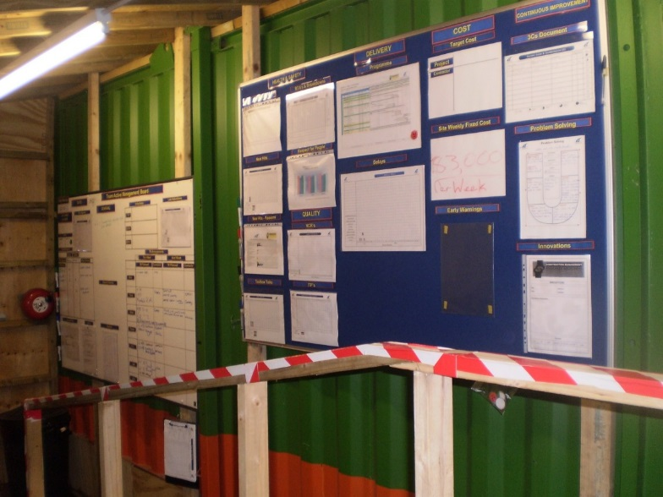
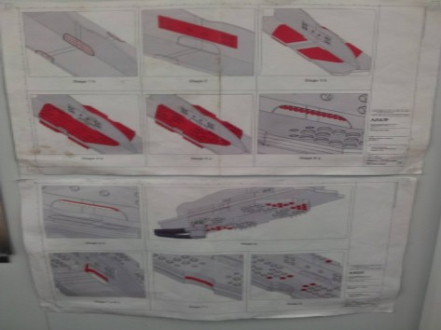
Visual Display examples, project information

Slide 23
Visual Display - potential information Project - layout, main activities, objectives, sequences - constraints: TM, access - costs: prelims daily / weekly cost People - faces, names, photos, - organogram, - training, vacancies Performance - Percentage Planned Complete - Progress against programme - Outputs Improvement - 3C’s with list of examples and case studies - graph of PPC and RNC outputs - display of savings made via Lean & Efficiencies

Slide 24
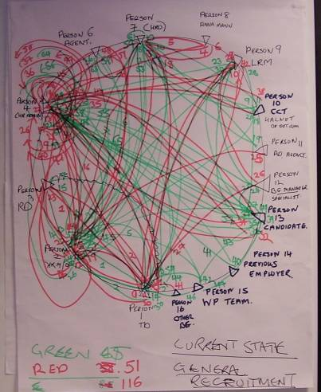
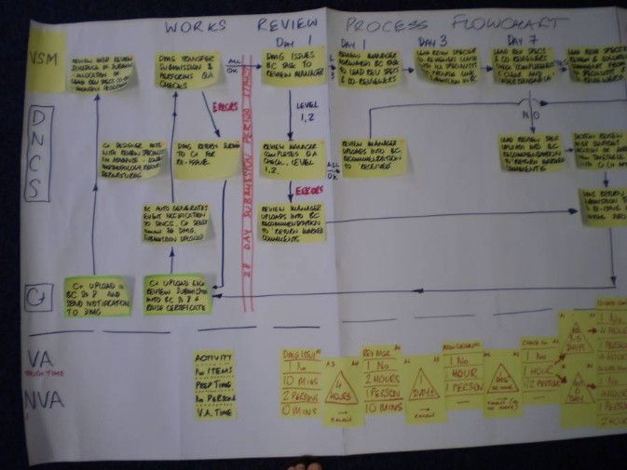
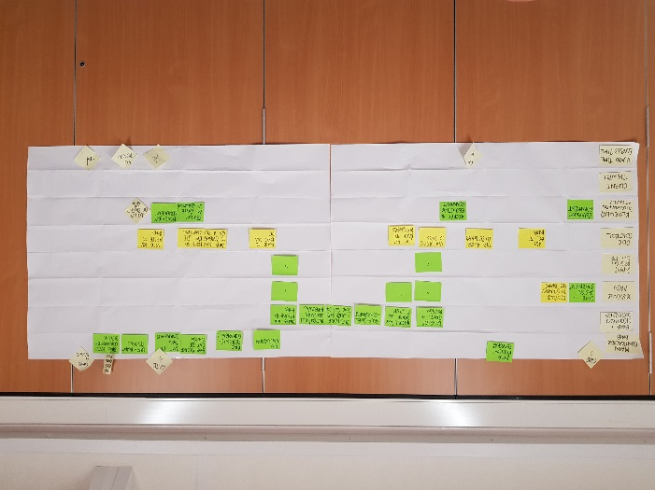
Process improvement

Slide 25
Process improvement – simple techniques, tools
3C’s – Concern > Cause > Countermeasure
5Y – Who / Why / Why / Why / Why – Kipling’s 5 friends
5S – workplace organisation –, sort, shine, straighten, standardise, sustain
PDCA – Plan Do Check Act
Fishbone diagram
Process mapping
Choosing By Advantages

Slide 26
Thank You Questions?
And what do we do about is?

Slide 27
Lean and PDWG – what of Lean can PDWG use?
Terms that cause confusion?
Any basic avoidable wastes we can address?
Where we can learn from past experience?
And some action plans to address?

