Slide 1
Home Safe and Well
Design - Innovation

Slide 2
Health and Safety Design Innovation
Interfaces
Workstreams
Key outcomes
5% reduction in field based work activities by RIS3
Removal of employees from workface
Operations
SES
Normalise the practice of off site build
Off site construction
Reliability centred maintenance
Equipment redundancy
Design Innovation
Work with SES to revised design standards
Major Projects
Estates
Environmental hygienist
Identify working areas for environmental
hygienists to pilot
Standardisation of design approach
clash detection and improve site records
for permit to dig
Clash Detection
Product Standardisation
Standardised kit bag of products

Slide 3
Aspiration areas
Reducing the number of those killed or seriously injured on our roads by 20%
Halving the number of lost time injuries
Halving the number of utility strikes
Achieving level 4 cultural maturity

Slide 4
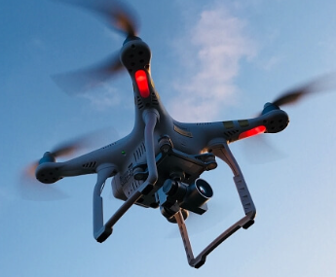

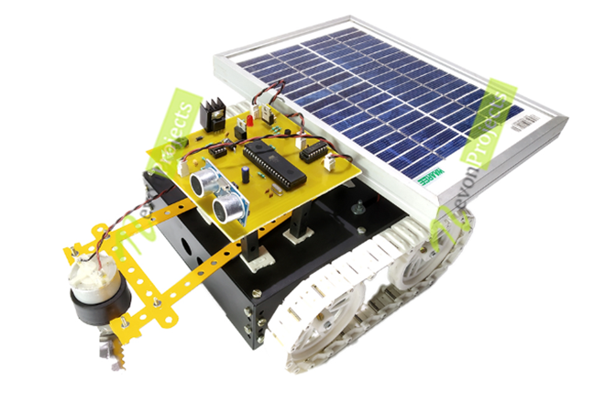
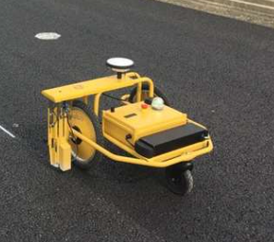
So what is happening against these workstreams
Removing workforce from live work space
Drone survey equipment, used for surveying, inspections,
delivery, final as constructed mapping
Work with designers to encourage use how to move into
Normal practice
Automated ADTs trialled on the A14
Review which schemes could use on in the future
Design element – design of haul road systems to allow for defined routes
Greater use of automated or semi automated plant on site
Supply chain review on what plant available and business decisions on what equipment should be mandated
Design element – how do we make the site suitable for use of automated or semi automated plant e.g compaction approach, gradients, safety zones
How can we work with industry to develop BIM models that can we used to facilitate automated or semi automated plant?
IP3 innovation Automation Road Map

Slide 5
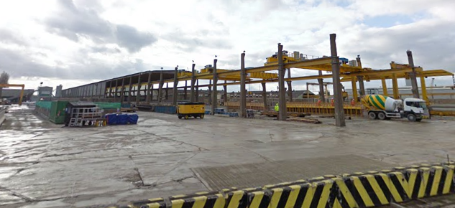
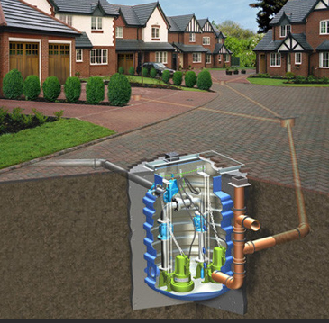
So what is happening against these workstreams
Off Site Construction
Bridge components
Modular Construction
Cabinet (SMP)
Pumping station

Slide 6
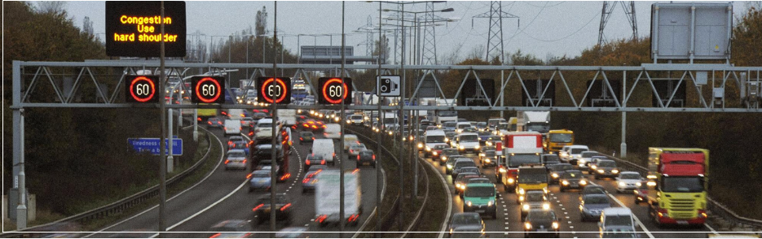
So what is happening against these workstreams
Reliability Centred maintenance
Redundancy in design
Huge improvements in Technology reliability (signs and signals v3)
Trials M25 DBRO camera coverage - 200% capacity. Reduction in emergency
call outs, allows safe planning of work
Improvements in access arrangements (accessible gantries)
IMIS analysis – failure mode
Significant opportunities remain on other key maintenance actives including:
Drainage design and incident management – screen rakes drone inspections
Pavement – road vehicle monitoring – condition monitoring – reliability centered maintenance
Bridge joints – failure mode analysis, product performance analysis
Central reserve barrier – Inspection reduction, emergency repairs
Spill management – Vehicle standards, product development, management

Slide 7

So what is happening against these workstreams
Environmental Hygienist
Environmental Hygienists:
Noise
Vibration
Chemical, Dust Exposure
Example:
Noise monitoring - Wacker Neuson dual load dumper

Slide 8
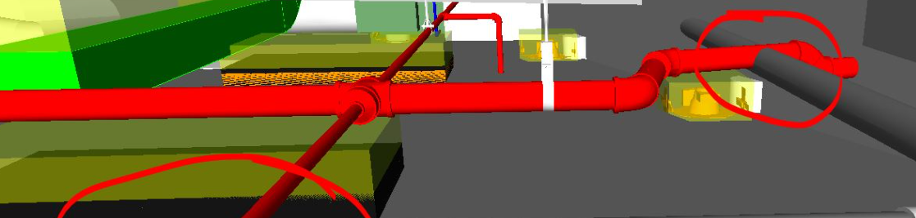
So what is happening against these workstreams
Clash Detection
Site 3D visualisation of site and end product for design management
e.g. Trimble system – site vision
BIM analysis
Ground Investigation technology

Slide 9
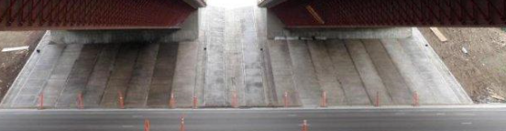
So what is happening against these workstreams
Product Standardisation
Automated ADTs trialled on the A14
Bridge abutment slabs installation
Mission room construction

Slide 10
Key Challenges
Define the Programme
Understanding the Innovate in design
Manage the overlaps
  Understand the business change workstreams
  Innovation reapplied (safety elements)
  HSAW Design workstream
  Business Innovation activities – Designated Funds
Develop a Programme
Condense and prioritise effort using a value vs complexity matrix
Build a Team
Working with existing and new user groups
  Design steering group
  Highway England innovation team
  Other business units SES Operations
  Supply Chain Safety Leadership Group
Establish the “norm”
Get a drumbeat of delivery activities in place

Slide 11
Programme Sprint

