Slide 1
Highways Accident Reporting Tool
For National Highways Supply Chain colleagues
Notes:
Welcome to this Highways Accident Reporting Tool presentation.
This presentation is designed to equip colleagues with the knowledge of what to report in terms of incidents and accidents, and where to report but most importantly by the end of this presentation I hope you really understand the why we report them.
Whether you are a colleague who hasn’t worked on our Strategic Road Network before, a colleague new to the Highways Accident Reporting Tool or just having a refresher on why we report, this presentation is the introduction to our Highways Accident Reporting Tool. This presentation is step 1. Step 2 consists of our ‘how to guides’ that walk you through a variety of processes such as, how to report an event, how to investigate an event, how to load an action etc.

Slide 2
Why do we need to report events?
Our Home Safe and Well approach is simple – we want everyone that works with us and everyone who travels on our network to get home, safe and well.
We’re all responsible for making positive safety behaviour change and we’re all leaders when it comes to safety.
With a focus on these 6 key areas we hope to achieve our goals:
Effective leadership
Capable people
Clear expectations
Engaged stakeholders
A learning organisation
Health, safety and wellbeing by design
Notes:
(Read, as per the slide content)

Slide 3
A learning organisation
Learning opportunities
Open reporting
Fair and just culture
Leading indicators
Notes:
(Learning opportunities) In order to improve, we must seek out learning opportunities. If we don’t learn, we risk the same events being repeated. If we don’t learn from events, we can’t stop them happening again, and so prevent our colleagues from being hurt or worse. We recognise that this will only be achieved within a fair and just culture too.
(Open reporting) Open reporting is actively encouraged and rewarded. If we don’t report events, we can’t learn from them.
(Fair and just culture) Whilst people are accountable for their actions, by operating in a fair and just culture, errors can be freely reported without repercussion to ensure that they are not repeated elsewhere. When things go wrong we want to understand why, so we can put them right, and help keep our colleagues safe. It’s about learning and improving – not blaming!
(Leading Indicators) We monitor our safety performance and culture through leading indicators – we analyse the data to learn from our events to help us make informed decisions on how we improve our safety practices.

Slide 4
Did you know?
Data correct as at Sep 2021
Since January 2021 the top 5 kind of events for Personal Injuries for Supply Chain are:
1) Fell, slipped, or tripped on same level
2) Hit by a moving or falling object
3) Injured while handling - Pushing or Pulling
4) Injured while handling - Lifting or Carrying
5) Hit by a moving vehicle or plant
In 2020 we had a total of 145 Personal Injuries reported for our supply chain colleagues.
Data as at September 2021
Notes:
Ok, so we know why we need to report, ultimately, we are all working to the same goal – we all want, our friends and colleagues we work with, to get home safe & well. If we actively report events – we can learn from what has happened – and stop it happening again!
The numbers here are real. It is real supply chain colleagues that sit behind these numbers and real colleagues that have been harmed. Real colleagues that on these occasions did not get home safe and well.
To achieve our goal, it is vital we all also understand what we need to report, so we can learn from the events.

Slide 5
What do we need to report?
RIDDOR reportable incidents
Lost Time Incidents
Utility strikes
High Potential Near Miss
Incursions
Undesired Circumstance
Structural Safety events
Environmental events
Wellbeing events
https://www.standardsforhighways.co.uk/dmrb
Notes:
So – what does need reporting?
This is a simple question to answer. Any work related event that involves a National Highways employee or someone who is employed to work on our Strategic Road Network.
In order for us to categorise our events effectively, within our Highways Accident Reporting Tool, we have what are known as ‘Event Types’. These are effectively different ‘pots’ of events to ensure we group them correctly. This ensures they are investigated correctly by the most appropriate teams, but more importantly, so the learning identified shapes the changes being made.
Please pause the presentation here to take time to familiarise yourself with our standards document GG128. This covers the requirements for reporting incidents, events and undesirable circumstances: health, safety, wellbeing, structural and environmental events. For ease, we’ve popped the link within the bottom left side of this slide.

Slide 6
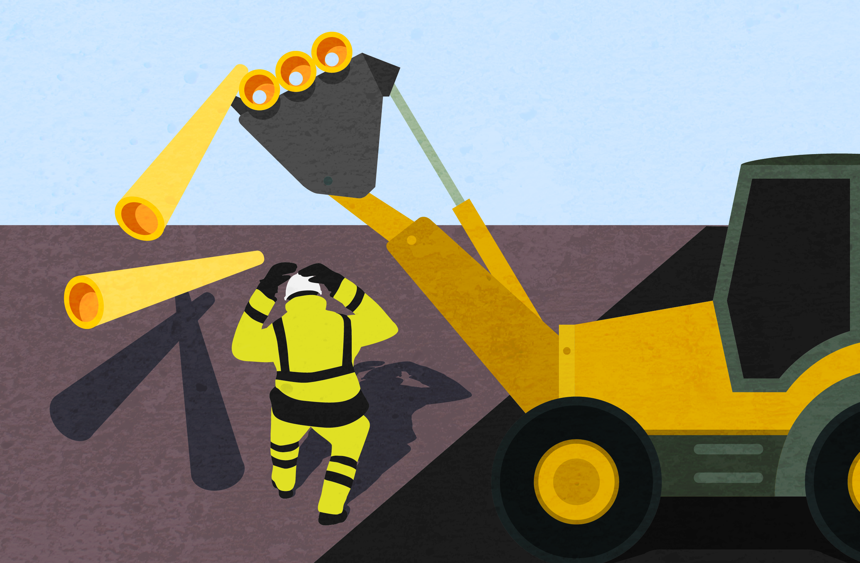
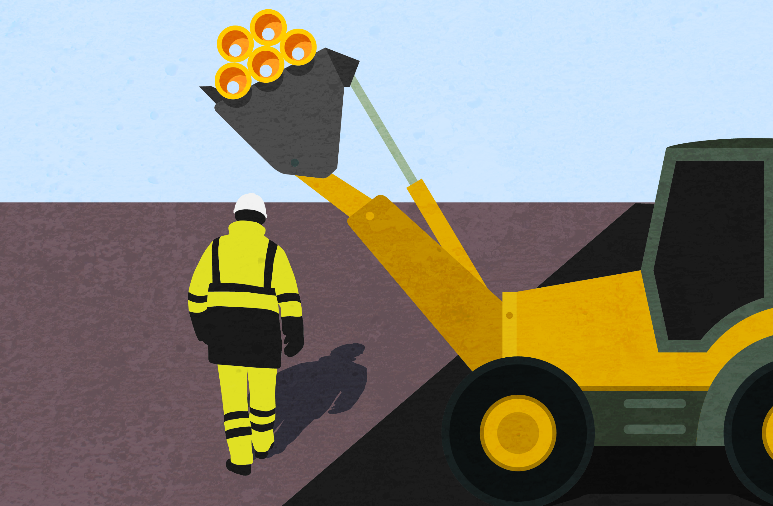
Near misses and Undesired circumstances – what is the difference?
This is an Undesired Circumstance.
- A set of conditions or circumstances that have the potential to cause injury or ill-health.
This is a Near Miss.
- An incident occurred that had the potential to cause injury, ill health or a dangerous occurrence.
Notes:
As we know – we encourage a strong reporting culture, the reporting of Near Misses & Undesired Circumstances are vital for us to build on becoming a learning organisation;
Reporting a near miss, allows an opportunity to investigate before harm occurs.
Reporting of undesired circumstance events, allows us to investigate before an incident occurs.
Both of these alert us to a potential hazard that can be removed, to prevent you or one of your colleagues, having an incident or getting hurt.
But sometimes the difference between a Near Miss & an Undesired Circumstance – can be difficult to understand. The images and descriptions here help demonstrate this difference and hopefully helps us remember, for when we need to report in the future.

Slide 7
When do we need to report events on Highways Accident Reporting Tool?
3 days for an initial investigation is completed (usually) by the colleagues line manager. The report must be uploaded and actions raised where applicable *
Incident records are updated the investigation uploaded to the record within 10 days.
Feedback to the reporting colleague shared
An event occurs
All incidents must be reported within 1 day
Notes:
Ok, so we know why it’s important to report.
We know what to report
So when do we report?
Reporting an event as soon as possible is always the best option. Details of what happened, when it happened, where it happened, who it happened to – are all details that are better captured as soon as possible. Recollection of events are easier and clearer the sooner details are recorded, but equally, the quicker an event is reported the sooner we can understand what has happened and stop the chance of it happening elsewhere! We recognise, it is not always possible to report immediately. Therefore, within 1 day of the event occurring, is our standard.
Once an event is reported onto the Highways Accident Reporting Tool, it is vital you tell your on-site supervisor that you have reported an event. This gives them the opportunity to act immediately!
Dependant on the severity of the event, the investigation may be completed by setting and completing an action. In other cases where the event is more severe, a full investigation may be needed. However, 3 days for an initial investigation to be uploaded onto the event record, is the standard. With 10 days as the timeframe for the full investigation to be uploaded.

Slide 8
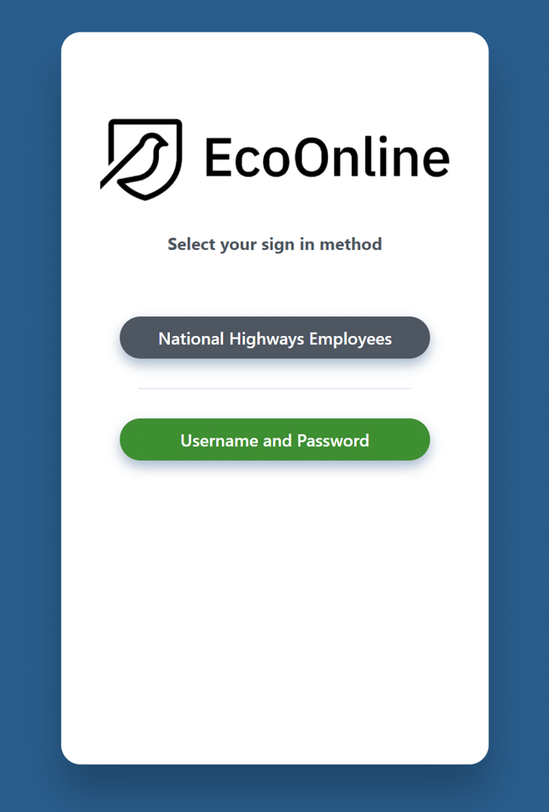
Where do we report?
https://ehsuk.ecoonline.net/nationalhighways
Notes:
So, where do you go to report.
The most simply way to access the Highways Accident Reporting Tool is via the web address shown here. Please save this to your favourites to make access as easy as possible.
Once you select the link, please select the ‘Username and Password’ button and log in. If you do not have log-in details, please contact the National Highways Health Safety & Wellbeing team, via the HARTsupplychain@highwaysengland.co.uk inbox, who will be able to register you as a user, for the project you are working on.
** Please note: if you are an existing Airsweb user, your account will be automatically migrated across to the Highways Accident Reporting Tool, once the system goes live and therefore you do not need to request access**

Slide 9
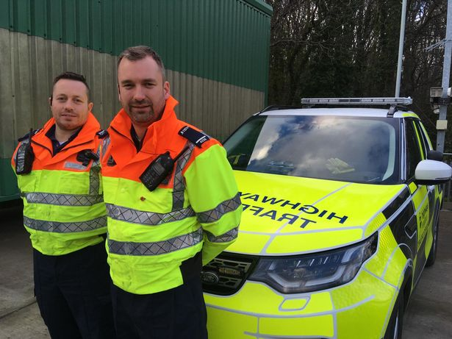
How do we report?
Reporting = Learning = we all get home safe and well.
Our guidance documents can be found here - Highways Safety Hub & the Safety Hub
Any questions – HARTsupplychain@highwaysengland.co.uk
Notes:
To summarise, the points we have covered;
For everyone to get home safe and well, and by ‘everyone’ that’s you, me, our colleagues we work on site with, other friend we sit next to in the office – reporting gives us the chance to learn. That learning shapes the decisions we make to stop people getting harmed and ensure we all get home safe and well.
For colleagues needing assisting with ‘how’ to report – there are lots of resources available for you to use.
If you haven’t yet reported an event onto the Highways Accident Reporting Tool, or need a refresher in how to do this, please select one of the guidance video's to view. These demonstrate various processes within the system from reporting an event, investigating an event and a whole lot more.
Equally we have a full library of guidance material in the form of step by step guides that you can follow, as you navigate through the system. These are all available via the Highways Safety Hub and the Safety hub site.
If you have any question or concerns please email, the Health Safety & Wellbeing team via the Highways Accident Reporting Tool inbox.

