Slide 1
GG104 Requirements for Safety Risk Assessment Overview
Ron Thompson

Slide 2
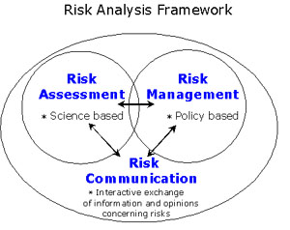
GG104 Requirements for safety risk assessment
Provides a framework that sets out the approach for safety risk assessment when undertaking any activity that can have an impact on safety on the strategic road network.
Incorporates the guidance in IAN191/16 on how to select an appropriate safety management system according to activity type categorisation.

Slide 3
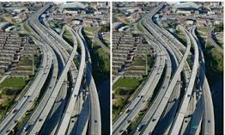
GG104 – GD04/12 Key differences
Emphasis placed on it being applicable to all activities having a potential impact on safety.
Written in a more usable style that conforms to new Highways England drafting rules.
Identifying criteria for populations and considering risk exposure steps combined. No longer includes HSE tolerability of risk triangle.
Activity type classification features redefined and reordered to enable more realistic categorisations.
Notes:
Overarching principles are retained in GG104 but lack of embedment shaped the improvements.
Tolerability of risk triangle encouraged the misconception that being within the tolerable range meant no further mitigation was necessary, whereas the aim should be to drive risks ALARP.

Slide 4
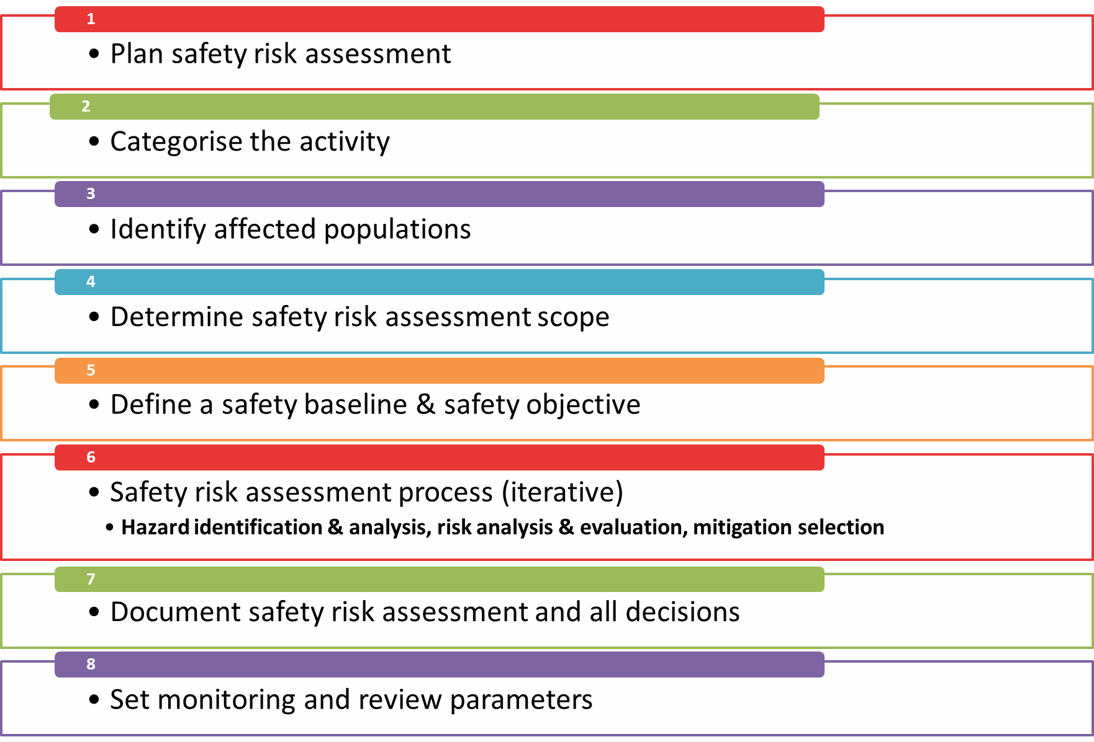
Requirements for safety risk assessment

Slide 5

What is it you are trying to achieve?
What are the options being considered?
Identify stakeholders and consultees?
What governance arrangements does your business area have for safety risk assessment?
Notes:
Option preferences made ahead the evaluation stage of the safety risk assessment can lead to unconscious biases influencing the outcome of the safety risk assessment process – don’t prejudge the process

Slide 6
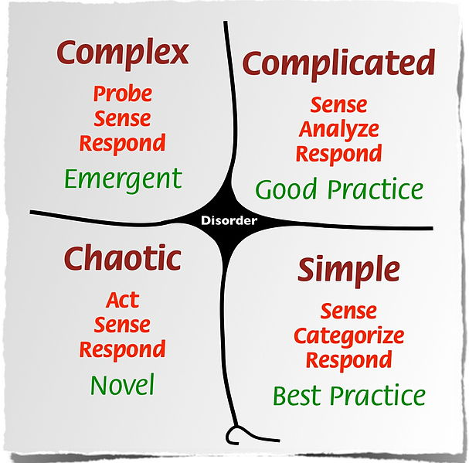
Extent of prior experience of activity.
Statutory and formal processes and procedures (including standards and legislation).
Impact on the organisation.
Activity scale.
Technical.
Stakeholder impact and interest.
This Photo by Unknown Author is licensed under CC BY-NC
Notes:
Experience: How much experience do we have of undertaking the activity previously within HE or by other industries or organisations.
Statutory and formal processes: How much is it within processes, guidance, standards and legislation?
Impact on organisation: The effect it will have on current Highways England processes, procedures, structure, roles and responsibilities, competencies, policies and strategy, in addition to contractual and workforce arrangements.
Scale: Is it localised, significant or national networkwide?
Technical: How technically novel or innovative is it?
Stakeholders: How many stakeholders does it affect, what’s their interest level and ability to influence or impact the activity? How are the safety issues being perceived? Are they capable of
being understood and fully addressed?

Slide 7
  Type A (basic) safety management
  Type B (moderate) safety management
  Type C (rigorous) safety management
Vast
majority
Type A
Type B
Type C
Relatively routine, familiar, no operational implications
Could have significant operational implications
Complex, unfamiliar, and major implications for the SRN
Increasing levels of effort and detail in safety risk management

Slide 8
Population | Classification
People directly employed by Highways England and who work on the motorway and all-purpose trunk roads either permanently e.g. Traffic Officers, or periodically e.g. those undertaking site visits. AND People in a contractual relationship with Highways England, including our National Vehicle Recovery Contract operatives, all workers engaged in traffic management activities and incident support services, and any other activities where traffic is present, such as persons carrying out survey and inspection work. | Workers
All road users, including the police and emergency services, equestrians, cyclists and pedestrians, as well as those others, who are at work but are not in a contractual relationship with Highways England such as privately contracted vehicle recovery and vehicle repair providers. | Users
Other parties includes any person or persons who could be affected by the Highways England motorway and all-purpose trunk roads, but who are neither using it, nor working on it i.e. living or working adjacent to the motorway and all-purpose trunk roads, using other transport networks that intersect with the motorway and all-purpose trunk roads | Other parties
Notes:
Who might you impact?
Safety risk assessments have to consider anyone and everyone who will or can be affected by the activity that is subject of the safety risk assessment, and when or in what circumstances?
Once affected populations are identified you need to think if there are any sub-populations with any differing safety risk characteristics that will mean the activity could affect their risk profile differently to the main population.
If any sub-populations are identified, their differing safety risk position should be assessed and evaluated separately to the main population.

Slide 9
What is the safety question you are trying to answer?
What is the extent of the question, physically, geographically or timewise
Each option being considered needs risk assessment.
How are each of the exposed populations affected by each option?
How complex is the activity and what level of experience do we have?

Slide 10
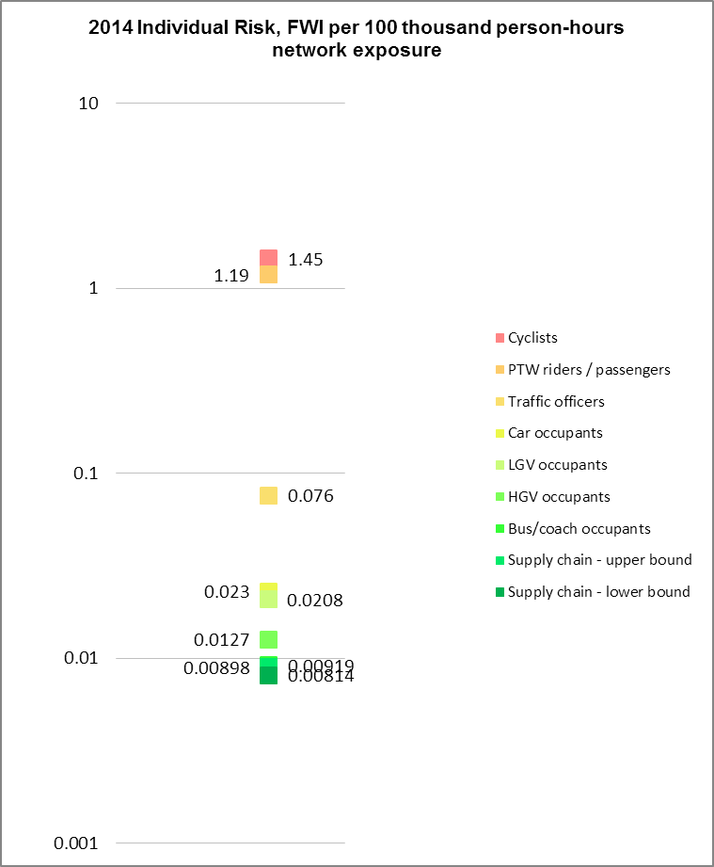
Quantitative
What are the current exposure levels?
This is most often illustrated with statistical data such as KSI rate or FWI rates.
The measure selected for the baseline and the safety objective should be the same for the purposes of comparison
For road workers the over-riding ALARP principle is to be satisfied; the safety objective for road workers should be set on this basis
(Safety Risk Model outputs)
Notes:
Talk about how to do this, what is there available to use.
They can use local and national data to establish current exposure and whether they are better or worse than the national picture.
They can use their own or ours but they need to say what they're using and why.

Slide 11


Identify the reasonably foreseeable hazards associated with the activity.
Analyse the hazards to understand the safety risks and consequences if risks are realised.
Assess the likelihood of the risk being realised potential severity of the consequences to give a risk value.
Compare the risk values against the baseline and objective.
Determine any mitigation required to achieve this or ALARP.
Evaluate effect of mitigation measures until safety objective and or ALARP is achieved.

Slide 12

All steps of the safety risk assessment and any decisions made.
All supporting evidence used to justify decisions.
Any assumptions made and the basis for them.
Update the safety risk assessment throughout the life of the activity.
Review if anything changes that affects the activity or any part of it.
The documentation should be retained for at least the life expectancy of the activity in line with business area safety risk governance requirements.
Notes:
What they need to ensure they document is what supports the risk assessment - so if it is an A then be clear it's routine, following standards or industry best practise (reference documents etc) if it's more complex and has used opinion/research/other industry experience and/or a mixture of these in qualitative then it all must be referenced & noted. Equally any assumptions made must be articulated, and the basis for them
Any data used you should reference the source
It's important for it to be clear and straightforward for an outsider to follow the process & logic

Slide 13

To validate the decisions made and ensure any safety risk mitigations are performing as expected.
The detail of any residual risks that require active monitoring shall be recorded and an owner assigned.
Assumptions made in relation to the safety risk assessment, will need to be validated as part of the review.
For type A categorised activities it is acceptable for monitoring to be a part of routine performance measurement.

