Slide 1
Eliminating Risk from the Outset
Mike Wilson

Slide 2
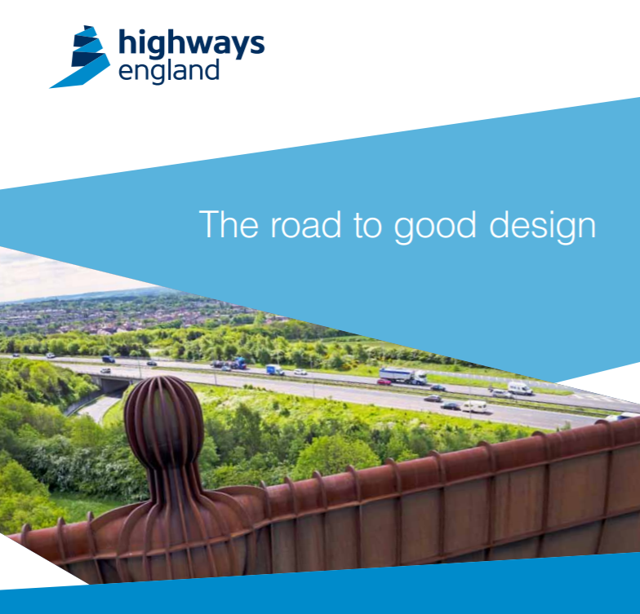
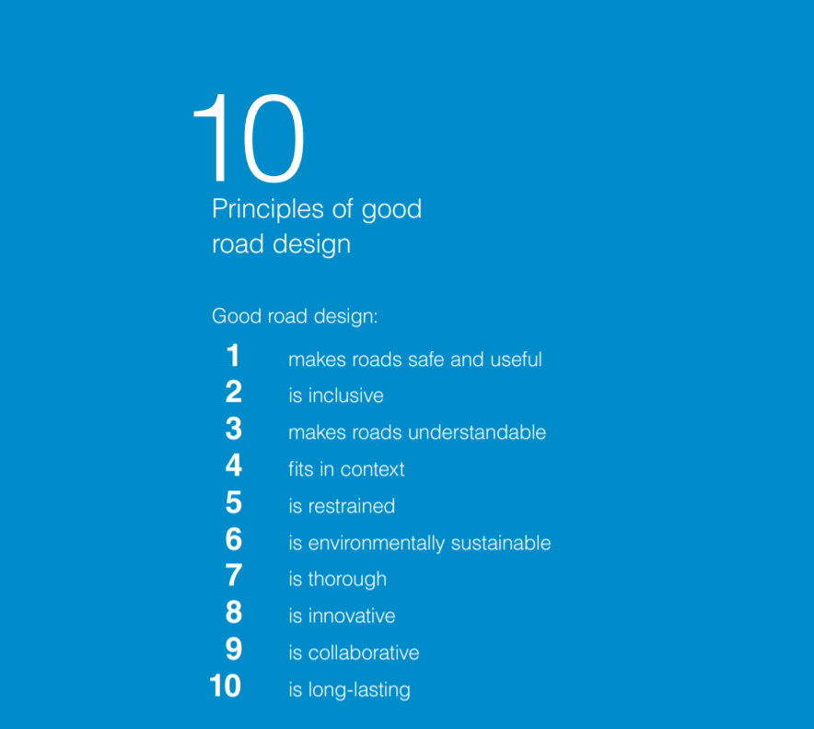
10 Principles of good road design

Slide 3
Design Review Process
identify
refer
brief
visit
review
report
learn
Highways England
long list
short list
design
team
progress report
Strategic Design Panel
agree scheme
to chair
to panel
Design Review Panel
schedule
review
brief
panel
visit
site
review
design
review
letter
annual report
Design reviews are managed by the Design Council on behalf of Highways England and the Strategic Design Panel. Review panels are composed of 5 independent built environment experts (engineers, architects, landscape architects, etc.). Reviews take place over a day and include a site visit. Design teams receive feedback via a letter within 2 weeks.
Notes:
Sensitivity of a scheme will primarily be determined through the stage 1 PCF project design report, but the most sensitive schemes will likely already have been identified due to their proximity to national parks, AONBs, SSSIs, ancient monuments, urban areas, etc.
Sensitive schemes are encouraged to engage with the review process as soon as possible - towards the end of stage 3 is too late to action feedback.
Note review feedback is only advisory and the process is there to help teams with input from a different view point.

