Slide 1
COVID-19 Safe Operating Procedure
Examples of best practice

Slide 2
Safe Operating Procedures CV19
THINGS WE HAVE PUT IN PLACE
COVID19 Addendum added to PEP/CPP
Extra signage health check process and social distancing
Enhanced cleaning regimes
Encouraged homeworking where possible
Collaboration with site teams and supply chain on our SOP measures for managing risks to COVID19
Stocking up on provision of hand cleaning materials widely to all
Changed accesses and egresses into building and layout of canteen/offices/toilets
Limited numbers of persons in offices and meeting rooms to maintain social distancing
Issued Key Worker letters to all Linkconnex / BMJV Staff
Issued letters to supply chain with our Safe Operating Process and COVID19 Briefing pack pre-commencement to site
Reviewed current stock of RPE within all BAM Highways/Rail projects for use with safety critical operations
Virtual safety site inspections
Risk review of all site activities for managing social distancing
Introduced a Permit system for where <2m cannot be maintained

Slide 3
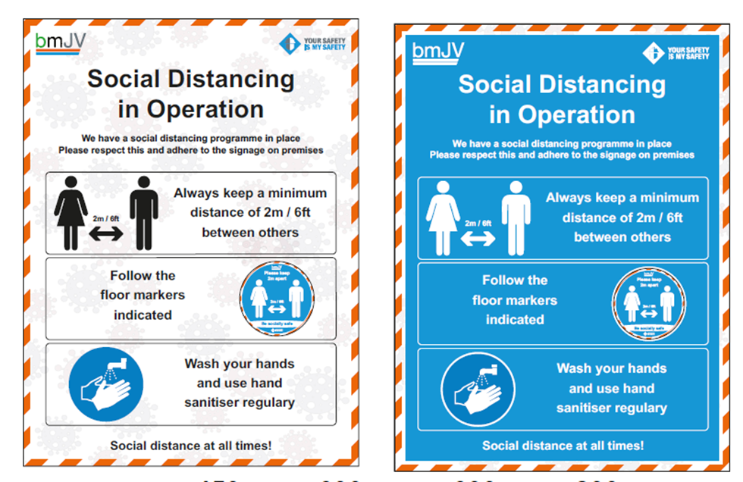
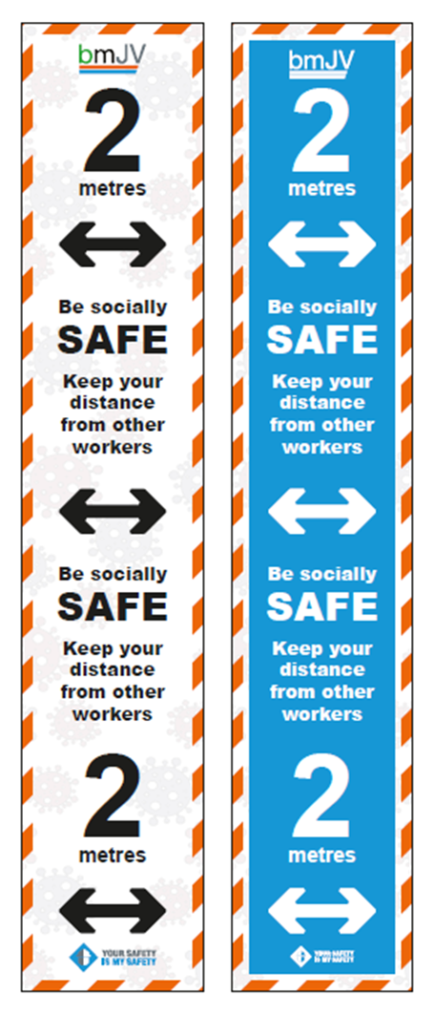
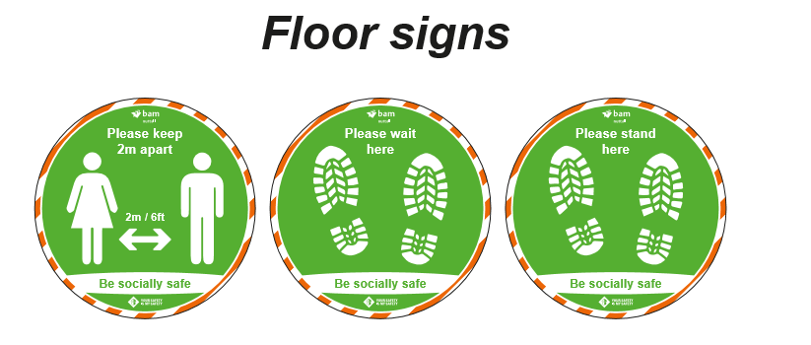
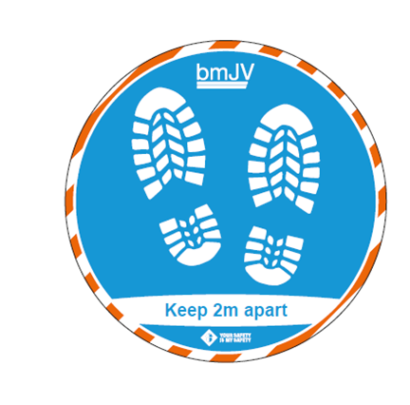
Signage

Slide 4
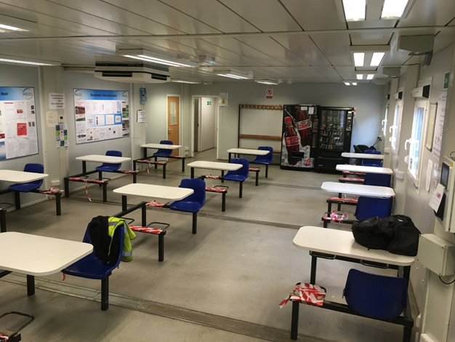
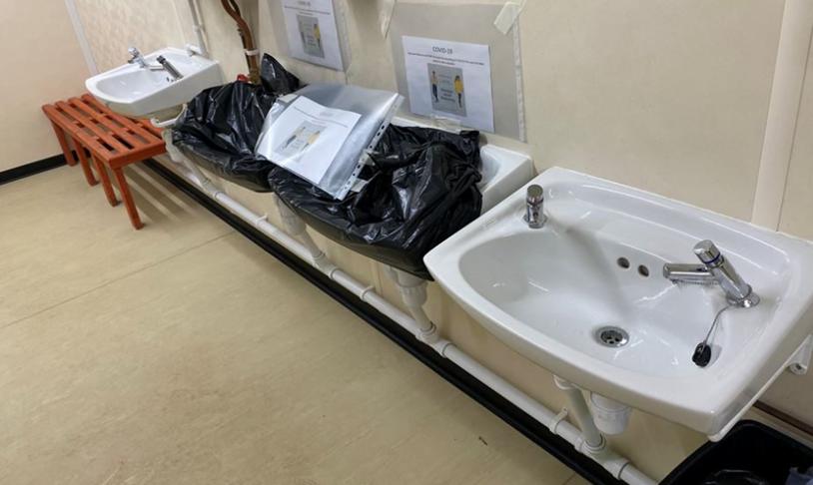
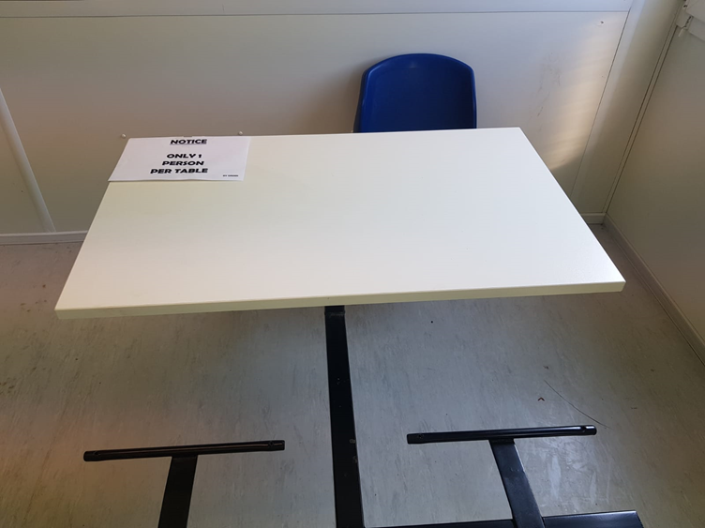
Welfare compounds

Slide 5
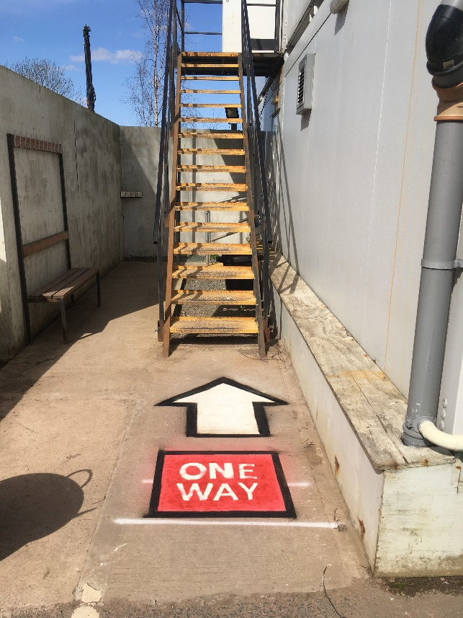
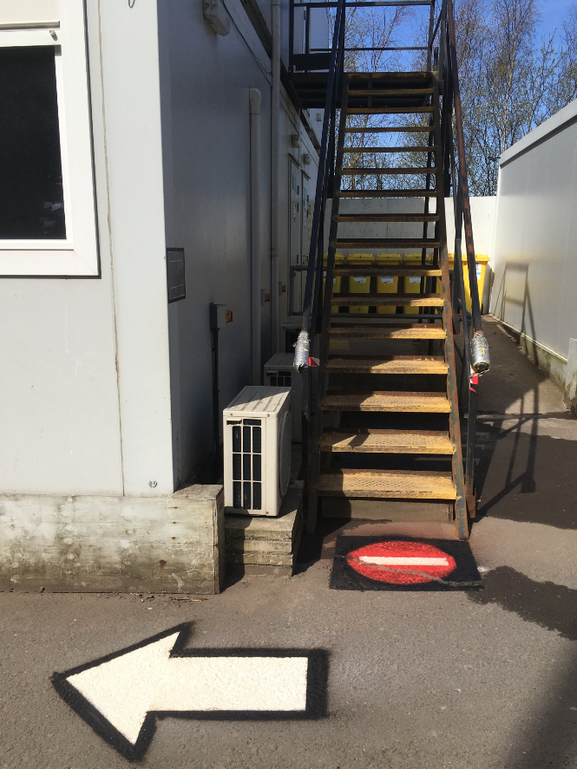
One Way Systems

Slide 6
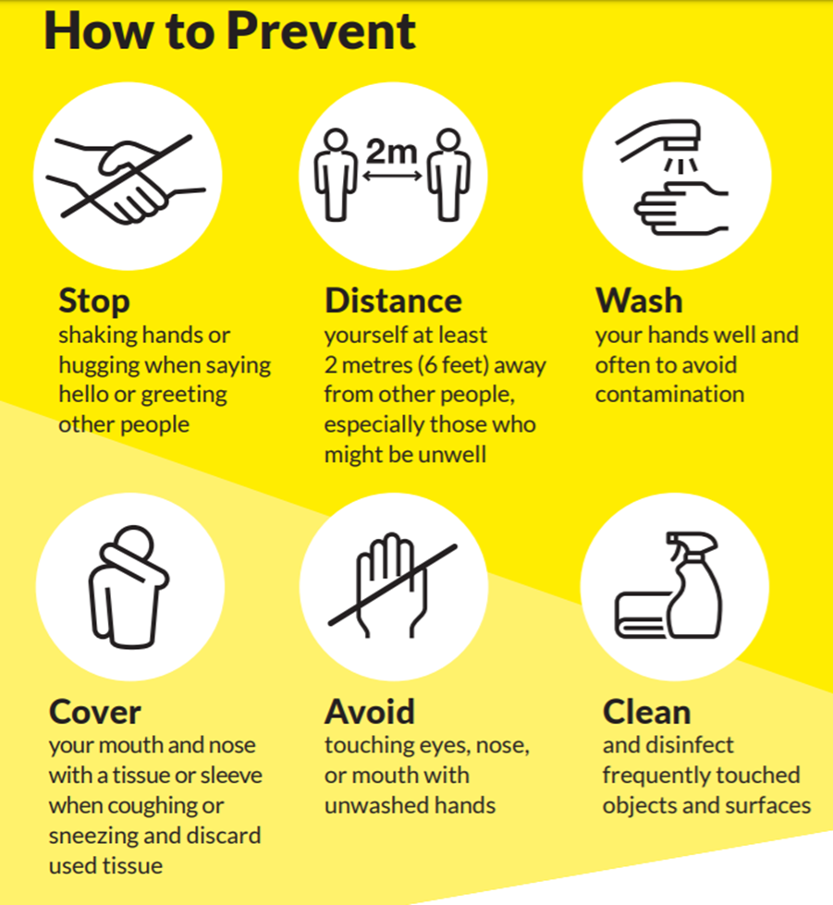
Enhanced Cleaning Regimes

Slide 7
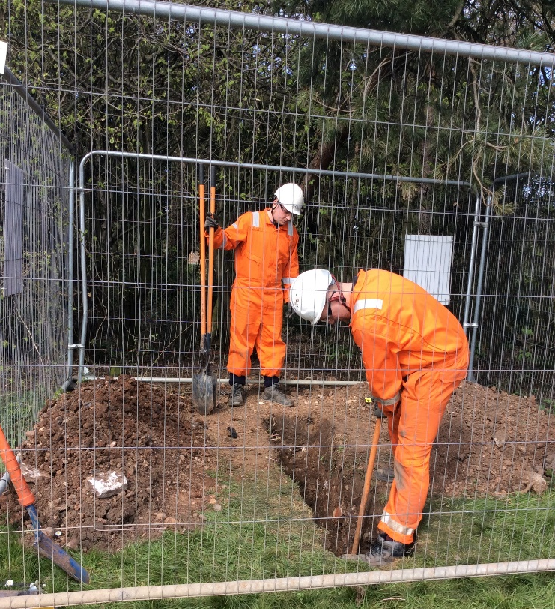
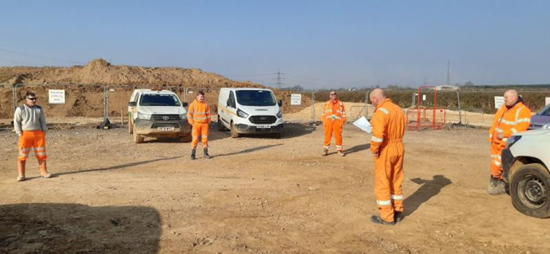
Social Distancing on Site

Slide 8
Virtual Safety Tours
Microsoft TEAMS and Site Team using an IPAD
Site team member stood in position of safety
Ability to record video and take still photos

Slide 9
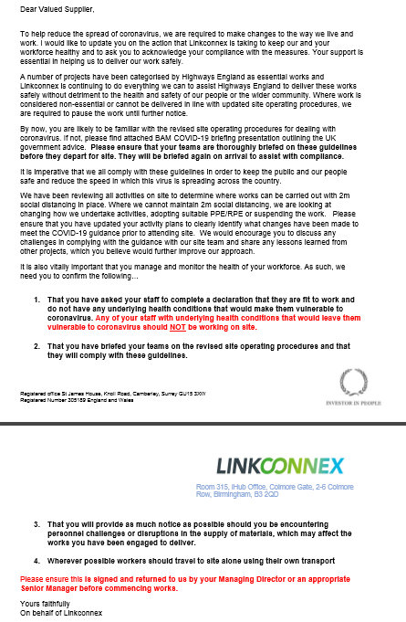
Early Interaction with SC

Slide 10
Key Activities Risk Review

Slide 11
Permit

