Slide 1
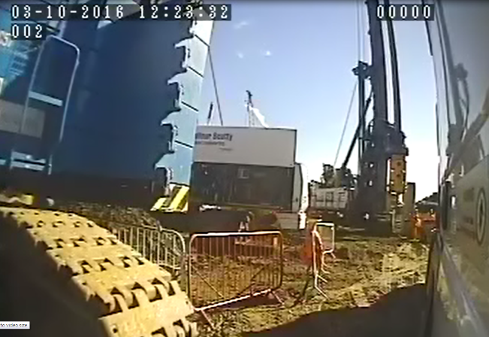

Plant Person Segregation
http://www.highwayssafetyhub.com/uploads/5/1/2/9/51294565/bbge_battersea_161003-1159_n4a0.wmv
Notes:
First lets remind ourselves what we are talking about; how familiar and complacent we can be around plant.
Play the video by clicking on the link
This incident was captured by a camera mounted on a works vehicle on Balfour Beatty Battersea power station project in 2016
This gives a short insight into why we need to look at a change in our mind-sets working near plant and to introduce controlled zones.

Slide 2
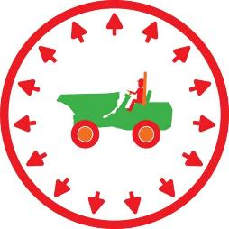
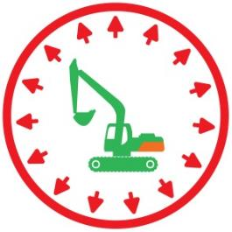
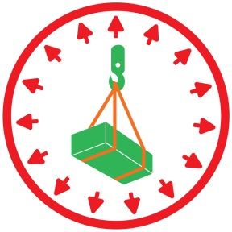
LIFESAVER
Never enter an exclusion zone.
Notes:
The number of plant person interface incidents have not reduced significantly and whilst they are not the most common cause of incidents; when they do happen the results are often very significant.
In the recent past the construction industry has seen many incidents involving plant and personnel coming into contact. The results are often serious life changing and unfortunately in some cases fatal.
Highways England projects are no different the list of incidents is all too familiar to us all.
A14 – Jamie Burnet Hit by a dumper, major injuries, life changing injuries.
A21 – Dale Pentney Hit by out of control HGV, when handbrake was not applied– Fatal.
M3 – Ben Collins Operative crushed by vacuum excavator/suction lifter – Fatal.
M1- Robert English Hit by a dumper, whilst working on a hard shoulder- Fatal.
LIFE SAVER Never enter an exclusion zone.

Slide 3
In the Zone
Notes:
Controlled zones
Introduction to controlled zones:
Three Controlled zones have been identified under which the majority of activities fall whilst carrying out day to day duties on site.
The three controlled zones have been defined as; Normal zones, Restricted zones and Exclusion zones.
Lets look at the different zones

Slide 4
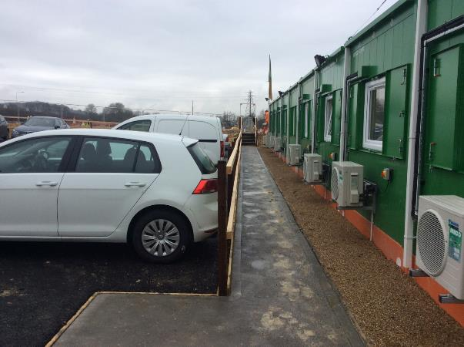
Normal zone
Notes:
Normal zone:
Normal working zones are not risk free and staff may require a site induction to access. They will include minor day to day hazards and will be accessible to all site personnel.
They are free from mobile plant movements. Examples being:
Safe walking routes
Offices
Footpaths in compounds
Car parking areas with designated footpaths and crossing points

Slide 5
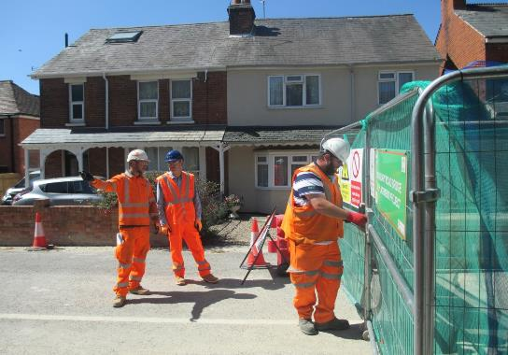
Restricted zone
Notes:
Restricted zones :
Restricted zones are areas where access is strictly controlled. All persons who enter a restricted zone must be authorised to do so.
Authorised persons must have received a site induction, be briefed on the relevant risks and control measures, confirm their understanding of the briefing and formally record it on a record of briefing form.
Restricted zones on sites should be clearly identified and controlled.
Controls may include:
Barriers with a controlled entry point.
Individuals responsible for authorising entry.
Signage to clearly identify the restricted area.
It is important to note, other restricted zones, such as confined spaces, are managed using a permit entry system and will continue to do so.
The cab of an excavator if suitable may be considered as a Restricted Zone within an Exclusion Zone.

Slide 6
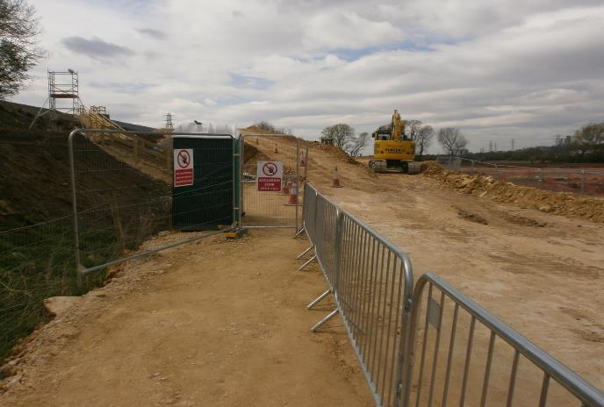
Exclusion zone
LIFESAVER
Never enter an exclusion zone.
Notes:
Exclusion zones :
An exclusion zone will almost always be located within a restricted zone, where as previously mentioned access is strictly controlled.
Exclusion zones should be identified during the planning stage and a Formal exclusion zone risk assessment produced.
The risk assessment will identify the control measures required to maintain the exclusion zone and must establish:
The person responsible for establishing and maintaining the exclusion zone.
The minimum dimensions/limits of the exclusion zone and how they will be established/identified
The method of suspending the zone and how this is communicated.
Who is responsible for agreeing that the exclusion zone is no longer required.
The obvious example of an exclusion zone being the slew radius of a working excavator or grab wagon, other examples would be lifting operations and haul roads.
So what should be in place?
First of all there should be a formal exclusion zone risk assessment in place, the person responsible for establishing the exclusion zone will have a copy of the risk assessment, and all of the control measures identified to hand, in order for them to establish the exclusion zone. These may be for example, an access gate, fences, a tape measure, signage, traffic cones, warning beacons, a member of staff to act as ‘gate man’.
The responsible person will establish and test the reliability of the exclusion zone before allowing work to commence.
Remember once an exclusion zone has been established and the plant is working entry into it is strictly forbidden.
Once the driver has lowered the bucket, applied the deadman, turned off the machine and given the thumbs up the area around the excavator becomes a restricted zone.
It maybe that an operation needs to be split down into tasks to ensure the safety of personnel with different zones being applied to each task. E.g. laying drainage pipes with a trench box would alternate between exclusion zone and restricted zone dependent upon the individual task taking place as part of that operation. Communication plus maintaining the zones are key to the safe system of work and safety of personnel involved in the operation.
In the picture shown on the slide, the whole area outside of the safety barriers is classed as an exclusion zone as mobile plant is operating up and down the haul road, and an excavator is working on the embankment. The cab of the excavator would be designated as a restricted zone within the exclusion zone. The remainder of the zone is an exclusion zone and will stay as such until suspended and communicated by the responsible person; it will then revert to a restricted zone.
LIFE SAVER Never enter an exclusion zone

Slide 7
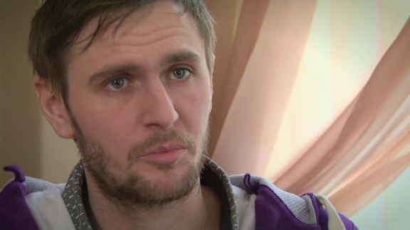
LIFESAVER
Never enter an exclusion zone.
Video
http://www.highwayssafetyhub.com/uploads/5/1/2/9/51294565/jamie_burnett_video-5_1.m4v
Notes:
You have probably seen this video before – it’s worth reminding ourselves what Jamie has to say.
Jamie was severely injured on the A14 project back in 2014
Play the video by clicking on the link
LIFE SAVER Never enter an exclusion zone

Slide 8
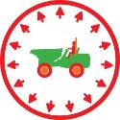
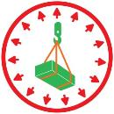


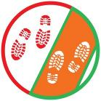

Thank you
Any Questions?
LIFESAVER
Never enter an exclusion zone.
Notes:
Thank you, any questions?

