Slide 2
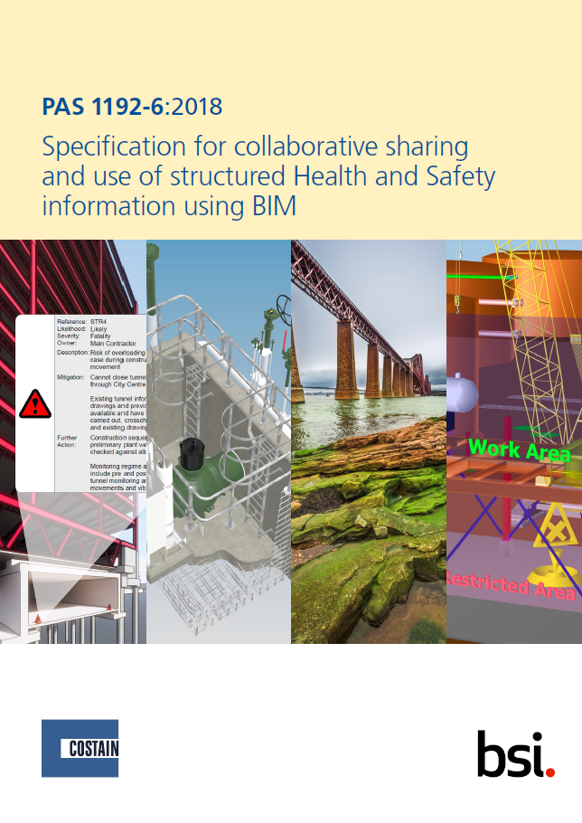
So why
do I need BIMsafe ?
PAS 1192-6 was published in February 2018, setting our obligations for embedding Health and Safety information into 3D models
This PAS specifies requirements for the collaborative sharing of structured H&S information throughout the project and asset life-cycles

Slide 3
Extracts from PAS 1192-6
PAS 1192-6 states
“The traditional tools of risk management used by H&S professionals, documenting safe systems of work through method statements base on risk assessments are variable in quality”
“There is a theory gap in the understanding of how to develop, use and apply these tools within information systems and digital processes”
“This PAS sets out to bridge this gap, explain how H&S information can be identified, shared and used by the key players in the construction process”
Notes:
The way people handle risks is very haphazard. Some do it well, some do it badly, and some ignore it… The PAS states this is what you should show.
No specification before, but now you can work to one. Don’t ignore what the industry is saying / leading. HSE knows the specification is there, if an accident occurs, why haven’t you followed it.

Slide 4
Aims of
PAS 1192-6
The PAS specifies how to use H&S information in order to:
provide a safer and healthier environment for end-users;
b) mitigate the inherent hazards and risks across the whole project lifecycle;
c) result in improved construction safety performance, less incidents and associated impacts;
d) provide for clearer, more assured and relevant health and safety information to the right people at the right time
e) reduce construction and operational costs
Notes:
What does this mean for you? How do you currently implement this?

Slide 5
Extracts from
PAS 1192-6
Paragraph 6.3.1 General states
The design team shall use the H&S information, provided by the client and others throughout the design process, to identify hazards, mitigate the apparent risks and produce an inherently safer design solution for end-use, commissioning and construction
The design team shall provide and make available H&S information required by the client and as needed by others for their use in developing an inherently safer design solution
Notes:
Need to proactively enable risk management

Slide 6
Extracts from
PAS 1192-6
Each designer shall examine the H&S information requirements set out in their contract and the EIR to:
identify and include the stated and apparent hazards and risks in their approach to design risk management (6.3.5).
identify and include the client specified design risk management tasks in their approach to design risk management (6.3.5).
identify and schedule the H&S information required by the client; and determine the purpose of the H&S information required and the criteria for providing such information to the client
Notes:
Being the safest provider isn’t something you’d be interested in doing right now, is it?
It’s guidance, yes, but being proactive in the health and safety of your teams isn’t that critical is it?

Slide 7
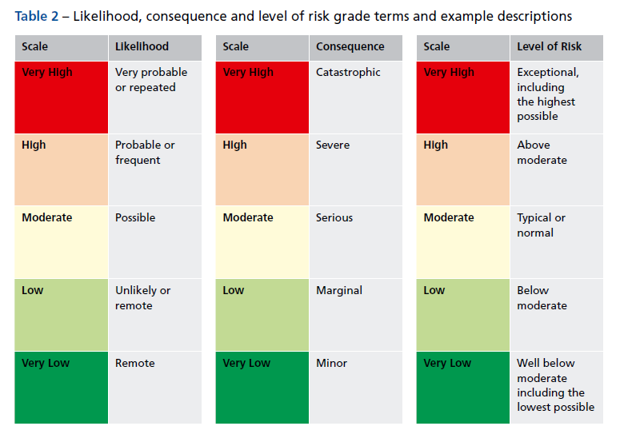
Delivery of risk information Table 2
Notes:
The product mirrors the guidance regarding risk in PAS

Slide 8
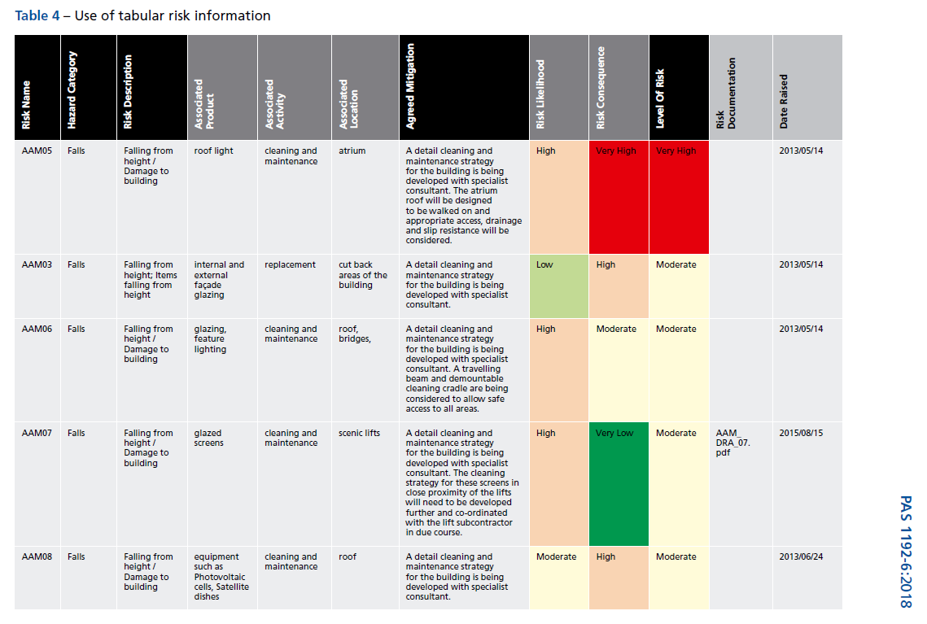
Delivery of risk information Table 4

Slide 9
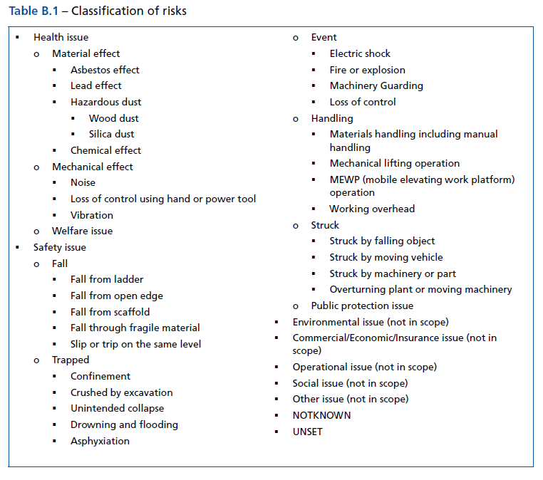
Classification of risks
Notes:
Environmental is included in our tool.
Taken the suggested risks and added to it.
Taking the guesswork out of Health and safety. Use the app and you will be aligned to the guidance

Slide 10
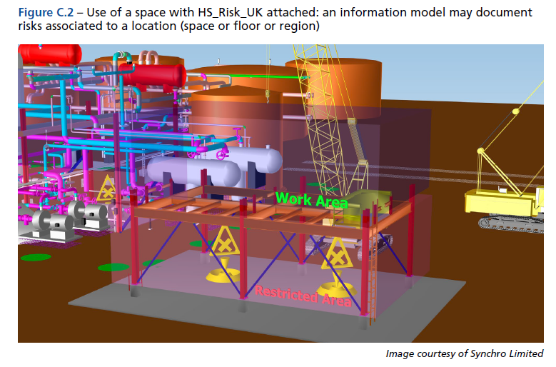
Viewing risks in a 3D model
Notes:
As suggested by PAS. But doesn’t show you what the risk is about.
We have improved on these symbols and made the risks instantly recognisable.

Slide 11
This is why you need BIMsafe
We have developed a PAS 1192-6 solution for you which addresses all of your needs.
We provide you with all of the tools you need, including:
A bespoke Designer Risk Register, Risk Assessment and Method Statement and Temporary Works Register
3D symbols in either the Autodesk, Revit or Bentley formats which you can insert into your model
Automatic guidance from Callsafe Services, the HSE and CIP Knowledge
Notes:
Construction Industry Publications
QR codes available at end. Print poster with QR code and put it on site. – transfer designer’s thoughts on site with the QR codes. Other apps leave he risks inside the model and not transferred to the site.

Slide 12
So how does it work ?
Simply, identify the risks you think exist on your project/site
Complete the appropriate database (DRR, RAMS or TWR)
Select the appropriate risk from the pull-down menu
Place the 3D block or cell into your model
Add hyperlinks from the databases to the 3D symbols within the model
Take your completed model onto site with all of the attached information
Notes:
Other applications don’t give you guidance – the guidance is automatically populated. Have callsafe services as a back-end to the process (H&S training business) – videos from callsafe / HSE website / CIP knowledge (subscription based)
The symbols are based on hazard warning signs, others are not – just an exclamation mark so you can’t tell the risk.

Slide 13
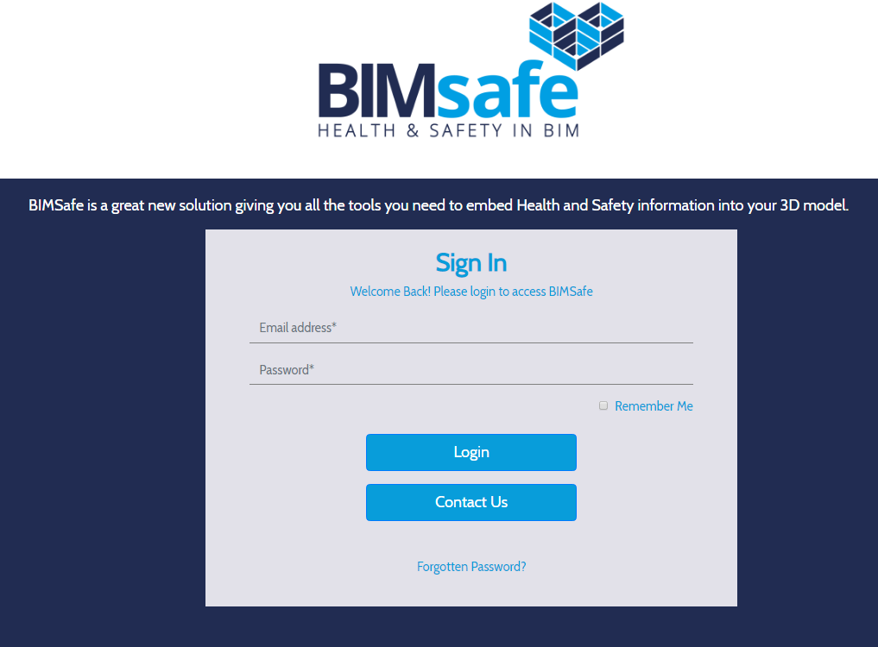
Secure sign-in to the BIMsafe Package
Notes:
Offline version coming this month

Slide 14
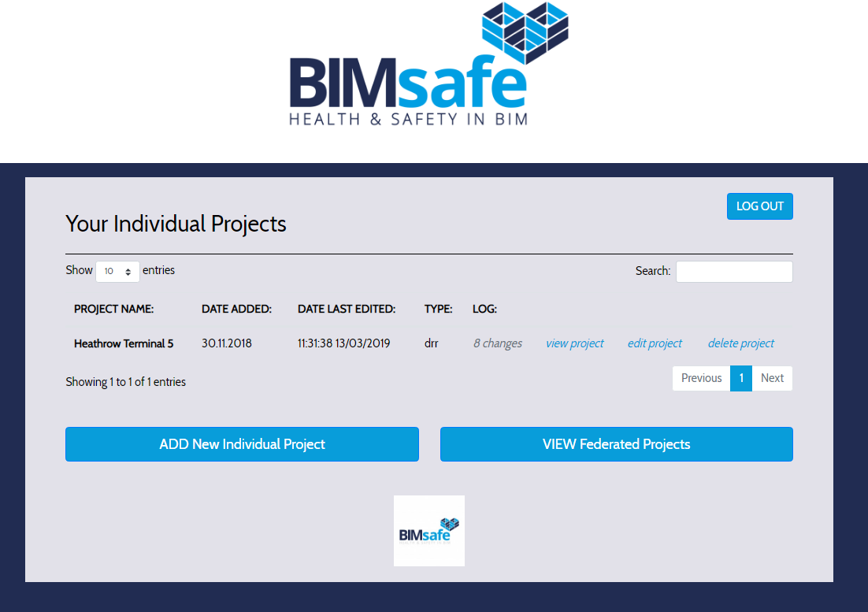
Add or select the project you wish to work on

Slide 15
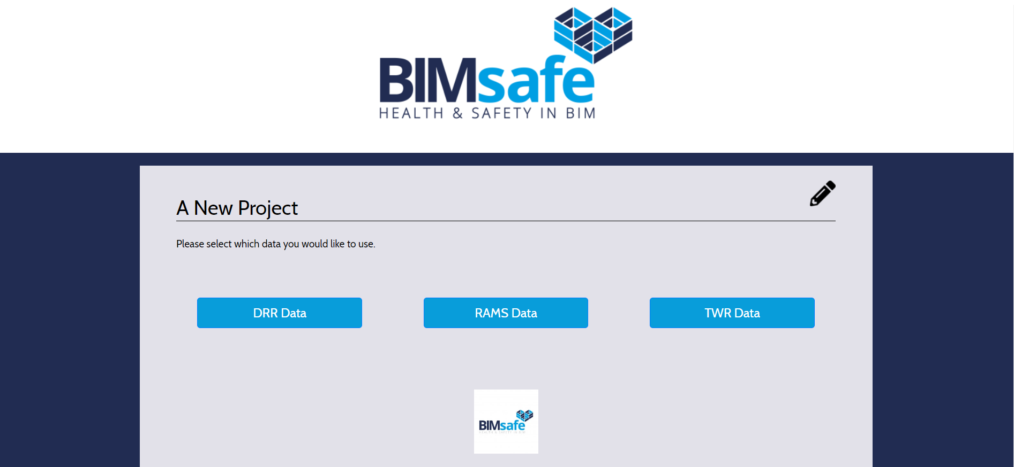
Select the data you wish to work on
Notes:
DDR = DRR

Slide 16
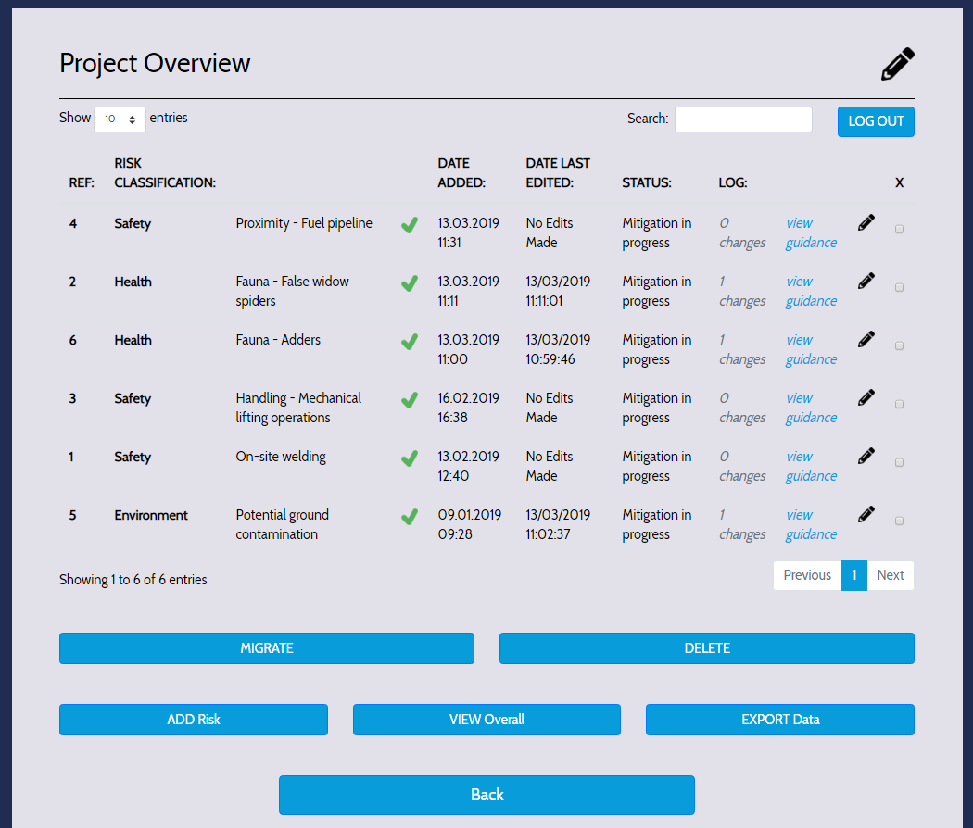
Project Overview

Slide 17
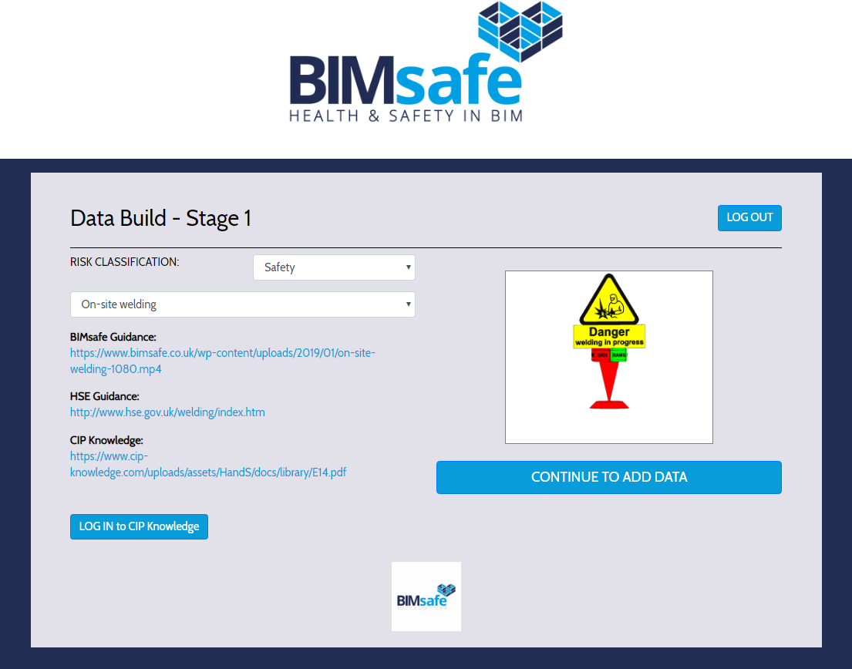
Data Build Stage 1
RISK CLASSIFICATION selected from drop-down menu – PAS 1192-6
Select risk from drop-down menu – PAS 1192-6
Guidance related to risk automatically completed
LOGIN to CIP Knowledge

Slide 18
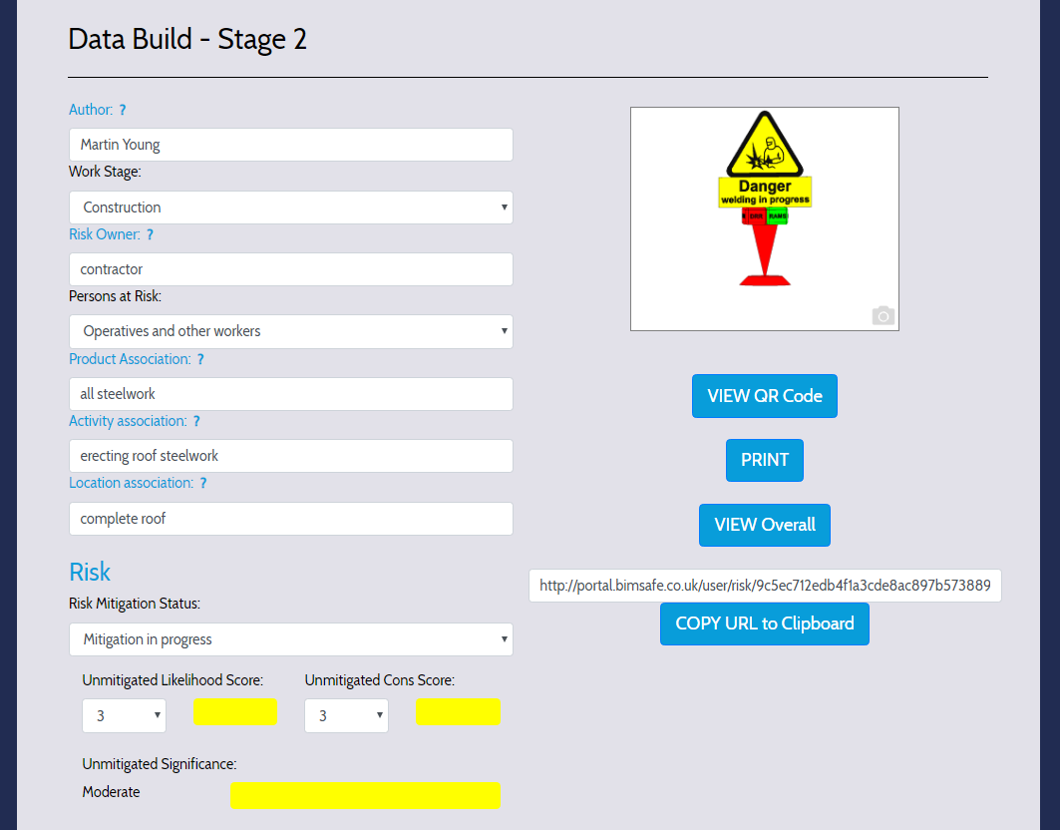
Data Build Stage 2
Preview of symbol
Generate and download a PDF document with either a particular risk or all risks on a project
Risk address to be added to the symbol in your software
Mitigation status selected from drop-down menu
Risk scores from PAS 1192-6

Slide 19
Data Build Stage 2

Slide 20
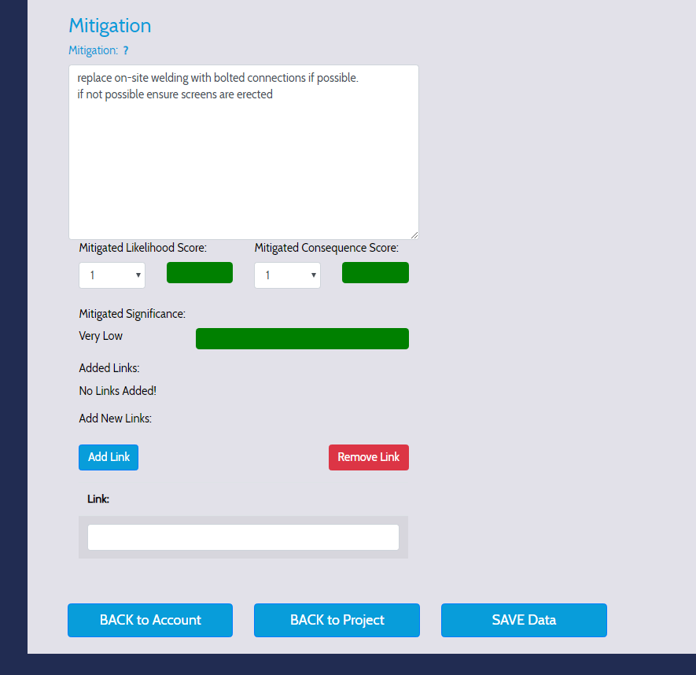
Data Build Stage 2
Mitigation allows you to enter details of your mitigation
Risk scores from PAS 1192-6
Add link allows you to add numerous links to your documents
BACK to Project goes back to the Project Overview screen
SAVE Data saves your entries and updates the Project Overview screen

Slide 21
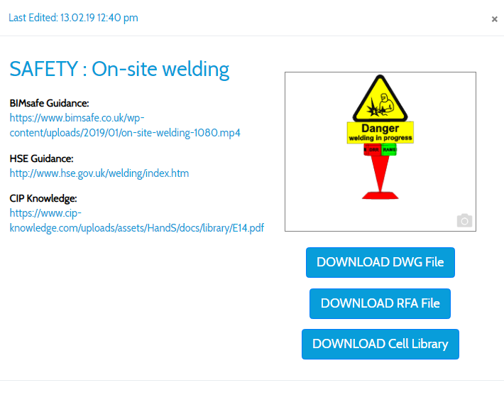
Data Build Stage 2
Preview of symbol
Guidance provided automatically
Download links for the 3D symbol in either the Autocad dwg format, Revit rfa format or as a Bentley cell library

Slide 22
A sample of a few of the 3D symbols

Slide 23
Symbols placed into the 3D model

Slide 24
Add information to the symbols from the databases

Slide 25
Some of the features of BIMsafe
60 years combined experience of construction health and safety, design and CAD experience at your fingertips
Compliance with PAS 1192-6, assistance with CDM2015 and BS 5975 requirements
Databases information hyperlinked to 3D symbols within models
3D symbols provided in either Autodesk, Revit and Bentley formats
Bespoke Designers Risk Register, Temporary Works Register and RAMS
Free upgrades for the first year
Risks automatically linked to the HSE website, the CIP Knowledge and Hazard Videos
Discounted access to Health & Safety and CAD advice and training
Help and Guidance provided automatically

Slide 26
Book your own demonstration
We will come to your offices to provide you with your own demonstration, or by webinar
You can try the package yourself
Explore how the BIMsafe package can be tailored for you
Call 0800 772 3605 or
Email info@bimsafe.co.uk
www.bimsafe.co.uk

