Slide 1
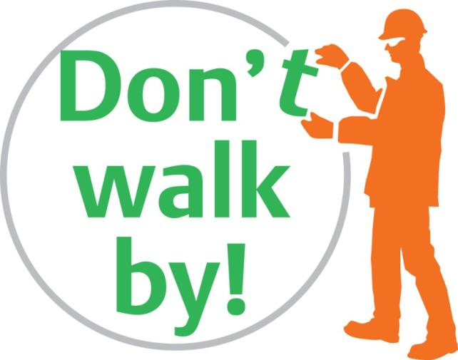
Choose to be safe
Notes:
Welcome people to the briefing
At BAM Nuttall we choose to be safe – If we see something unsafe we Don’t walk by! No one is going to get hurt here.
It is our aim to give you a safe working environment so that you go home unhurt at the end of each working day. This will only happen if you also choose to be safe. Please look after your work area and ensure it is a safe place for you and other people. We have an open, honest, culture that allows you to take action if you do find an unsafe situation. We ask that you don’t walk by and make it safe. You should never put yourself or others at risk in doing so. If it’s simple and safe then sort it. If you need assistance – speak to your Supervisor. If you see unsafe behaviour then you are free to challenge the individual involved in a respectful way that shows your concern for the other person. Best of all, set a good example by acting safely yourself and don’t do anything that could put anyone else at risk.
If we Don’t walk by! we will all have a safer and happier workplace where people show a genuine concern for each other. So please choose to be safe and look out for yourself and others. This is surely what we all want and expect. If you have any questions please ask your Supervisor.

Slide 2
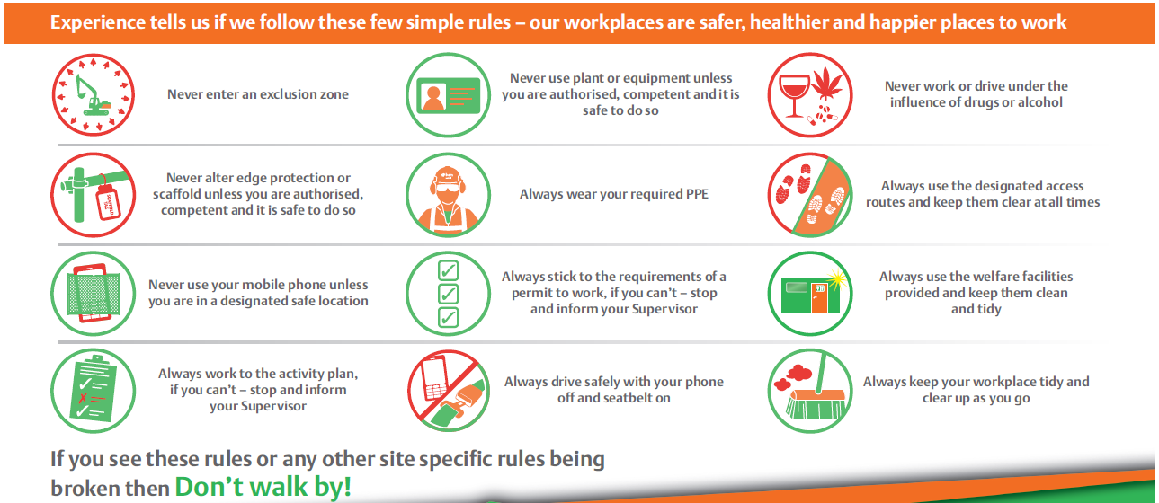
The Rules
Notes:
The Rules
We have the twelve rules of Don’t walk by!
The rules are there to keep us from being hurt. Once we’re hurt we can’t turn back and undo what’s happened. A rule that seemed unnecessary often becomes the opposite when we’re heading towards the local A&E. So let’s make the rules necessary and worth sticking to before we learn the hard way.
There are twelve Rules – these have been created through a review of incidents and observations received in recent years. Some relate to serious hazards encountered on site – others on issues which crop up regularly in observations, inspections and near miss reports. This month we will concentrate on rule number 1 – ‘Never enter an exclusion zone’ and give a briefing on it.

Slide 3
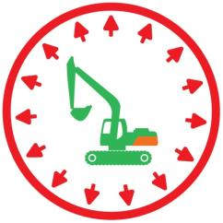
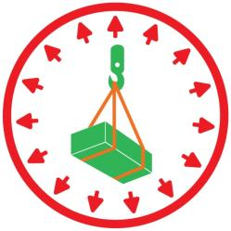
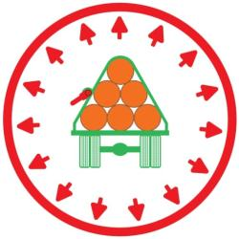
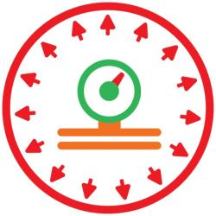
Rule 1
Never enter an exclusion zone
Notes:
Rule 1 - Never enter an exclusion zone
This is rule number one for a simple reason - if you never enter an exclusion zone your chances of being seriously hurt or killed are vastly reduced.
The three main causes of fatality in construction are:
Being struck by plant
Being struck by a falling object and
Falls from height
The first two relate directly to exclusion zones.
As we work we create locations which should not be entered as it could lead to serious injury or a fatality. These are ‘exclusion zones’ and we can often recognise them instinctively. We sense danger and act on it. They can be large areas or limited locations relative to a specific activity. For example:
The operating area of an excavator or dumper.
The area adjacent to or under a slung load.
Areas where there is a possibility of a sudden release of forces such as when a tight ratchet is loosened on a load.
Areas around systems under pressure such as concrete pumps, pipe bungs and compressors.
Exclusions zones represent one of the major hazards on our sites and being in such an area can and does lead to serious injuries every year.
Spend a few minutes discussing where the exclusion zones on the project are.

Slide 4
1
Mobile plant
Seen is safe
Never enter an exclusion zone
Notes:
Mobile plant – be seen be safe
The areas where mobile plant operate are among the most dangerous locations on our projects. If you are struck by the bucket of an excavator experience tell us you will be lucky to survive. If you are caught by the tracks of an excavator you will be seriously injured. Mobile plant does not compromise – it is extremely dangerous. You cannot afford to let your guard slip and be complacent around this equipment.
Never enter the slew area of an excavator if the machine is operating and the driver is unaware of your presence. If you are working with mobile plant – you must constantly find a place of safety. Do not linger in operating areas even when plant is idling. Do not use a mobile phone and do not stand in areas where operators may not be able to see you.

Slide 5
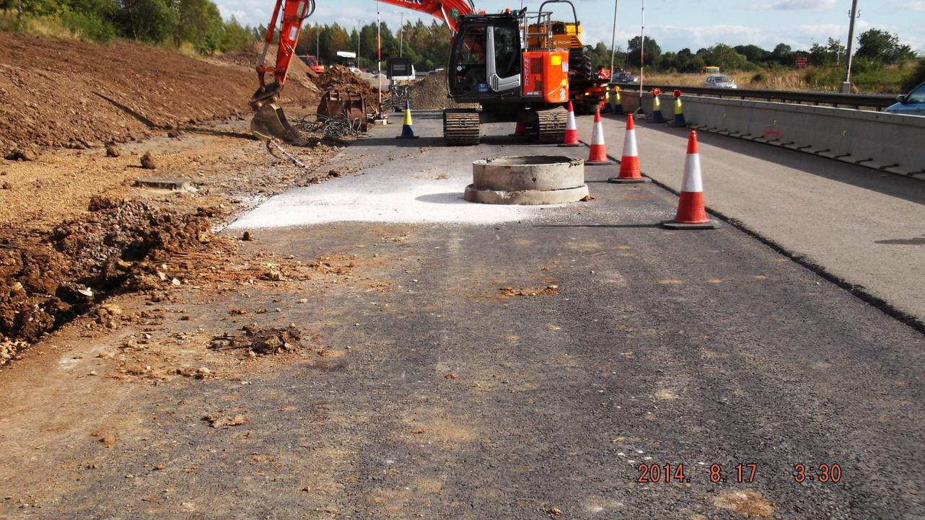
1
Mobile plant
Seen is safe
Never enter an exclusion zone
Notes:
Mobile plant – be seen be safe
As recently as January this year a man was struck by a reversing excavator on one of our projects. He sustained serious leg injuries and is still in hospital nearly four months later.
Last August a young banksman was run over by a dumper as he sat on a manhole ring between loads – lets hear from him what happened. Play victim video.

Slide 6
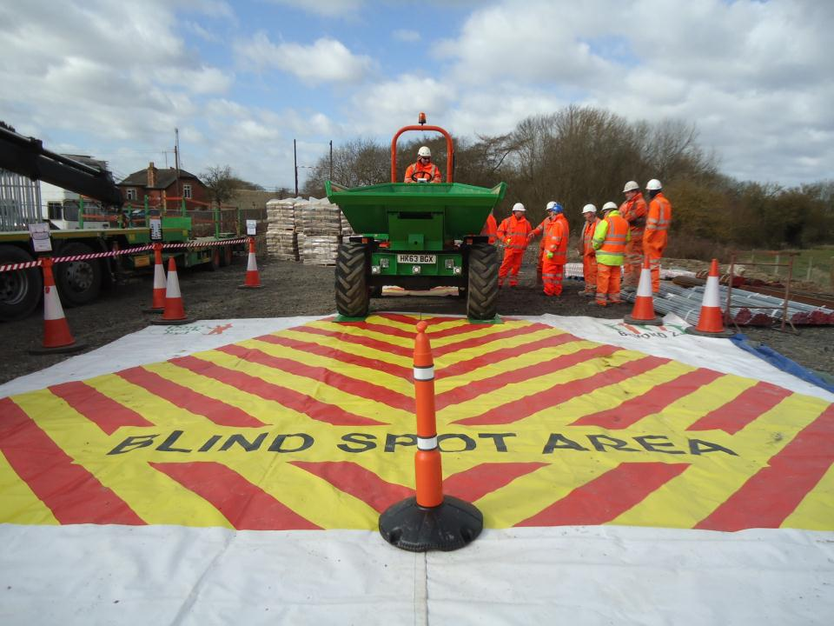
1
Mobile plant
Seen is safe
Never enter an exclusion zone
Notes:
Mobile plant – be seen be safe
So - There are many items of mobile plant on our sites.
They all have a series of blind spots.
We try to mitigate the risk by fitting them with:
Mirrors
Sensors
Cameras
We have introduced rules around approaching excavators – getting the operator’s attention, ‘thumbs up’, bucket down.
We have minimized the presence of banksmen with machines and of people generally around mobile plant.
We have asked people to ‘get in the cab’.
Yet – on a regular basis – people are severely injured - being struck by plant.
If you operate this type of plant you will be more than aware of the challenge of operating this type of equipment when people are in the location. Ask if any plant operators want to share their experiences.
Never approach an item of operated mobile plant until it is safe to do so. Make sure the operator is aware of your presence and has made the machine safe. Until that is done – the area is an exclusion zone.

Slide 7
1
Lifted loads
Look up
Let go
Never enter an exclusion zone
Notes:
Lifted loads – look up and let go
Every year there are significant number of incidents and injuries during lifting operations.
Slinger/signallers are particularly vulnerable – injuries usually occur as loads are being lowered into position when hands and feet can be trapped as loads are being maneuvered into position for landing..
Landing areas are never perfect and often there are items or structures adjacent to the landing area.
So it is important to keep these areas free of waste materials and people not involved in the operation.
Loads should also be checked before they are lifted for loose items that could fall off in transit.
Never stand under suspended loads and remember loads should only be slung by competent people with the appropriate CPCS card.

Slide 8
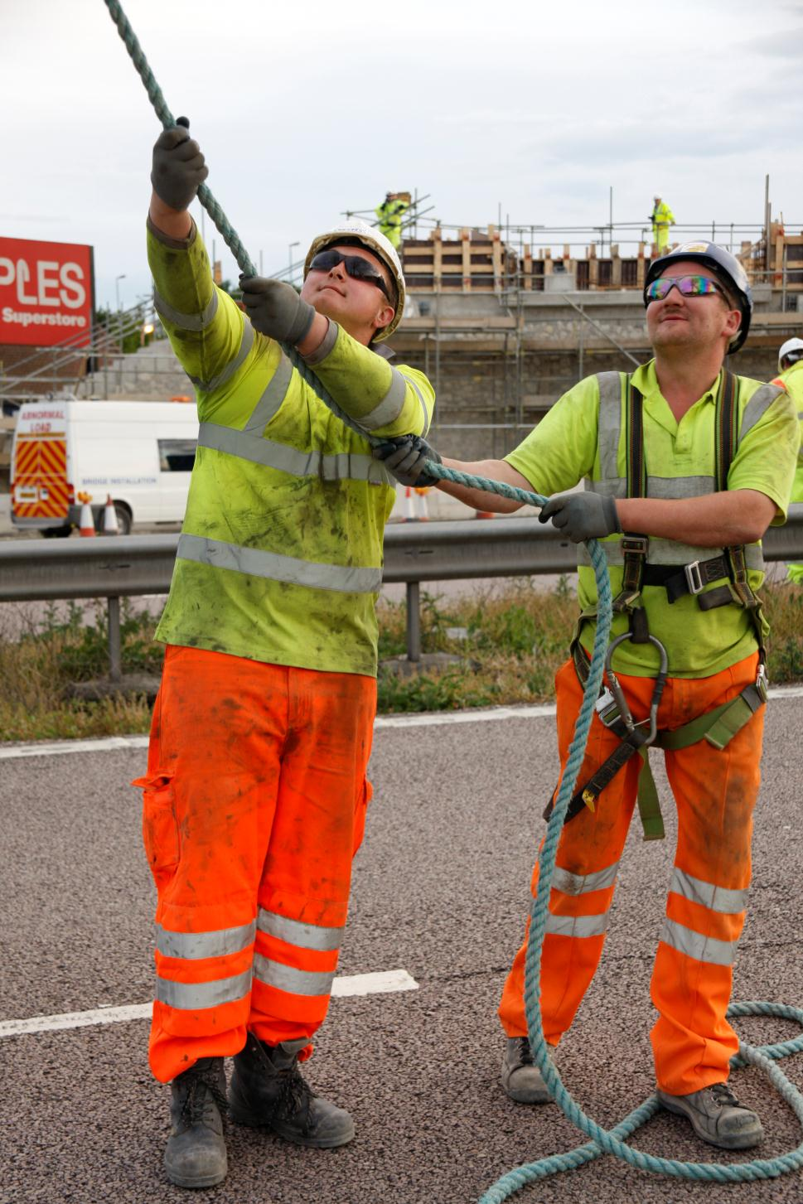
1
Lifted loads
Look up
Let go
Never enter an exclusion zone
Notes:
Incident during a lifting operation
Never stand directly under a slung load.
If it releases you are in trouble.
If you are a slinger always check the integrity of slings/chains/grabs and any other lifting accessory before use.
If there are cracks on welds or missing bolts in lifting frames – don’t use the equipment.
Make sure the load is stable and lifting accessories are slack before unslinging a load.
Never reach inside a grab mechanism to sling or unsling a load.

Slide 9
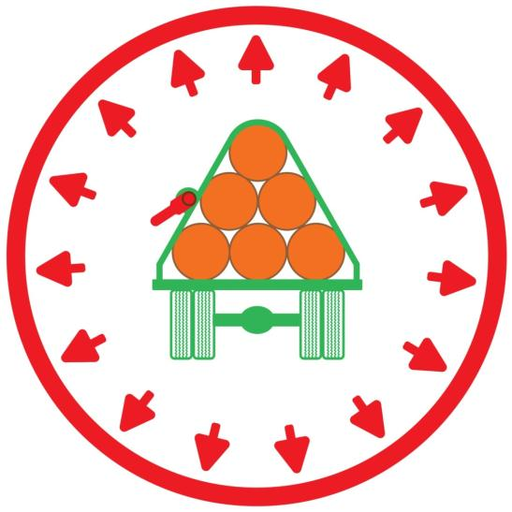
1
Secured materials
Release with caution
Never enter an exclusion zone
Notes:
Secured materials – release with caution
There have been a number of serious injuries sustained during the unloading of materials from flatbed wagons.
Unloading materials is actually one of the most hazardous activities on our projects.
In particular the sudden release of forces built up in loads during transit. Particularly when releasing ratchets or banding securing loads. Never stand next to load as it is released unless you are sure it is stable and not under tension.
It is important that the people undertaking the unloading of vehicles are experienced and have the competence requirements required for example a slinger/signaller competence and ALLMI or CPCS cards being held the delivery vehicle operator.

Slide 10
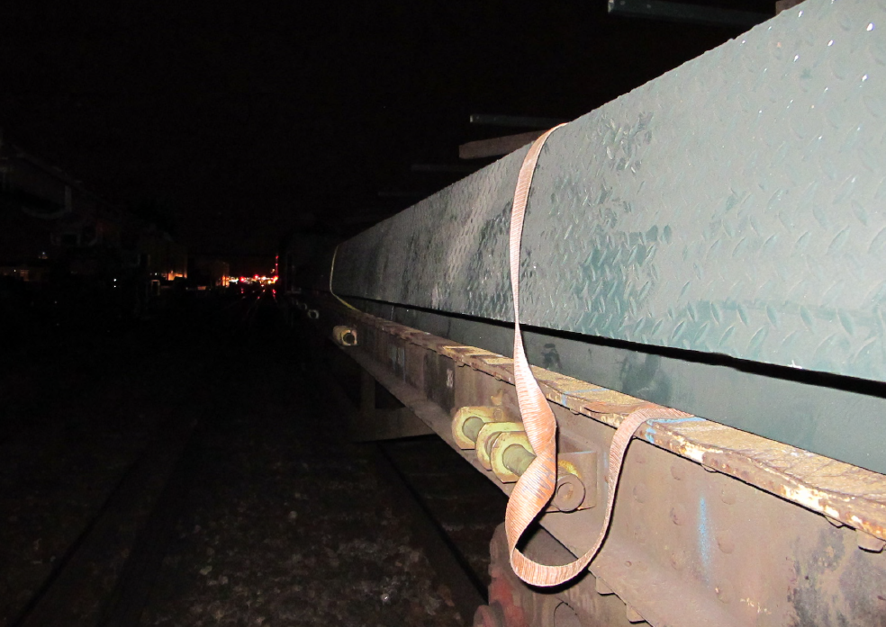
1
Secured materials
Release with caution
Never enter an exclusion zone
Notes:
Secured materials – release with caution
In December 2010 during a rail possession a slinger undid a ratchet securing a steel beam to a rail wagon. The beam had shifted in transit and was unstable – it fell over trapping both of the slinger’s legs against the deck of the wagon. He lost one leg and is still undergoing treatment on the other leg.
In May 2015,he returned to work in an office role.
5 years of his life so far have been focused on a partial recovery.
Always check the stability of a load before releasing securing straps or ratchets. If in doubt – leave it.

Slide 11
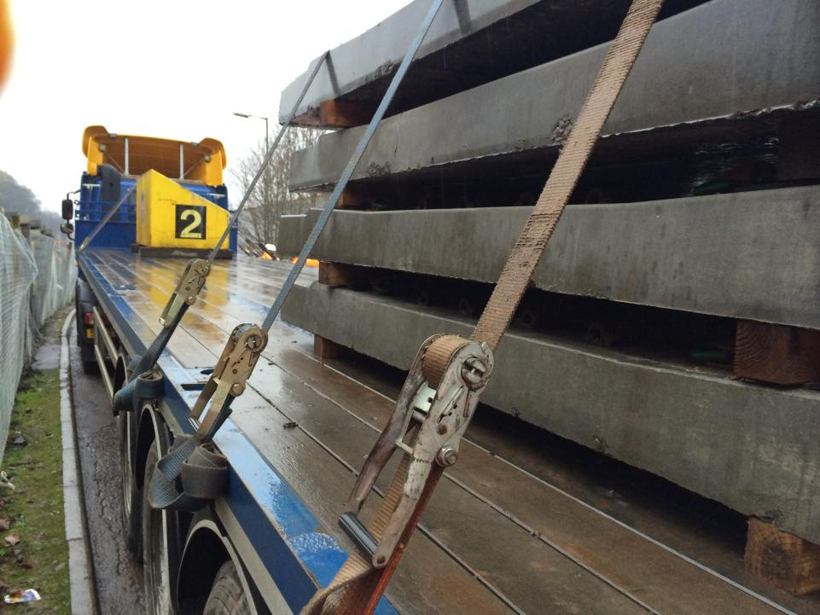
1
Secured materials
Release with caution
Never enter an exclusion zone
Notes:
Secured materials – release with caution
Always check the stability of a load before releasing securing straps or ratchets. If in doubt – leave it.
The same principal applies to any situation where an item is in tension.
If you are releasing banding around materials such as kerbs or breeze blocks – again ensure you are not releasing loads that cam make the pack unstable - and wear your safety glasses. Banding has a habit of springing on release and there have been incidents of people being struck in the face.

Slide 12
1
Pressure systems
Stay on your guard
Never enter an exclusion zone
Notes:
Pressure systems – Stay on your guard
We carry out a number of operations involving pressurized equipment. There have been a number of incidents whereby sudden pressure release has lead to injury.
These include:
Cleaning balls being projected out of concrete pumps.
Failure of couplers on hoses.
Test bungs being projected out of pipes.
You must stay on your guard and vacate discharge areas when concrete pumps are being cleaned.
It is important that hoses and pipelines are regularly inspected and the correct whipchecks are in place.
Ensure that large pipe bungs are propped in accordance with manufacturers recommendations and monitoring is carried out at a safe location.

Slide 13
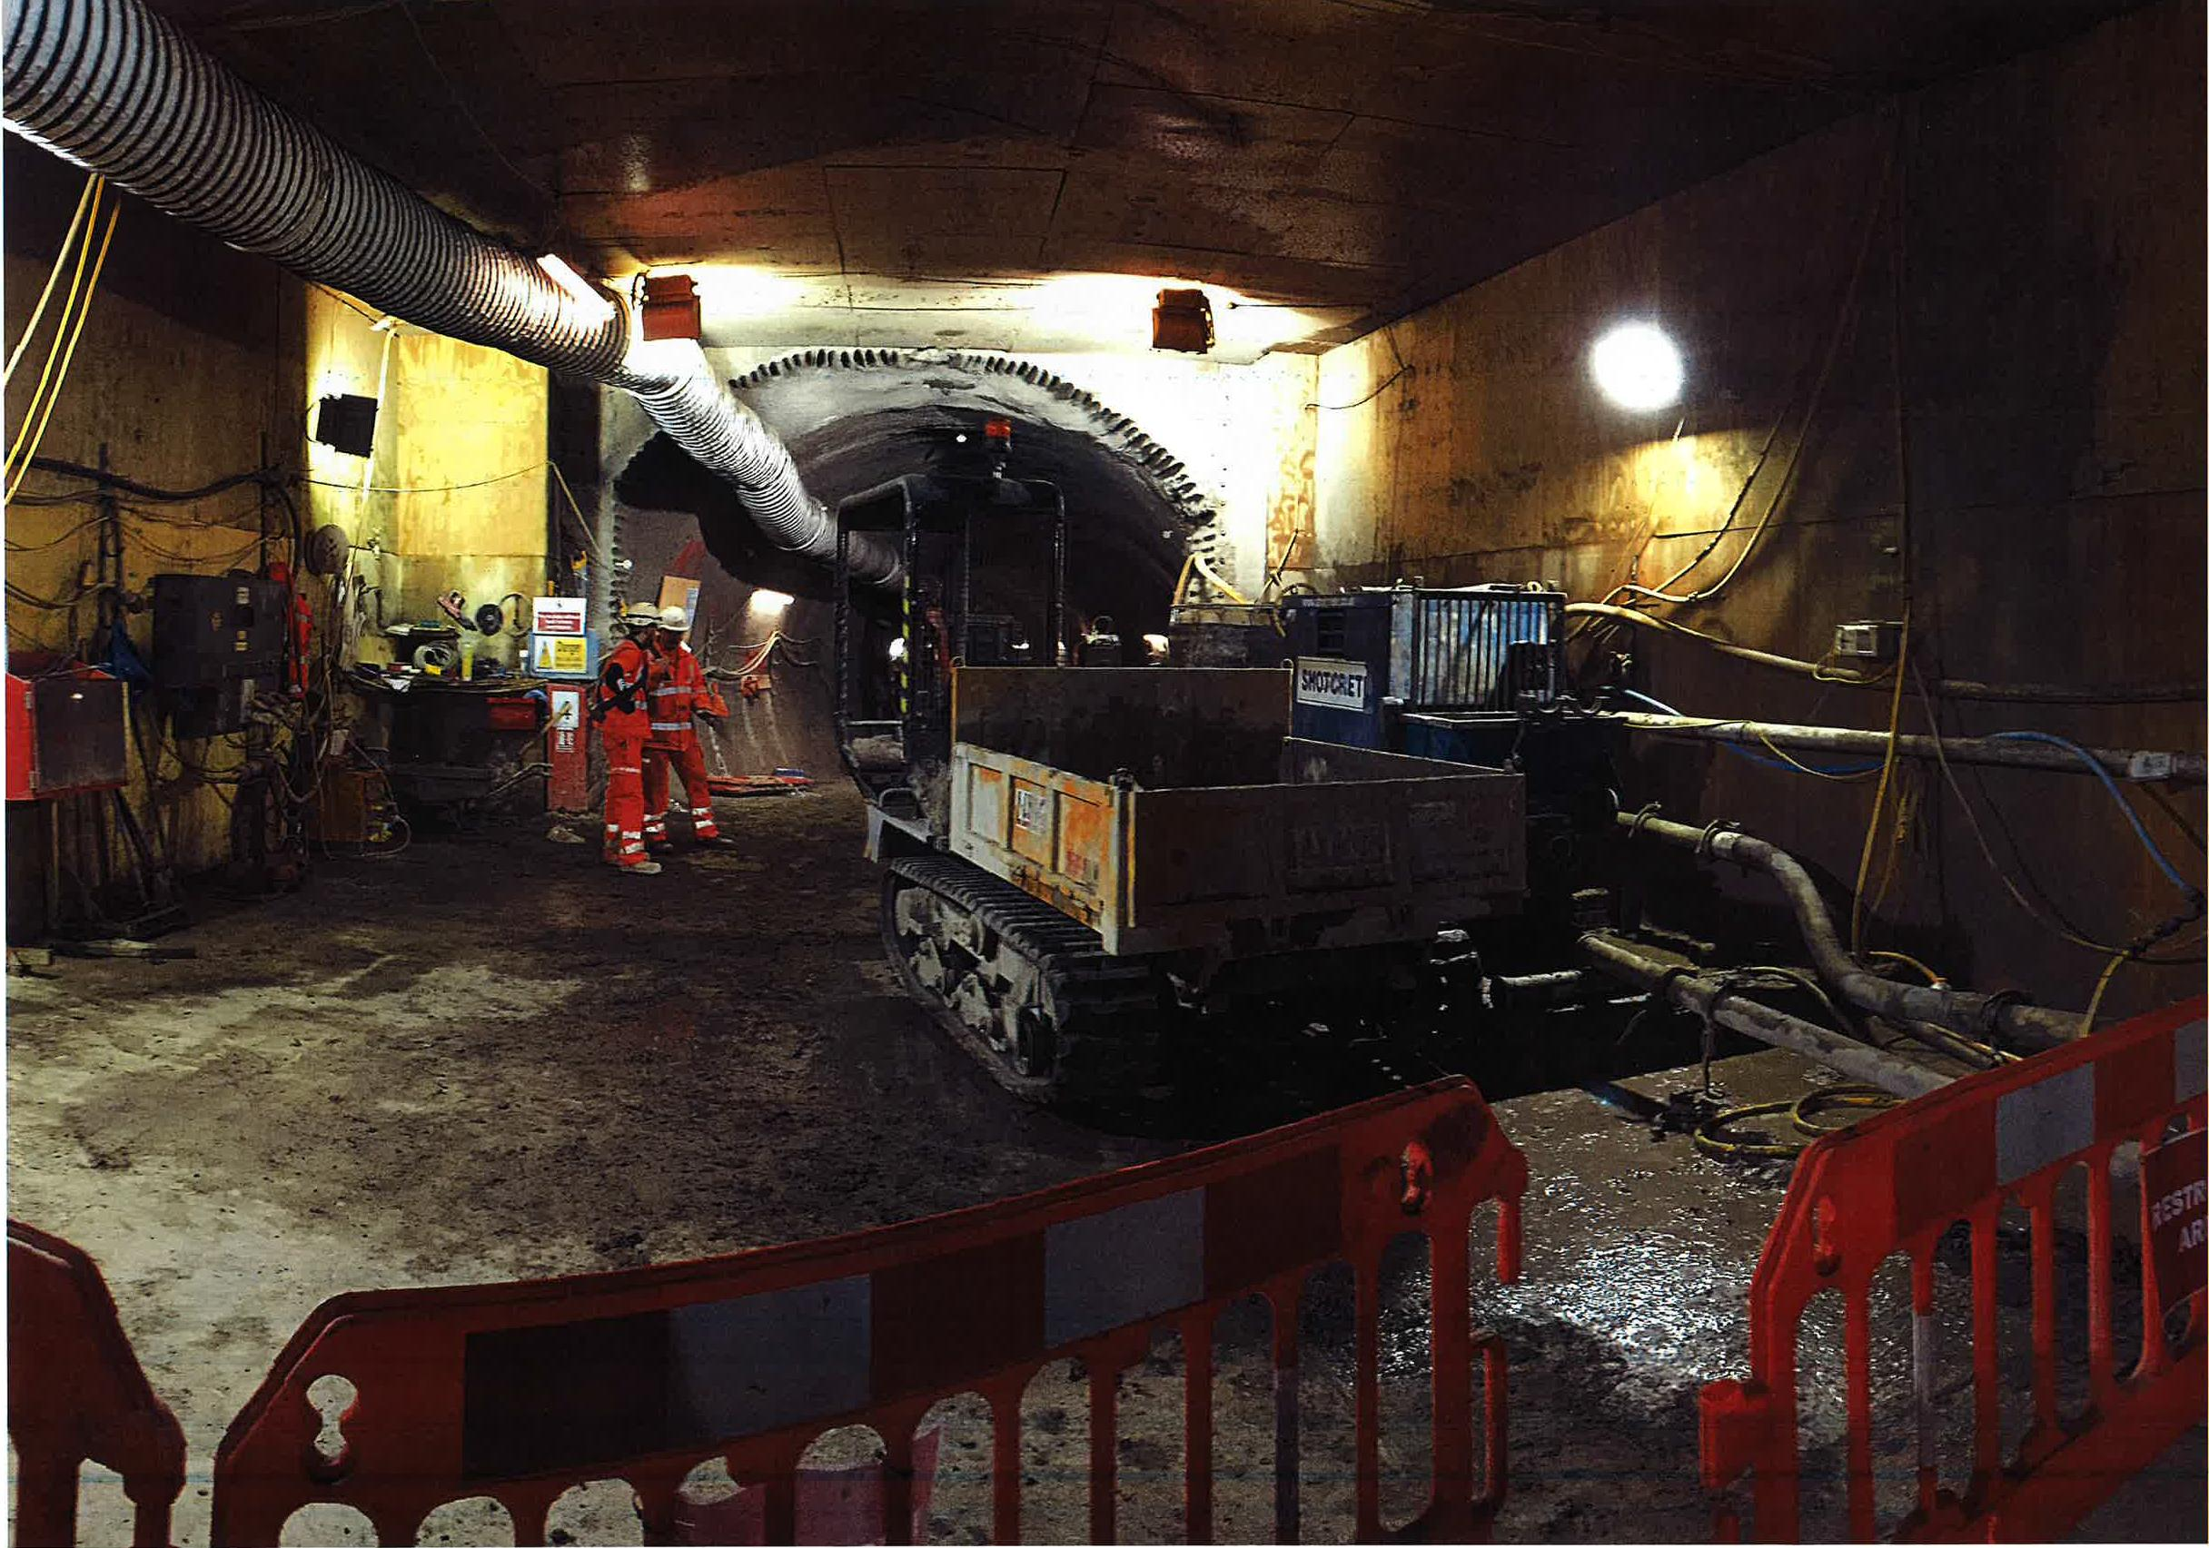
1
Pressure systems
Stay on your guard
Never enter an exclusion zone
Notes:
Pressure systems – Stay on your guard
In January this year an operative was clearing up in the area in front of a concrete pump. The cleaning ball was suddenly discharged through the system and on exit struck the operative on the leg. He fell over, striking his head on some machinery and fractured several fingers. He has not returned to work since.
Cleaning balls used to clear concrete pumps are regularly involved in serious incidents. Often there is poor communication or operating procedures are not followed during the cleaning process.

Slide 14
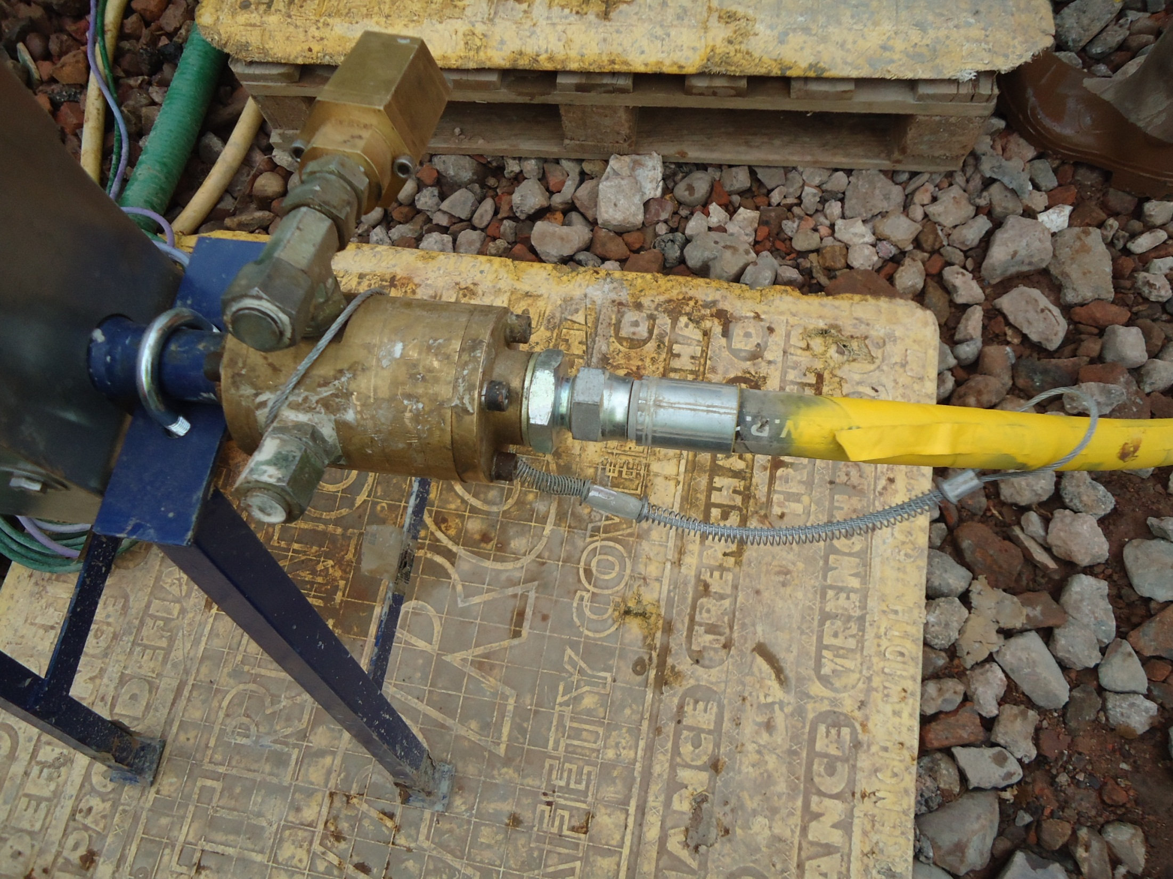
1
Pressure systems
Stay on your guard
Never enter an exclusion zone
Notes:
Pressure systems – Stay on your guard
When working with compressed air or grout pressure systems the maintenance of the plant involved is of particular importance. Whip checks must be fitted properly to all couplers and must be undamaged and of the correct rating for the coupler involved. Coupling must be checked regularly for wear and tear.

Slide 15
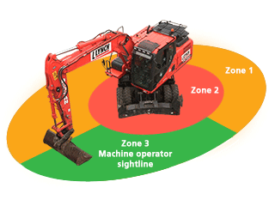
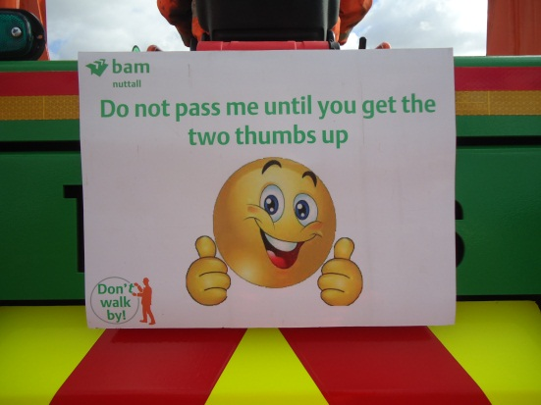
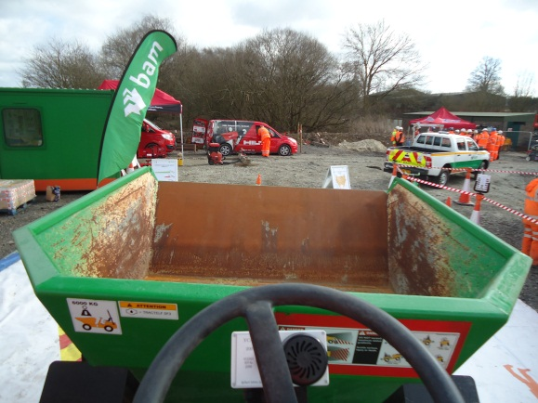
1
Never enter an exclusion zone
Notes:
Over the last year a number of people have been seriously injured on construction sites when they have entered a location or accepted a situation which has lead to the injury. The reasons for this are not simple and therefore the solution is not straightforward..
Construction sites place people in vulnerable places. We try very hard to avoid this and have invested in technology, training and planning to reduce exclusion zones to a minimum.
You can help us by staying on your guard. Particularly on entering new areas of site or situations where you are changing activity.
Even when you are doing a routine activity – occasionally rethink what you are doing. If there is a particular aspect of your work that troubles you and you think should be improved – tell your Supervisor.
The victims of an incident aren’t just the injured person. Families have to deal with the aftermath and even people involved in an incident who are not hurt can be left with the mental scars. We will finish with a video featuring a plant operator who was involved in an incident where the machine he was operating accidently struck the banksman. Play Plant operator’ s video.

