Slide 1
CDM v Asset Lifecycle
Health and Safety Management
May 2019

Slide 2
Aim
To develop a model, standard and associated procedures that describe the Highways England approach to the asset including the Strategic Road Network (SRN) design, construction, maintenance and operational management.
The model, standard and associated procedures will create a consistent framework for Highways England project, scheme and operational management to follow. Where possible the work will consider, replace and amalgamate existing standards, procedures, documents and guidance.
Any model and associated documents will also ensure that regulatory requirements are met including CDM 2015.

Slide 3
Challenges
Although the legislative requirements with CDM 2015 may be the pre-dominant element within supply chain and project management there are other considerations to be given.
Within Major Projects the Project Control Framework has both health and safety associated products and requirements to be met.
There has to be continual and further alignment with the PCF and CDM Regulations. This will make more practical sense to those in Major Projects.
Other existing documentation including Interim Advice Notes (105) must be considered and amalgamated into the standard and procedures where possible.
Work is carried out on the ‘Asset’ or Strategic Road Network (SRN) which may not be applicable to the CDM Regulations such as non intrusive surveys and inspections
Access to the network by statutory undertakers may not be CDM applicable work but consents and management of the proposed work requires action from operational management is required.
Due to the variances in work and approach to CDM together with the requirements of PCF and Frameworks a traditional approach to a CDM Standard could result in several procedures for the two different directorates (Operations and Major Projects).

Slide 4
Solution, the ‘Lifecycle’ Model
The model allows the user to access a project at any stage and understand what should be in place and what is required to be done.
The model includes and incorporates the PCF and other assurances which will need to undertaken.
Both Major Projects and Operations can use the procedure and also see a visual link between design, development, construction, operation and maintenance.

Slide 5
Pre-project (PCF Stage 0)
De-Commission and demolition
Strategy and Prioritisation
Renewal and alteration
Option Identification
Options Phase (PCF Stage 1 & 2)
Continual asset and operational management
Asset Health and Safety Management Lifecycle
Maintenance
Option Selection
Preliminary Design
Operations
Statutory procedures and powers
Construction Commission and handover
Construction Preparation
Development Phase (PCF Stage 3, 4 & 5)
Construction Phase (PCF Stage 6 & 7)

Slide 6
The Asset Lifecycle
The blue inner circle identifies the various stages of an asset life. From concept and feasibility through design, development, construction, handover, operation, maintenance, alteration to the eventual decommission or demolition.
Each stage (click link on each will be inserted) will have a procedure which will outline the requirements within the CDM2015 Regulations, the PCF products and other assurance requirements that may already be in place or will support the new standard. The procedures will have a summary of ‘Actions to be taken’ and link to relevant forms.
De-Commission and demolition
Strategy and Prioritisation
Renewal and alteration
Option Identification
Option Selection
Maintenance
Preliminary Design
Operations
Construction Commission and handover
Statutory procedures and powers
Construction Preparation

Slide 7
Pre-project (PCF Stage 0)
The Asset Lifecycle
The yellow outer circle highlights and visually aligns the PCF to the lifecycle, essentially the concept, design and construction. Click links could be inserted to take the user to the relevant section of the PCF handbook. This section will pre-dominantly used by the Major Projects division.
Using an example, the Northern Trans-Pennine (A66) Project. The project has just entered stage two of the PCF. The Project team could easily access the appropriate stage and quickly understand from the Action Summary what should be in place and what is required to be done during stage two.
Strategy and Prioritisation
Option Identification
Options Phase (PCF Stage 1 & 2)
Option Selection
Preliminary Design
Construction Commission and handover
Statutory procedures and powers
Construction Preparation
Development Phase (PCF Stage 3, 4 & 5)
Construction Phase (PCF Stage 6 & 7)

Slide 8
The Asset Lifecycle
The outer grey circle identifies the stages which will be pre-dominantly managed by ‘Operations’, focusing on the constructed asset.
Some work will not be associated with the CDM regulations, this may include access by statutory bodies such as Network Rail who require access to the network (asset) to undertake non-intrusive surveys. Although CDM may not be applicable a procedure for consent and possible monitoring is.
Maintenance will be invariably associated with CDM however the procedure would be more onerous in terms of requirements than Major Projects working at design stage.
De-Commission and demolition
Renewal and alteration
Continual asset and operational management
Maintenance
Operations

Slide 9
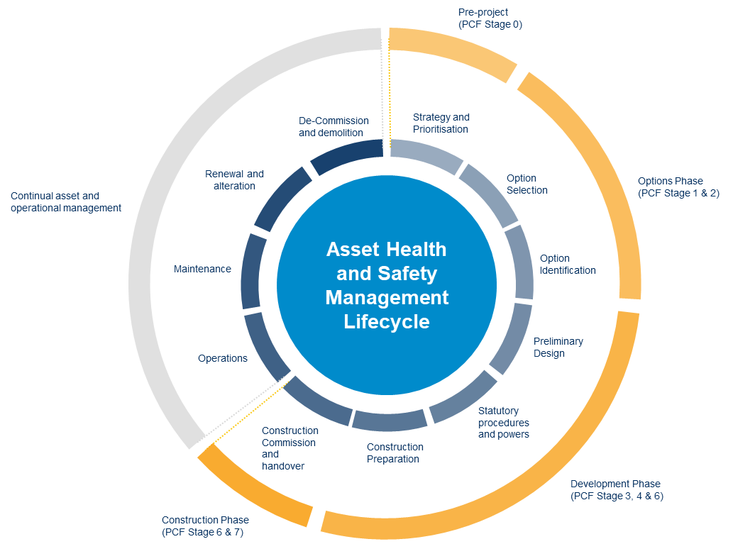
The Asset Lifecycle
The model is a draft, there are comments, feedback and further collaboration required. We may lose a stage or add a stage for example depending on how the procedures develop.
The wording or titles may also alter again during development but essentially the lifecycle model will be able to adapt to those changes and changes in the future.

Slide 13
Delivery……
A decision on the Standard structure and approach requires agreement as soon as possible due to the critical nature of the topic.
Timescales for first draft (Procedures) will be end of May 2019 with collaboration and feedback end of June 2019. Roll out July 2019.
I am happy to speak to, present and generally discuss the approach to ensure we get agreement and movement at the earliest opportunity.

