Slide 1
SPaTS HSW - H&S Alerts
H&S Alerts Review & Recommendations
Toria Thomas

Slide 2
H&S Alerts Review & Recommendations
Current process – GG128
investigations by the “employing organisation”
identify immediate, underlying and root causes
establish and implement corrective and preventative actions
learn and share lessons
Notes:
Mailing list for issuing H&S Alerts collated and manged by HE Business Information Management team.

Slide 3
H&S Alerts Review & Recommendations
GG128 Safety Alert process
Information only
Urgent need to inform people
Significant risk of injury/non-compliance
Significant business risk
Likelihood of multiple occurrences
Action required
Clear benefit from proposed action
SMART actions reduce risk of undesirable event
Current processes/procedures need to change
Relevant part of management system to be reviewed

Slide 4
H&S Alerts Review & Recommendations
Network Rail Comparison
4 types of H&A Alert
Safety Alert
Safety Bulletin
Safety Advice
Shared Learning
All investigations are undertaken by NR’s in-house safety team or by the Rail Accident Investigation Branch.
Network Rail host a safety information portal Safety Central
Notes:
https://safety.networkrail.co.uk/

Slide 5
H&S Alert Review & Recommendations

Slide 6
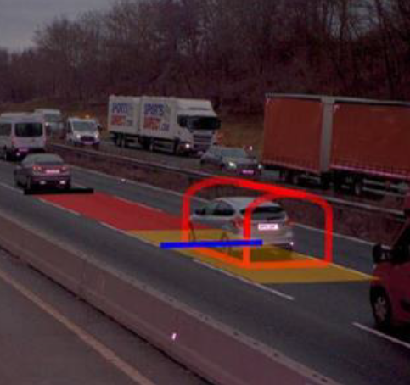
H&S Alert Review & Recommendations
Recommendations
Safety alert database
Amendments to the safety alert procedure
Amendments to the requirements of GG128
Standards drafting process
Provision of investigatory advice
Investigatory report and alert templates
H&S Alerts Review & Recommendations
Notes:
Having reviewed the documents provided by Highways England, and taking account of the practices employed in
other sectors, such as rail, Arup has made the following recommendations:
1. creation of a safety alert database, cataloguing all safety learning in an open access, easy to use system
2. amendment to the safety alert procedure, replacing the existing system and supplying well-defined criteria for
the issue of safety alerts.
3. amendment to the requirements of GG128 linking with the safety alert procedure and improving investigatory
requirements and advice.
4. improvement to the standards drafting processes, highlighting the need for cross-checking safety learnings
5. providing investigatory advice through existing supply chain frameworks.
6. supplying updated alert templates and a new template for investigatory reports, standardising the outputs from the investigation process and streamlining the communication of vital safety learning.

