Slide 1
Principal Designer Working Group Event No 22
Health and Safety Files Digital Development
Mark Lamport

Slide 2
Task and Finish Group Membership
Mark Lamport - Arcadis
Natalie Mansell - Atkins
Tim Bowes – Atkins
David Owen – GallifordTry
Rob Butcher – Jacobs
Darren Allen – Telent
Jon Horrill – WSP
Highways England representatives TBC

Slide 3
Current Status
Terms of Reference and T&F Group Objectives not yet defined
Several key actions required first
New Highways England CDM Standard (which contains a H&S File template) to be launched – target launch date August 2021
IAN 105/08 is likely to be withdrawn and not replaced

Slide 4
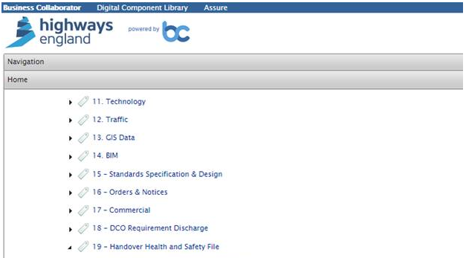
Action 1
Rename the HE BC folder 19 from "Handover Health and Safety File" to "Handover Asset Data" or "Handover Asset Information" as much of the information in HE BC Volume 19 is not health and safety related.

Slide 5
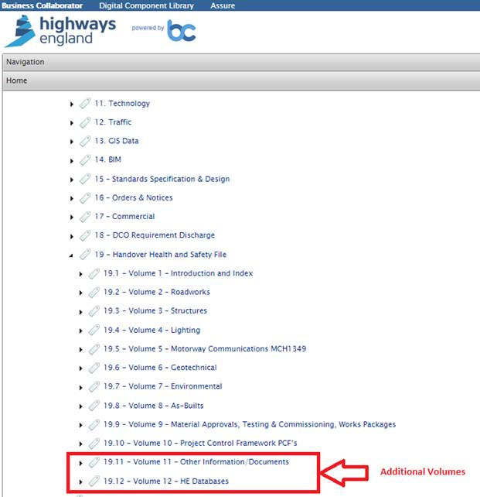
Action 2
Consider adding an additional folder to the HE BC folder structure: 19.13 - Volume 13 Health and Safety File, to provide a specific repository for the Health & Safety File document

Slide 6
Action 3
The Civils Maintenance (AD/MAC/ASC) “Civils Maintenance Handover Document and Certificate” PCF Product is within the Handover section of the PCF matrix.

Slide 7
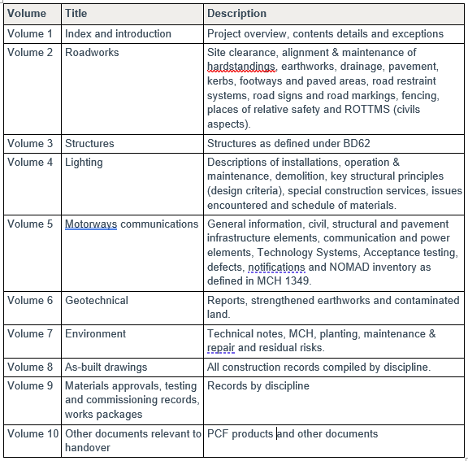
Action 3 (continued)
Resolve inconsistency between the table in Section 3.1 “Health and Safety File” of the “Civils Maintenance (AD/MAC/ASC) Handover Document and Certificate” PCF Product Template, V3 which refers to a 10 Volume structure and HE BC which currently uses a 12 Volume structure.

Slide 8
Action 4
Provide additional guidance as to precisely what information is required to be provided within each of the 12 volumes (19.1 to 19.12 inclusive) in HE BC ie to provide additional granularity with sub-folders and sub-sub-folders as appropriate…..and ensure requirements are clearly mandated.

Slide 9
Action 5
Resolve access issues to the HE BC platform as currently OD do not have access to it.

Slide 10
Action 6
Terms of Reference and T&F Group Objectives to be defined, relating to ultimate objectives of providing:
Digital model of HE assets with asset/location-specific H&S information tagged to it – to replace the conventional Health and Safety File document.
Easy means of updating H&S information when assets are added to, altered, replaced or removed.

