Slide 1
PRINCIPAL DESIGNER WORKING GROUP
Root Cause Analysis – Capture and Application of Lessons Learnt / Design Change Process
16th January 2020

Slide 2
Safety Alerts - Recent
Within the period since our last PDWG meeting on 17th October 2019 we have received and reviewed 16 safety alerts within our safety team (Principal Designers / H & S Practitioners) at monthly Safety, Design and Designers meetings.
Highways England Safety Alert | Topic | Date Received
HEi122 | Finger Trapped in Swivel Shackle - Resulting in Fracture | 30th October 2019
HEi123 | Battery Explosion | 6th November 2019
HEi124 | Reversing Incident - Balfour Beatty M4 SMP | 11th November 2019
HEi125 | Overturned Crawler Crane - Balfour Beatty Incident on M4 | 11th November 2019
HEi126 | RIDDOR Fractured Skull - Balfour Beatty M1/A1 DBFO | 18th November 2019
HEi127 | Spray Can Explosion | 18th November 2019
HEi128 | Slips, Trips and Falls | 18th November 2019
HEi129 | Gas Utility Strike | 5th December 2019
HEi130 | Ignition of Gas Service Following Strike | 6th December 2019
HEi131 | Loading of Winter Maintenance Vehicles | 10th December 2019
HEi132 | Lightiing Unit Dropped Through Incorrect Fixing | 10th December 2019
HEi133 | Use of Remote Controlled Lorry Loaders | 11th Debember 2019
HEi134 | IPV Incident | 16th December 2019
HEi135 | Excavator Injury | 20th December 2019
HEi136 | People Plant Interface | 8th January 2020
HEi137 | Lighting Column Failure | 13th January 2020
Available at http://www.highwayssafetyhub.com/alerts.html

Slide 3
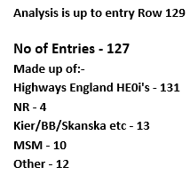
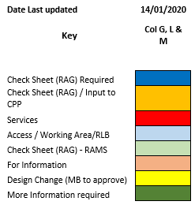
Categorising – Safety Alerts

Slide 4
Highways England H & S Alerts – Arcadis Summary
HEi122 - Finger Trapped in Swivel Shackle Resulting in Fracture
Lessons Learned:
These have particular relevance to Arcadis staff, a number of whom both undertake and supervise ground investigation works. The root cause would appear to be associated with lack of compliance with RAMS (or RAMS unclear).
No design root cause here, design of GI equipment perhaps. Significant forces arise in GI works together with repetitive actions which can induce complacency. share with M4CaN where Arcadis are undertaking GI demobilisation works
HEi123 - Battery Explosion
Lessons Learned:
Lithium Ion batteries can overheat through a process called “thermal runaway.”. This can happen for many reasons, such as external heat sources, internal shorts, or other malfunctions. In this case the batteries had been stored in direct contact with conducting materials, (2 x £1 coins and a metal carabiner clip). These acted as a conductive material causing the batteries to overheat and explode.
Manufacturers provide the following advice on safe handling and storage:
■ Always store batteries in a cool and dry place. (Between 10 to 30 degrees Centigrade)
■ Battery Terminals should always remain covered whilst in storage
■ Avoid battery terminals coming into direct contact with electrically conductive materials such as keys and coins, which can cause a short circuit of the battery.
Can affect children too. If AA type batteries with the poles at each end then it's not immediately clear how a short can occur? Freak accident, carabiner clip may have been the key component causing the short.
HEi124 - Reversing Incident M4 SMP
Lessons Learned:
Attach video from concrete truck reversing camera which shows incident. Site operatives don't appear to be too bothered by what has happened, although if the concrete truck had not stopped where it did then it could have taken the operative's head off. The driver would appear to have been in too much hurry and failed to use a banksman.

Slide 5
Highways England H & S Alerts – Arcadis Summary
HEi125 - Overturned Crawler Crane Incident at M4 SMP
Lessons Learned:
Temporary works issues: the ramp was too narrow/ steep. - not necessarily built in accordance with the design.
More control is required over realisation of TW design on site: TW Supervisor role. CPP was not followed perhaps. What does TW procedure/ process require? BB management system. Check what BBMS says about assurance. A further issue was that the temporary works were constrained spatially by bridge pier scaffolding on one side and sheet piling on the other - insufficient working space. Possible that scaffolding on bridge pier and its effect on construction room was not considered during the TW design process.
HEi126 - RIDDOR Fractured Skull
Lessons Learned:
Not well written safety alert. It is not clear from the alert exactly what happened, or who suffered from the fractured skull incident. It would appear that it related to the second low-loader driver falling from his cab rather than an injury caused to the JCB driver, or an injury caused by the low loader ramp being lowered. It was a potentially serious injury, although the IP was released from hospital within 2 days. Was he back at work too early? Concussion can cause brain damage, those injured need to get checked over and not just carry on. Injured parties can collapse later due to swelling on the brain. Various sports injuries - quite common.
HEi127 Spray Can Explosion
Lessons Learned:
Spray can incident, explosion caused by hot asphalt heating a pressurised paint contained which then struck an IP who then fell and suffered burns. Could be relevant to Arcadis staff who undertake site supervision of surfacing works. Most likely to affect the user of the paint can, but could also affect others in the vicinity.
HEi128 Slips Trips and Falls Reminder
Lessons Learned:
Doesn't take a lot to twist an ankle, common ground features on site can cause an incident, which in turn could have a serious effect and result in operatives being hospitalised and off work for a number of days or weeks.

Slide 6
Highways England H & S Alerts – Arcadis Summary
HEi129 - Gas Utility Strike
Lessons Learned:
Need to identify how this was missed on a major project where utilities' management is well organised/ coordinated. EF has discussed with HS2 DJV's Utilities design manager, who responded: ‘this work is being carried out by Fusion the Central EWC, not EK. Fusion will have undertaken their own utilities searches. We’ll review Utilities entries in the CDM Risk Register as we discussed yesterday’.
Unusual example to be at such a shallow depth. Why was pressure release valve covered over/ surfaced over. Usually planing is low risk? Would CAT scan not have picked this up?
HEi130 Ignition of Gas Service Following a Strike
Lessons Learned:
(NB: this is not the same utilities' strike as HEi129).
What voltage was involved? Not recorded on alert. 35 mm cable suggests it could have been up to 1Kv main possibly. Hand dig or machine? Probably machine dig. New estate, services should have been recorded. One of about 65000+ service strikes per year. Probably wouldn't have been reported if it hadn't set alight.
HEi131 Loading of Winter Maintenance Vehicles
Lessons Learned:
Material was left standing on the filter grid intended to ensure the sand/ salt mixture is broken up.
Drivers need to ensure that any salt left heaped above the grid is removed by the use of long handled rakes before leaving the depot. It is very important that this includes any larger pieces of crusted salt that have failed to fall through the grid or have come to rest on other parts of the vehicle.
How are operatives supposed to access to top of the vehicles to do this. Is there a high level access platform for this purpose? Not usually.
Why is the salt not broken up by the excavator bucket? Procedure not followed.

Slide 7
Highways England H & S Alerts – Arcadis Summary
HEi132 – Lighting Unit Dropped Through Incorrect Fixing
Lessons Learned:
The connection required a full 100mm engagement due to the location of fixing bolts and the internal taper of the lantern fixing. Remedial works were required to all lighting units installed in this manner with the unauthorised detail, to provide the full 100mm connection along with re-torqueing the fixing bolts to manufacturer’s settings.
Lanyard secondary connection appears to have made things worse. Tapered joint is now unable to close fully because of the lanyard attachment point.
There have been a number of safety alerts over time involving lighting columns and street furniture. Some of these have arisen because the of equipment attached (e.g. solar panels), which places undue load on the structure or through an unapproved connection. Other alerts have arisen because of fatigue or corrosion in columns that have come to the end of their design life. Hei 137 in the current set of alerts for review is one such; there was also an issue 2-3 years back when luminaires fell from lighting columns due to fatigued connections. Also solar panels fitted to street furniture and a recent alert re. holding down bolts on matrix sign. There is a bit of a theme here.
Change control issue: Retrofit changes, such as attaching kit to columns and signs, should go through TA process. Changes to the lanyard connection should have been approved by the designer /manufacturer and agreed with the overseeing organisation. This doesn't appear to have happened. The maintainer has made an unauthorised change without recognising the significance of what they have done. Column/ fitting design is done by the manufacturer in most cases, not lighting designers who merely specify components from a lighting catalogue.
Bob Tuthill's safety alert database is on safety hub website is good source for locating relevant alerts.
HEi133 – Use of Remote Controlled Lorry Loaders
Lessons Learned:
Remote control units are ubiquitous on sites for operating plant, including concrete pumps and HIABs etc. A death occurred on M3 3-4 years ago when an operative using a vacuum excavator failed to isolate his remote before climbing into the pit to clear a blockage. The remote then got struck in error, causing the suction excavator to reactivate. The individual was lone working to try and save time while his colleagues were on a break. Remote control equipment should never be used in lone working scenario. Furthermore the crane involved in alert 2020-UK-SA-001 in the current set may also have been operated by this type of remote control - conceivably the operator on the ground did not have clear sight of what was happening?

Slide 8
Highways England H & S Alerts – Arcadis Summary
HEi134 – IPV Incident
Lessons Learned:
The role of the IPV driver/ operator was simply to protect the sweeping and trimming operation while maintaining a set distance. The exclusion distance to be maintained was 75m +/- (25m) as per LANTRA guidance. He had no other role/ no other activity to be responsible for. Was he distracted? Procedure was not followed? Why was technology not used to maintain a safe distance? Would have been daylight conditions.
HEi135 – Excavator Injury
Lessons Learned:
The excavator operator' s coat had hooked over the left control lever when he had accessed the cab. Once the ‘dead mans’ arm was lowered the excavator arm immediately slewed, contacting the injured party in the ribs and causing him fall and hit his head on the ground. Hit his head by being knocked to the floor.
Why was procedure not followed in terms of operating within swing radius? Both the excavator operator and injured party knowingly worked within the swing radius of the long reach excavator. Why did the excavator driver release the dead man's handle without proper check on the controls?
Need to look at what type of PPE the excavator operator was using - was it fit for purpose? Perhaps a tighter fitting jacket may have been appropriate. Coat restricts movement, cab will have heating.
How best to use technology or other means to ensure everyone is out of the way before starting work?
HEi136 – People Plant Interface
Lessons Learned:
(This is the same Alert as HEi134)
HEi137 – Lighting Column Failure
Lessons Learned:
See discussion for HE1132

Slide 9
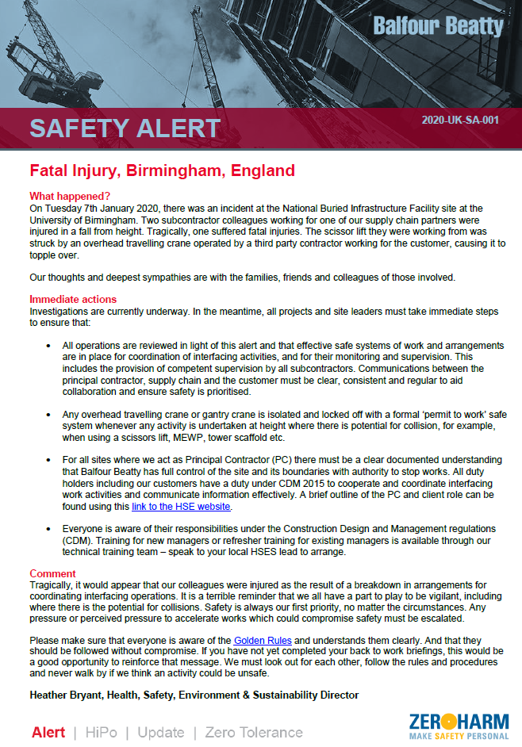
H & S Alerts
2020-UK-SA-001 Fall from Height
Lessons Learned:
This alert was passed on by Bob Tuthill.
The incident occurred at the University of Birmingham National Buried Infrastructure Facility site. 'The key feature of NBIF is its large pit (25m x 10m x 5m deep), which can be subdivided into smaller bays, with a 10 m x 5 m moveable floor section to simulate subsurface ground displacements. This enables research to be carried out at full-scale or near full-scale under fully-controlled conditions'. (NK sent through construction photos to attach to this note) Not clear if this was a construction site or inside a building. Accordingly, does CDM apply here?
There was an interface between 2 adjacent sites/ operators/contactors. A crane or cranes was working alongside MEWPs. If CDM applied, who was the Principal Designer? ( Birmingham University may have been PD, because of multiple activities taking place on this site?) Did all parties have the appropriate competence? Not planned and managed well. There appears to have been a breakdown in arrangements for coordinating interfacing operations. Overhead cranes are normally remotely controlled from ground level. Factory environment. More information required.
DA advised that the severity of the incident was compounded because there is no requirement to wear harnesses in scissor lifts. The catapult effect of arm lift is the reason why a harness needs to be worn in other types of aerial platforms.

