Slide 1
Calendula
Reducing the risk of managing risks digitally.
Principal Designers Working Group
13/10/2022

Slide 2


In the growing digital space, comes the opportunity for design risks to be handled in different ways…
… compounded with lots of different people who rightly need to add and contribute to the documenting of design risks.

Slide 3
In an attempt to reduce these interfaces we combined two of them with our Calendula tool
Input
Input
Single Source of Truth

Slide 4
Demonstration

Slide 5
What are the key benefits of Calendula?
01
02
03
Single Source of Truth
Excel
At the design stage, not just federation

Slide 6
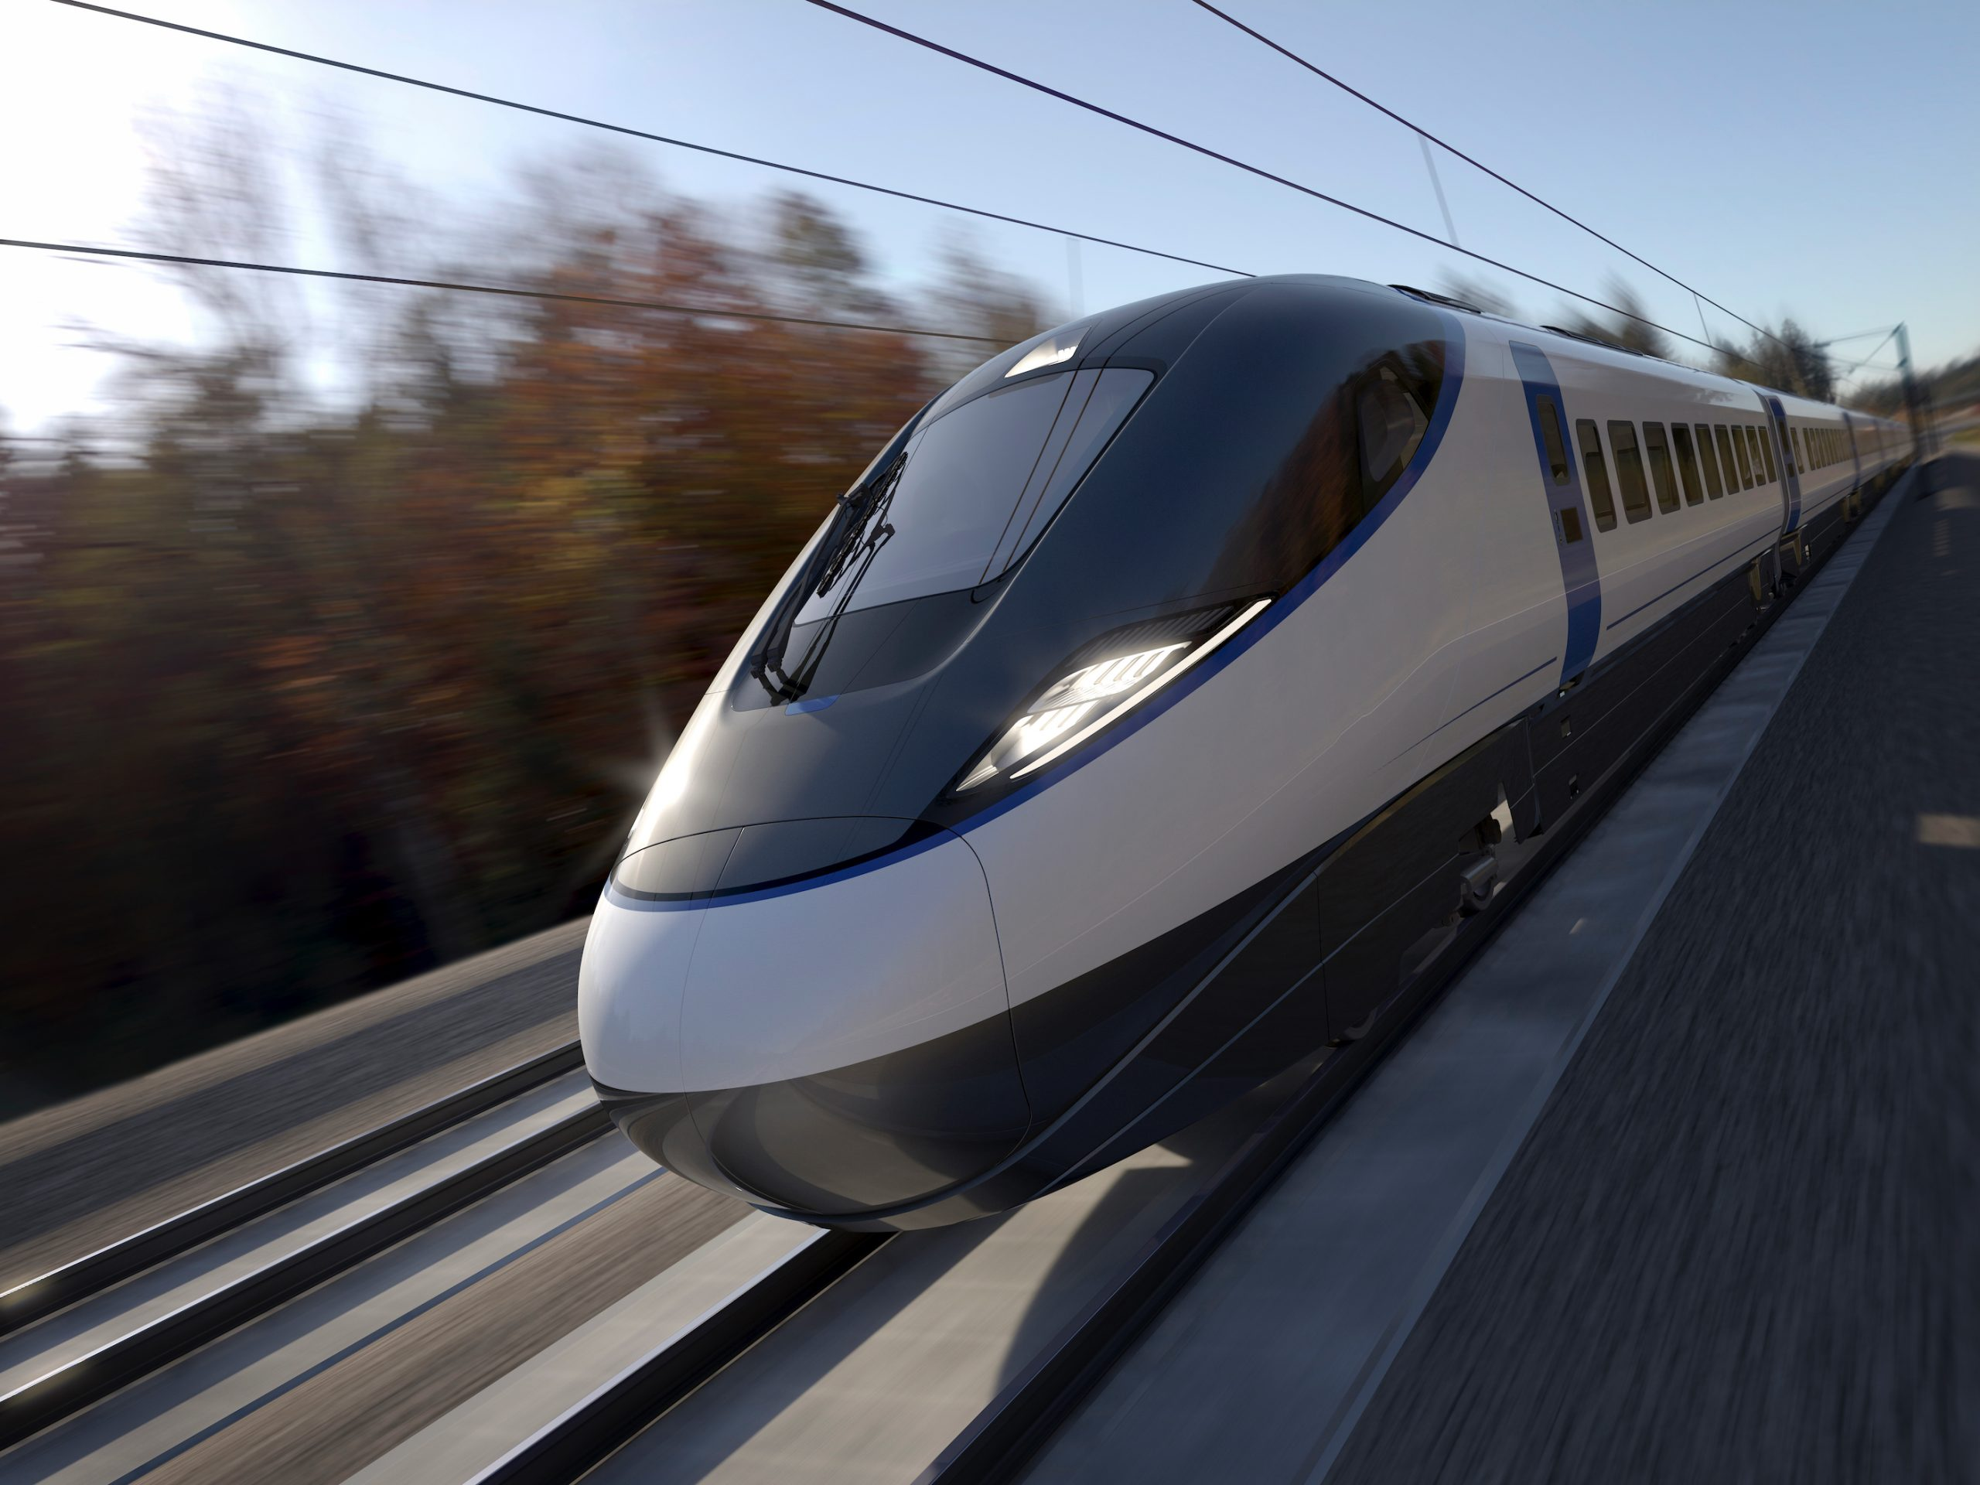
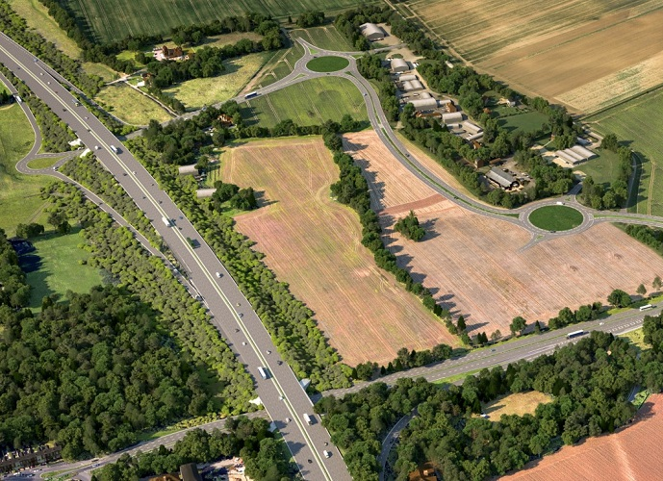
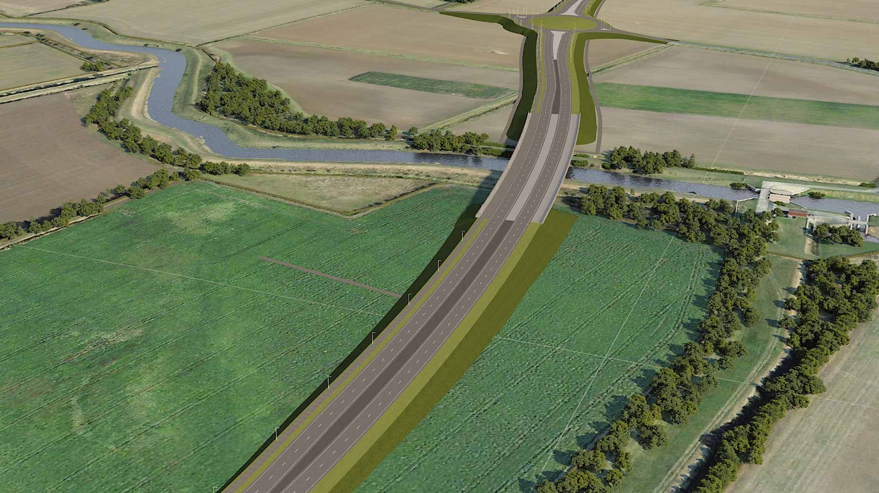
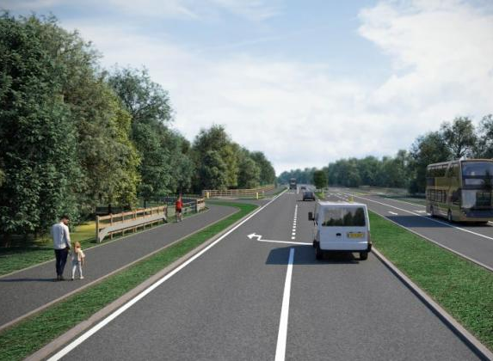
Which projects are we currently using it for?
HS2 Projects
Various clients including LMJV
M27 J10
Volkerfitzpatrick
North Hykeham Relief Road
Balfour Beatty
A40
Balfour Beatty
Any transport projects where we digitally model risks uses Calendula by default

Slide 7
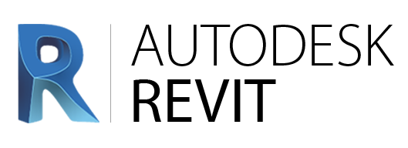



Where are we looking to develop it to next?
Add more controls and features within the application itself
Extend to Revit and other modelling platforms
Joining with open source initiatives like SafetiBase
Link with our global risk management solution – RamRisk.
Build it into ADMM handover to NH, with objects related to risks linked within them.

