Slide 1
Whole Life Health and Safety in Design Task Group
Update 11th October 2018

Slide 2
Current Members
Andrew Finch, Jacobs (Chair)
Pav Singh, Arcadis
Paul Brown, WSP Group
Tim Goddard, Arcadis
Steve Yates, Jacobs
Meeting Venue – Jacobs Birmingham office

Slide 3
Overview
Andrew Finch
Traffic Officer Service / Roadside Assistance
WLD examples
PAS1192:6 application
RIDDOR database
Paul Brown
RTB 26 update
Doug Potter / Liz Brathwaite
RTB 13 Excavations protection, access and egress – issue for comment
Tim Goddard
Design Change Process / HE Alerts

Slide 4
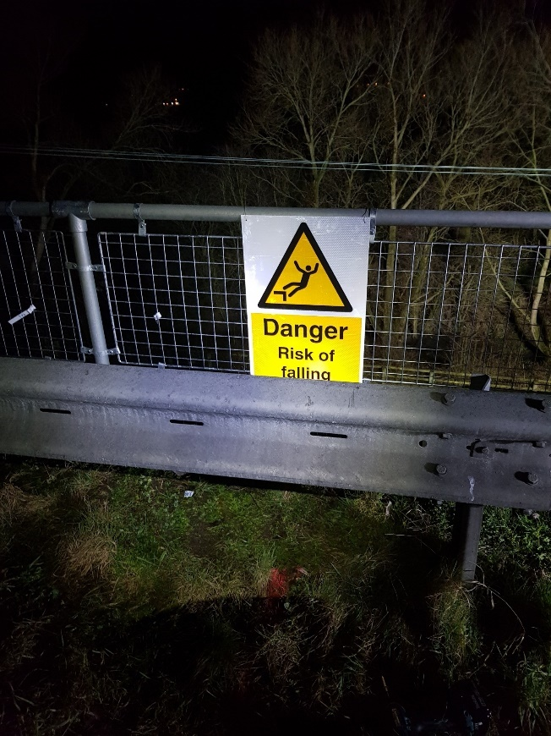
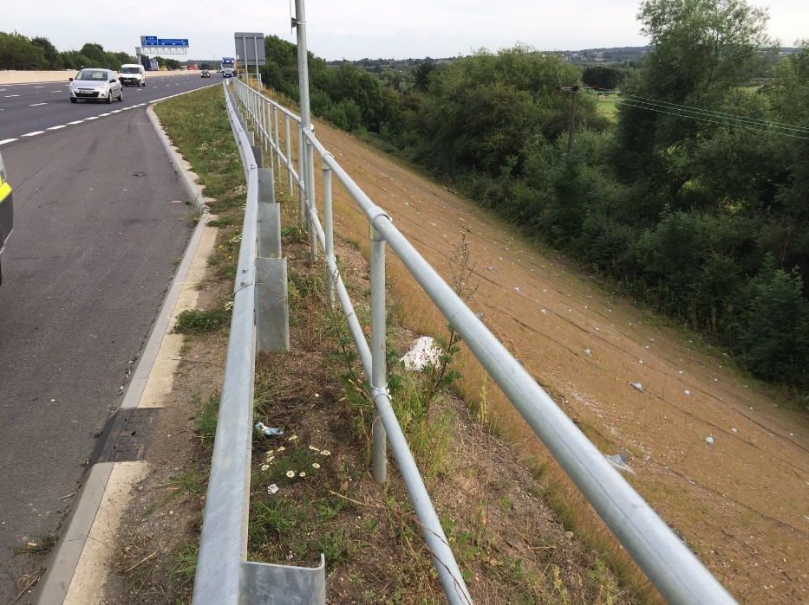
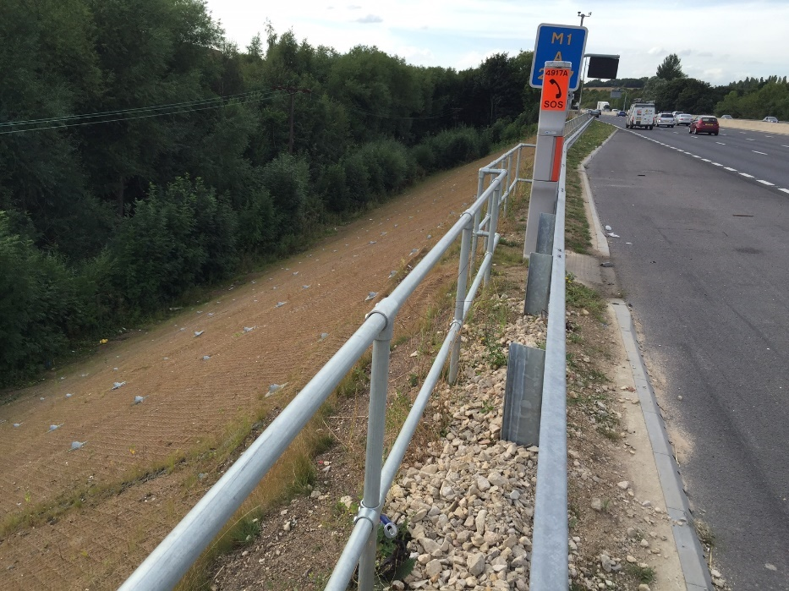
Traffic Officer Service / Roadside Assistance

Slide 5
WLD Examples

Slide 6
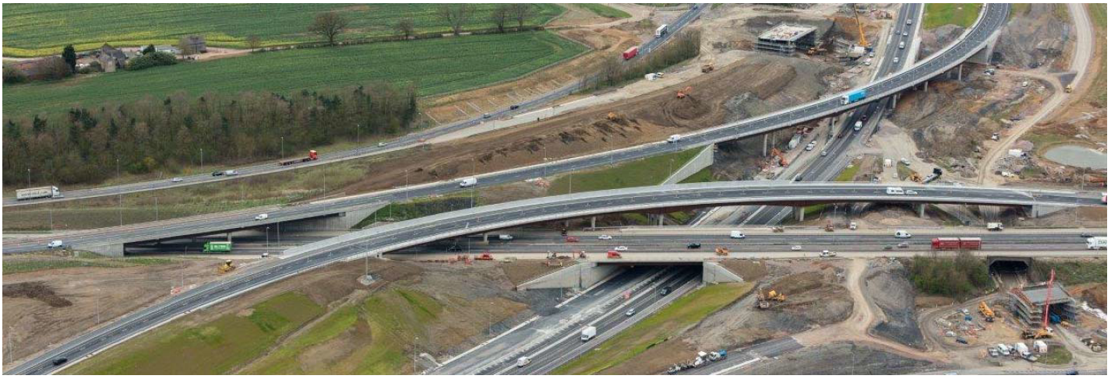
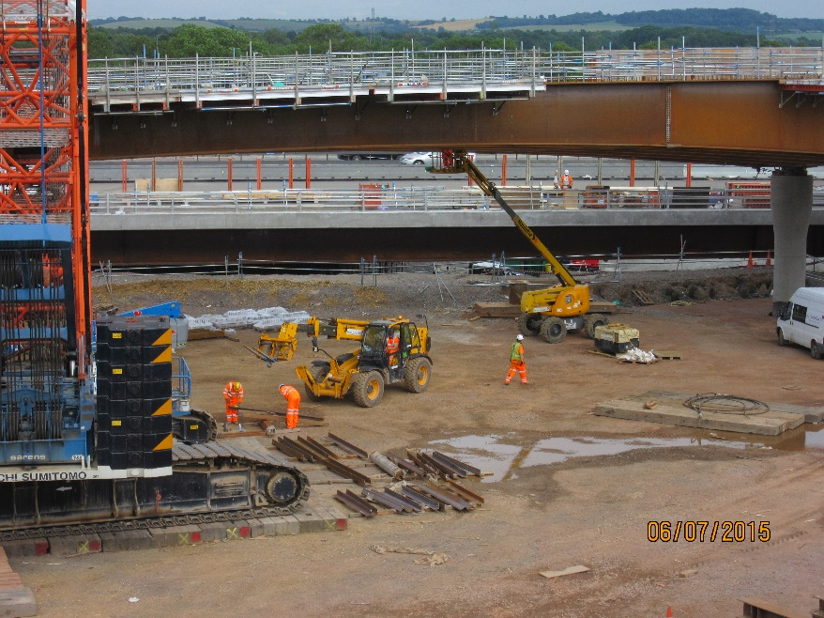
WLD Examples

Slide 7
WLD Examples
Plan bracing added in the fabrication yard Site erection is limited to the horizontal ties, and plan bracing members over splices – Consequently reduced working at height, programme duration etc.
All bracing is intended to be permanent – Objective to design out the removal of temporary bracing with safety and programme benefits
Limited risk of members not fitting on site – With temporary bracing the deflection and rotation of the pairs of girders is hard to predict increasing the risk of the bracing members not fitting and requiring adjustment on site (on M1 J19 some of the temporary bracing members were welded together onsite once the beams had been erected to overcome this problem)

Slide 8
PAS1192:6
https://projectmapper.com/map.aspx?cid=75&sid=Xf1jgJbUtzQ%3D (SafetyWeb Hazards layer)
https://northwestquadrant.trackrec.com/login.aspx (MNWQ TrackRecord site)
RIDDOR Database
http://www.hse.gov.uk/construction-dashboard/

Slide 9
PAS1192:6

Slide 10
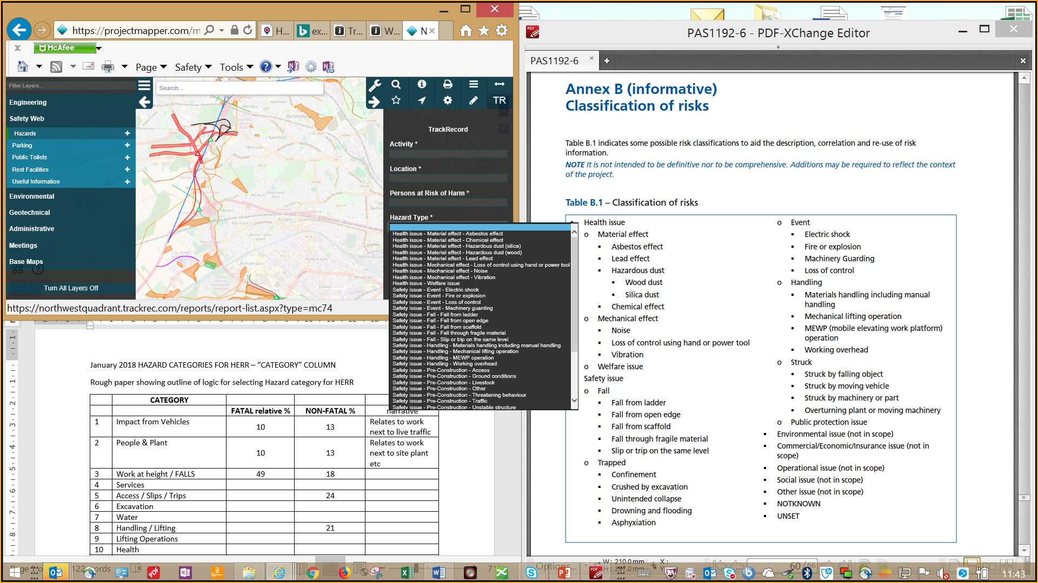
PAS1192:6

Slide 11
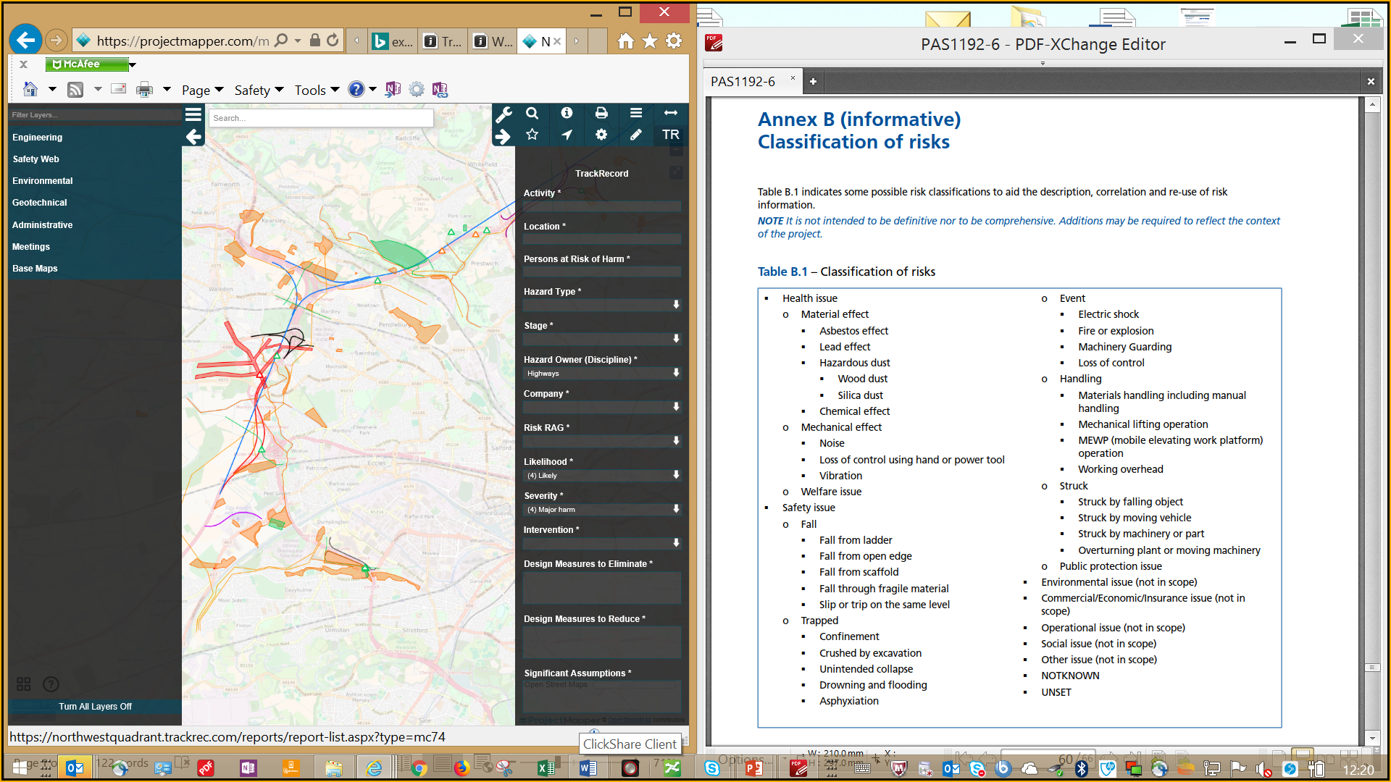
PAS1192:6

Slide 12
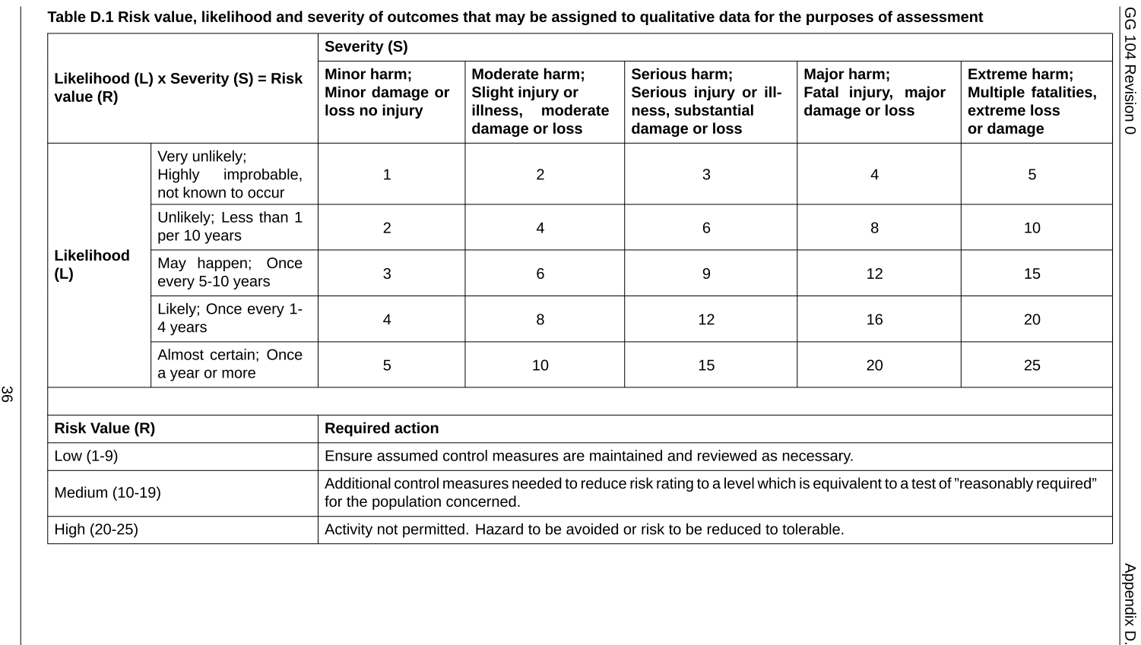
PAS1192:6

Slide 13
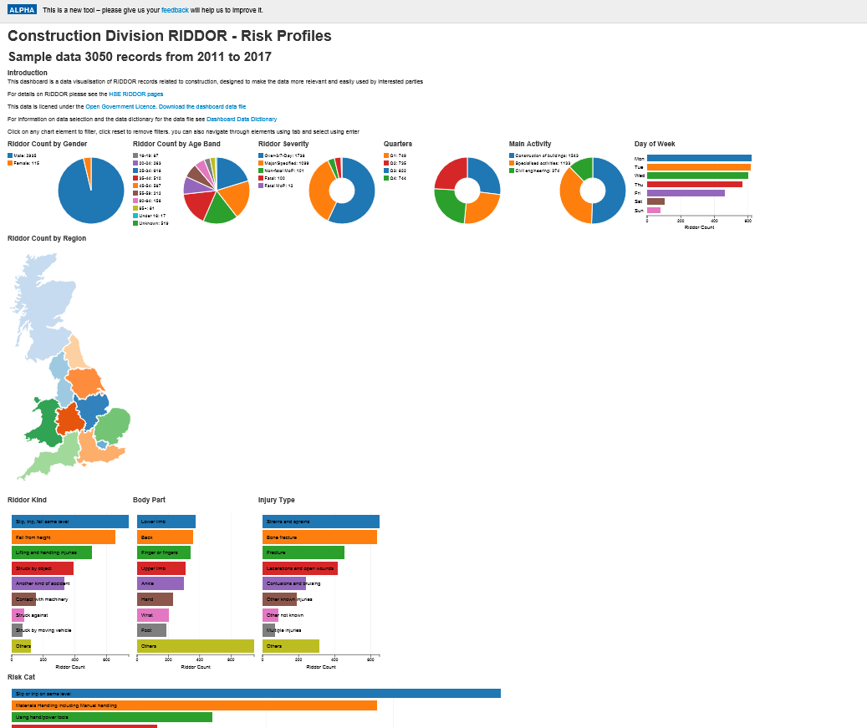
RIDDOR database

Slide 14
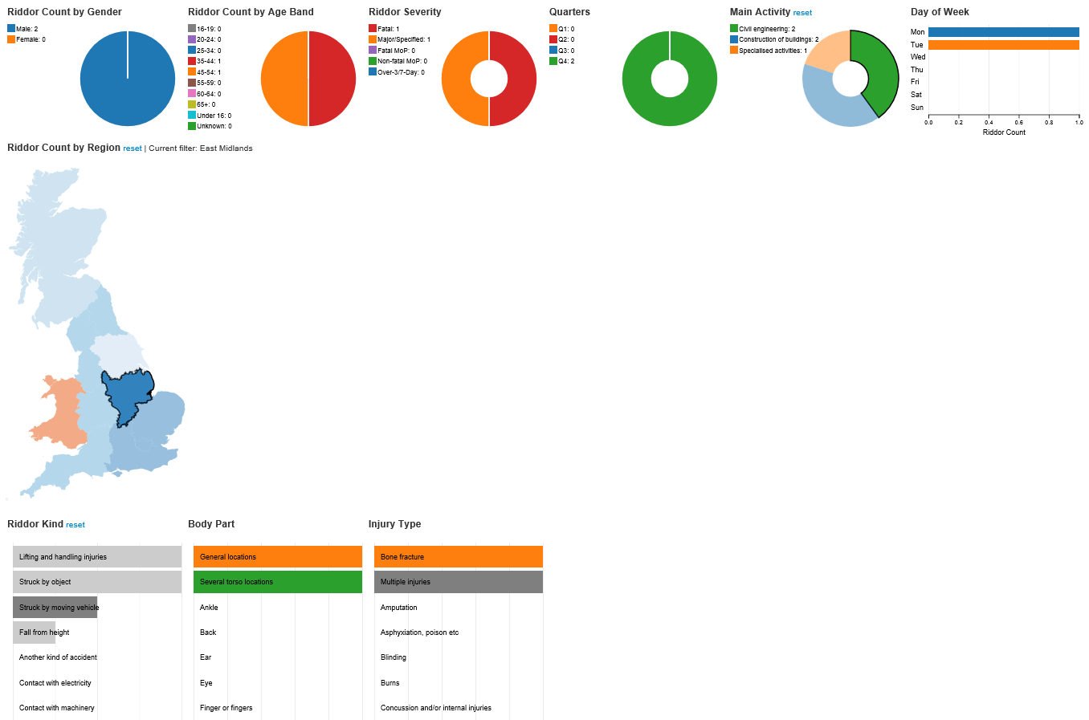
RIDDOR database

Slide 15
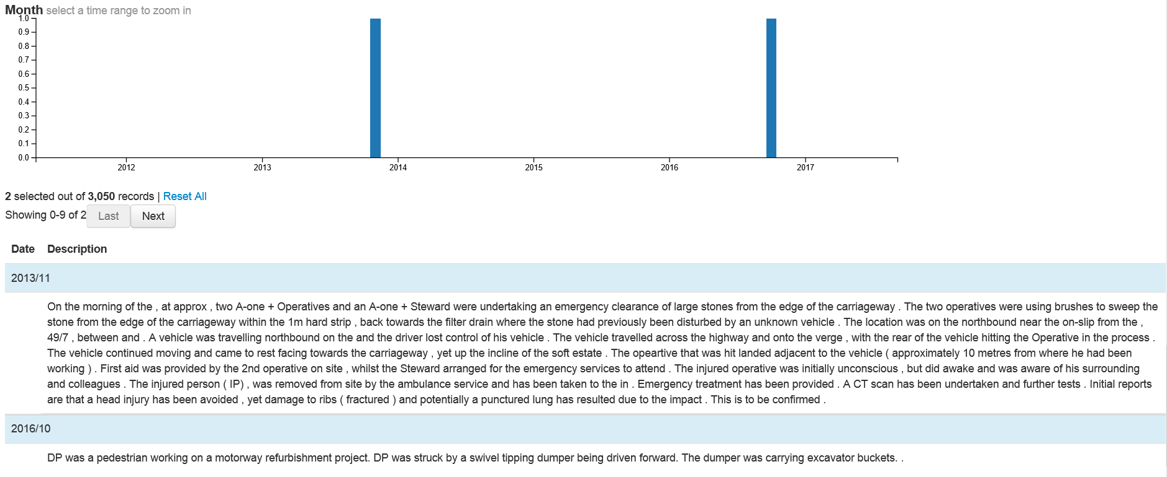
RIDDOR database
http://www.hse.gov.uk/construction-dashboard/

Slide 16
PCI – Stats Information / SMP M1 J13-16 example
Anglian water drawing showed 13 locations where clean water services crossed the carriageway; the C3 tracker had information for 1; the “Utilities General Arrangement” drawing showed none. Following a 90-minute meeting with Anglian Water, the JV were made aware of 29
All comms had been shown as BT on the drawings; the C3 tracker stated that BT in areas was redundant; multiple live fibre optic networks were incorrectly being shown as redundant
A multipurpose fuel line had been drawn as existing gas
Meetings with National Grid revealed that public footpaths had been misinterpreted as gas mains. Some gas mains were not adequately drawn as there were sections missing as well as a gas main missed altogether

