Slide 1
Principal Designer Working Group Root Cause Analysis – Capture & Application of Lessons Learnt
Supporting Home Safe and Well

Slide 2
Safety Alerts - Recent
Within the period since we last presented our Safety Alerts review back on the March 2021 we have received 28 and reviewed 25 safety alerts within our safety team (Principal Designers / H & S Practitioners) at our monthly Safety, Design and Designers meetings.
Highways England Safety Alert | Topic | Date Received
HEi213 | Excavator Use Near Trenches | 18 March 2021
HEi214 | CCTV Track Bracket Near Miss | 18 March 2021
HEi215 | M6 Gantry Sign Fixings | 19 March 2021
HEi216 | Winch Cable Failure Incident | 22 March 2021
HEi217 | Mobile VMS Wheel Incident | 24 March 2021
HEi218 | Spider Bite | 26 March 2021
HEi219 | Finger Injury – 3 Day Lost Time Accident | 29 March 2021
HEi220 | Drilling Contractor – Lost Time Injury | 31 March 2021
HEi221 | Hazardous Tree Removal | 31 March 2021
HEi222 | Safe Use of Trailers | 1 April 2021
HEi223 | Damaged Street Lighting Cable | 6 April 2021
HEi224 | Cracked Failed Lantern Spiggot | 6 April 2021
HEi225 | Piling Rig Concrete Delivery Pipe Failure | 12 April 2021
HEi226 | Reverse Incident | 12 April 2021
HEi227 | Street Lighting Cable Strike | 12 April 2021
HEi228 | Precast Copings | 19 April 2021
HEi229 | A38 Specified Injury | 19 April 2021
HEi230 | A47 Guyhirn Junction Water Supply Damage | 27 April 2021
HEi231 | Environmental Surveys | 30 April 2021
HEi232 | Skip Lorry Driver Trapped Between Skips | 4 May 2021
HEi233 | 11KV Service Strike | 4 May 2021
HEi234 | Water Service Strike | 4 May 2021
HEi235 | Operations, North West Region RIDDOR Incident | 4 May 2021
HEi236 | Corroded Drain Cover | 5 May 2021
HEi237 | Chemical Toilet Incident | 7 May 2021
HEi238 | Overturned Dumper | 11 May 2021
HEi239 | Unsafe Position of Worker Alongside Live Traffic | 12 May 2021
HEi240 | Tailgating | 12 May 2021
Available at http://www.highwayssafetyhub.com/alerts.html

Slide 3
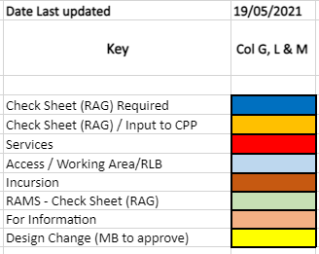
Categorising – Safety Alerts

Slide 4
Highways England H & S Alerts – Arcadis Summary
HEi213 Excavator Use Near Trenches- Link
Lessons Learned: PCI
Unclear why the excavator was working adjacent to an unsupported trench, apparently not barriered off. Conceivable that lack of space was a factor (as on SMART motorway works) or that the excavator had just excavated the trench in question. If the latter then a further question arises whether RAMS/ safe systems of work were being adhered to? Notes on Safety Alert the importance of Pre-Construction Information and ensuring this is passed on (i.e. GI / Ground Conditions). More information required.
HEi214 CCTV Track Bracket Near Miss Link
Lessons Learned:
The split link in question connecting links of the winch chain is similar in principle to those in use on many cycle and other chains. It is rare that these fail. It is possible that, when installing, the trailing end of the split link had not been pushed home correctly? The incident could have been avoided by better inspection of the chain installation after fitting or before use.

Slide 5
Highways England H & S Alerts – Arcadis Summary
HEi215 M6 Ganrty Sign Fixings Link
Lessons Learned:
Noted that this type of incident, where signs have fallen off gantries, has been relatively common in recent times. In this case the incident was caused by galvanic corrosion with two dissimilar metals coming into contact. It could have been avoided in a number of straightforward ways which might include:
o More frequent inspection, noting this as a potential cause of failure
o Use of a larger number of rivets or other fixings
o Use of a security lanyard or similar
o Use of nylon or similar washer to keep dissimilar metals apart.
Item to be raised at PDWG: HE to be asked what should be done about this. Is this an action for the asset team/ maintenance community to consider: if so, what options exist for additional maintenance or increased frequency of inspection? Should older sign plates be replaced? Need to review current design standards also. Is what is specified actually built? This is a more important issue on SMART motorways, where access for maintenance may be more difficult and the implications of a sign plate falling onto a live carriageway are more severe.
HEi216 Winch Cable Failure Incident Link
Lessons Learned:
Possible issue for winch designer to consider is a safeguard to prevent the winch hook and spliced ferrule termination from being retracted back into the winch drum under load. Another item of site equipment which will suffer abuse on site without necessarily receiving the appropriate level of inspection/ maintenance.

Slide 6
Highways England H & S Alerts – Arcadis Summary
HEi217 Mobile VMS Wheel Incident Link
Lessons Learned:
A failure of management not to have ensured that the operatives tasked with fitting the wheels to the trailer were trained/ competent and had the appropriate tools and briefing for the job, i.e. a torque wrench and information about the torque settings to be used. It is apparent that time pressure was an additional factor, as was the reluctance of the TM crew to use any stop/work authority. Noted that VMS trailers have smaller wheels with high pressure tyres; the torque settings would potentially be more important as a consequence.
HEi218 Spider Bite Link
Lessons Learned:
Site staff to be made aware in briefings that some types of spider such as the varieties listed can bite and may cause an allergic reaction. Noted that the woodlouse spider is small in size but nevertheless has quite powerful jaws.

Slide 7
Highways England H & S Alerts – Arcadis Summary
HEi219 Finger Injury – 3 Day Lost Time Accident Link
Lessons Learned:
Failure to adhere to RAMS/ SSoW.
HEi220 Drilling Contractor – Lost Time Injury Link
Lessons Learned:
Failure of management to provide manual handling training or to highlight risks associated with lifting, handling and carrying of the casings was at the root of this incident. Potentially also a lack of supervision or bad practice by the site operative in question came into play.
HEi221 Hazardous Tree Removal Link
Lessons Learned:
This operation does not appear to have been planned very well, including failure to provide appropriate PCI or information about the height/ likely fall zone of the tree(s) being cut. Noted that the tree did not behave as expected and 'pivoted on its hinge' before falling into the carriageway. The single lane closure was not enough to contain the full height of the tree. It may have been more appropriate to bring it down in sections or lower it with a rope.

Slide 8
Highways England H & S Alerts – Arcadis Summary
HEi222 Safe Use of Trailers Link
Lessons Learned:
Noted that the item of plant illustrated on the trailer looks to be quite large/ heavy; the security of the coupling (and secondary coupling devices) would be particularly important. Consideration should be given to transporting items of this size/ weight on a flatbed lorry rather than a trailer where the opportunity exists.
HEi223 Damaged Street Lighting Cable Link
Lessons Learned:
Noted that procedure was not followed, and information about the buried services was not provided to the gang on site. Potentially appropriate safe systems of work were not considered.
HEi224 Cracked Failed Lantern Spiggot Link
Lessons Learned:
This incident occurred at Ascot Road on M4SMP. Another overturning incident had occurred on M4SMP scheme recently; yet another incident had occurred on HS2. Noted that this type of incident is quite common where machines operate with an extended bucket radius and high bucket height, .

Slide 9
Highways England H & S Alerts – Arcadis Summary
HEi225 Piling Rig Concrete Delivery Pipe Failure Link
Lessons Learned:
As with the winch failure reported under HEi216, this is an item of site equipment which will routinely suffer abuse in service and requires appropriate inspection, maintenance and replacement.
HEi226 Reverse Incident Link
Lessons Learned:
It would appear there was no designated safe route for pedestrians in operation in the materials storage yard. A 'controlling mind' might have foreseen that the risk was exacerbated by the multiple operations ongoing in preparation for demobilisation and should have highlighted that. The IP in question may not have been aware of the heightened risk but should have been paying attention to his own safety.

Slide 10
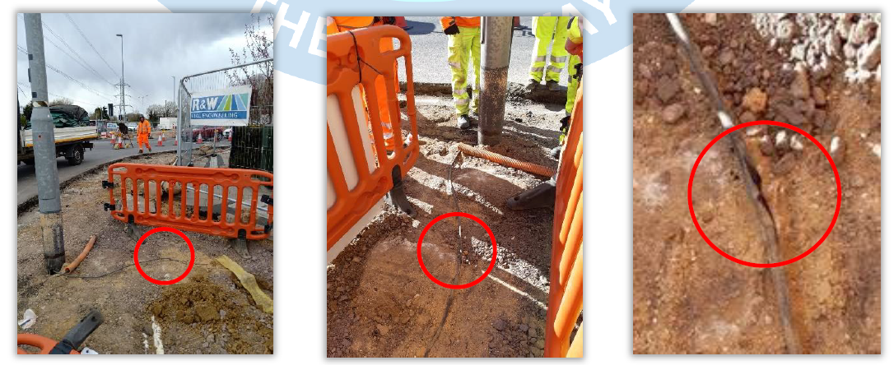
Highways England H & S Alerts – Arcadis Summary
HEi227 Street Lighting Cable Strike Link
Lessons Learned: PCI
It is not stated if a GPRS survey had been undertaken prior to breaking ground; if not this is a contributory factor. Noted that handheld GPRS equipment is available and this should be instructed/ utilised in all cases. The cables had apparently been identified, but the shallow depth and lack of ducting around one of the cables may have been a contributory factor leading to the incident. Site procedure appears to have been somewhat slapdash. Possible involvement of a smaller contractor where safe systems of work are less rigorously enforced?

Slide 11
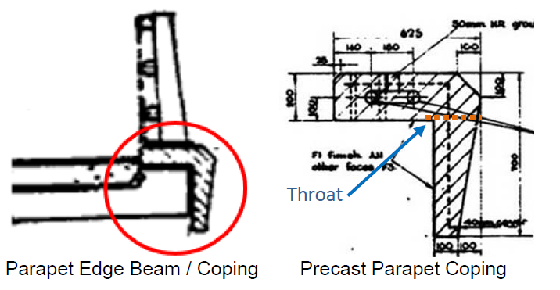
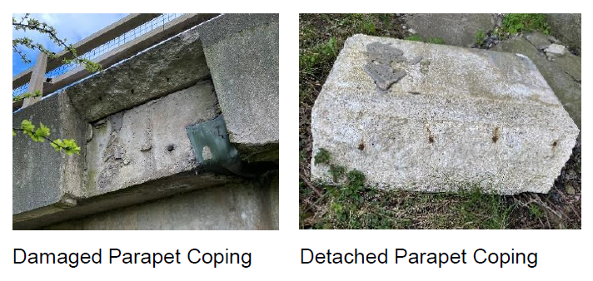
Highways England H & S Alerts – Arcadis Summary
HEi228 Precast Copings Link
Lessons Learned: PDWG
This type of incident is thought to be relatively common, although it is less common that the coping would actually shear off. The coping may move under load from thermal forces but is constrained by fixed element on the other side of the expansion joint. The design of precast units should take this movement into account. The unit in question appears to be very lightly reinforced: was this an appropriate design detail? Has fatigue occurred due to expansion/ contraction over long period? Was there a lack of site supervision when it was installed or was there installation damage? Has there been a lack of maintenance inspection?
Ingress of water into cracks may have exacerbated the corrosion of rebar. Conceivable that high temperatures in April 2021 was the final straw causing it to fail. If cracking or movement is apparent in the ‘throat’ of any units, inspectors should consider further special / monitoring inspections, or removal of the copings.
Currently designs still incorporate a bolted-on precast edge beam.

Slide 12
Highways England H & S Alerts – Arcadis Summary
HEi229 A38 Specified Injury Link
Lessons Learned:
This was a similar RIDDOR incident on M4SMP involving tripping over shallow excavations. No action for designers.
HEi230 – A47 Guyhirn Junction Water Supply Damage Link
Lessons Learned: PCI ??
This was a non-standard installation both in terms of its depth and the colour/ type of pipe. No markings to identify. GPRS done, but unlikely this would have picked up the service over the length in question. Not feasible to hand dig to expose over this length. Poor workmanship. No as built records.
HEi231 – Environmental Surveys Link
Lessons Learned: Surveys in Pre-Construction Phase / Communication
Coordination of activities is required. That appears to have been lacking here. There needs to be communication with landowners to ascertain there are no other activities ongoing at the time of survey (or GI etc.)

Slide 13
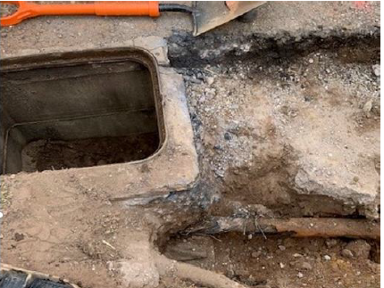
Highways England H & S Alerts – Arcadis Summary
HEi232 Skip Lorry Driver Trapped Between Skips Link
Lessons Learned:
Better site coordination is required to avoid conflicting activities. Poor housekeeping is evident on this site. Principal Contractor responsibility was not being fulfilled here. It doesn't appear that an appropriate assessment/ segregation of activities was undertaken. Why were the pipes stacked up so high? This does not appear to be ideal site storage arrangements.
HEi233 11KV Service Strike Link
Lessons Learned: Service Strike / Failure to Follow RAMS
There appears to be an issue around competence here as well as poor site
management/ poor supervision. Was a permit to work raised? If an 11kV cable
had been identified by CAT and genny, why had this not been fully exposed? Any
works involving breaking ground should require a 1.5 metre x 300 wide trial hole
hand dug to clarify what is present in accordance with PAS 128. Associated UXO
survey. Appropriate procedures were apparently not followed here. .

Slide 14
Highways England H & S Alerts – Arcadis Summary
HEi234 Water Service Strike Link
Lessons Learned: Failure to Follow RAMS / Permit
Poor supervision, failure to follow RAMS / Permit. No trial hole to locate? Why did vac ex not expose the pipe? (Vacuum excavation had previously been undertaken to expose services around the new drainage chamber location, but this did not expose the subsequently damaged watermain location).
HEi235 Operations, North West Region RIDDOR Incident Link
Lessons Learned:
This appears to have involved a freak combination of events: the TM signs fell over when retaining bolts were dislodged by overhanging tree. Then (unrelated to this?) the truck impacted/ drove over the IP's foot (presumably the IP was not in the vehicle at the time?). The retaining bolt should have been more robust to contend with the weight of signs involved Had the signs been secured properly? Not a design issue, although it is possible that the retaining bolt was under-designed by manufacturer.

Slide 15
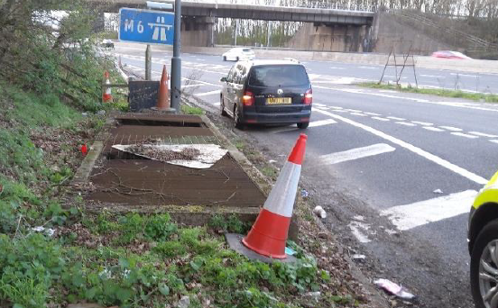
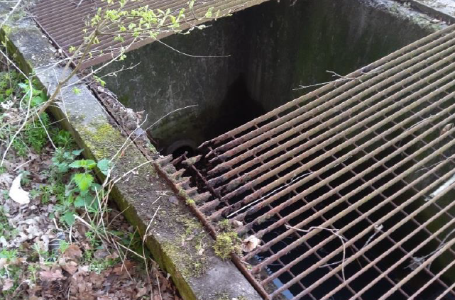
Highways England H & S Alerts – Arcadis Summary
HEi236 Corroded Drain Cover Link
Lessons Learned: Don’t Walk / Drive By
The corroded grating should have been picked up and reported by routine HE inspections. This would appear to have occurred near the operational boundary between HE and the service area operator. Irrespective of who owned it, it should have been subject to inspection as it was within the highway boundary. It may have been missed because of debris covering it? Corrosion had clearly taken place over a long period of time.
HEi237 Chemical Toilet Incident Link
Lessons Learned:
The labels on both substances contained sufficient information to have prevented this incident from occurring. The label on the bleach advised that: 'contact with acid liberates toxic gas'. Chemical toilet disinfectant advised that it contained acid. A lack of appropriate briefing or risk assessment is evident.

Slide 16
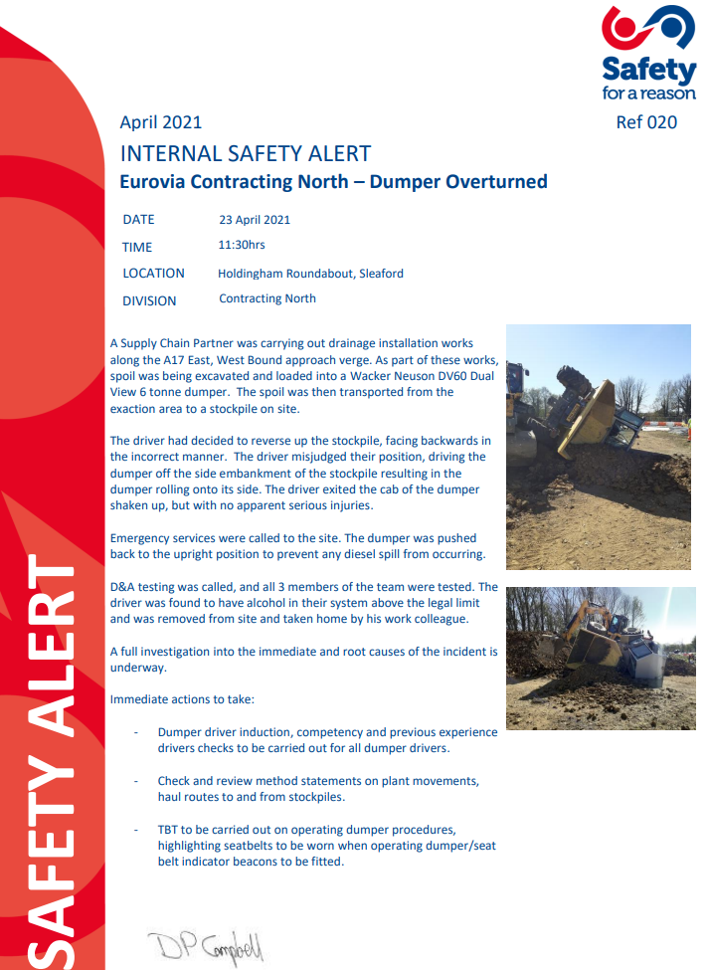
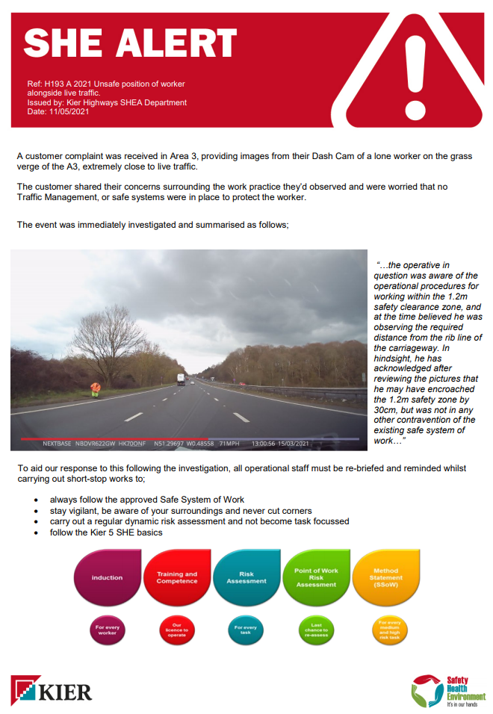
Highways England H & S Alerts – Arcadis Summary
HEi238 Overturned Dumper – Link
HEi239 Unsafe Position of Worker Alongside Live Traffic - Link

Slide 17
Highways England H & S Alerts – Arcadis Summary
HEi240 Tailgating - Link

