Slide 1
Safety Passport T&F Clare Brown

Slide 2
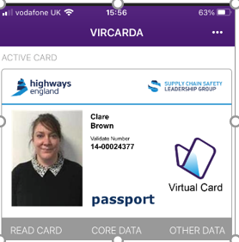
Virtual Card – Vircarda App List of schemes that have adopted passport A number of LOSC are invited on Steering Group Reference Point offered to help projects set up Case studies Newsletter April “Inside Lane”

Slide 3
Designers Where designers are not involved in any site works but work in a design office or office compound only, there is no requirement for a Highways Passport or HCI. *Please note that those design organisations undertaking assurance or Technical Advisor roles or supporting projects through the construction phase who do undertake regular site visits may be required by the relevant Principal Contractor to hold a Passport and HC To get set up with Passport https://highwayspassport.co.uk/

