Slide 1
Principal Designer Working Group Root Cause Analysis – Capture & Application of Lessons Learnt
Supporting Home Safe and Well

Slide 2
Safety Alerts - Recent
Within the period since we last presented our Safety Alerts review back on the 12th November 2020 we have received 19 and reviewed 13 safety alerts within our safety team (Principal Designers / H & S Practitioners) at our monthly Safety, Design and Designers meetings.
Highways England Safety Alert | Topic | Date Received
HEi196 | Fractured Ankle | 18 November 2020
HEi197 | Vehicle Compliance Checks | 26 November 2020
HEi198 | Vehicle Uncontrolled Movement | 09 December 2020
HEi199 | High Potential Near Miss Plant & Operator Procurement | 11 December 2020
HEi200 | Assault on Cleaner | 14 December 2020
HEi201 | Excavator Bucket Falling onto a Live Carriageway | 17 December 2020
HEi202 | Safe Return to Work | 04 January 2021
HEi205 | Ride on Rollers | 20 January 2021
HEi207 | Damage to Structural Element of Bridge | 02 February 2021
HEi208 | Failure of a Sensor on an Impact Protection Vehicle Whilst Working Under a Rolling Road Block | 11 February 2021
HEi209 | Excavators Fitted with Ditch Maintenance Buckets | 16 February 2021
HEi210 | Live Lane Crossing | 17 February 2021
HEi211 | High Pressure Gas Main | 04 March 2021
HEi212 | In Ear Headphones | 15 March 2021
HEi213 | Excavator Use Near Trenches | 18 March 2021
HEi214 | CCTV Track Bracket near miss | 18 March 2021
HEi25 | Gantry Sign Fixings | 19 March 2021
HEi216 | Winch Cable Failure Incident | 22 March 2021
HEi217 | Mobile VMS Wheel Incident | 24 March 2021
Available at http://www.highwayssafetyhub.com/alerts.html

Slide 3
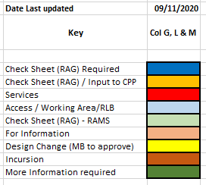
Categorising – Safety Alerts

Slide 4
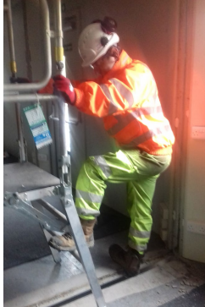
Highways England H & S Alerts – Arcadis Summary
HEi196 Fractured ankle- Link
Lessons Learned:
This incident arose out of a lack of common sense/ poor observation/ poor site procedure/ lack of
tidiness. The team should have replaced the cover to the gap in the floor prior to operating the
mobile platform, or at least looked where they were stepping when dismounting from the platform.
In practice this is unlikely to be resolved by amending the method statement. They were lucky in
this instance that the mobile platform didn't run into the floor void and turn over.
HEi197 Vehicle Compliance Checks Link
Lessons Learned:
It is worrying that the levels of non-compliance were so high. 39% of vehicles were found to be non-compliant (illegal) in some way. Some areas were worse: 64% of vehicles on M6 were non-compliant. Issues identified were divided into three categories :
Critical: e.g. no ‘O’ licence (HGV) / tacho fraud (HGV) / no driving licence or wrong entitlement;
Neglect: items that should have been identified as needing attention over a period of time, e.g. worn tyres
Concern: e.g. insecure load / overload /damaged tyres / faulty lights
Dave Avery noted that on a CJP site in the north east they are trialling an app with forms to aid vehicle inspection/ reporting of defects. It is hoped that this will lead to improved standards of compliance with vehicles.

Slide 5
Highways England H & S Alerts – Arcadis Summary
HEi198 Vehicle Uncontrolled Movement Link
Lessons Learned:
The safety alert doesn't say so explicitly, but it is possible that unfamiliarity with the specific vehicle may have been a factor here. Some vehicles have an auto hold function which applies the parking brake automatically when the vehicle is stationary/ footbrake is applied. Others rely on the driver to manually apply the parking brake by moving a lever or similar. The driver may be used to the former type but required on this occasion to operate a vehicle with manual parking brake application.
This highlights the need for drivers to have some sort of
familiarisation with each new/ different vehicle they operate,
and not just rely on having the appropriate ticket
HEi199 High Potential Near Miss: Plant & Operator procurement Link
Lessons Learned:
Noted that operators need to be familiar with the operation of a specific machine - even when they are able to present evidence of qualification/ticket/card for the machine type - as for HEi198 above.
Are the controls on vehicles/ machines broadly standardised? Noted that, as some cars have reverse gear up and to the left while others have it right and down, it would be unsurprising if different manufacturers of plant also vary the ways in which controls operate. Another factor may be that older plant may lack aids such as 360 degree cameras and slew restrictors present on modern vehicles.

Slide 6
Highways England H & S Alerts – Arcadis Summary
HEi200 Assault on cleaner Link
Lessons Learned:
It was determined that a 'public amenity site' constitutes a roadside services with toilets, etc. for the purposes of this alert. It was not immediately clear that this incident was in any way construction related; nevertheless the lessons to be taken away revolve around the dangers of lone working, the need to have appropriate supervision and monitoring in place and the need for appropriate risk assessments (including Point of Work Risk Assessments). Also training in how to handle confrontation is required for public facing roles. These are also required by designers travelling to site, particularly when the site works are contentious (HS2, A27 Arundel etc.)
HEi201 Excavator bucket falling onto a live carriageway Link
Lessons Learned:
This incident of an excavator bucket being dropped onto a live carriageway appears to have happened when the excavator driver lowered the bucket attached to his machine to place stacked, spare buckets onto the flatbed of the lorry being used to move his machine. The spare buckets appear to have been nested one inside the other, but it is not clear if they were chained together or otherwise restrained. The bucket could also have been dropped when the excavator tipped forward at the top of the vehicle ramp.
A Point of Work Risk Assessment should have identified a potential risk to the public from loading the excavator in a layby adjacent to a live carriageway. It is not clear if this was done, or if the method statement specified a minimum clearance to be maintained from the live carriageway. Nor is it clear if the standard nesting/ stacking procedure was followed.

Slide 7
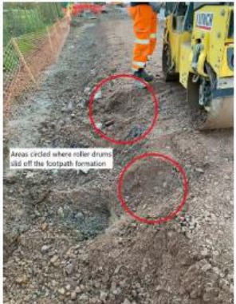
Highways England H & S Alerts – Arcadis Summary
HEi205 – Ride on Rollers Link
Lessons Learned:
People Plant Interface (PPI) is the cause of many incidents. A recent ride on roller incident initiated an HE review of safety alerts relating to the safe operation of rollers. The following recommendations are from previous alerts: Planning and Procedures
Assess the route and ground conditions to ensure they are suitable for the plant to be used. Ensure Safe Systems of Work are appropriate, understood and briefed before work starts.
Consult with supervision and reassess if anything changes. Use physical barriers to identify edge protection. Develop a specific assessment for compact / smaller plant due to lack of stability Avoid the use of rollers less that 1.2m wide, substitute for remote controlled
vibration compaction plates etc If the roller has to be smaller that 1.2m wide, this must be approved by Project
Director ( Supply Chain)
Plant Operation Rollers must travel with the seat locked in the forward position. The seat must only be adjusted when stationary.

Slide 8
Highways England H & S Alerts – Arcadis Summary
HEi207 – Damage to Structural Element of Bridge Link
Lessons Learned:
To prevent a similar occurrence the following should be considered when carrying out excavation works of this nature: Ensure all historical drawings and as-built information is fully examined as part of the management of preconstruction information.
Joint venture workshops and regular communications should take place between the design team and construction team. The message of ‘stop and don’t continue work if you are unsure about anything’ must be strongly and regularly reinforced. Review and check your incident escalation communication procedures for clarity and understanding by all relevant parties.
DISCUSS – Doug P to add
HEi208 - Failure of a sensor on an Impact Protection Vehicle whilst working under a rolling road block Link
Lessons Learned:
The operational limits of an item of plan should not be dependent on the correct operation of a sensor activation. Noted that in this case the IP67 sensor failed to operate correctly because it had been subject to a high pressure water jet, imposing a greater head of water than it was capable of accepting. Noted an IP68 sensor extends the immersion features of IP67, allowing for deeper immersion beyond three feet or one meter. The highest rating is IP69 which provides complete protection from dust and protection from steam-jet cleaning (water temperatures up to 80 degrees Celsius).
Highways England aspires to eliminate the use of IPVs in order to reduce the risk to IPV drivers of rear end shunts. Not clear however what would be substituted. (Discussion held around trailers or self-driving units, separated from the drive unit by a shock absorbent damper system).

Slide 9
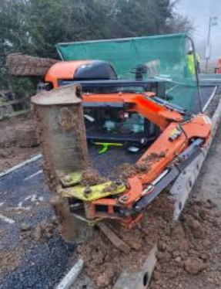
Highways England H & S Alerts – Arcadis Summary
HEi209 - Excavators fitted with Ditch Maintenance Buckets Issue Link
Lessons Learned:
This incident occurred at Ascot Road on M4SMP. Another overturning incident had occurred on M4SMP scheme recently; yet another incident had occurred on HS2. Noted that this type of incident is quite common where machines operate with an extended bucket radius and high bucket height, .
Use of ditching buckets should be limited to plant of sufficient size to handle them. It is further
recommended that operations higher than the swing post be prohibited. Mark Lamport is writing
to Richard Wilson stating that this restriction is insufficient given that plant operatives may be unaware
where the swing post is on their machine. As a consequence this is an accident waiting to happen. Action
to feed back this alert to the PDWG (Ed) also to Structures Technical Excellence Steering Group.
HEi210 - Live Lane Crossing Link
Lessons Learned:
Discussion that the risk of lane crossings needs to be balanced against the significant risk of setting up traffic management, sometimes over an extended distance. This has the effect of putting a number of people from the TM team at risk. There are instances where a quick lane crossing would be the safer option. Albeit SSOWs need to be complied with at all times and insurance is an issue; both safe access AND egress needs to be considered. It is always preferable to try and combine inspection visits with other works. This will minimise risk overall. (David Riley – Amey currently completing CiD on Live Lane Working / / Live Lane Crossings)

Slide 10
Highways England H & S Alerts – Arcadis Summary
HEi211 - High Pressure Gas Main Strike Link
Lessons Learned:
The SSoW was not followed in a number of respects here. The data logger had wrong information uploaded and no checks were made to verify the information provided. The PoWRA did not pick this up.
Pav to present this alert at PDWG – Detailed below

Slide 11
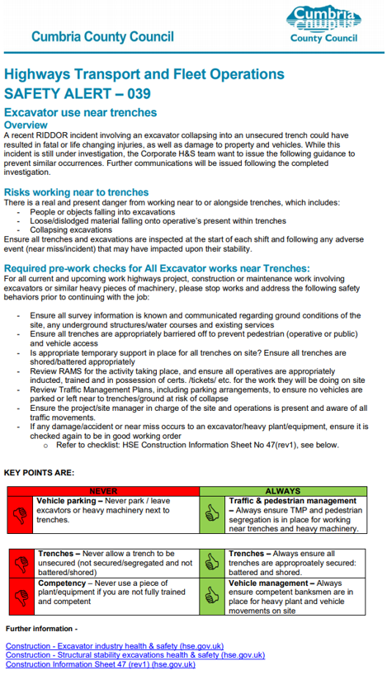
Highways England H & S Alerts – Arcadis Summary
HEi212 – In Ear Headphones – Link
HEi213 – Excavator Use Near Trenches - Link

Slide 12
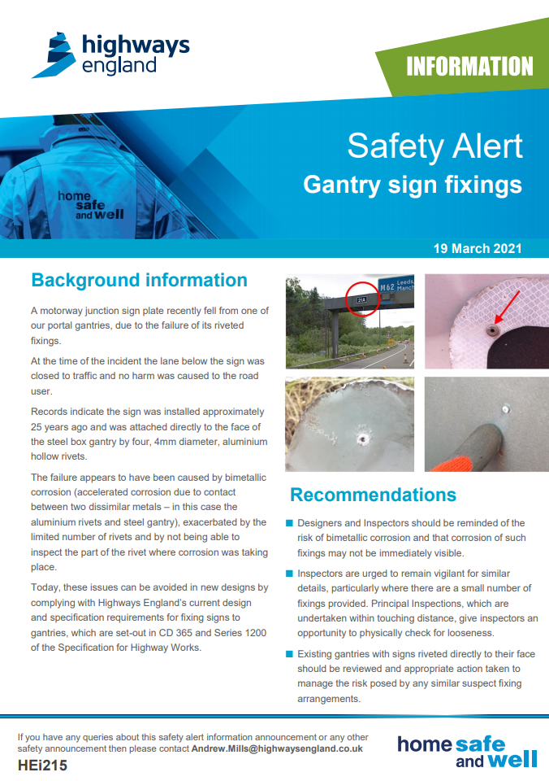
Highways England H & S Alerts – Arcadis Summary
HEi214 – CCTV Track Bracket Near Miss - Link
HEi215 – Gantry Sign Fixings – Link

Slide 13
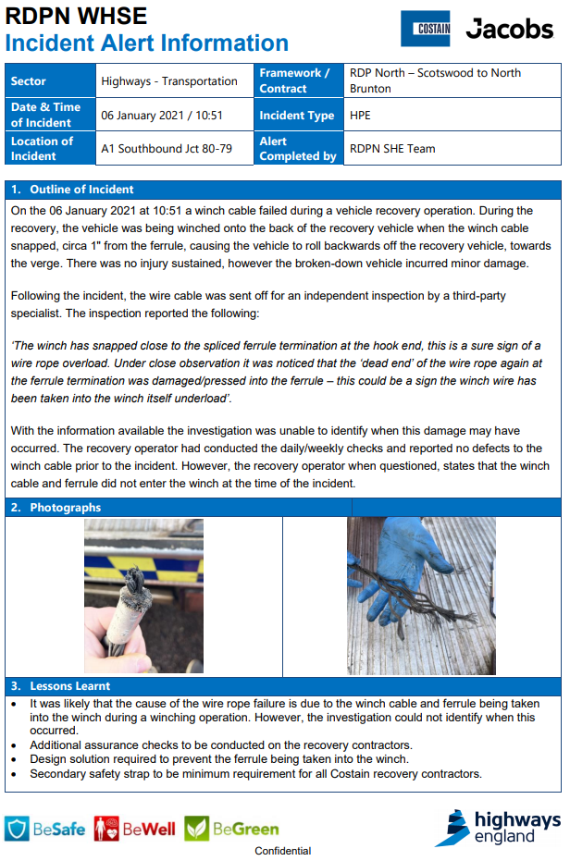
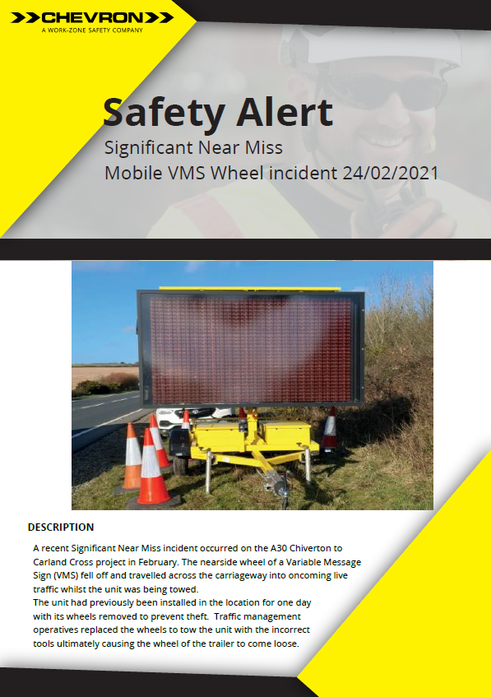
Highways England H & S Alerts – Arcadis Summary
HEi216 – Winch Cable Failure Incident - Link
HEi217 – Mobile VMS Wheel Incident

Slide 14
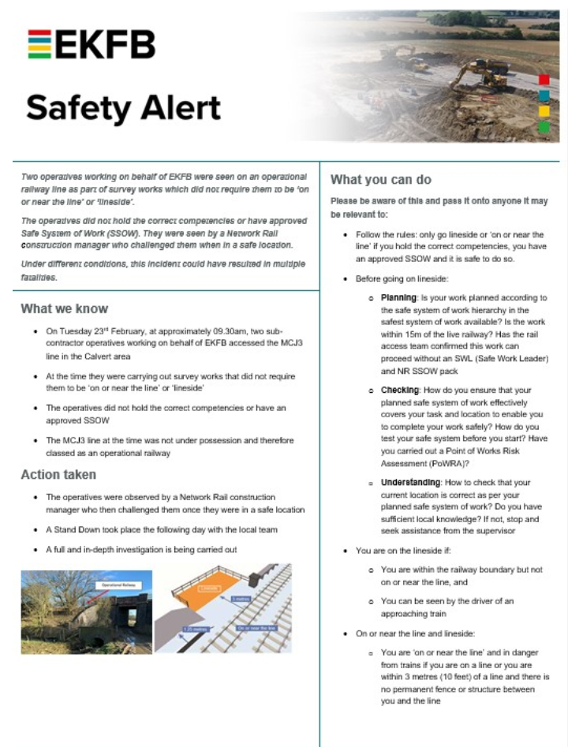
Highways England H & S Alerts – Arcadis Summary
Non HE
Railway Operatives 'Lineside' without authorisation
Lessons Learned:
Another incident where the SSoW did not get followed. The operatives in
question were undertaking a number of trial pits or boreholes, most of which
were remote from an operational railway. In this case the PoWRA had not triggered
a realisation that there were additional risks present. Additional training may be
required to highlight the need to undertake an effective PoWRA at all times.

Slide 15
Highways England H & S Alerts – Arcadis Summary
HEi211 - High Pressure Gas Main Strike Pav Singh (LTC PD Manager)

Slide 16
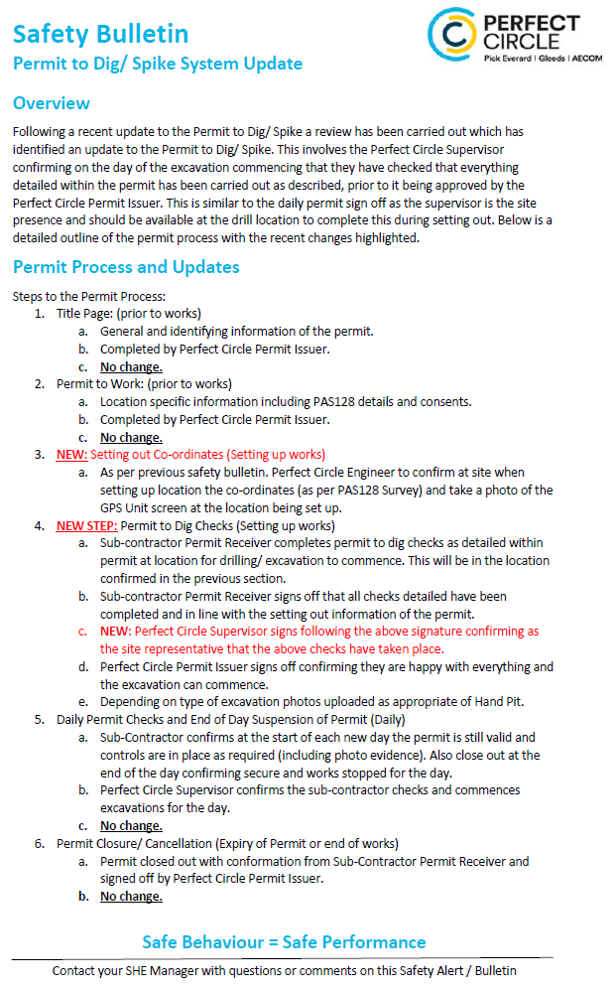
Safety Alert HE211
Perfect Circle (AECOM JV), it was identified within AECOM’s GIS system as directly over a high-pressure gas main, which was a clear failure of CDM process.
This was addressed by the site team and the location was moved with the trial pit having the same reference number TP01302.
The permit to dig with the correct location was provided but not followed.
The location was set out using GPS device with data that had not been updated.
Permit to dig was updated

Slide 17
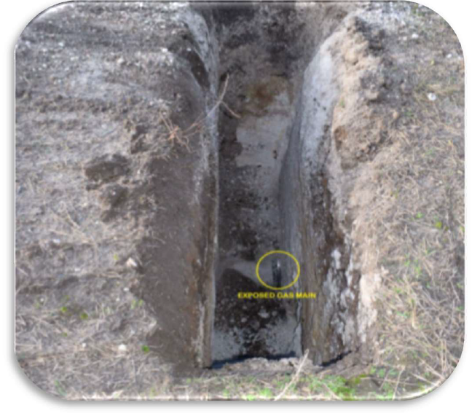
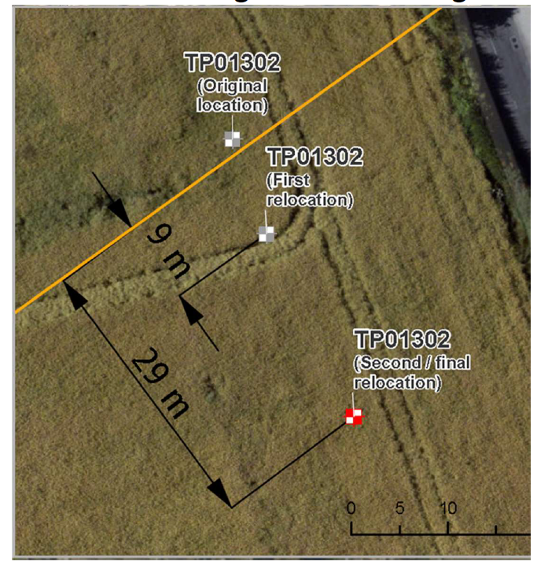
High Pressure Gas Main LTC Root cause
LTC Incident Root causation with the design teams to address how the design teams did not identify gas pipe clash on drawings.
Buried information was not effectively utilised in the design.
Unexpected changes to programme of GI works compressed time and resources and budget.
Principal Designer working group recommendations.
A common accident investigation approach is requested for focusing on the client decisions and design process.
Safety Alerts need an initial design and client review to determine projects where a deep dive is required
Discussion needed on Services information communication on drawings
Risk that data is superseded
Contractor assumes information is up to date
Process roles and responsibilities were not clear.
Communication of changes of updated trial pit reference not undertaken.
Communication of Utilities on drawings due to Industry practice – could have prevented confusion.

Slide 18
Safety alert for designers
Stephanie Goldsmith
Skanska

Slide 19
Why ?
Within Skanska we complete a safety alert for sharing and communication after an incident to share the learning and prevent future re-occurrences from occurring on our schemes.
This tends to occur within construction phase only.
As we carry out more investigations we begin to see more elements that relate to the causation that stem back to the beginning of a project within design phase. This phase is key for preventing future incidents within our schemes .

Slide 20
Change
There is currently no mechanism's that we have in place within Skanska that capture the information of sharing at design stage like what we have at construction phase.
This was an area that we needed to improve upon and as a result this is what we have developed…

Slide 21
Designer safety alert template

Slide 22
Collaborative approach
The designer safety alert is designed to be completed collaboratively by both the design partners on our projects and the project team.
It is to be shared both internally within the project but also to the wider designer community

