Slide 1
PRINCIPAL DESIGNER WORKING GROUP (PDWG)
Knowledge Transfer – Safety Hub Webpage.
25th July 2019
Pav Singh
Associate Technical Director CDM HSEQ Services

Slide 2
Knowledge Transfer
Our objective as professional engineers within PDWG is to leave a whole life learning legacy for future generations where each person feels that they have been empowered to contributed to:
Change in culture and behaviour considering Occupational Health and Safety Hazards in Design
Demonstrating a personal impact in Occupational Health & Safety Leadership – Your Shadow
Leaving a positive H&S legacy
Developing an exemplar culture in H&S with lessons shared with industry
Notes:
BIM & it’s characteristics:
BIM evolves throughout the project life cycle; Plan, Design, Built, and Manage

Slide 3
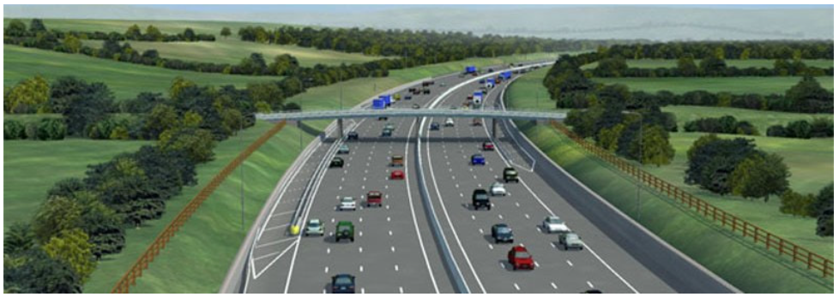
Current Website
Overview – provides overview of PDWG including leading in CDM
Objectives - supporting HE initiatives
Presentations from PDWG meetings
Safety By design resources
Whole life H&S for design construction O&M
Temporary works
Other Subjects – Asset data management, Lean / BIM etc

Slide 4
Website update progress
The themes are being developed including owners and key information being developed .
Develop sub-tiles to coordinate information on website.
Advanced searches develop metadata
Develop lessons learnt including Safety Case studies for Designers and contractors
Provide good visual examples
Progress :
We have has a meeting with Safety Hub Web page team who have provided proforma documents to develop the scope for each page and sub page.

Slide 5
Proposed Governance & Delivery
The Governance
The knowledge share web page proposals will be passed through the PD Whole Life H&S Sub Group - Andrew Finch and /or Design Risk Management Subgroup
This will ensure consistency
Validation of information
The Delivery
There will be nominations for each of the web pages
We will develop better visualisation and feel for easy route map for information
Workshop this afternoon
Develop subgroup to support delivery of information
Find areas of intertest so that we can all have input
Subject Areas Proposal & Nominations

Slide 6
Topics – Principal Designer
CDM with Highways England – TBC
Existing actions
Highways England application of CDM – IAN 105
PCF
Quality Assurance
Resources
HSE
CIRIA
Site visualisations including time lapse videos
Presentations on CDM

Slide 7
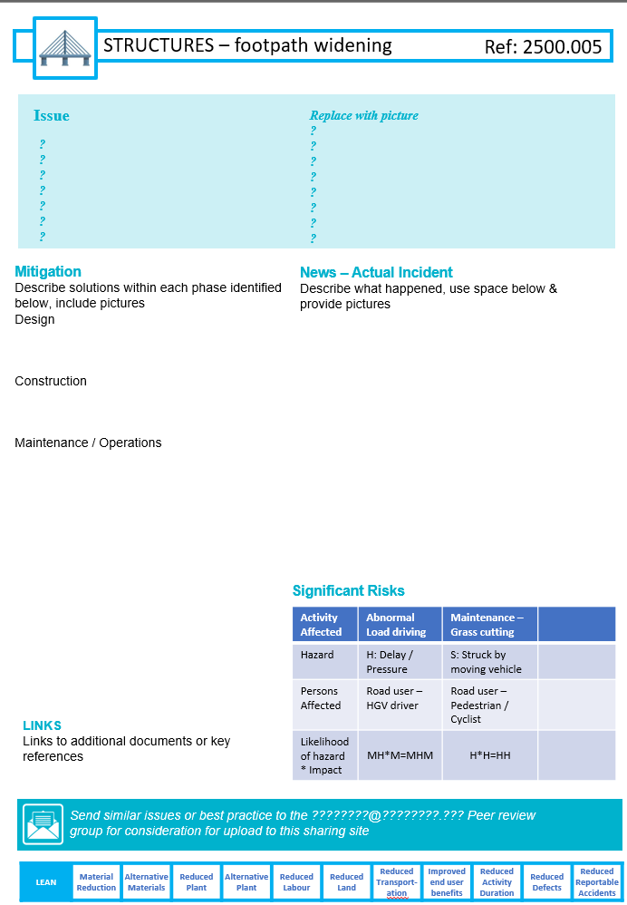
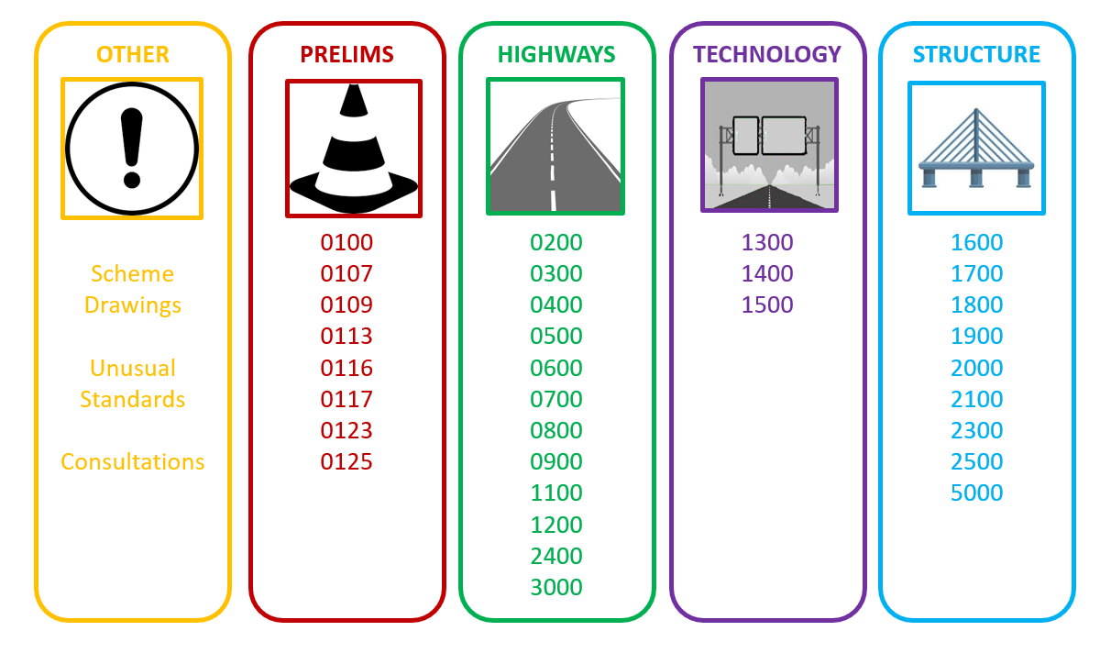
Whole Life Task Group Webpage
Martin Partington – Webpage Layout Development
The proposed webpage coordinates the information developed by the PD Whole life task group to the Safety Hub
Integrating issues and actions log
Design change management
Safety by Design
Buildability
Design feedback O&M

Slide 8
Topics – Temporary Works Forum
Jim Tod & David Thomas
Provide visual tiles and links regarding the TWF
Provide links to guidance sheets
Develop metadata and case studies
Develop a feedback loop to permanent works designers
Structural safety Confidential Reporting on Structural Safety
The TWF have a good interface with CROSS
They can support a link to the website and interface
https://www.structural-safety.org/

Slide 9
Topics - Health & Human Factors
Web Page using Design for Health Working With Liz Bennett
Supporting Highways industry to add into the webpage
The DfH Task Group reports to the CONIAC Health Sub-Group & HICLG.
Working with RSSB to develop a cross industry Health in design resource
https://www.rssb.co.uk/Pages/Health-by-Design.aspx
DfH Task Group Projects
Guidance for Designers
Clients reasonable expectations for Health in design
Top ten think points for designers
Skills, Knowledge, Attitude, Training, Experience
Training Development

Slide 10
Topics
Services Coordination – TBC
Best Practice in coordinating Statutory Undertaker information
Data management
Designer guide to service management
CDM management and coordination of service diversions
M4SM; A14
The Delivery
There will be nominations for each of the web pages
We will develop better visualisation and feel for easy route map for information

Slide 11
Next Steps
Next Steps:
We need nominations for web pages
Develop quick wins with existing information

