Slide 1
Health, Safety and Wellbeing Harm Assessment Tool
Sam Allin, HSW / CDM Client Assurance lead for Lower Thames Crossing
Sam.allin@lowerthamescrossing.co.uk

Slide 2
National Highways Major Projects Implementation of Home Safe and Well Strategy
Dean Sporn, Director Regional Projects (South)
Delivery Partners Workstream Lead

Slide 3
Sub Work Streams
Gap assessments – Culture
Gap Assessments – Engineering Controls
Charter
Drumbeat
Safety By Design
Andrew Scatchard
Emily Jones
Edgar VilaPuca
Esther Gordon-Smith
Sam Allin

Slide 4
HSW Harm Assessment Tool:- PCF 0-3
Provide HSW information enabling SLT to make Informed decisions
Data entered by 7 of the DMRB design disciplines and Utilities.
14 health safety and wellbeing risks in focus.
Select the linear meterage with presence or absence of a feature with potential to cause harm for the worst case and average km length of a scheme.
Road Layout / Highway Design
Overhead Services
5
3
0
Jan Mar Jun Sep Jan
Working on/near water
5
3
0
Jan Mar Jun Sep Jan

Slide 5
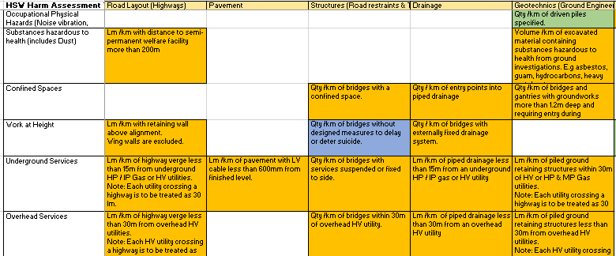

Slide 6
HSW Harm Assessment Tool:- PCF 4-5
Application of Control Measures, including from SCSLG Raising the Bars
Changes to inherent harm identified at PCF stage 3.
Record the engineering controls, including digital technologies applied in preparation for construction.

