Slide 1
Safety by Design & Engineering – Florida Footbridge
Nick Boyle - April 2018

Slide 2
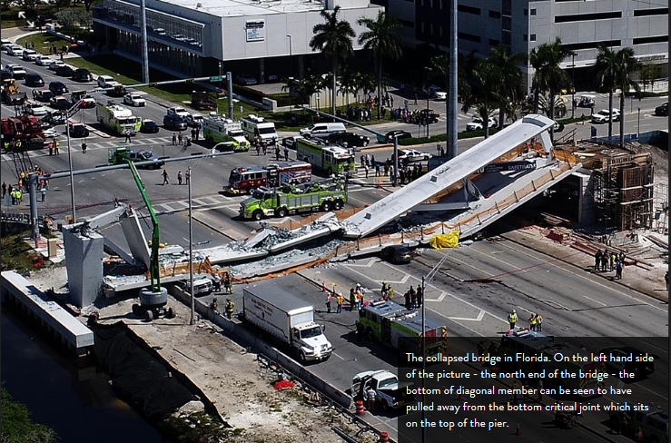
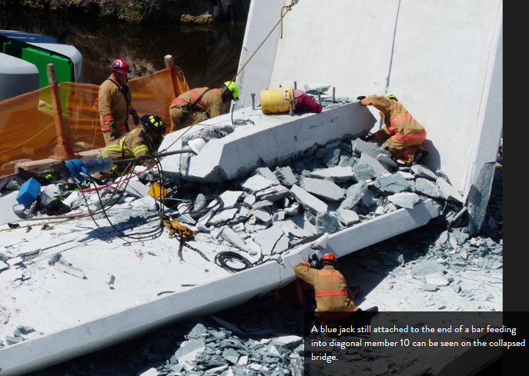
www.youtube.com/watch?v=D6pGzgm4zZ4

Slide 3
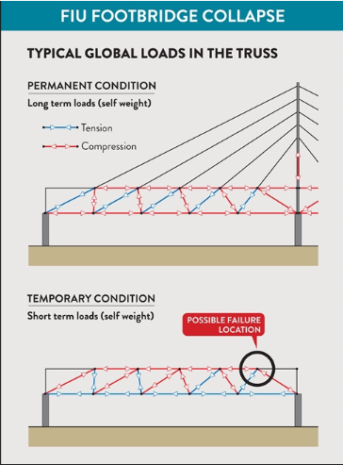
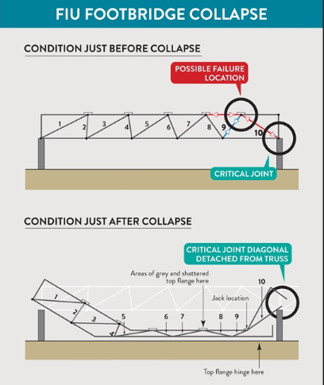

Slide 4
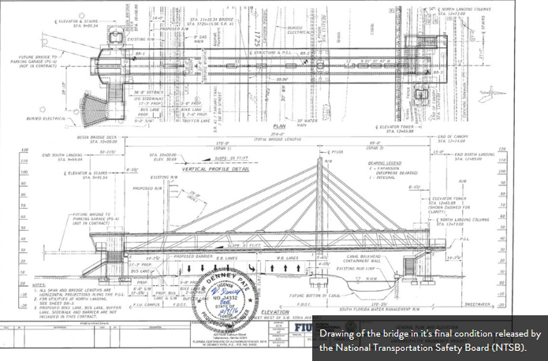

Slide 5
Questions – what would you do?
https://www.youtube.com/watch?v=D6pGzgm4zZ4
Who was responsible for reviewing method - Peer review? What if?
When things changed - who was responsible for reviewing method - Peer review? What if?
Why a prestressed concrete bridge – Designer preference?
Why change in method of installation – movement of SPMT’s. What if?
WHY LIVE TRAFFIC WHEN WORKING ON THE BRIDGE? What if?
https://www.youtube.com/watch?v=KtiTm2dKLgU

